Slide 1
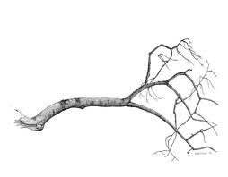
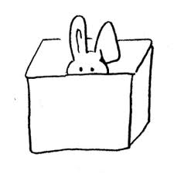
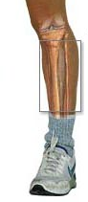



Mathematical Rebus
E

Slide 2
Recall from last lesson...
Definition: Given an ideal
the j^{th} elimination ideal is
Definition: The variety of partial solutions is .
Question How does the variety of partial solutions relate to the original variety ?

Slide 3
Geometric Interpretation
In elimination, we are interested in the set
(where )
This set is the projection of onto the coordinate plane defined by
Denote the projection map by
C^{n} C^{n-k}
Claim: Let be the k^{th} elimination ideal of I. Then
C

Slide 4
Geometric Interpretation
Claim: Let be the k^{th} elimination ideal of I. Then
C
Proof: Let .
Then there exists C such that
If then vanishes at because
But implies that C ,
so must vanish at .
Hence , so

Slide 5
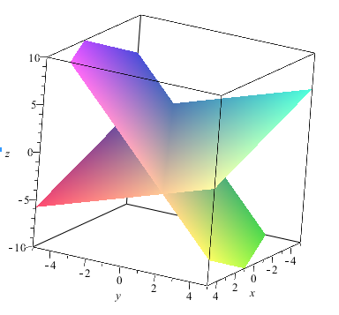
Example 1
Consider , where
and
Using lex order
with z > y > x,
is a Groebner basis.
Hence
The variety of partial solutions, is equal to in this case.
Every partial soln (blue line) extends to full soln (red line).

Slide 6
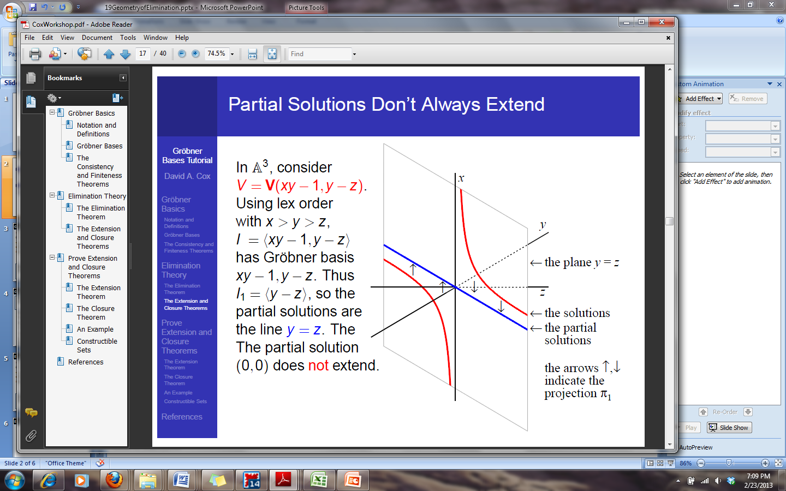
Example 2. Consider
Using lex order
with x > y > z,
G = { } is a Groebner basis.
Hence I₁ = , so the variety of partial solutions, is the line y = z.
y
The partial solution (0, 0) does not extend.
is strictly smaller than

Slide 7
To Recap...
Eliminating the first k variables in a system of polynomial equations
amounts, geometrically, to a projection of the variety onto the “coordinate subspace” defined by setting
This projection, , satisfies
where and C .
So what are the points in that are not in ?

Slide 8
The missing points?
So what are the points in that are not in ?
In this example, it’s the origin; the partial solution (0, 0) does not extend.
More generally, the Extension Theorem tells us when partial solutions to do not extend...
y

Slide 9
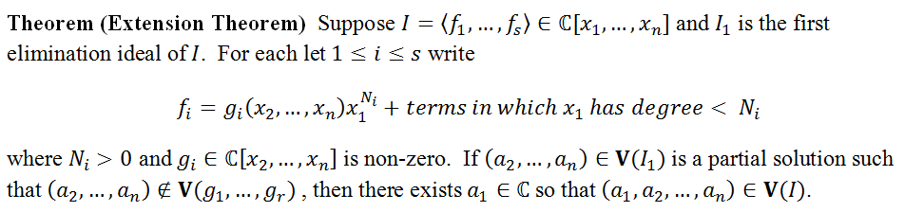
The Extension Theorem
A partial solution fails to extend precisely when
When k = 1, the “missing points” are .
In fact, the Extension Theorem implies that
This is an affine variety!

Slide 10
The Closure Theorem
Let C^{n}. Then
i) is the smallest affine variety containing C^{n-k}.
ii) When there is an affine variety
such that
Proof of i) requires the Nullstellensatz See textbook for proof of ii); main idea:
This is W!

