Slide 1
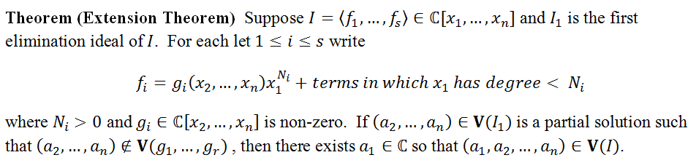
Today’s Goal: Proof of Extension Theorem
If a partial solution fails to extend, then
Corollary. If is constant for some i, then all partial solutions extend.
The proof makes use of the resultant...

Slide 2
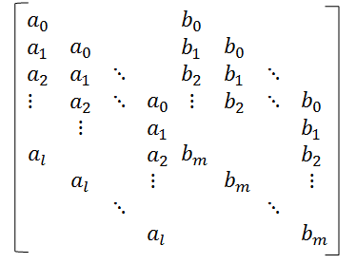
Recall from last lesson...
Let f and g be two polynomials in R[x] of positive degree:
Syl(f, g, x)) is the matrix:
Definition: The resultant
of f and g with respect to x, denoted by Res(f, g, x), is the determinant of the Sylvester matrix,
Res(f, g, x) = det(Syl(f, g, x)).
m columns
n columns
Recall: Res(f, g, x) = 0 iff f and g share a common factor.
Question What if one of the polynomials is a constant?
Notes:
Let be two polynomials of positive degree
.

Slide 3
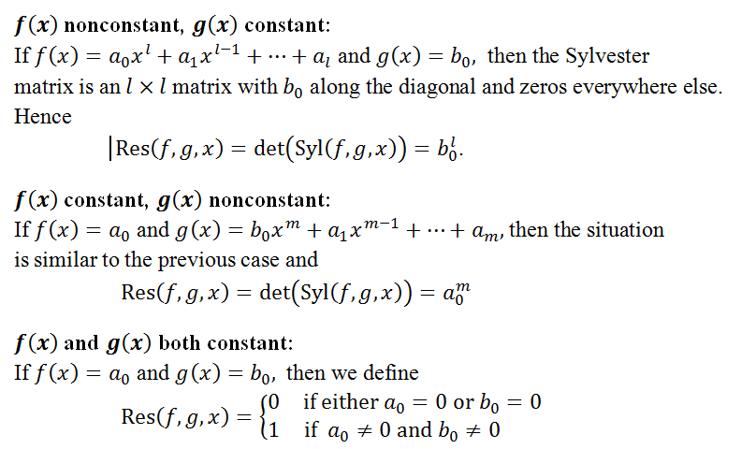
Resultants involving constant polys
See Exercise 14 on page 161 of your textbook for more on this.

Slide 4
Time for a Game...
The game is called
“Make a Conjecture”
I will present some examples;
then you make a conjecture.
Ready?

Slide 5
Example
The Sylvester matrix is a
4 x 4 square matrix.
Compute Res(f, g, x).
h =Res
Res(f, g, x) is a polynomial in y; indeed, Res(f, g, x) is in the first elimination ideal ‹ f, g ›  k[y]

Slide 6
Specialization
h(y) = Res
Consider the specialization of the resultant obtained by setting y = 0.
h(0)
More generally...if then Res(f, g, x₁)  .
Definition If c = (c₂, c₃,..., c_{n})  k^{n-1} and R(x₂, x₃, ..., x_{n}) := Res(f, g, x₁), then a specialization of the resultant Res(f, g, x₁) is R(c₂, c₃,..., c_{n}).

Slide 7
Specialization Example
What if we plug 0 into the polynomials at the start?
Res( f(x, 0), g(x, 0), x) = Res(6x² – 4, 3x – 1)
Compare this with the specialization h(0)...
× 6
h(0)
WHY 6?
We’re off by a factor of 6.
The 6 was “zeroed” out in Res( f(x, 0), g(x, 0), x) because plugging 0 into g(x, y) caused the degree of g to drop by 1.

Slide 8
Specialization Example
Let’s modify the previous example slightly...
Setting y = 0 causes deg g to drop by 2.
y
Res( f(x, 0), g(x, 0), x) = Res(6x² – 4, – 1)
y
h(y) = Res
y
× 6²
h(0)
More generally, if f, g  k[x, y] and deg g = m with deg(g(x, 0)) = p then
h(0) = LC(f)^{m-p} Res(f(x, 0), g(x, 0), x)

Slide 9
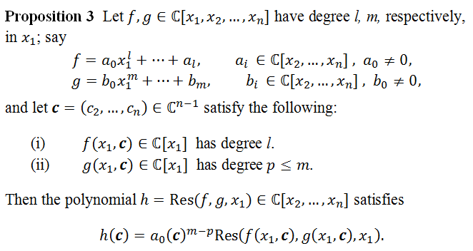
Proposition 3 (Section 3.6)
This result, which describes an “interplay” between partial solutions and resultants, will be used in the proof of the Extension Theorem...

Slide 10
Proof of Extension Theorem
Let , where
and let , a partial solution.
Want to show that if , then there exists
such that .
Consider the evaluation homomorphism
defined by:
The image of under is an ideal in , and is a PID.
Hence .

Slide 11
Proof of Extension Theorem
We get a nice commutative diagram:
where
We consider two cases:
We’ll use resultants to show that the second case can’t actually happen.
is nonconstant.
Case 1:
, a nonzero constant.
Case 2:

Slide 12
Proof of Extension Theorem
is nonconstant.
Case 1:
In this case, the FUNdamental Theorem of Algebra ensures there exists such that
Since
for all .
In particular, all generators, f₁, f₂ , ..., f_{s}, of I vanish at the point .
Hence , so the partial
solution extends, as claimed.

Slide 13
Proof of Extension Theorem
is a nonzero constant.
Case 2:
In this case, we show
leads to a contradiction.
Since
there exists such that
Since , there exists such that .
Now consider the resultant:
h = Res(f_{i}, f, x₁)

Slide 14
Proof of Extension Theorem
is a nonzero constant.
Case 2:
Applying Proposition 3 to h = Res(f_{i}, f, x₁) yields:
= 0
Hence .
But recall: h = Res(f_{i}, f, x₁)
and
A contradiction!

