Slide 1
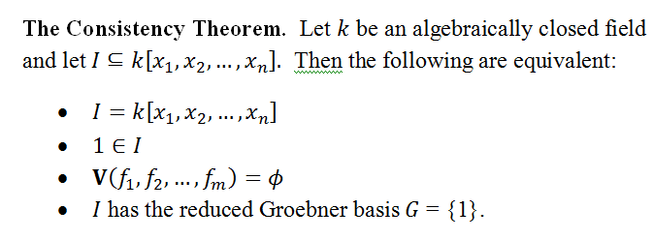
Last Lesson:
Upshot: We can show a system of equations has no solutions by computing the reduced Groebner basis.

Slide 2
Application: Radical Membership
Question: Given an ideal ,
can we find generators for its radical, ?
While existing algorithms are impractical, we can determine radical membership...
Proposition (Radical Membership) Let k be an arbitrary field and let
be an ideal.
Then iff

Slide 3
Radical Membership proof...
Observe (as in the proof of Hilbert’s Nullstellensatz):
If , then we can write 1 as a polynomial combination:
Setting yields
Multiplying by high enough power, , we get

Slide 4
Radical Membership proof...
We have established the forward implication:
If
then .
For the reverse implication, if then
for some positive integer m.
Next we get sneaky:
both in I
Hence

Slide 5
Radical Membership Test
We have established:
iff .
The Consistency Theorem then tells us we can test if by computing the reduced Groebner basis of
If the reduced Groebner basis of is {1} then
.

