Slide 1
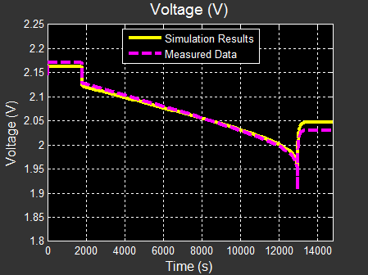
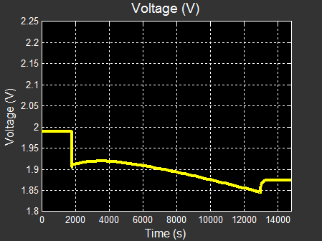
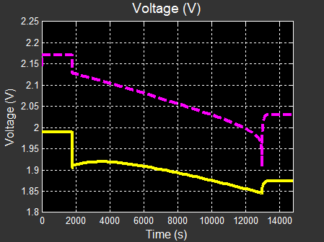
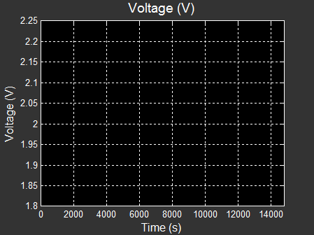
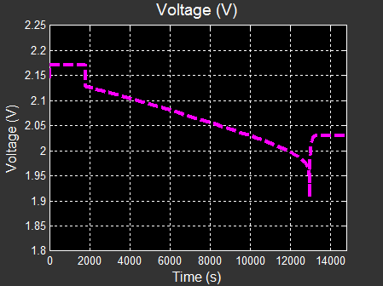
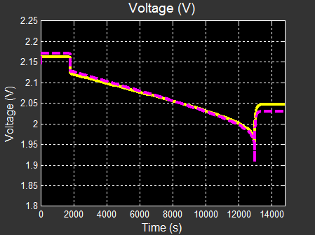
Estimating Parameters Using Measured Data
Model:
A22 = Constant
Ao = Constant
Emo = Open Cir. Voltage
Qe_init = Initial Extr. Chg.
Ambient Temperature
Discharge Cycle
Battery Cell
Voltage
Problem: Simulation data does not match measured data because the parameters are incorrect
Solution: Use Simulink Design Optimization to automatically tune model parameters
A22 | Ao | Emo | Qe_init
-4 | -1 | 2 | 1.0e4
A22 | Ao | Emo | Qe_init
-9.99 | 0.402 | 2.20 | 3.84e4

Slide 2
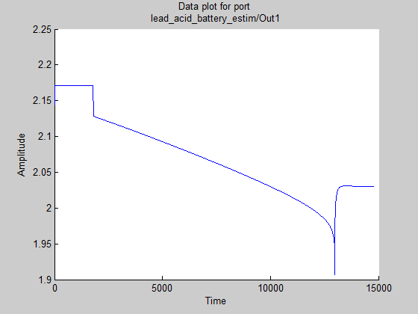
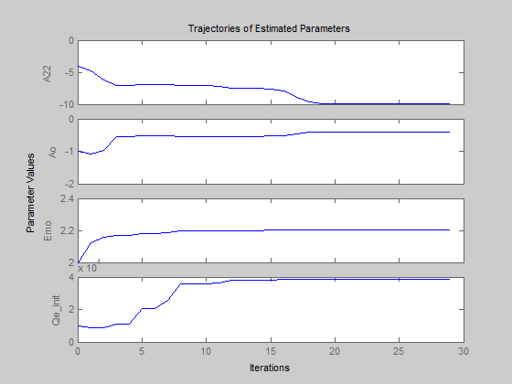
Estimating Parameters Using Measured Data
Steps to Estimate Parameters
Import measurement data and select estimation data
Identify parameters and their ranges
Perform parameter estimation
Validate estimation
A22 | Ao | Emo | Qe_init
-4 | -1 | 2 | 1.0e4

Slide 3
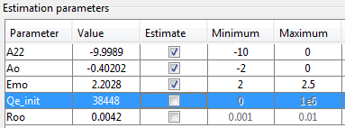
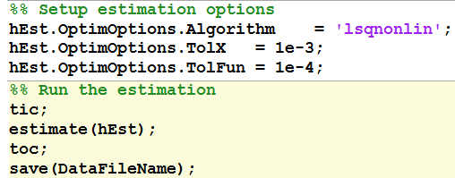
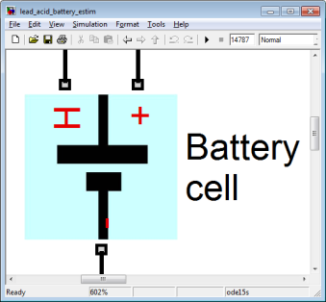

Tuning Models Additional Strategies and Capabilities
Tune parameters in stages
Narrowing range for values
Tune sets of parameters
Tune with different data sets
Use scripting to automate tuning process
Accelerate parameter tuning by using parallel computing
Multi
Core

Slide 4
References
SAE Papers
SAE Paper 2009-01-1381: Parameterization of a Battery Simulation Model Using Numerical Optimization Methods
SAE Paper 2007-01-0778: A Simple, Effective Lead-Acid Battery Modeling Process for Electrical System Component Selection
Recorded Webinar: Developing Accurate Battery Simulation Models
http://www.mathworks.com/company/events/webinars/wbnr37544.html

