Slide 1
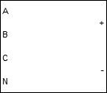


TRU, DC

Slide 2
TRU, DC
ϕ

Slide 3
TRU, DC

Slide 5
ϕ

Slide 7
ϕ

Slide 9
ϕ

Slide 11
Fan
Projector

Slide 12
Fan
Projector
Battery Cell

Slide 13
Fan
Projector

Slide 14



Slide 15
GEN
AC Bus
AC1
AC2
AC3
TRU
DC Bus
DC1
DC2
DC3
Batt

Slide 16
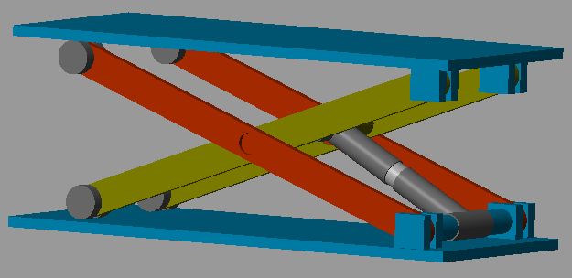
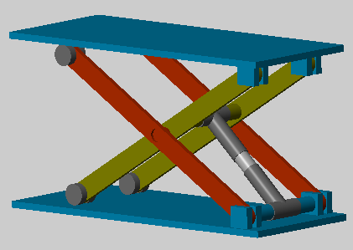

Images

Slide 17

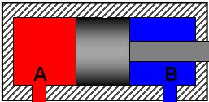

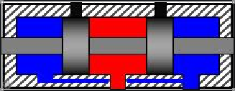


V+
V-
Light gray: 242 242 242
Light green: 235 242 195

