Slide 1
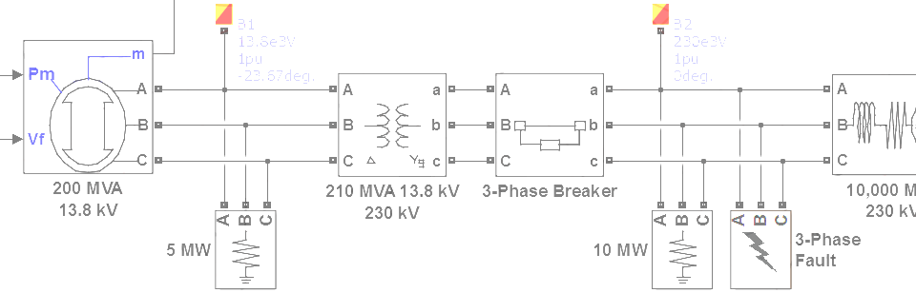

SimPowerSystems Hands-on Workshop: Modeling and Simulation of Electrical Power Systems with SimPowerSystemsTM
Workshop Outline
Carlos Osorio
Principal Application Engineer
MathWorks – Natick, MA

Slide 2




Workshop Setup Instructions
Copy the ZIP file: SPSHandsOnWorkshop.zip
Unzip the file:
At the MATLAB command prompt type: >> start_SPSHandsOnWorkshop
Computer
-
Local Disk (C:)
-
AnyWorkingDirectory
-
SPSHandsOnWorkshop
+
files
+
print

Slide 3
Workshop Outline
Introduction
SimPowerSystems component libraries
How does SimPowerSystems work?
Three-Phase Systems
Measurements
State initialization
Transformers
Star vs. delta connections
Floating vs. neutral connections
Reference frame transformations

Slide 4
Workshop Outline
Electrical Machines
Machine measurements
Machine initialization
Load flow calculation
Mechanical connections to loads and prime movers
Simulation Performance
Model fidelity vs. simulation speed
SimPowerSystems simulation modes

Slide 5
Workshop Outline
Control of Electrical Machines
Electrical disturbances
Control of synchronous generators
Electric motor drives
Custom Electrical Components
Simulink-based electrical components
Modifying Specialized Technology library components
Simscape language and Simscape Components library
Simscape and SimPowerSystems interfaces
Model sharing and IP protection

Slide 6
Workshop Outline
Power Electronics
SimElectronics or SimPowerSystems?
Ideal switching algorithm
Power quality and harmonic analysis
Control design and linearization
Discussion and Q&A

Slide 7
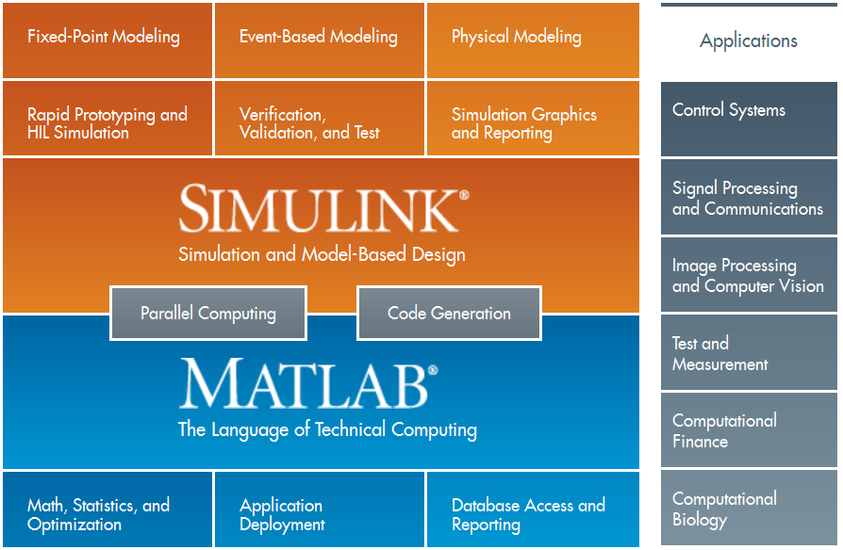
MathWorks Product Overview

Slide 8
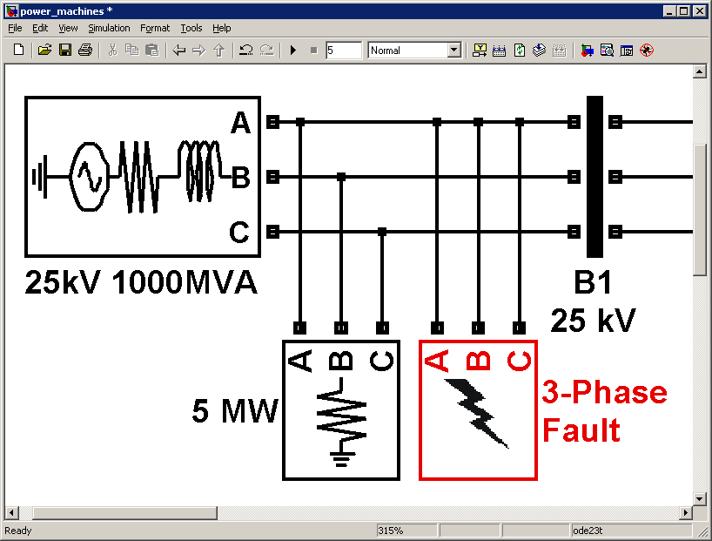
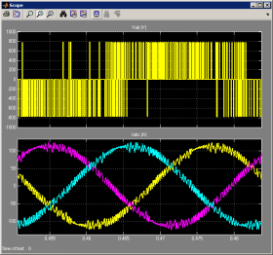
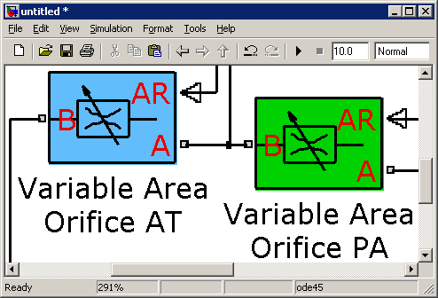
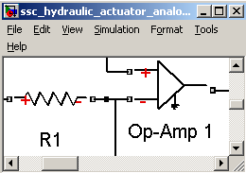
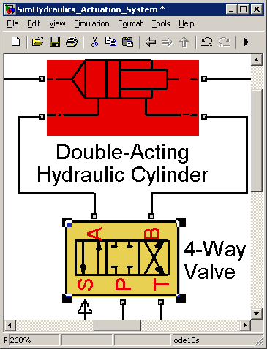
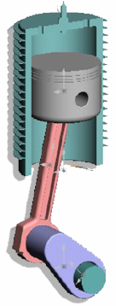
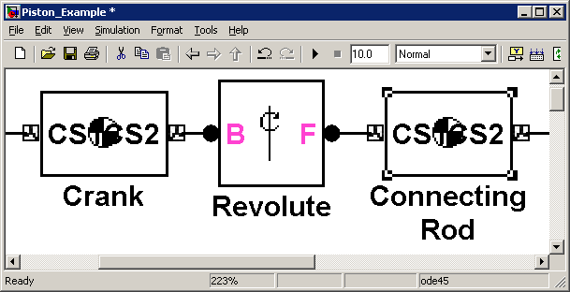
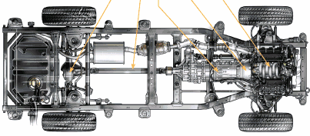
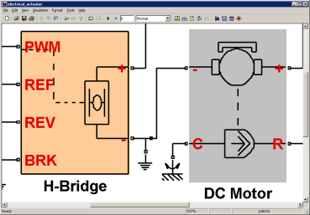
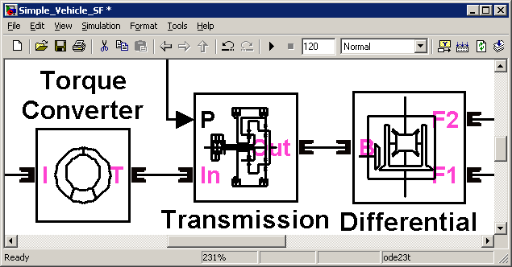
Physical Modeling in Simulink®
SimPowerSystems™
SimHydraulics®
Simscape™
Multi-domain physical systems
SimMechanics™
SimDriveline™
SimElectronics™
Electrical power systems
Fluid power and control
Mechanical dynamics (3-D)
Drivetrain systems (1-D)
Electromechanical and electronic systems

Slide 9


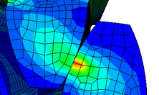
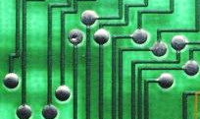
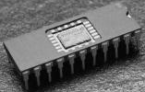
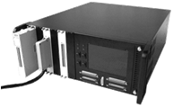
Model-Based Design Process System and Component Level Design
REQUIREMENTS
System-level simulation refines requirements for component design
DESIGN
SYSTEM LEVEL DESIGN
COMPONENT DESIGN
Control
Mechanical
Electrical
JMAG
SABER
SPICE
TEST & VERIFICATION
Co-simulation can be used as a verification step
IMPLEMENTATION
Embedded Software
HIL System
Results from detailed simulation refine system-level simulation for use in rest of design process
INTEGRATION AND TEST
Notes:
Blue arrow from “Component Design” to “System Level Design” includes:
Parameter estimation based on simulation results
Mode export from FEA
Reduced order modeling

