Slide 1
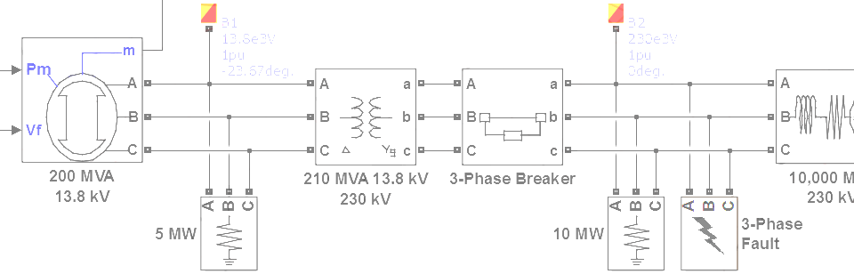

SimPowerSystems Hands-on Workshop: Modeling and Simulation of Electrical Power Systems with SimPowerSystemsTM
1. Introduction
Carlos Osorio
Principal Application Engineer
MathWorks – Natick, MA

Slide 2
Outline
SimPowerSystems component libraries
How does SimPowerSystems work?

Slide 3
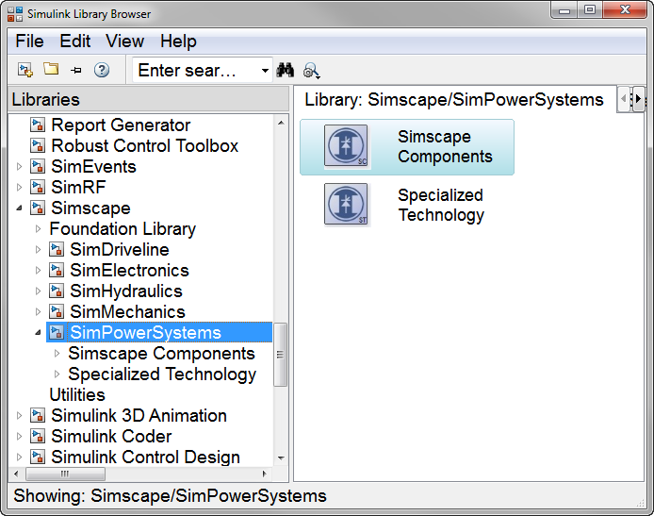
SimPowerSystems component libraries
Simscape based components
Simultaneous linear and nonlinear network equations solution
Direct Simscape integration for multi-domain modeling
Create custom components using the Simscape Language
Simulink based components
Sequential solution of linear and nonlinear equations
Continuous, discrete and phasor solver modes
Large number of detailed electric and electronic components library
Specialized analysis and initialization tools
Notes:
Make sure to convey that there are 2 separate libraries based on different technologies. They can not be necessarily connected directly, but can need to be connected through Simulink when appropriate. By the end of the workshop, users will be given the information required to decide when to use one or the other based on the needs of their modeling efforts.

Slide 4
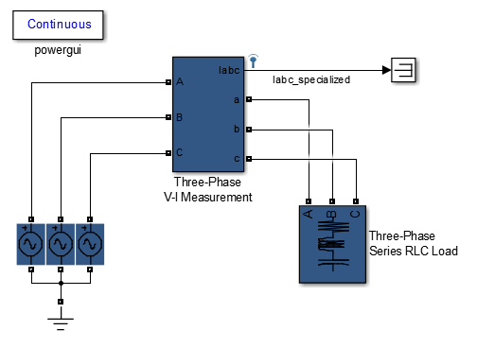
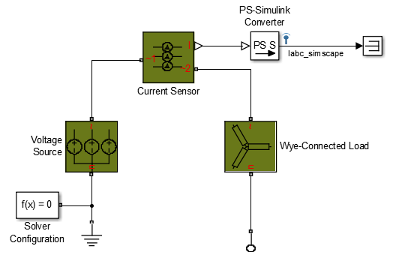
SimPowerSystems component libraries
>> threephase_specialized
>> threephase_simscape
Specialized analysis and
initialization tools
Single line for three-phase
connections
Direct
Simscape
integration
Specialized Technology
Simscape Components

Slide 5
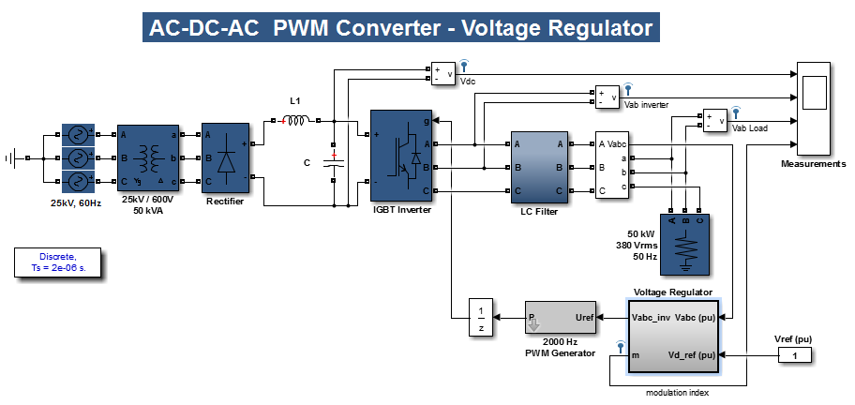
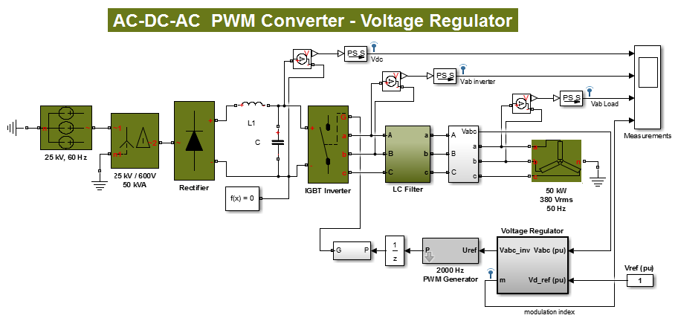
SimPowerSystems component libraries
>> acdcac_specialized
>> acdcac_simscape
Specialized Technology
Simscape Components

Slide 6
How does SimPowerSystems work? Specialized Technology
The SimPowerSystems network is analyzed and a state-space model of the linear part of the network is created
Any nonlinear elements are integrated as feedback elements around the linear state-space model
This is all handled automatically by the powergui, but the user can also access the relevant analysis functions
Linear Model
Sources
(inputs)
State Space
Matrices
Measurements
(outputs)
u
y
Nonlinear
Models
i
v

Slide 7



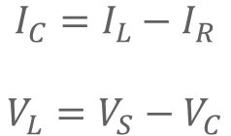



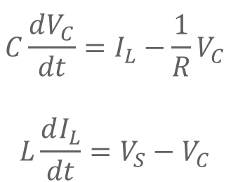


How does SimPowerSystems work? Consider a simple RLC network
$$L$$
$$+$$
$$I_{L}$$
$$V_{S}$$
$$C$$
$$V_{C}$$
$$R$$
$$\begin{matrix}\begin{aligned}I_{C}=C\frac{dV_{C}}{dt},{ V}_{L}=L\frac{dI_{L}}{dt},{ V}_{R}=RI_{R}=V_{C}\end{aligned}\end{matrix}$$
$$\begin{matrix} \\ \begin{aligned}C\frac{dV_{C}}{dt}=I_{L}−\frac{1}{R}V_{C} \\ \end{aligned} \\ L\frac{dI_{L}}{dt}=V_{S}−V_{C}\end{matrix}$$
node currents:
$$\begin{matrix}\begin{aligned}I_{C}=I_{L}−I_{R} \\ \end{aligned} \\ V_{L}=V_{S}−V_{C}\end{matrix}$$
loop voltages:
>> rlc_simulinkFinish

Slide 8
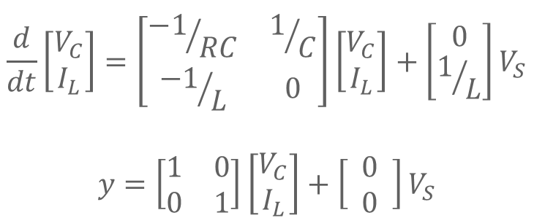
How does SimPowerSystems work? Consider a simple RLC network
$$L$$
$$+$$
$$I_{L}$$
$$V_{S}$$
$$C$$
$$V_{C}$$
$$R$$
$$\begin{aligned} \\ \frac{d}{dt}\left[\begin{matrix}V_{C} \\ I_{L}\end{matrix}\right]=\left[\begin{matrix}{−1}/{RC} & 1/C \\ {−1}/L & 0\end{matrix}\right]\left[\begin{matrix}V_{C} \\ I_{L}\end{matrix}\right]+\left[\begin{matrix}0 \\ 1/L\end{matrix}\right]V_{S} \\ \\ y=\left[\begin{matrix}1 & 0 \\ 0 & 1\end{matrix}\right]\left[\begin{matrix}V_{C} \\ I_{L}\end{matrix}\right]+\left[\begin{matrix} 0 \\ 0 \end{matrix}\right]V_{S}\end{aligned}$$
A
B
C
D
>> rlc_sps

Slide 9
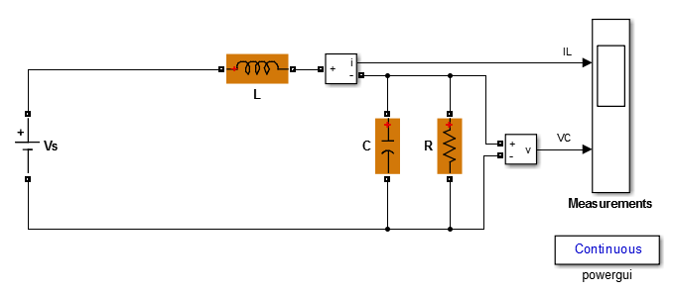
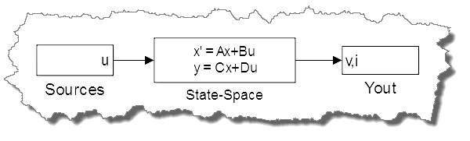
How does SimPowerSystems work? Consider a simple RLC network
Equivalent Model
>> sys = power_analyze(’rlc_sps’,’structure’);

Slide 10
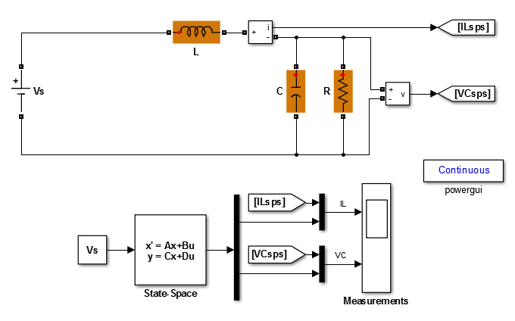
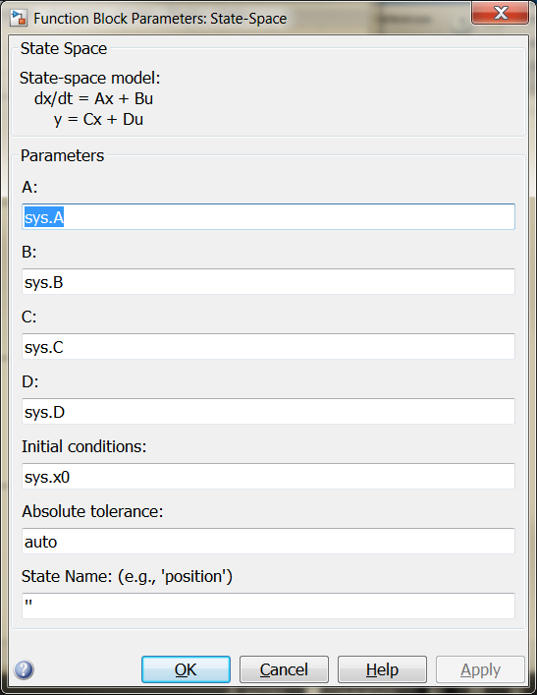
How does SimPowerSystems work? Consider a simple RLC network
>> rlc_sps_sl

Slide 11
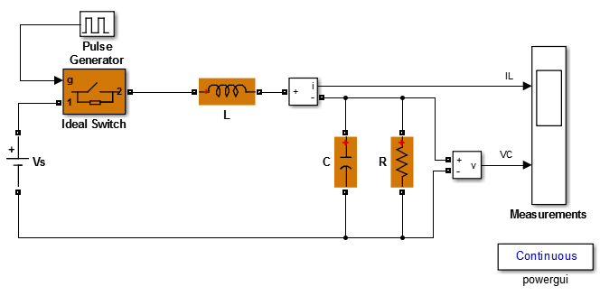
How does SimPowerSystems work? Introduce an ideal switch
[A,B,C,D]
[A_{switch},B_{switch},C_{switch},D_{switch}]
system with the switch open
system with the switch closed
>> sys = power_analyze(’rlc_switch_sps’,’structure’);

Slide 12
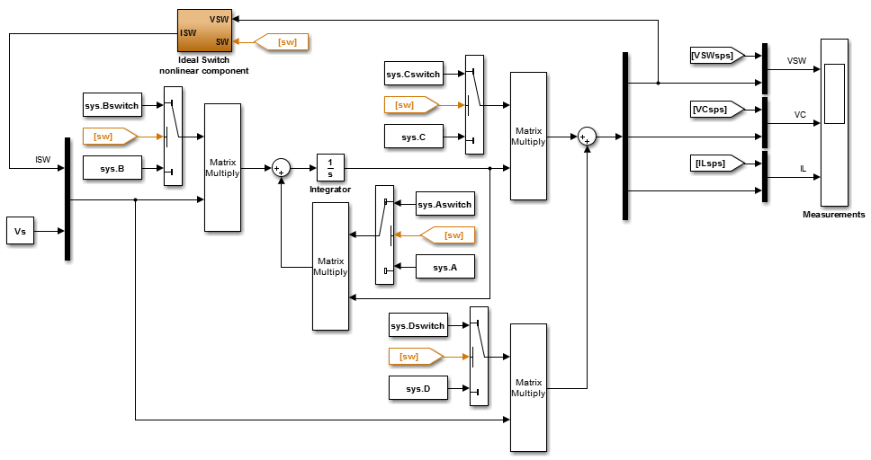
How does SimPowerSystems work? Introduce an ideal switch
C
B
A
Need to maintain
state information
during switching
D
The switch dynamics are
modeled as a nonlinear
relationship between
voltage and current
>> rlc_switch_sps_sl

Slide 13
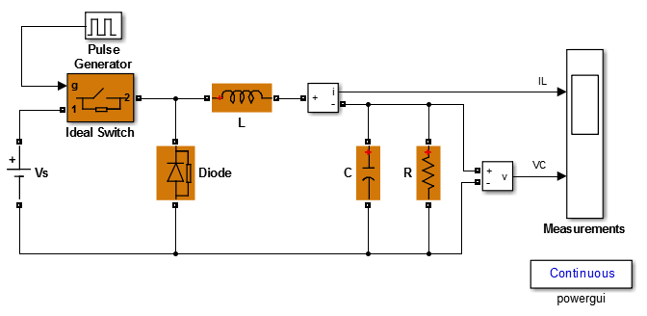
How does SimPowerSystems work? Introduce a diode to mitigate flyback
Both the switch and the diode
are nonlinear elements and must
be placed in the feedback path
of the state-space model
>> rlc_diode_sps

Slide 14
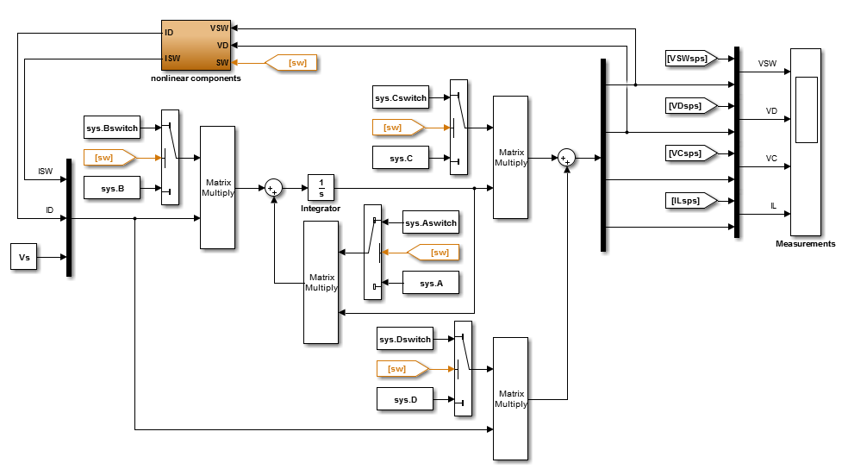
How does SimPowerSystems work? Introduce a diode to mitigate flyback
The nonlinear components could introduce discontinuities and algebraic loops on the model
>> rlc_diode_sps_sl

Slide 15
How does SimPowerSystems work? Introduce a diode to mitigate flyback

