Slide 1
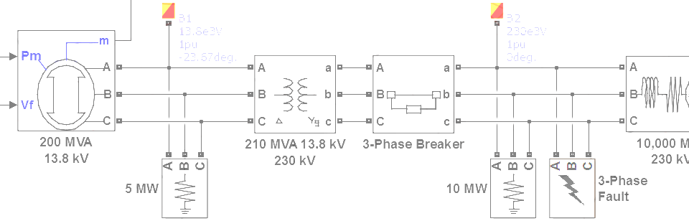

SimPowerSystems Hands-on Workshop: Modeling and Simulation of Electrical Power Systems with SimPowerSystemsTM
2. Three-Phase Systems
Carlos Osorio
Principal Application Engineer
MathWorks – Natick, MA

Slide 2
Outline
Measurements
State initialization
Transformers
Star vs. delta connections
Floating vs. neutral connections
Reference frame transformations

Slide 3
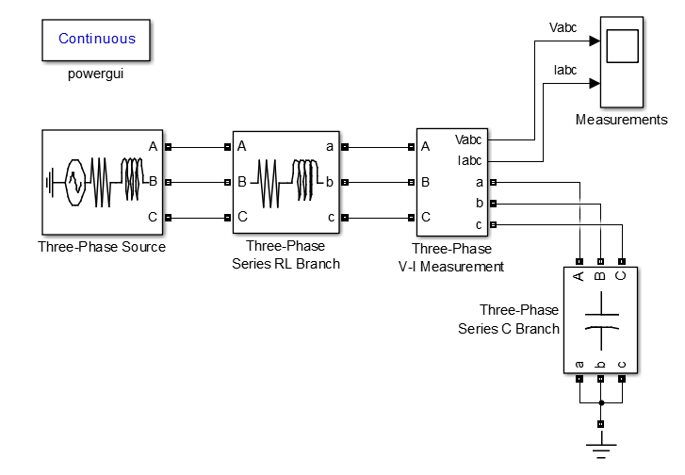
Build a simple three-phase circuit

Slide 4
Build a simple three-phase circuit
Always required if there
are SimPowerSystems
Specialized Technology
blocks in the model
>> threephase_rlc

Slide 5
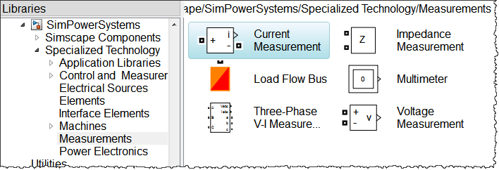
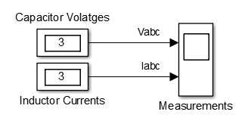
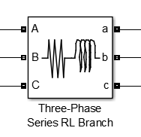
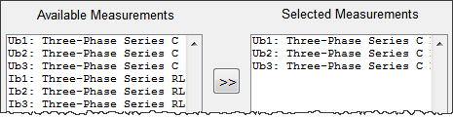
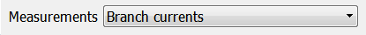
Multimeter measurements
>> threephase_rlc_mm

Slide 6
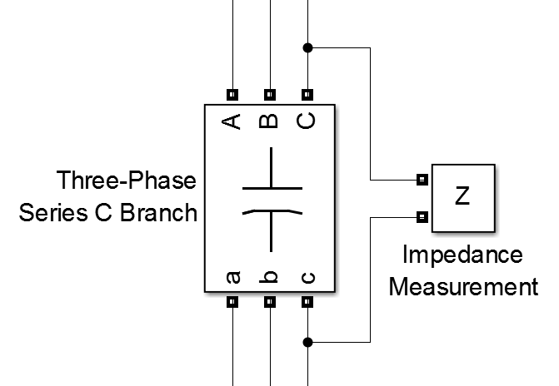
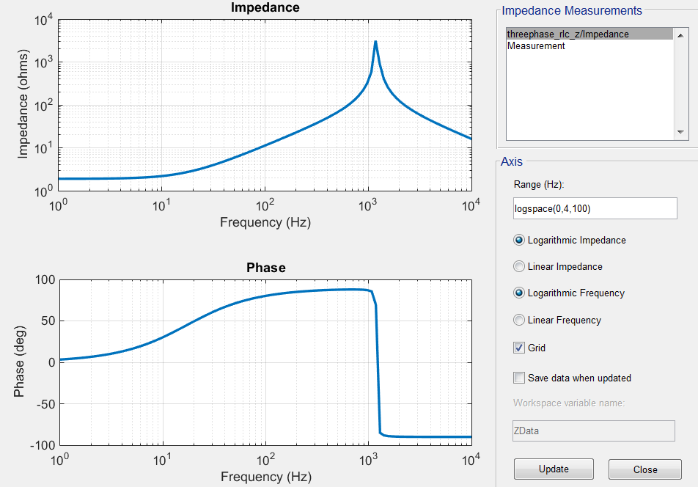

Impedance measurement
powergui
>> threephase_rlc_z

Slide 7
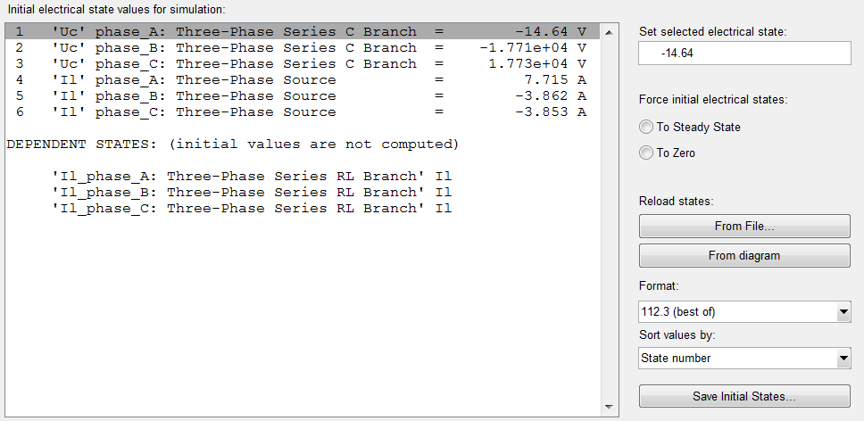
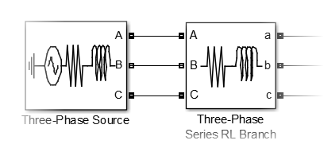

State initialization
Independent states
Settings
Dependent states
powergui

Slide 8
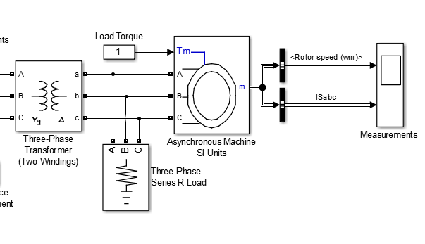
Complete the simple three-phase circuit
>> threephase_rlc_motor

Slide 9
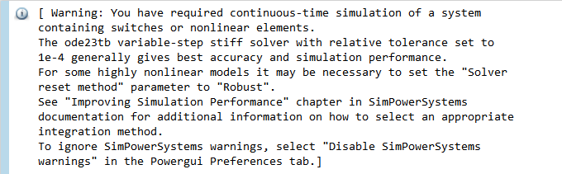
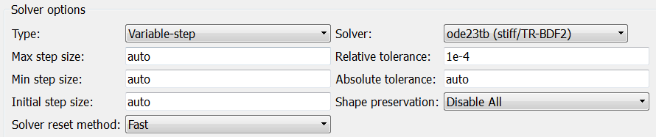
Complete the simple three-phase circuit Recommended variable-step solver
Setting the recommended solver configuration

Slide 10
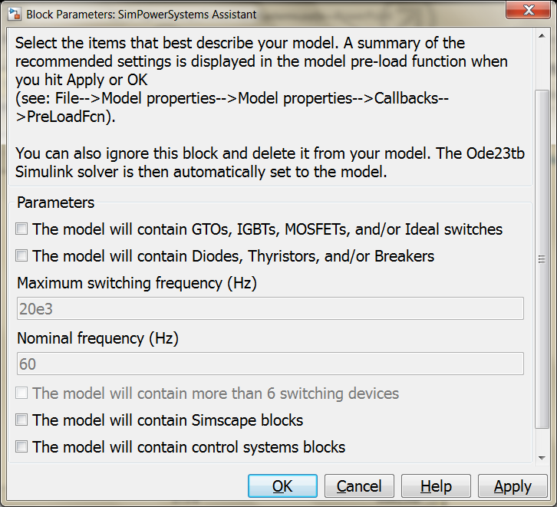
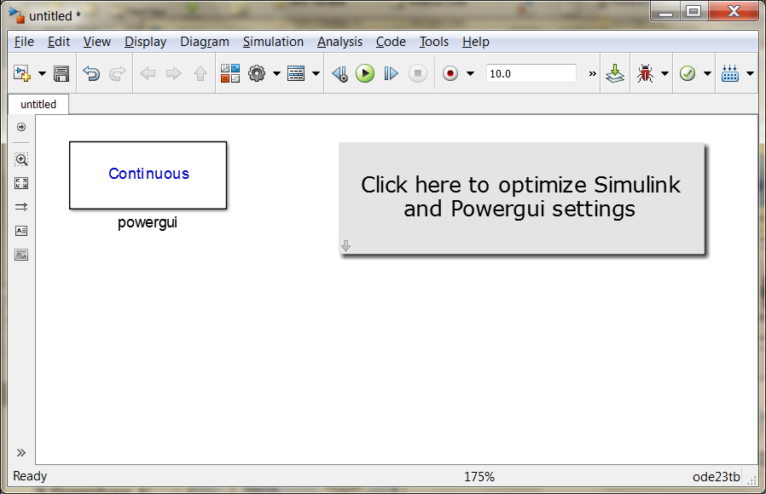
Complete the simple three-phase circuit Recommended variable-step solver
Additional solver setting recommendations
Automatically opens a model that includes the powergui block and sets the solver to the recommended settings
>> power_new

Slide 11
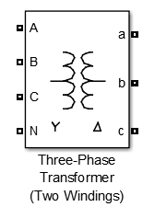
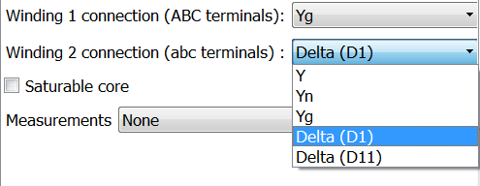
Transformers Phase shifting
1 : 1
D1
A
30º
N
D1: Adds 30º to the phase (lead)
D11: Subtracts 30º from the phase (lag)
C
B
>> transformer_phaseshifting

Slide 12
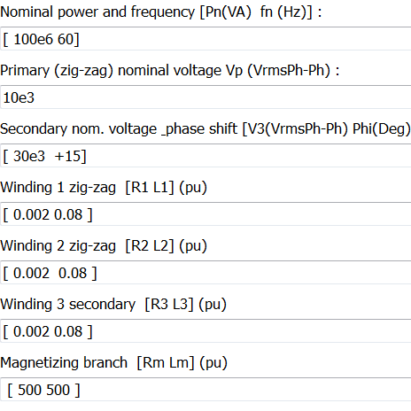
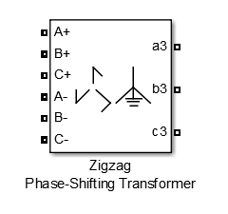
Transformers Zig-zag transformers
A1
Zig-zag transformers are used to facilitate phase shifts between 0º and 30º
Zig-zag transformers use three windings to achieve the desired phase shift
15º
C1
B1
A3
C3
B3

Slide 13
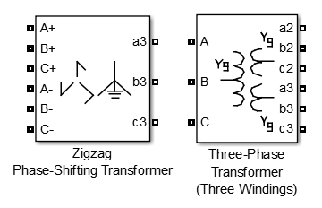
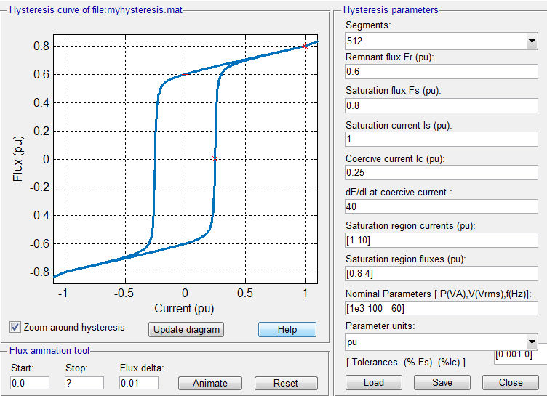
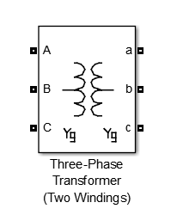
Transformers Saturation and hysteresis
powergui
MAT-file
When modeling hysteresis it is recommended to use a discrete solver for better accuracy and simulation performance
>> transformer_saturation

Slide 14
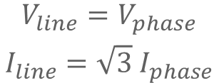

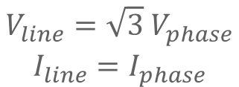



Star vs. delta connections
A
A
$$V_{phase}=V_{AN}$$
$$V_{line}=V_{AB}$$
$$V_{line}=V_{AB}$$
(phase to neutral)
(phase to phase)
30º
N
C
B
C
B
Star
Delta
$$\begin{matrix}V_{line}={\sqrt{3} V}_{phase} \\ I_{line}=I_{phase}\end{matrix}$$
$$\begin{matrix}V_{line}=V_{phase} \\ I_{line}={\sqrt{3} I}_{phase}\end{matrix}$$
$$V_{peak}={\sqrt{2} V}_{rms}$$

Slide 15
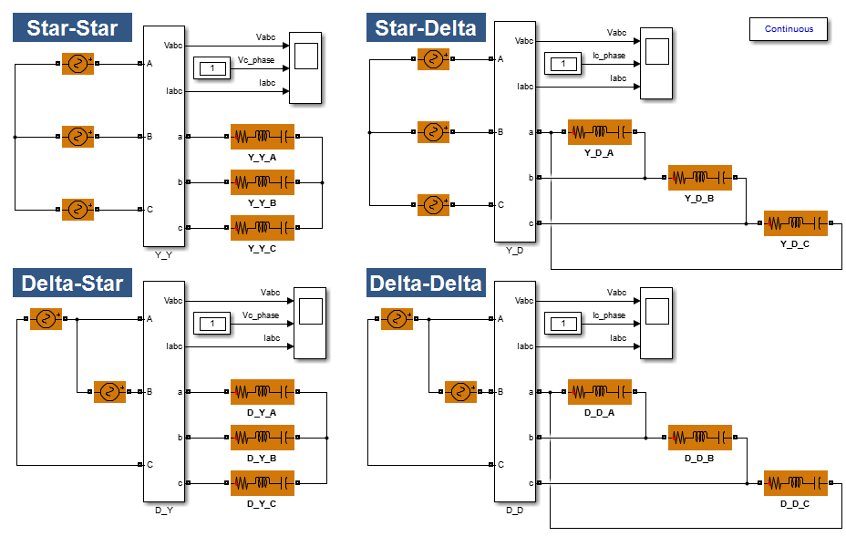
Star vs. delta connections
>> star_delta

Slide 16
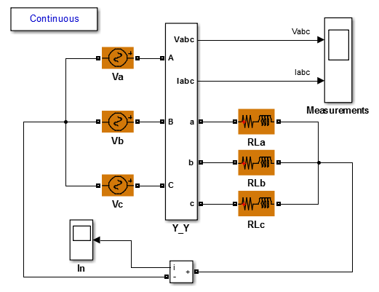


Floating vs. neutral connections
In a three-phase system, a floating star-connected load containing inductors will result in dependent states because of the following equation.
If the supply is star-connected and a neutral or ground connection is made between source and load, then there is no longer a dependent state.
$$I_{a}+I_{b}+I_{c}=0$$
$$I_{a}+I_{b}+I_{c}=I_{n}$$
>> floating_neutral

Slide 17
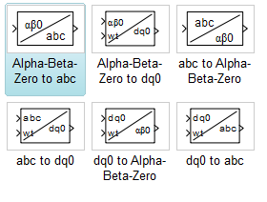

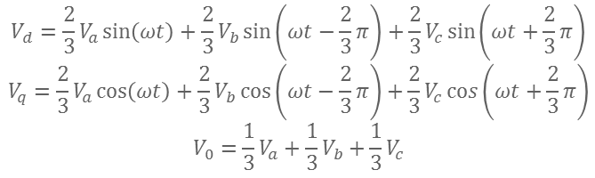

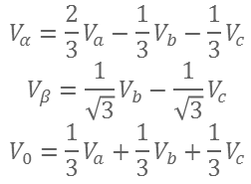






Reference frame transformations Park and Clarke transforms
$$V_{α}=\frac{2}{3}V_{a}−\frac{1}{3}V_{b}−\frac{1}{3}V_{c}$$
$$V_{β}=\frac{1}{\sqrt{3}}V_{b}−\frac{1}{\sqrt{3}}V_{c}$$
$$V_{0}=\frac{1}{3}V_{a}+{\frac{1}{3}V}_{b}+\frac{1}{3}V_{c}$$
$$V_{c}$$
$$V_{β}$$
Clarke
(stationary reference frame)
$$V_{q}$$
$$ωt$$
$$V_{α}$$
$$V_{a}$$
$$V_{d}$$
Park
(rotating reference frame)
$$V_{b}$$
$$V_{d}=\frac{2}{3}V_{a}\sin\left(ωt\right)+\frac{2}{3}V_{b}\sin\left(ωt−\frac{2}{3}π\right)+\frac{2}{3}V_{c}\sin\left(ωt+\frac{2}{3}π\right)$$
$$V_{q}=\frac{2}{3}V_{a}\cos\left(ωt\right)+\frac{2}{3}V_{b}\cos\left(ωt−\frac{2}{3}π\right)+\frac{2}{3}V_{c}\cos\left(ωt+\frac{2}{3}π\right)$$
$$V_{0}=\frac{1}{3}V_{a}+\frac{1}{3}V_{b}+\frac{1}{3}V_{c}$$
>> park_clarke

