Slide 1
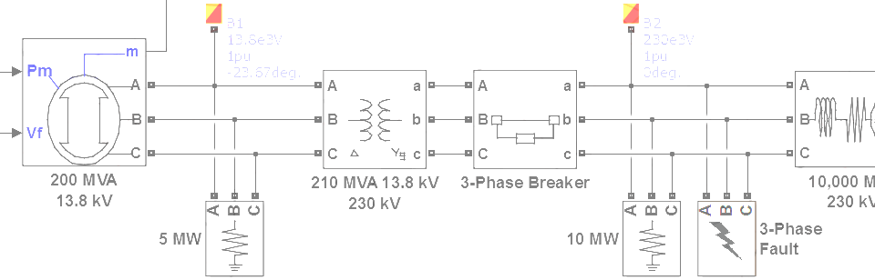

SimPowerSystems Hands-on Workshop: Modeling and Simulation of Electrical Power Systems with SimPowerSystemsTM
3. Electrical Machines
Carlos Osorio
Principal Application Engineer
MathWorks – Natick, MA

Slide 2
Outline
Machine measurements
Machine initialization
Load flow calculation
Connections to mechanical loads and prime movers

Slide 3
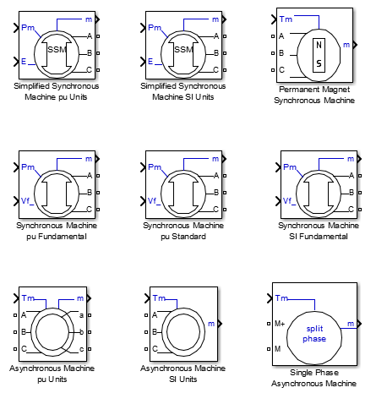
Electrical machines library
Synchronous and asynchronous machines
Detailed and simplified models
Generator mode or motor mode
PQ generators or PV generators
SI units or per unit system

Slide 4
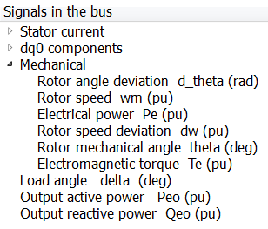
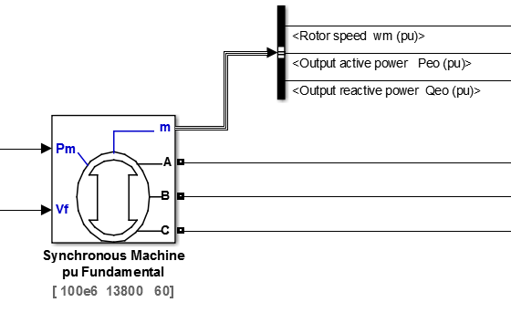
Machine measurements
Internal machine quantities are output as a Simulink bus signal
>> single_generator_init

Slide 5
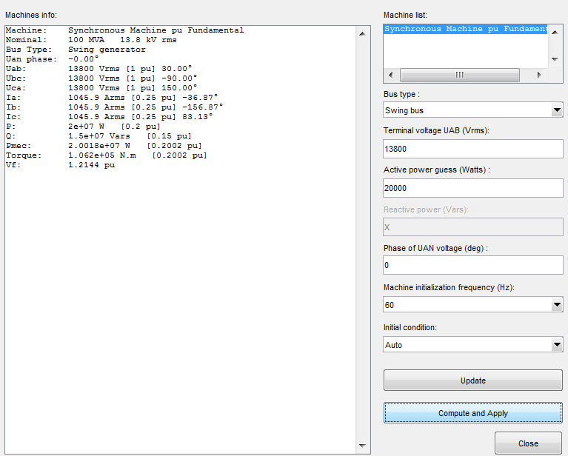

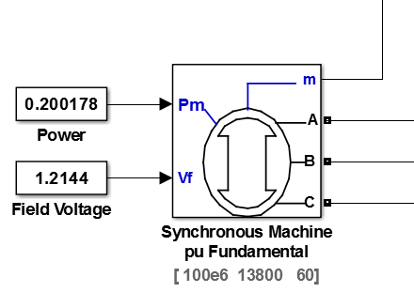
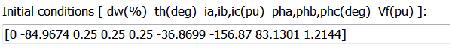
Machine initialization
powergui
Machine
information
Machine
settings
Initialize
machine
>> single_generator_initFinish

Slide 6
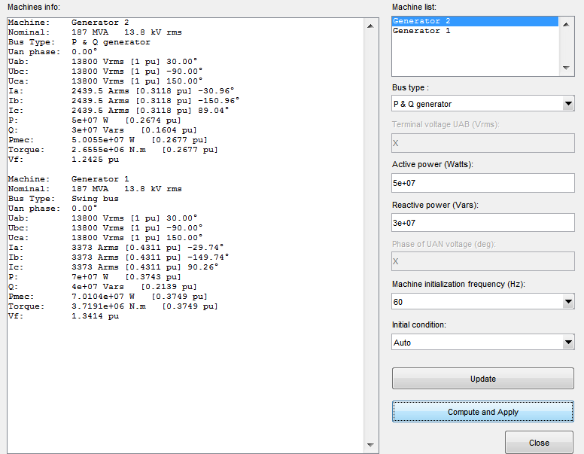
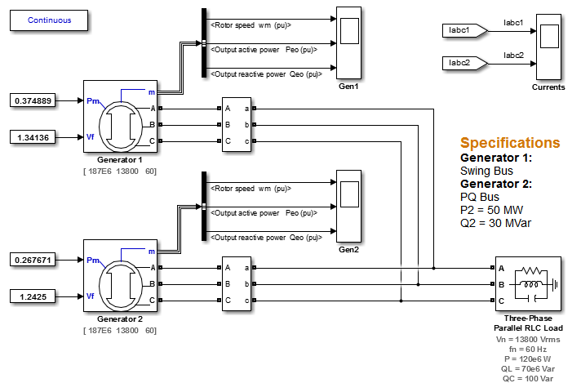
Machine initialization Multiple machines
At least one machine needs to be designated as a Swing Bus
>> two_generators_initFinish

Slide 7
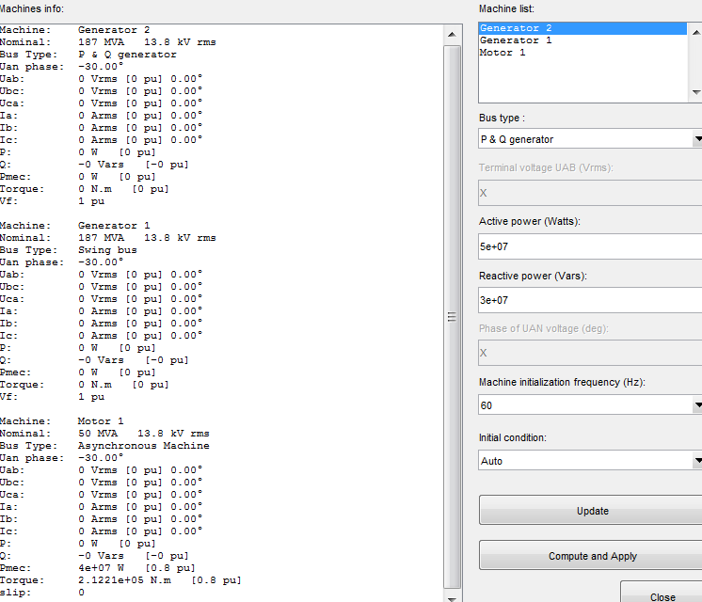
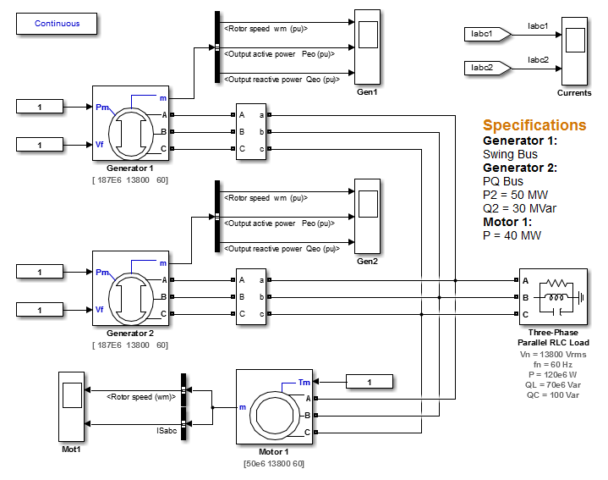

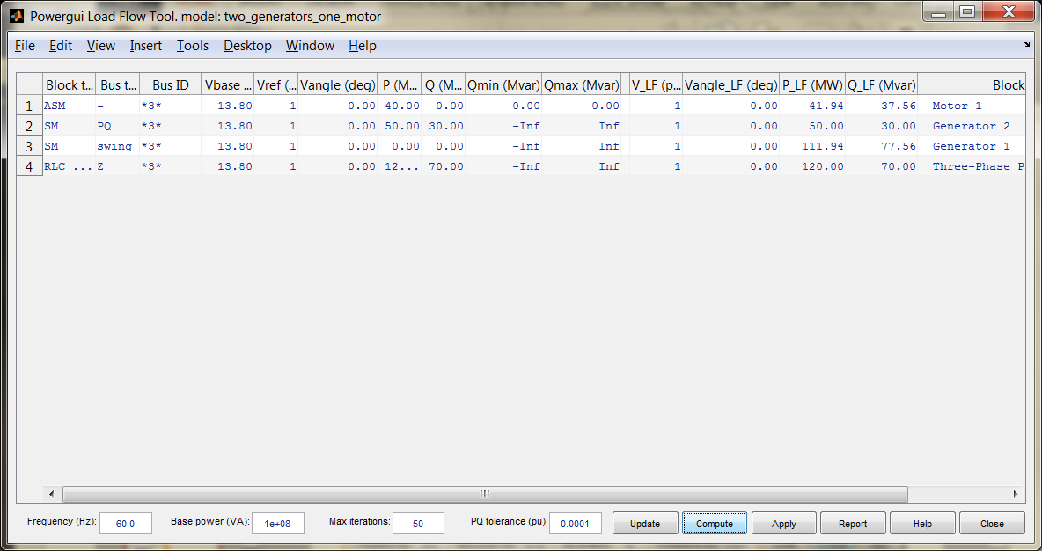
Load flow calculation
powergui
More powerful solution method and extended controls
powergui
Load flow analysis results
>> two_generators_motor

Slide 8
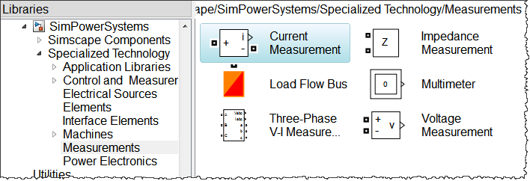
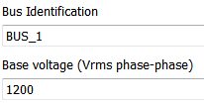
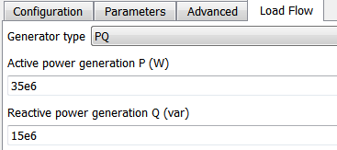
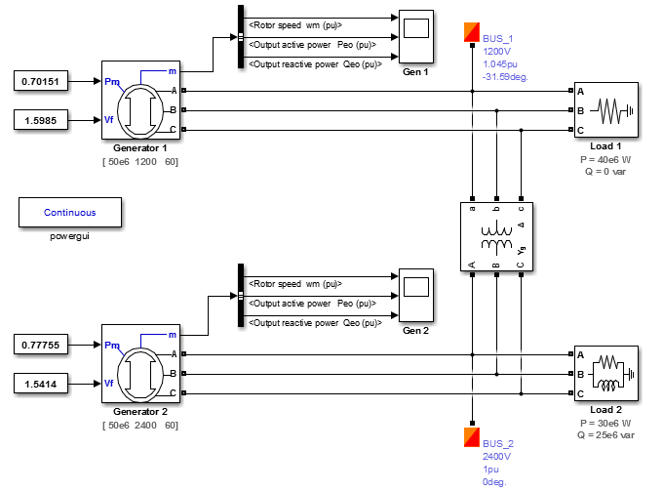

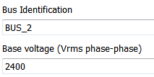
Load flow calculation
>> two_generators_loadFlowFinish

Slide 9
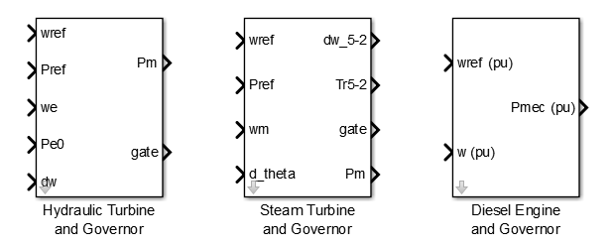
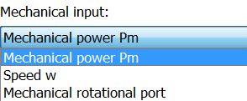
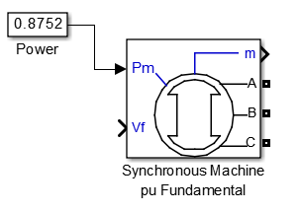
Connections to mechanical loads and prime movers
Direct connections to mechanical power sources – for generators – and loads – for motors – using standard Simulink signals
Notes:
Incorporating Physical Loads
SimPowerSystems has several interfaces to Simscape. You can use Simscape components to connect a SimPowerSystems network to Simscape domains such as the electrical and mechanical domains.
Change the model to create the torque input for the induction motor using Simscape components.
In the Asynchronous Machine pu Units block, change Mechanical input to Mechanical rotational port.
Remove the Torque Constant block.
Add an Ideal Torque Source block from the Simscape → Foundation Library → Mechanical → Mechanical Sources library.
Add a Mechanical Rotational Reference block from the Simscape → Foundation Library → Mechanical → Rotational Elements library.
Add a PS Constant block from the Simscape → Foundation Library → Physical Signals → Sources library and set Constant to -2500.
Connect a Solver Configuration block from the Simscape → Utilities library to any location in the Simscape network. This block is required in every model containing Simscape blocks.
Note Using Simscape is discussed in detail in the course Physical Modeling of Multidomain Systems with Simscape™.
Try
Actuate the motor with a Simscape torque source.
>> ch3_motor_simscapetorque
Model with hydraulic pump model providing torque to the motor.
>> ch3_motor_simscapepump

Slide 10
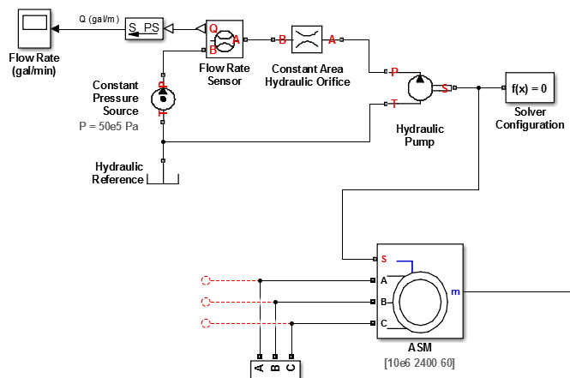
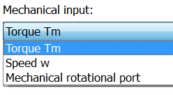
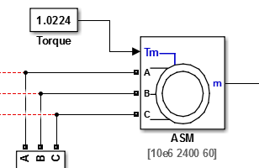
Connections to mechanical loads and prime movers
Simscape physical network
rotational shaft
Simscape
>> motor_simscapepump
Notes:
Incorporating Physical Loads
SimPowerSystems has several interfaces to Simscape. You can use Simscape components to connect a SimPowerSystems network to Simscape domains such as the electrical and mechanical domains.
Change the model to create the torque input for the induction motor using Simscape components.
In the Asynchronous Machine pu Units block, change Mechanical input to Mechanical rotational port.
Remove the Torque Constant block.
Add an Ideal Torque Source block from the Simscape → Foundation Library → Mechanical → Mechanical Sources library.
Add a Mechanical Rotational Reference block from the Simscape → Foundation Library → Mechanical → Rotational Elements library.
Add a PS Constant block from the Simscape → Foundation Library → Physical Signals → Sources library and set Constant to -2500.
Connect a Solver Configuration block from the Simscape → Utilities library to any location in the Simscape network. This block is required in every model containing Simscape blocks.
Note Using Simscape is discussed in detail in the course Physical Modeling of Multidomain Systems with Simscape™.
Try
Actuate the motor with a Simscape torque source.
>> ch3_motor_simscapetorque
Model with hydraulic pump model providing torque to the motor.
>> ch3_motor_simscapepump

