Slide 1
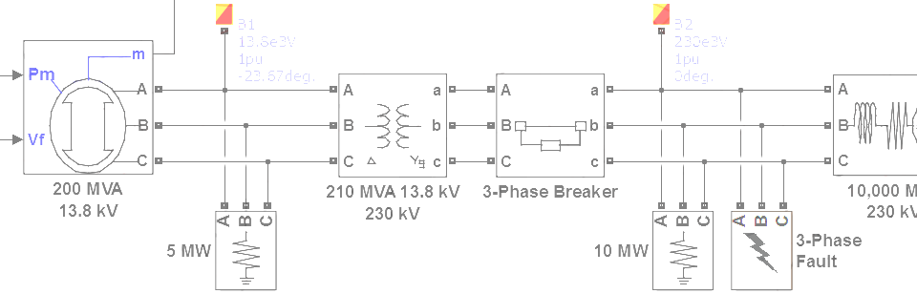

SimPowerSystems Hands-on Workshop: Modeling and Simulation of Electrical Power Systems with SimPowerSystemsTM
4. Simulation Performance
Carlos Osorio
Principal Application Engineer
MathWorks – Natick, MA

Slide 2
Outline
Model fidelity vs. simulation speed
SimPowerSystems simulation modes
Inter-machine oscillation example
Matrix converter example
Power inverter example

Slide 3
Model fidelity vs. simulation speed
Computation Time vs. Model Complexity
Nonlinear
Power
Electronics
Realistic Loads
High Frequency Switching
Computation Time
Abstract Loads
Phasor Simulation
Averaged Voltage
Model Complexity & Detail
Configure your model to balance the trade-off between simulation speed and model fidelity based on the goals of your simulation

Slide 4
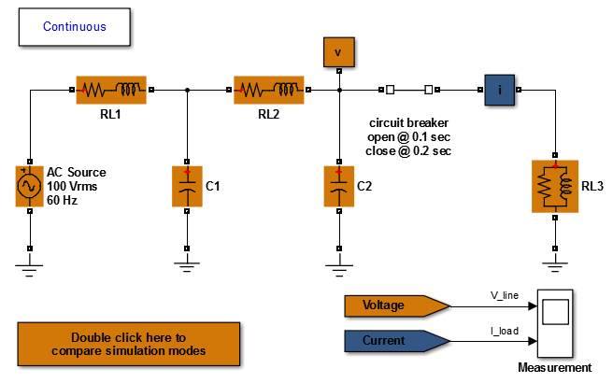
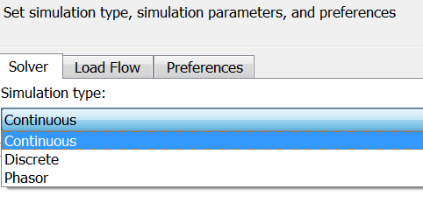
SimPowerSystems simulation modes
>> edit test_simulation_modes

Slide 5
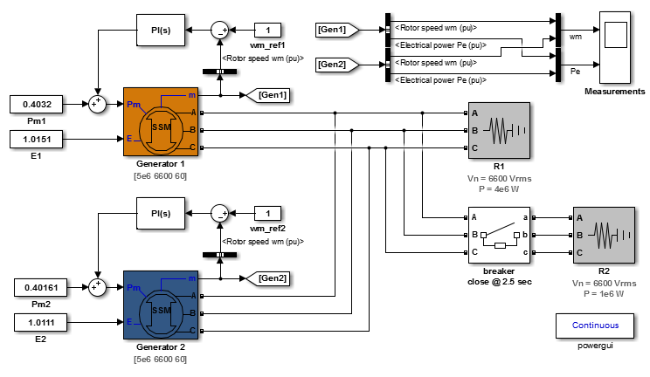
SimPowerSystems simulation modes Inter-machine oscillation example
>> inter_machine_oscillation

Slide 6
SimPowerSystems simulation modes Inter-machine oscillation example
When there is no active control, the frequency will drop when the load R2 is connected
This will result in the phasor model results becoming increasingly inaccurate the further the frequency moves away from nominal
If active control* is in place, then the phasor simulation method is very effective for fast, credible results (*Note: in this example voltage regulators were excluded for clarity)

Slide 7
SimPowerSystems simulation modes Inter-machine oscillation example
Simulation Mode | Normalized Time
Continuous | 0.788
Discrete T_{s} = 1e-04 | 1
Phasor | 0.034
>> edit bench_inter_machine_oscillation

Slide 8
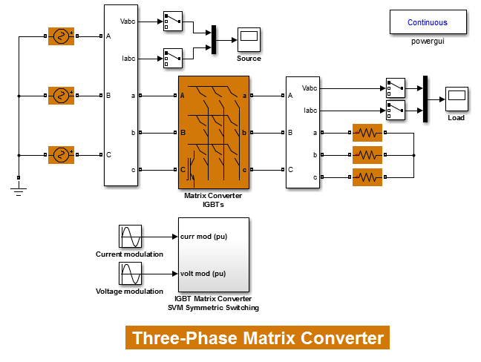
SimPowerSystems simulation modes Matrix converter example
Note: Phasor mode is not supported for systems with power electronic devices
>> threephase_matrix_converter

Slide 9
SimPowerSystems simulation modes Matrix converter example
Simulation Mode | Normalized Time (Normal Mode) | Normalized Time (Accelerator Mode)
Continuous | 1 | 0.220
Discrete T_{s} = 2.5e-06 | 0.128 | 0.024
>> edit bench_threephase_matrix_converter

Slide 10
SimPowerSystems simulation modes Discrete mode - Selecting the integration step size
circuit dynamics
x 10…20
switching frequency (f_{pwm})
x 100…500
duty cycle resolution (f_{s})
T_{s}
?
………..
T_{pwm}
T_{pwm}

Slide 11
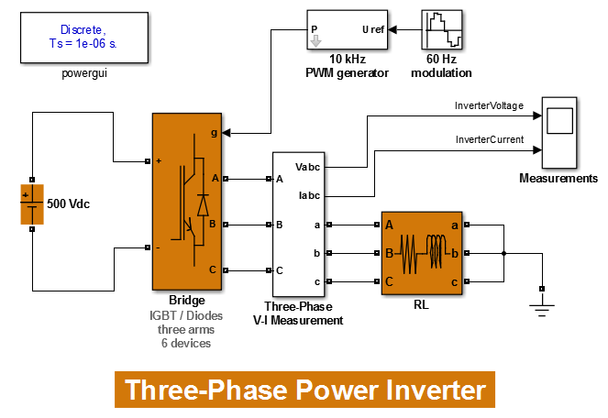
SimPowerSystems simulation modes Power inverter example
>> threephase_power_inverter

Slide 12
SimPowerSystems simulation modes Power inverter example
Simulation Mode | Normalized Time
Continuous | 1
Continuous Ideal Switches | 0.279
Discrete T_{s} = 1e-06, Normal Mode | 0.285
Discrete T_{s} = 1e-06, Accelerator Mode | 0.071
>> edit bench_threephase_power_inverter

