Slide 1
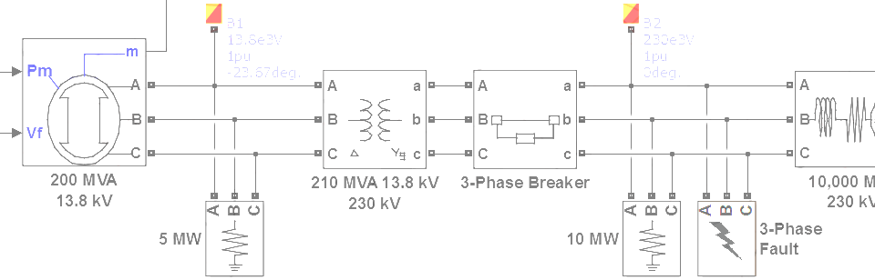

SimPowerSystems Hands-on Workshop: Modeling and Simulation of Electrical Power Systems with SimPowerSystemsTM
6. Custom Electrical Components
Carlos Osorio
Principal Application Engineer
MathWorks – Natick, MA

Slide 2
Outline
Simulink-based electrical components
Modifying Specialized Technology library components
Simscape Language and Simscape Components library
Simscape and SimPowerSystems interfaces
Model sharing and IP protection

Slide 3
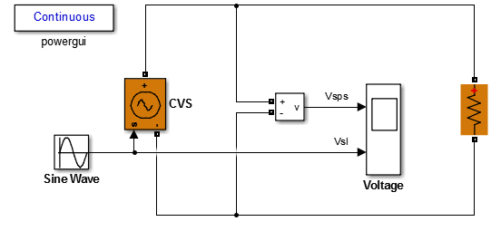
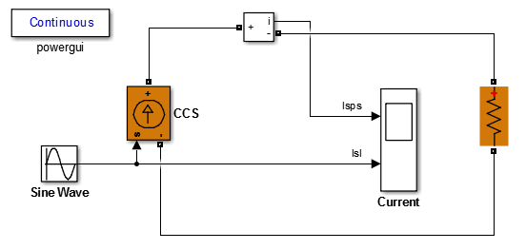
Simulink-based electrical components Controlled voltage and current sources
>> controlled_voltage_source
The voltage across the source terminals equals the input Simulink signal, regardless of the current requirement
The current through the source terminals equals the input Simulink signal, regardless of the voltage requirement
>> controlled_current_source

Slide 4
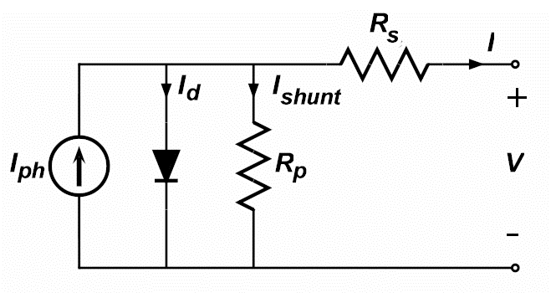
Simulink-based electrical components Photovoltaic solar cell example
exponential diode
Where:
I_{ph} Solar induced current (proportional to irradiance)
I_{s} Diode saturation current (exponential behavior)
N Diode quality factor (emission coefficient)
V_{t} Thermal voltage kT/q (k: Boltzmann constant, T: device temperature)
R_{p} Shunt resistance (models leakage currents, primarily due to defects)
R_{s} Series resistance (models bulk and contact resistances)

Slide 5
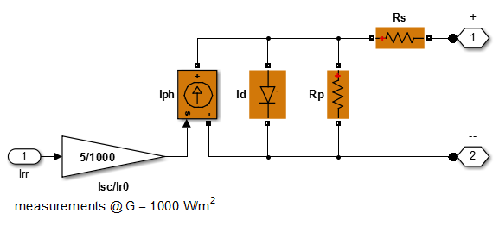
Simulink-based electrical components Photovoltaic solar cell example
SPS diode is modeled as a piecewise linear switch
>> sps_solarcell

Slide 6
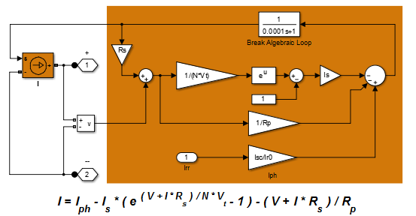
Simulink-based electrical components Photovoltaic solar cell example
Always need to properly break the algebraic loop
>> sl_solarcell

Slide 7
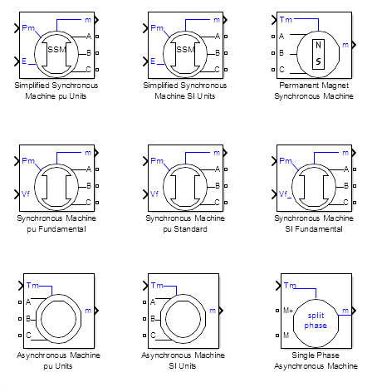
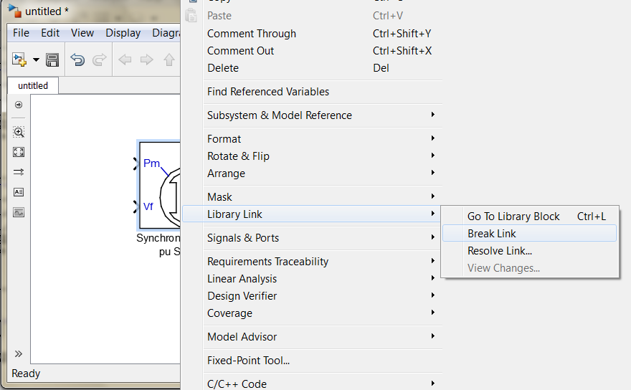
Modifying Specialized Technology library components Custom synchronous machine example
1
Original machines library
powerlib/Machines
Break the link and save the original block to a user defined library
i.e. mySMBlocks_userDefinedLib

Slide 8
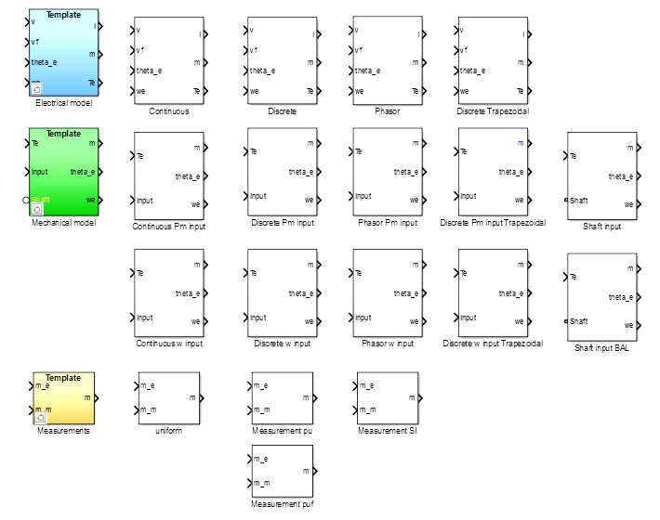
Modifying Specialized Technology library components Custom synchronous machine example
2
Copy the underlying machine model library to a new user defined library
i.e. spsSynchronousMachineModel → mySMModels_userDefinedLib

Slide 9
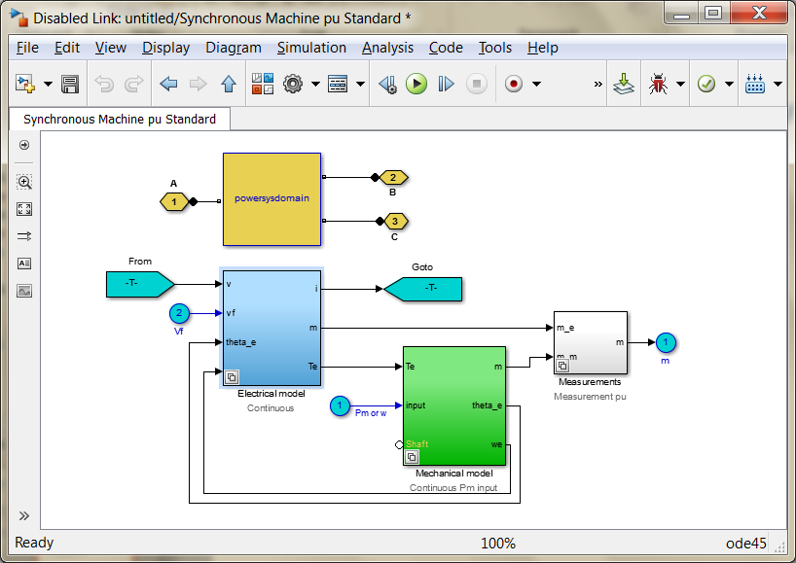
Modifying Specialized Technology library components Custom synchronous machine example
4
Replace the configurable subsystem templates under the mask of the original block with your modified templates
i.e. mySMBlock
3
Modify any of the blocks in this new library and update the configurable subsystem template blocks
i.e. mySMModels_userDefinedLib

Slide 10
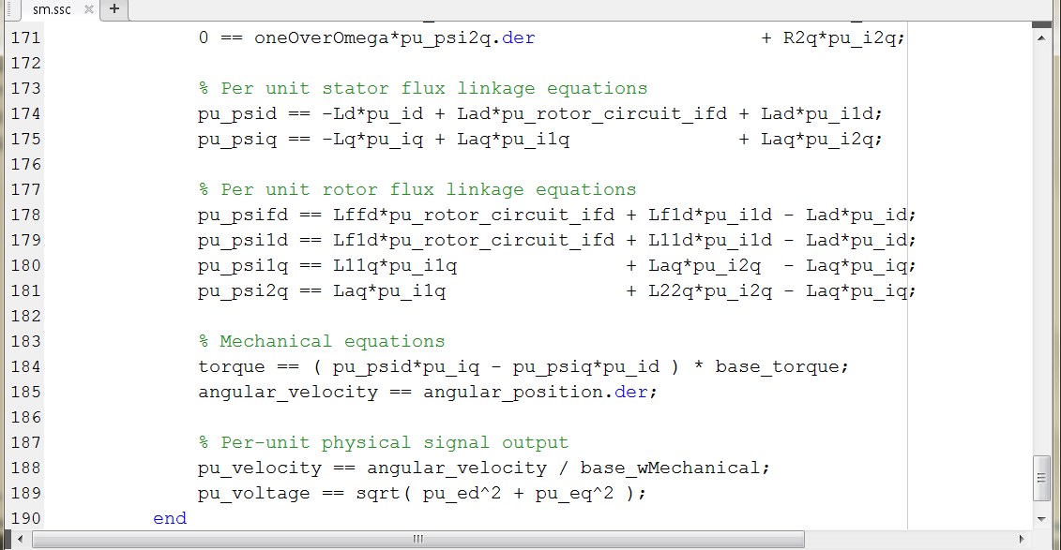
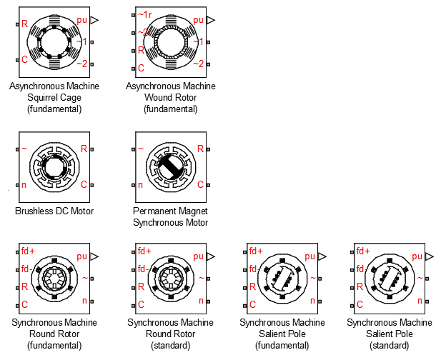
Simscape Language and Simscape Components library Three-phase electrical domain
Leverage the Simscape Language and the three-phase electrical domain to create custom components
>> simscape_custom_generator

Slide 11
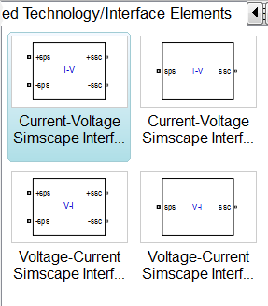
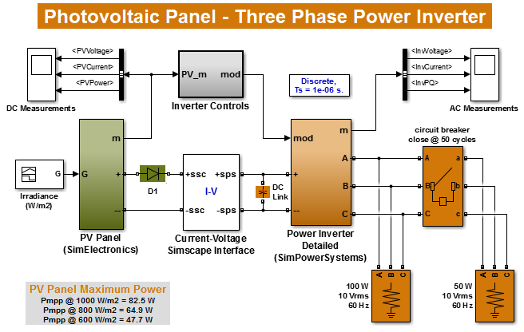
Simscape and SimPowerSystems interfaces Interfacing electrical domains
>> sps2se_pvinverter_avg
>> sps2se_pvinverter_det

Slide 12
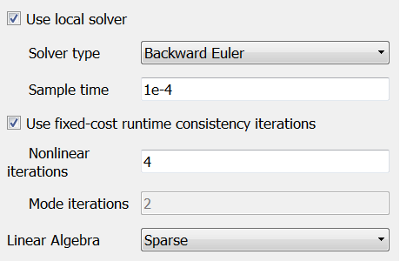
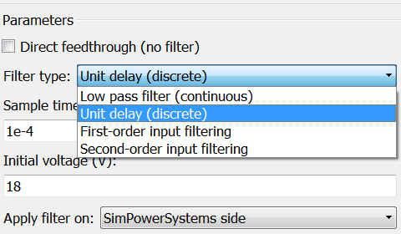
Simscape and SimPowerSystems interfaces Interfacing electrical domains
1
Use the Simscape local solver to simulate slower dynamics
2
Use the appropriate filter in the interface block to break the algebraic loop
>> sps2se_pvinverter_avg
>> sps2se_pvinverter_det

Slide 13
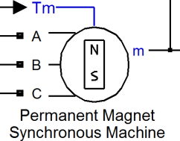
Model sharing and IP protection Simscape Editing Mode
Model Developer
Share SimPowerSystems models with other Simscape users
Simulate, analyze and generate code without requiring an extra SimPowerSystems license
Simscape license
SimPowerSystems license
Function | Full Mode | Restricted Mode
Add or delete regular Simulink blocks | Yes | Yes
Change Simulink solver, simulate | Yes | Yes
Change numerical parameters | Yes | Yes
Access PowerGUI functions, settings | Yes | Yes
Generate code | Yes | Yes
Add/delete blocks from SimPowerSystems | Yes | No
Make or break physical connections | Yes | No
Change block parameterization options | Yes | No
Model using Simscape and SimPowerSystems
Model Users
Simscape license
SimPowerSystems installed, but no license required

Slide 14
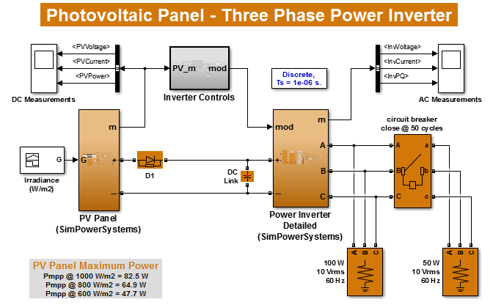
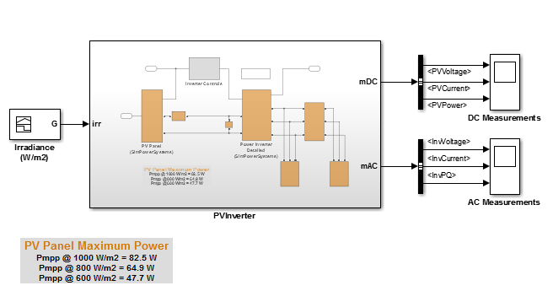
Model sharing and IP protection Protected model reference
1
Group the part(s) of the model you want to protect in a subsystem – note that only normal Simulink signals can be allowed to cross the subsystem boundaries
>> pvinverter_det_vsub

Slide 15


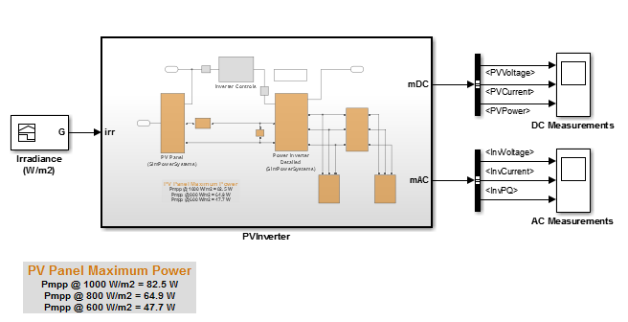
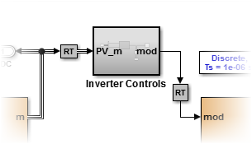
Model sharing and IP protection Protected model reference
3
Specify the inport/outport signal attributes – data type, port dimensions, sample time, etc. – of the atomic unit explicitly
2
Convert the subsystem to an Atomic unit
Block Parameters (Subsystem)
Create the appropriate <bus object> data type for any bus ports
4
Change the solver to FixedStepDiscrete
Add Rate Transition blocks where needed
Check the Inline parameters option
Configuration Parameters → Optimization → Signals…
>> pvinverter_det_asub

Slide 16
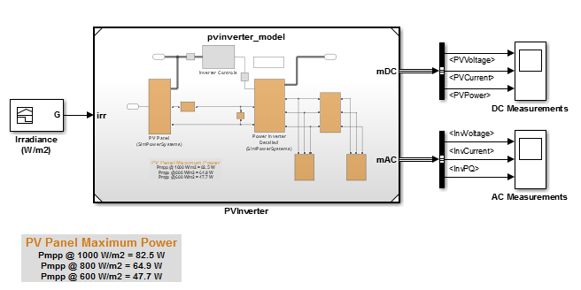
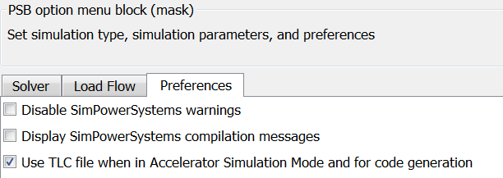
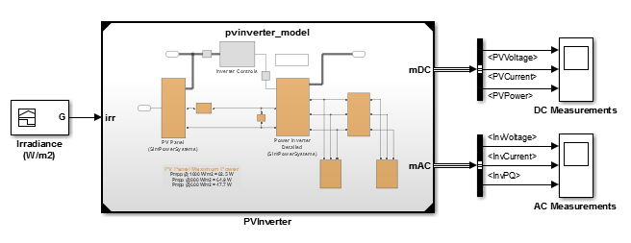
Model sharing and IP protection Protected model reference
6
Switch the Simulation Mode of the referenced model to Accelerator
Block Parameters (ModelReference)
On the referenced model powergui → Configure parameters menu check the Use TLC file… option
5
Convert the subsystem to a Reference Model
Subsystem & Model Reference → Convert Subsystem to…
>> pvinverter_det_mrefacc

Slide 17
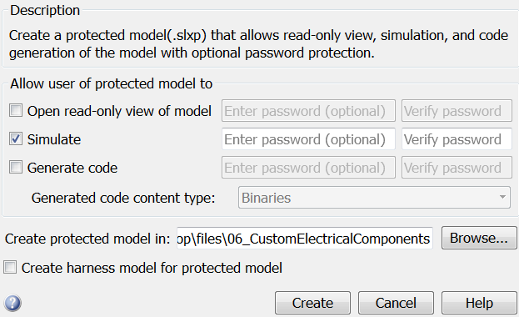
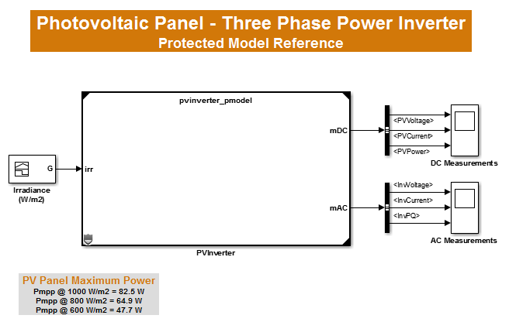

Model sharing and IP protection Protected model reference
7
Create the Protected Model
Subsystem & Model Reference → Create Protected Model …
>> pvinverter_det_pmref

