Slide 1

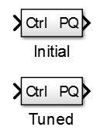
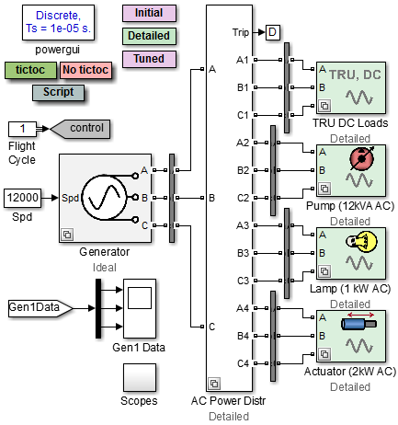
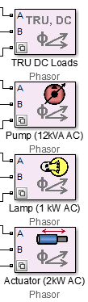
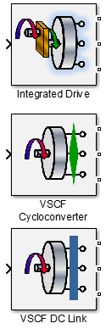
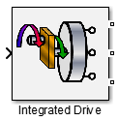


Aircraft Power Network Variants
Initial and Tuned use phasor mode
Detailed uses discrete
Integrated Drive runs in phasor, others must use discrete mode

Slide 2
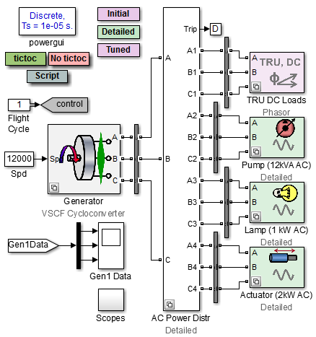
Aircraft Power Network Variant with Cycloconverter
If cyclcoconverter variant is used, use abstract version for TRU

