Slide 1
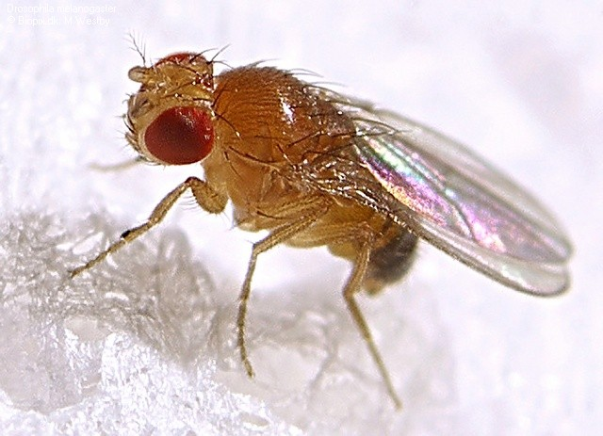
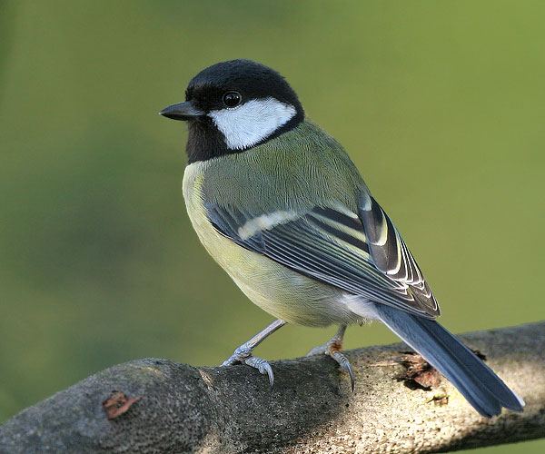


On the Complexity of Designed Systems (and its effect on technology deployment)
David Meyer
CTO and Chief Scientist, Brocade
Director, Advanced Technology Center, University of Oregon
Internet Technology Adoption and Transition Workshop
December 04 - 05, 2013
Cambridge, UK
http://www.iab.org/activities/workshops/itat
dmm@{brocade.com,uoregon.edu,1-4-5.net,…}
http://www.1-4-5.net/~dmm/talks/itat2013.pdf

Slide 2
Agenda
Premise of the Talk
Robustness, Fragility, and Complexity
Universal Architectural Principles
A Few Conclusions and Q&A if we have time

Slide 3
Premise
Much of the difficulty that we have had in
modifying certain protocols, in particular those
that reside in a waist or knot structure in an
architecture, is actually "by design". That is, the
difficultly we have had in deploying a protocol
that significantly modifies a “waist protocol”, IP
for example, is an important consequence of
robust network design.

Slide 4
Agenda
Premise of the Talk
Complexity, Robustness, Fragility
Universal Architectural Principles
A Few Conclusions and Q&A if we have time

Slide 5
Complexity and Robustness
“In our view, however, complexity is most succinctly discussed in terms of functionality and its robustness. Specifically, we argue that complexity in highly organized systems arises primarily from design strategies intended to create robustness to uncertainty in their environments and component parts.”
See Alderson, D. and J. Doyle, “Contrasting Views of Complexity and Their Implications For Network-Centric Infrastructures”,
IEEE TRANSACTIONS ON SYSTEMS, MAN, AND CYBERNETICS—PART A: SYSTEMS AND HUMANS, VOL. 40, NO. 4, JULY 2010
Notes:
Weaver: Problems of Simplicity, Problems of Disorganized Complexity, Problems of Organized Complexity

Slide 6
Robustness is a Generalized System Feature
Scalability is robustness to changes to the size and complexity of a system as a whole
Evolvability is robustness of lineages to changes on various (usually long) time scales
Other system features cast as robustness
Reliability is robustness to component failures
Efficiency is robustness to resource scarcity
Modularity is robustness to component rearrangements
Of course, these are the same features we’re seeking from the network

Slide 7
A Few Definitions
A [property] of a [system] is robust if it is [invariant] with respect to a [set of perturbations], up to some limit
Robustness is the preservation of a certain property in the presence of uncertainty in components or the environment
Obviously a core Internet design principle
Systems Biology: Biological systems are designed such that their important functions are insensitive to the naturally occurring variations in their parameters.
Limits the number of designs that can actually work in the real environment
Fragility is the opposite of robustness
If you're fragile you depend on 2nd order effects (acceleration) and the “harm” curve is concave
A little more on this later…
A system can have a property that is robust to one set of perturbations and yet fragile for a different property and/or perturbation → the system is Robust Yet Fragile
Or the system may collapse if it experiences perturbations above a certain threshold (K-fragile)
For example, a possible RYF tradeoff is that a system with high efficiency (i.e., using minimal system resources) might be unreliable (i.e., fragile to component failure) or hard to evolve
Another example: VRRP provides robustness to failure of a router/interface, but introduces fragilities in the protocol/implementation
Complexity/Robustness Spirals

Slide 8
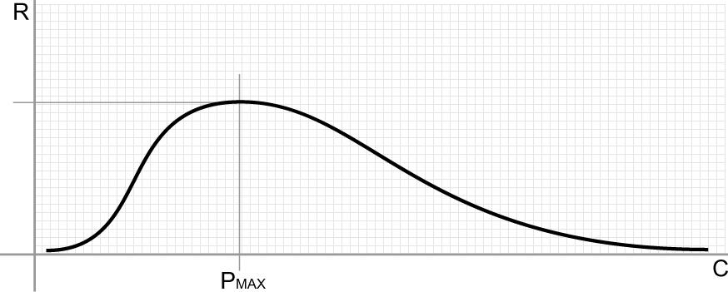
BTW, Complexity Isn’t Inherently “Bad”
Domain of the Robust
Biology and technology
Domain of the Fragile
A system needs complexity to achieve robustness
Increasing number of policies, protocols, configurations and interactions (well, and code)

Slide 9
Another way to look at the CR “Frontier”
Biology and technology
robust
Bummer
Robustness
“Optimal Frontier”
fragile
Physics
simple
hard
Complexity
Original slide courtesy John Doyle

Slide 10
Robust
So RYF Behavior is Everywhere
Yet Fragile
Efficient, flexible metabolism
Complex development and
Immune systems
Regeneration & renewal
Complex societies
Advanced Technologies
Obesity and diabetes
Rich microbe ecosystem
Inflammation, Auto-Im.
Cancer
Epidemics, war, …
Catastrophic failures
“Evolved” mechanisms for robustness allow for, even facilitate, novel, severe fragilities elsewhere
Often involving hijacking/exploiting the same mechanism
We’ve certainly seen this in the Internet space (consider DDOS of various varieties)
These are hard constraints (i.e., RYF behavior is conserved)

Slide 11
Fragility and Scaling are Related
A bit of a formal description of fragility
Let z be some stress level, p some property, and
Let H(p,z) be the (negative valued) harm function
Then for the fragile the following must hold
H(p,nz) < nH(p,z) for 0 < nz < K
For example, a coffee cup on a table suffers non-linearly more from large deviations (H(p, nz)) than from the cumulative effect of smaller events (nH(p,z))
So the cup is damaged far more by tail events than those within a few σ of the mean
Too theoretical? Perhaps, but consider: ARP storms, micro-loops, congestion collapse, AS 7007, …
BTW, nature requires this property
Consider: jumping off something 1 foot high 30 times vs. jumping off something 30 feet high once
When we say something scales like O(n²), what we mean is the damage to the network has constant acceleration (2) for weird enough n (e.g., outside say, 5 σ)
Again, ARP storms, congestion collapse, AS 7007, DDOS, … → non-linear damage
Idea courtesy Nassim Taleb, see http://www.fooledbyrandomness.com/

Slide 12
Summary: Understanding RYF is The Challenge
It turns out that managing/understanding RYF behavior is the most essential challenge in technology, society, politics, ecosystems, medicine, etc. This means…
Understanding Universal Architectural Principles
Managing spiraling complexity/fragility
Not predicting what is likely or typical
But rather understanding what is catastrophic (fat tailed)
→ understanding the hidden nature of complexity
BTW, it is much easier to create the robust features than it is to prevent the fragilities
In addition, there are poorly understood “conservation laws” at work
Let’s quickly look a a few Universal Architectural Principles

Slide 13
So First and Remarkably, These Principles are Universal Across Technology and Biology
Biology and Advanced Technology differ widely at the molecular and device levels
However, they show remarkable convergence at higher layers of organization…why?
Convergent Evolution
Fruit fly, bird, bat, 747 → Wings + control might be a good idea if you want to fly
“Network Motifs” in Escherichia coli and Saccharomyces cerevisiae
…
These same universal architectural building blocks occur over and over again in systems that scale and are evolvable.
A couple of examples
Micro: Biological Transcription Networks vs. Engineered Circuits
Macro: Bowties/Hourglasses

Slide 14
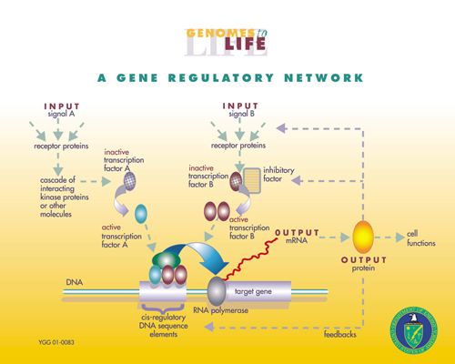
Biological Transcription Networks (a 30 second tour through Biology’s “Central Dogma”)
Signals
Transcription factors
RNA
DNA
Promoters
Genes
Proteins
Network Motifs

Slide 15
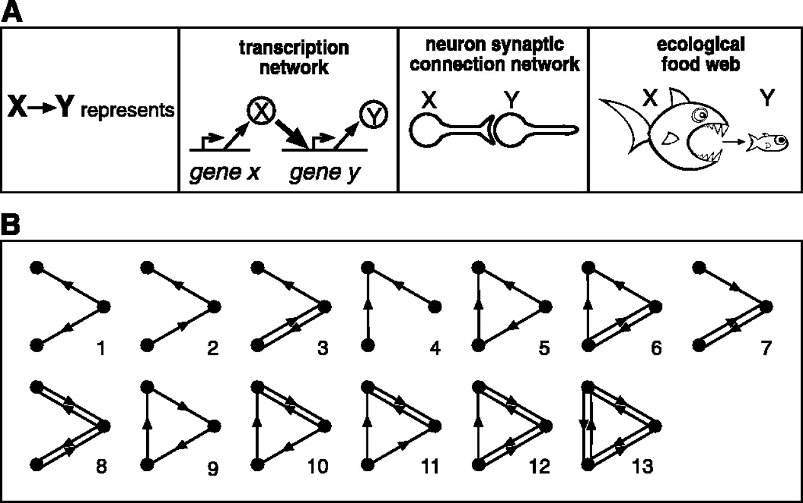
Network Motifs There are 13 three node motifs

Slide 16
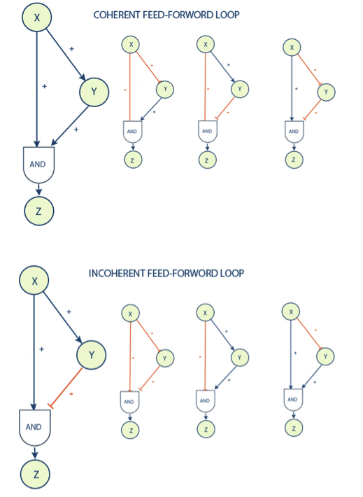
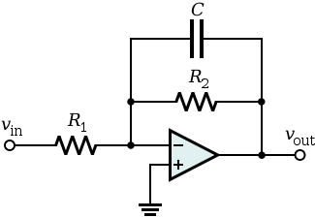
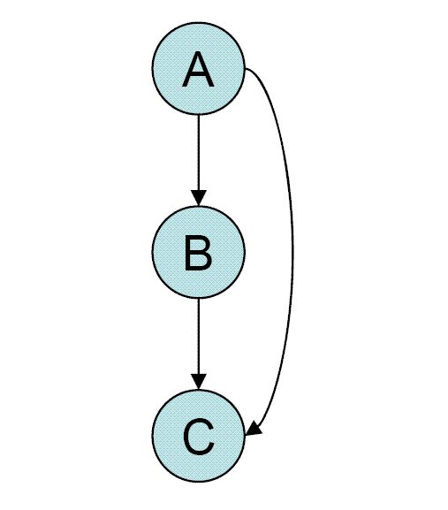

Feed Forward Loops
Technology
Biology
Sign Sensitive Low Pass Filter
Pulse Generator
See Alon, U., et.al. “Coherent FeedForward Loops Serves as a Sign-Sensitive Delay Element in Transcription Networks”,
http://ender.bu.edu/~tgardner/be567_readings/Cell signalling/Feedforward/Mangan.S_JMB_03.pdf

Slide 17
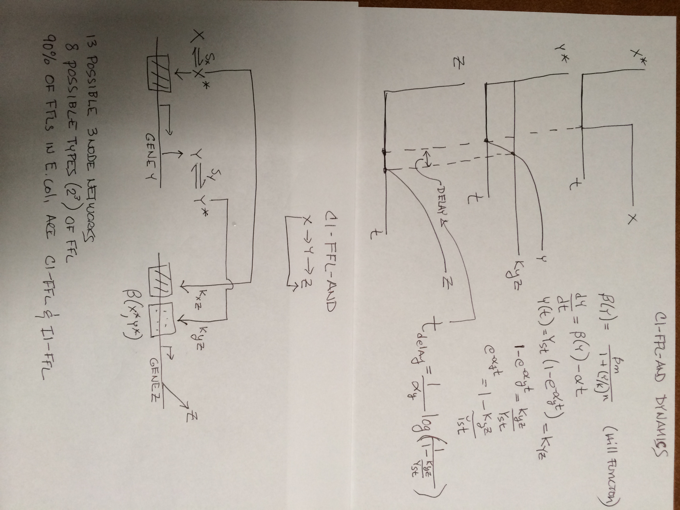
How Does This Actually Work? (ON step for C1FFL-AND)
Dynamics
Biology

Slide 18
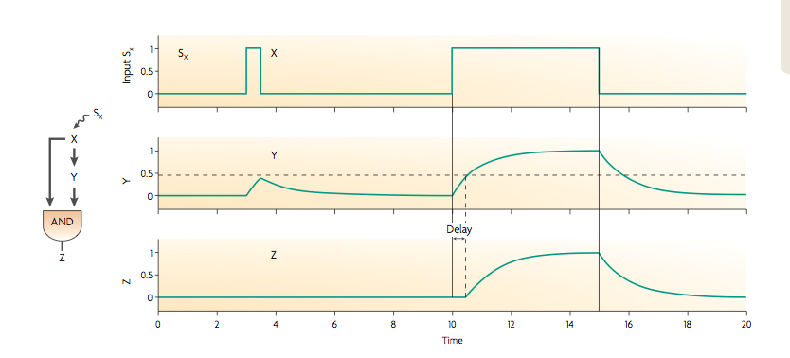
C1FFL-AND Dynamics
Graphic courtesy Alon, Uri, “Network motifs: theory and experimental approaches”,
Nature Reviews Genetics 8, 450-461 (June 2007) | doi:10.1038/nrg2102

Slide 19
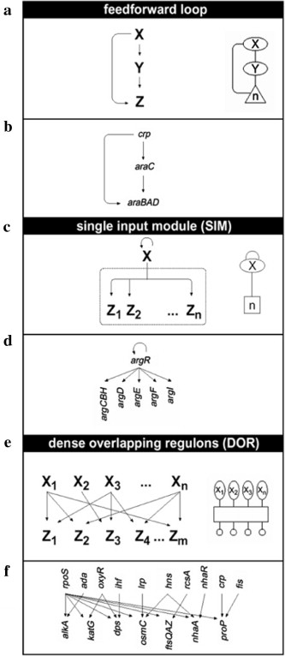
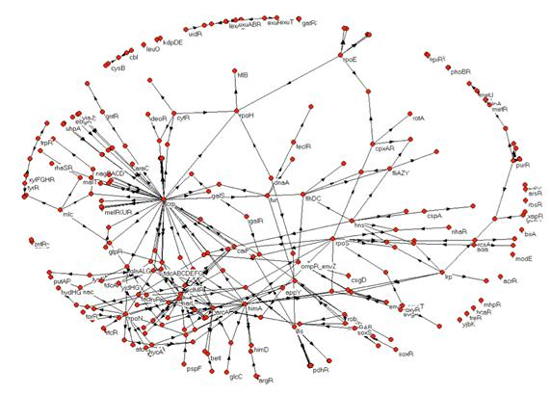
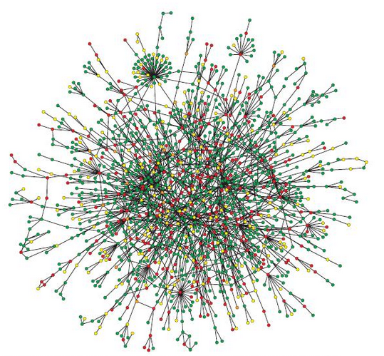
Surprisingly, E.coli and S. cerevisiae regulatory networks have the same 3 network motifs
Number of Nodes | Number of Possible Motifs
3 4 5 6 | 13 199 9364 1,530,843
Gate Array Temporal Sequencing Sign-sensitive filter
E.coli
S. cerevisiae

Slide 20
Universal Architectural Building Blocks
So we’ve seen that complex biological, technological, and sociological networks are built out of a small number of building blocks (“network motifs”) that retain their identity when combined in more complicated ways¹
And hence we hope, be understood
Popping up a level: What we have learned is that there are universal architectural building blocks found in systems that scale and are evolvable. These include
RYF complexity
Bowtie/Hourglass architectures
Protocol Based Architectures
Massively distributed with robust control loops
Contrast optimal control loops and hop-by-hop control
Highly layered
But with layer violations, e.g., Internet, overlay virtualization
¹ See Milo, R., et al., “Superfamilies of Evolved and Designed Networks”, Science 5 March 2004: 303 (5663), 1538-1542. [DOI:10.1126/science.1089167]

Slide 21
fan-in
of diverse
inputs
fan-out
of diverse
outputs
Bowtie
Universal Carriers
Diverse
function
Universal Architectural Principles
Universal
Control
Hourglass
Hourglasses for layering of control
Bowties for flows within layers
Diverse
components
Slide courtesy John Doyle

Slide 22
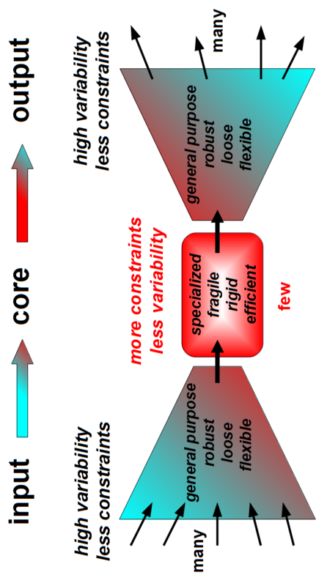
Bowties 101 Constraints that Deconstrain Schematic of a “Layer”
For example, the reactions and metabolites of core
metabolism, e.g., ATP metabolism, Krebs/Citric Acid
Cycle, … form a “metabolic knot”. That is, ATP is a
Universal Carrier for cellular energy.
Processes L-1 information and/or raw material flows into a “standardized” format (the L+1 abstraction)
Provides plug-and-play modularity for the layer above
Provides robustness but at the same time fragile to attacks against/using the standardized interface
See Kirschner M., and Gerhart J., “Evolvability”, Proc Natl Acad Sci USA , 95:8420–8427, 1998.

Slide 23
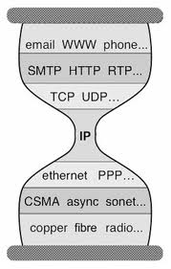
But Wait a Second Anything Look Familiar?
Bowtie Architecture
Hourglass Architecture
The Protocol Hourglass idea appears to have originated with Steve Deering. See Deering, S., “Watching the Waist of the Protocol Hourglass”, IETF 51,
2001, http://www.iab.org/wp-content/IAB-uploads/2011/03/hourglass-london-ietf.pdf. See also Akhshabi, S. and C. Dovrolis, “The Evolution of Layered
Protocol Stacks Leads to an Hourglass-Shaped Architecture”, http://conferences.sigcomm.org/sigcomm/2011/papers/sigcomm/p206.pdf.
Notes:
Bowties for flows w/in layers, and Hourglasses for layering of control

Slide 24
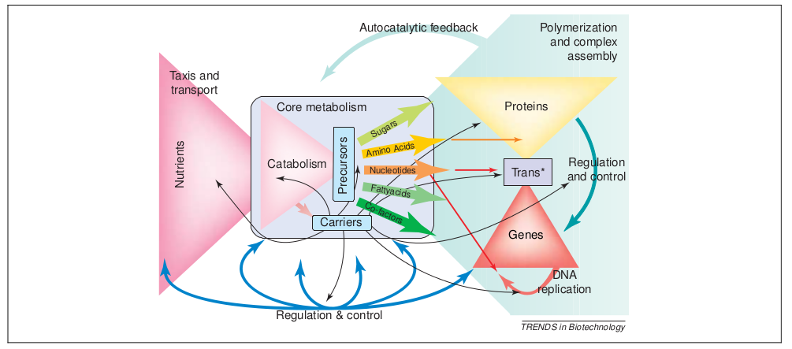
In Practice Things are More Complicated The Nested Bowtie/Hourglass Architecture of Metabolism
See Csete, M. and J. Doyle, “Bowties, metabolism and disease”, TRENDS in Biotechnology, Vol. 22 No. 9, Sept 2004

Slide 25
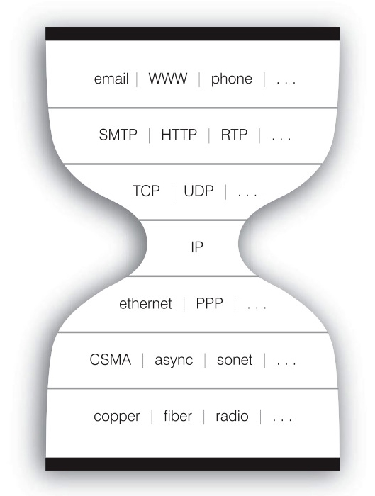
The Nested Bowtie/Hourglass Architecture of the Internet
Layering of Control
HTTP Bowtie
Input: Ports, Datagrams, Connections
Output (abstraction): REST
TCP/UDP Bowtie
Input: IP Packets
Output (abstraction): Ports, Datagrams, Connections
REST
Connections
Datagrams
Ports
HTTP(S)
REST
Layering of Control/Abstractions
TCP/UDP
Connections
Datagrams
Ports
IP Packets
Flows within Layers

Slide 26
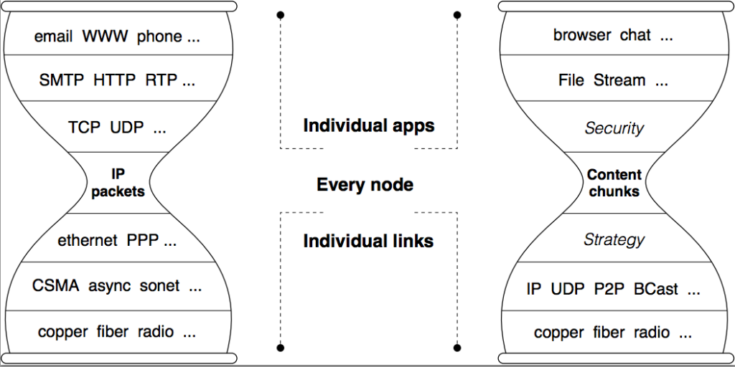
NDN Hourglass
See Named Data Networking, http://named-data.net/

Slide 27
Summarizing…
It is the same (universal) architectural features that make the Internet scalable and evolvable that make some protocols hard to evolve and/or deploy.
In particular, the difficulty we find in evolving protocols that form the knot or waist of a bowtie or hourglass is “by design”.
Looked at this way, the difficultly deploying IPv6
(DNSSec,…) can be seen as a direct and inescapable consequence of robust network design.

Slide 28
So What Are Our Options?
Robust systems “might be” intrinsically hard to understand
RYF complexity is an inherent property of advanced technology
Software (e.g., SDN, NFV, Cloud, …) exacerbates the situation
And the Internet has reached an unprecedented level of complexity…
Nonetheless, many of our goals for the Internet architecture revolve around how to achieve robustness…
which requires a deep understanding of the necessary interplay between complexity and robustness, modularity, feedback, and fragility¹
which is neither accidental nor superficial
Rather, architecture arises from “designs” to cope with uncertainty in environment and components
The same “designs” make some protocols hard to evolve
Understanding these universal architectural features will help us achieve the scalability and evolvability (operability, deployability, understandability) we’re seeking from the Internet architecture today and going forward
Multi-disciplinary approaches provide a template of how we might go about this (e.g., Systems Biology)
¹ See Marie E. Csete and John C. Doyle, “Reverse Engineering of Biological Complexity”,
http://www.cds.caltech.edu/~doyle/wiki/images/0/05/ScienceOnlinePDF.pdf

Slide 29
Q&A
Thanks!

