Slide 1
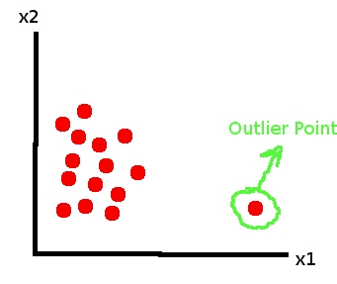
Anomaly Detection Introduction and Use Cases
Derick Winkworth, Ed Henry and David Meyer

Slide 2
Agenda
Introduction and a Bit of History
So What Are Anomalies?
Anomaly Detection Schemes
Use Cases
Current Events
Q&A

Slide 3
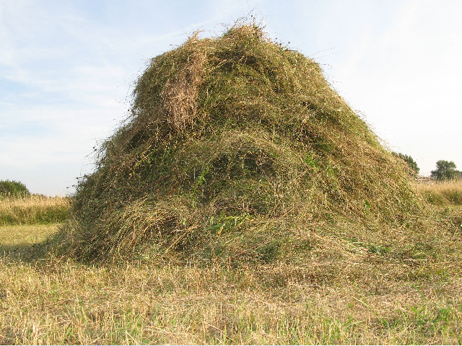
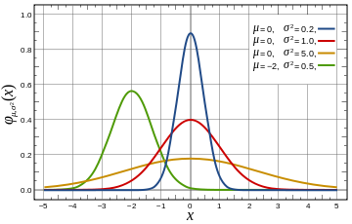

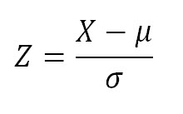
Introduction Anomaly Detection: What and Why
It is clear that one of the major challenges we face as a civilization is dealing with deluge of data that are being collected from our networks at global (and beyond) scale
While at the same time we are “knowledge starved”
Can’t find the needles in an exponentially growing haystack
Anomaly Detection is one piece of the puzzle
Machine Learning is a fundamental part of the answer
Key Assumption for Anomaly Detection
Anomalous events occur relatively infrequently (alternatively: most events normal)
Second order assumption: Common events follow a Gaussian distribution (likely to be wrong)
What is obvious: When anomalous events do occur, their consequences can be quite serious and often have substantial negative impact on our businesses, security, …

Slide 4
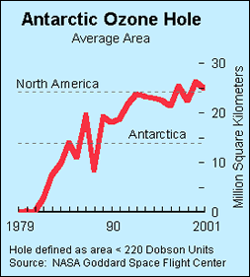
A Bit of History On the Importance of Anomaly Detection
Ozone Depletion Measurement
In 1985 three researchers (Farman, Gardinar and Shanklin) were puzzled by data gathered by the British Antarctic Survey showing that ozone levels for Antarctica had dropped 10% below normal levels
Why did the Nimbus 7 satellite, which had instruments aboard for recording ozone levels, not record similarly low ozone concentrations?
The ozone concentrations recorded by the satellite were so low they were being treated as outliers by a computer program and unfortunately discarded, causing modeling to make incorrect predictions
Graphic courtesy http://www.epa.gov/ozone/

Slide 5
Agenda
Introduction and a Bit of History
So What Are Anomalies?
Anomaly Detection Schemes
Use Cases
Current Events
Q&A

Slide 6
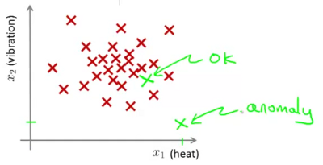
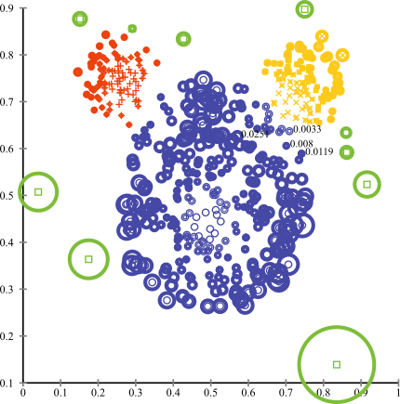
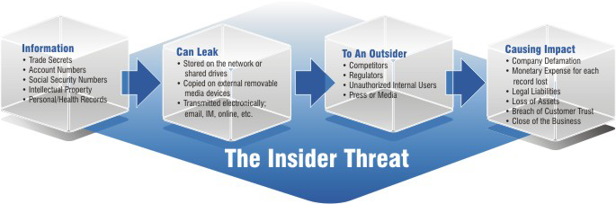
So What are Anomalies?
An anomaly is a pattern that does not conform to the expected behaviour
How to define expected behaviour?
How to find the “outliers”?
Anomalies translate to significant real life events
Cyber intrusions
Cyber crime
Manufacturing/product defects
…
Linear Decision Boundary
Graphic courtesy Andrew Ng, others

Slide 7
Basic Idea Behind Anomaly Detection
An anomaly
Idea: Assume that a boundary exists and that - Nominal data is inside the boundary - Anomalous data is outside the boundary
Problem: How to estimate/approximate the boundary?
Problem: What measurement(s) caused the anomaly?
Collected ‘Nominal’ Data
Problem: How far off-nominal is the anomaly/feature?

Slide 8
Simple Example
N₁ and N₂ are regions of normal behaviour
Say, normal flows in a network
Points o₁ and o₂ are anomalies
Points in region O₃ are anomalies
Challenge:
How to define “normal” regions?
How to find the outlier points?
This is the job of machine learning
Y
N₁
o₁
O₃
o₂
N₂
X

Slide 9
Agenda
Introduction and a Bit of History
So What Are Anomalies?
Anomaly Detection Schemes
Use Cases
Current Events
Q&A

Slide 10
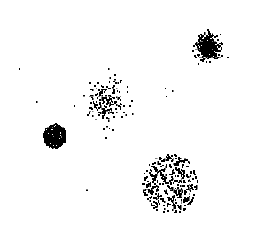
Anomaly Detection Schemes
General Steps
Build a profile of the “normal” behavior
Profile can be patterns or summary statistics for the overall population
Use the “normal” profile to detect anomalies
Anomalies are observations whose characteristics differ significantly from the normal profile
Types of anomaly detection schemes
Graphical & Statistical-based
Distance-based
Model-based
FP Mining, K-means, …

Slide 11
3 Main Types of Anomaly
Point Anomalies
Contextual Anomalies
Collective Anomalies

Slide 12
Point Anomalies
An individual data instance is anomalous if it deviates significantly from the rest of the data set.
Y
Anomaly
N₁
o₁
O₃
o₂
N₂
X

Slide 13
Contextual Anomalies
Individual data instance is anomalous within a context
Requires a notion of context
Also referred to as conditional anomalies
Anomaly
Normal

Slide 14
Collective Anomalies
A collection of related data instances is anomalous
Requires a relationship among data instances
Sequential Data
Spatial Data
Graph Data
The individual instances within a collective anomaly are not anomalous by themselves
Anomalous Subsequence
Anomalous Subsequence

Slide 15
Key Challenges for Anomaly Detection Algorithms
Defining a representative normal region is challenging
The boundary between normal and outlying behaviour is often not precise
The exact notion of an outlier is different for different application domains
Availability of labelled data for training/validation (unsupervised learning)
Malicious adversaries
Data is very noisy
False positive/negatives
Normal behaviour keeps evolving

Slide 16
Machine Learning Approaches
Time-Based Inductive Methods
Use probability and a directed graph to predict the next event
Bayesian approaches
Can also use undirected approaches (Markov Random Fields)
Instance Based Learning
Define a distance to measure the similarity between feature vectors
K-Means, …
Neural Networks
This is where we want to go
…

Slide 17
Aside: Why Use Neural Networks?
Very good at creating hyper-planes for separating between classes
e.g., anomalous vs. normal
Non-linear decision boundaries
Extremely powerful models for mapping vector spaces
Good when dealing with huge data sets/handles noisy data well
Downside: Training can be compute intensive

Slide 18
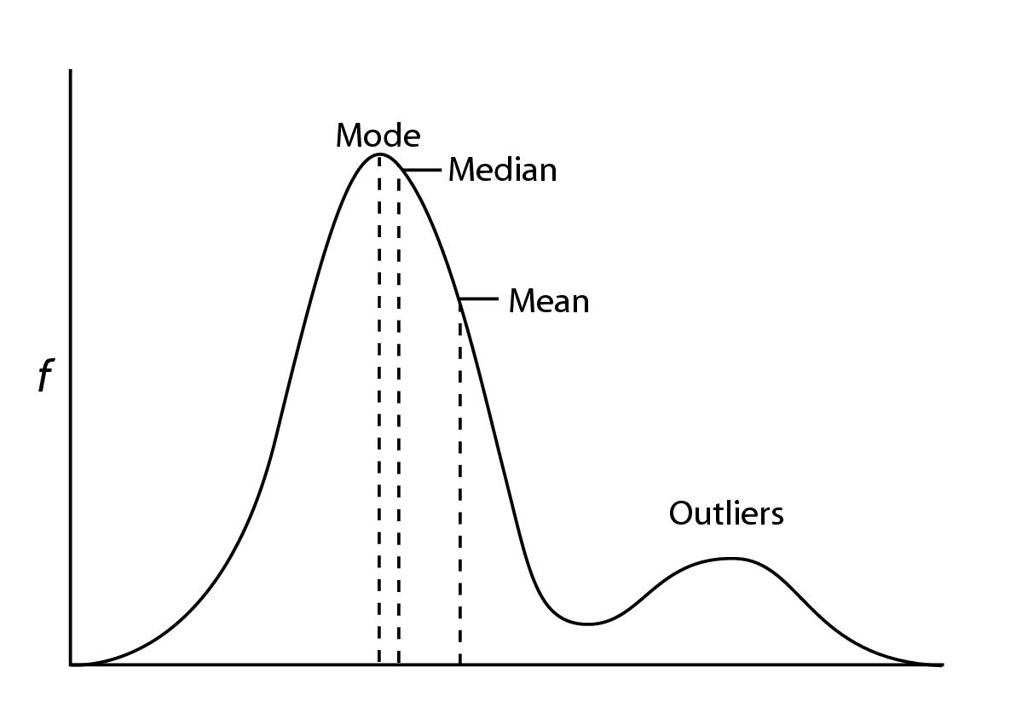
Summary
Challenges
Many, but the key ones include:
What is normal?
Where are the outliers (and what do they look like)?
What is the shape of the boundary between the two?
False positive/negative mitigation
Method is unsupervised (unsupervised learning)
Validation can be challenging (just like for clustering)
Finding a needle in a haystack
And the haystack is growing at an exponential rate
Both in raw terms (size of data sets) and
Dimensionality of data items (curse of dimensionality)
Both make finding outliers more challenging
Key working assumptions
There are considerably more normal than abnormal observations
Normal observations follow a Gaussian distribution (likely wrong)
p(X;μ,σ) < ϵ

Slide 19
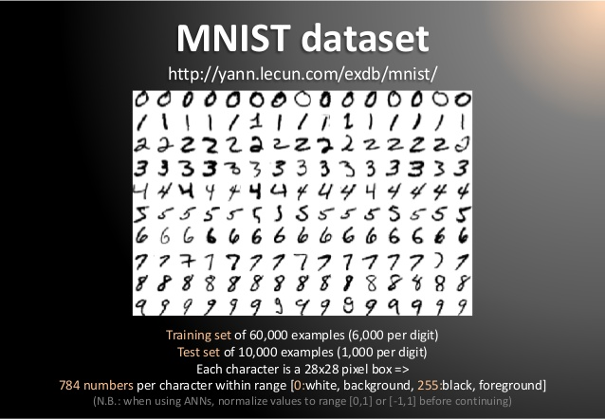
What is the Issue with Dimensionality?
Machine Learning is good at understanding the structure of high dimensional spaces
Humans aren’t ☹
What is a dimension?
Informally…
A direction in the input vector
“Feature”
Example: MNIST dataset
Mixed NIST dataset
Large database of handwritten digits, 0-9
28x28 images
784 (28²) dimensional input data (in pixel space)
Consider 4K TV → 4096x2160 = 8,847,360 dimensions in the pixel space
But why care?
Because interesting and unseen relationships
frequently live in high-dimensional spaces

Slide 20
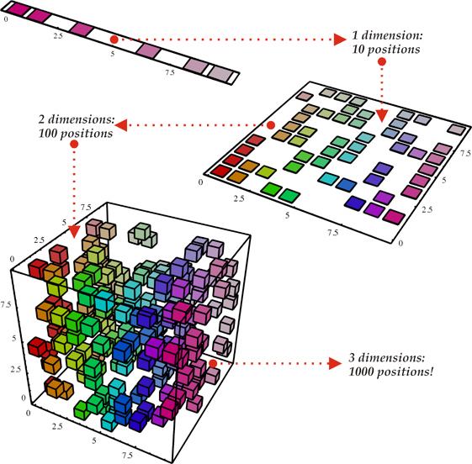
But There’s a Hitch The Curse Of Dimensionality
To generalize locally, you need representative examples from all relevant variations
But there are an exponential number of variations
So local representations might not (don’t) scale
Classical Solution: Hope for a smooth enough target function, or make it smooth by handcrafting good features or kernels. But this is sub-optimal. Alternatives?
Mechanical Turk (get more examples)
Deep learning
Distributed Representations
Unsupervised Learning
…
(i). Space grows exponentially
(ii). Space is stretched, points
become equidistant
See also “Error, Dimensionality, and Predictability”, Taleb, N. & Flaneur, https://dl.dropboxusercontent.com/u/50282823/Propagation.pdf for a different perspective

Slide 21
Agenda
Introduction and a Bit of History
So What Are Anomalies?
Anomaly Detection Schemes
Use Cases
Current Events
Q&A

Slide 22







Workflow Schematic
Domain Knowledge
Domain Knowledge
Domain Knowledge
Domain Knowledge
3rd Party Applications
Analytics Platform
Learning
Presentation Layer
Intelligence
Data Collection
Packet brokers, flow data, …
Preprocessing
Big Data, Hadoop, Data Science, …
Model Generation
Machine Learning
Oracle
Model(s)
Anomaly Detection
Remediation/Optimization/…
Oracle
Logic
Intent
Topology, Anomaly Detection,
Root Cause Analysis,
Predictive Insight, ….

Slide 23
Obvious Use Cases
Intrusions
Actions that attempt to bypass security mechanisms
E.g., unauthorized access, inflicting harm, etc.
Example intrusions
Denial-of-service attacks
Scans
Worms and viruses
Host compromises
Intrusion detection
Monitoring and analyzing traffic
Identifying abnormal activities
Assessing severity and raising alarms
Kill-chain Lifecycle Management
In general, look at Enterprise Cybersecurity
Information leakage, data misuse, …
Includes endpoint identity, role and behavior analysis
Needed to identify Insider threats/data breaches

Slide 24
Simple Example: Application Profiling
Goal: Build tools for the DevOps environment
Provide deeper automation and new capabilities/insight
First application: Anomaly Detection
Low Hanging Fruit: Use Frequent Pattern Mining and K-Means to learn/predict anomalous application behavior
Detecting unusual access to intellectual property and internal systems
Identifying abnormal financial trading activities or asset allocations
Proving alerts when behaviors or actions fall outside of typical patterns
Traditional anomaly detection; use a variety of methods
Detect the installation, activation, or usage of unapproved software
Alert when computers or devices are used in unauthorized ways
…
Let’s briefly look at FP Mining and K-Means

Slide 25
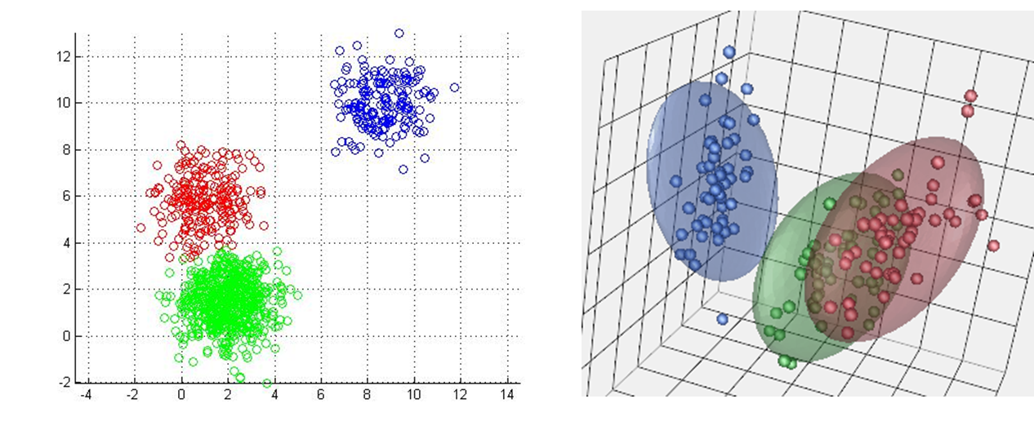
Frequent Pattern Mining and K-Means
FP Mining finds patterns in categorical data
Returns “itemsets”
Sets of Transaction IDs (TIDs) corresponding to some pattern
[src,dest,srcprt,destprt,oif,appname,…]
K-Means finds clusters in continuous data
A cluster can be things like
The set of TIDs that show congestion, …
Putting these algorithms together allows us to make the following (very) simple inference:
TIDset_{FP} ∧ TIDset_{K-Means} → patterns that cluster together
“These application patterns may result in anomalous behavior”
TID sets
(clusters)

Slide 26
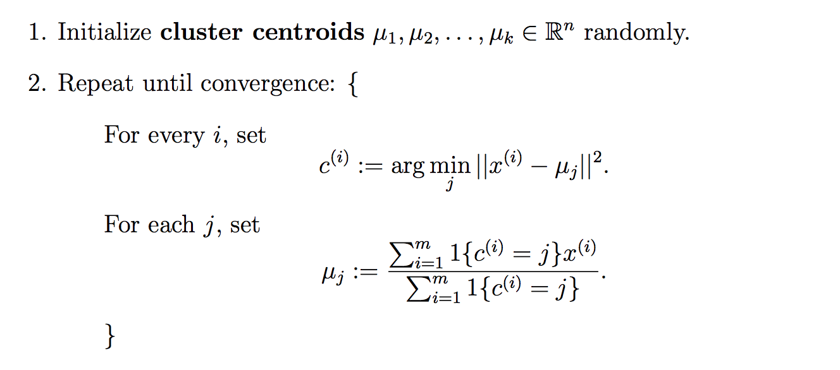
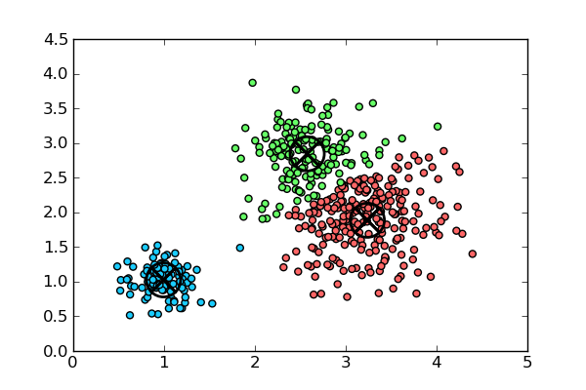
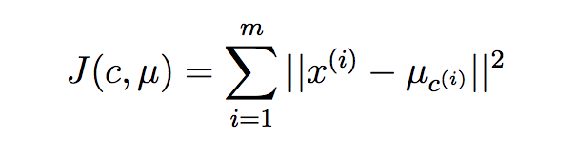
A Little More on K-Means K-Means Algorithm
Can show that this algorithm minimizes this distortion function
In words
Randomly initialize cluster centroids (the μ_{i}’s)
Until convergence
Assign each observation to the closest cluster centroid
Update each centroid to the mean of the points assigned to it

Slide 27

Application Profiling, cont
First, we need data (obvious, but ingestion, … not trivial)
Lots of frameworks/engines (spark, storm, tigon/cask.io,…)
Data we have (public datasets, collected here @brcd)
Network and endpoint information
Environmental sensor data
Chef/Puppet, Openstack Heat, server/cluster state,…
…
The FP-KMeans pipeline can be used build application profiles
Which endpoints an application talks to (and associated templates)
Which ports and protocols it uses
and associated meta-data, geo-ip, …
Flow characteristics including as TOD, volume and duration
Other CSNSE configuration associated with the application
ACL/QoS, routing policies,…
…
We are really limited only by our imagination and (of course) our datasets
Primarily descriptive/diagnostic analyzes

Slide 28
So what is more interesting…
We can use the same FP-KMeans pipeline in a predictive way
For example, we can analyze changes to predict possible behavior
This ACL/Routing/QoS change will cause event <X> with probability P
If you configure app <X> with params <Y> there is prob P of congestion
…
We can correlate real-time application profiles with events/state
Application <X> is green (intelligent dashboard)
Queue <X> is dropping <Y>% of it's packets; app <Z> is talking to this endpoint
…
We can detect/predict anomalous behaviors
Points that are far from any cluster (K-Means), and/or
p(X) < ε (say in a multivariate Gaussian anomaly detection setting)
…
Note: We will eventually use much more powerful methods (e.g., deep neural networks)
However, note Occam’s Razor: start simple

Slide 29
Agenda
Introduction and a Bit of History
So What Are Anomalies?
Anomaly Detection Schemes
Use Cases
Current Events
Q&A

Slide 30
Current Events Malware Capture Facility Project
Czech Technical University ATG Group
Project capturing, analyzing and publishing real/long-lived malware traffic
The goals of the project include
To execute real malware for long periods of time
To analyze the malware traffic manually and automatically
To assign ground-truth labels to the traffic, including several botnet phases, attacks, normal and background
To publish these dataset to the community to help develop better detection methods
Datasets
The pcap files of the malware traffic
The argus binary flow files
The text argus flow files
The text web logs
A text file with the explanation of the experiment
Several related files, such as the histogram of labels

Slide 31
Agenda
Introduction and a Bit of History
So What Are Anomalies?
Anomaly Detection Schemes
Use Cases
Current Events
Q&A

Slide 32

Q&A
Thanks!

