Slide 1
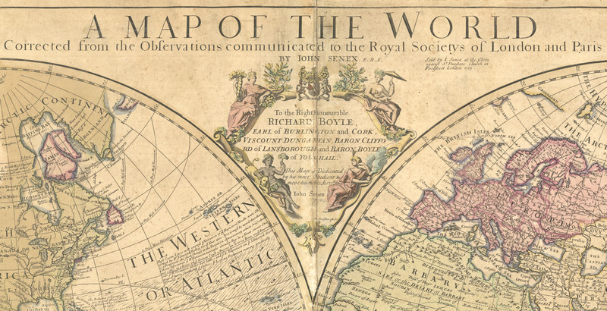
Anomaly Detection for the
IDEAS Mapping System A Machine Learning Approach
David Meyer
Brocade Chief Scientist, VP and Fellow
Senior Research Scientist, Computer Science, University of Oregon
dmm@{brocade.com,uoregon.edu,1-4-5.net,..}
IDEAS Kickoff Meeting
IETF 97
13 – 18 Nov 2016
Seoul, Republic of Korea

Slide 2
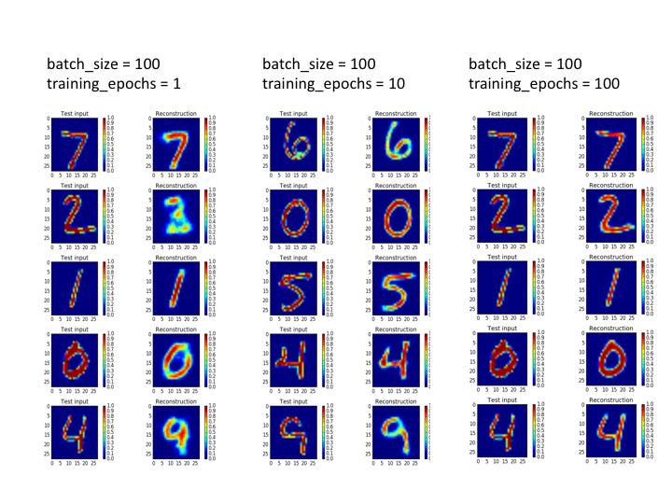
Agenda
Potential Use Cases
What Can We Do Today, And What Are The Challenges?
Discussion
Technical explanations/code
https://github.com/davidmeyer/ml
http://www.1-4-5.net/~dmm/ml

Slide 3
First, What Does The Scientific Method Look Like When Applied To Machine Learning?
Automation meets ML
This needs to be fast!
Use Case / problem definition
Scripting
HPC, GPUs, …
Hypothesis
Design ML Experiment
Execute ML Experiment
Use cases collected through Research/Customer(s)/others
e.g. Autoencoders can detect anomalies in various data sources
Prototype environment, variable def., experimental control, significance, etc.
Execute, measure, and update hypothesis if necessary
“If you want to increase your success rate, double your failure rate” Thomas Watson Sr. (founder of IBM)
Original slide courtesy Armin Wasicek

Slide 4
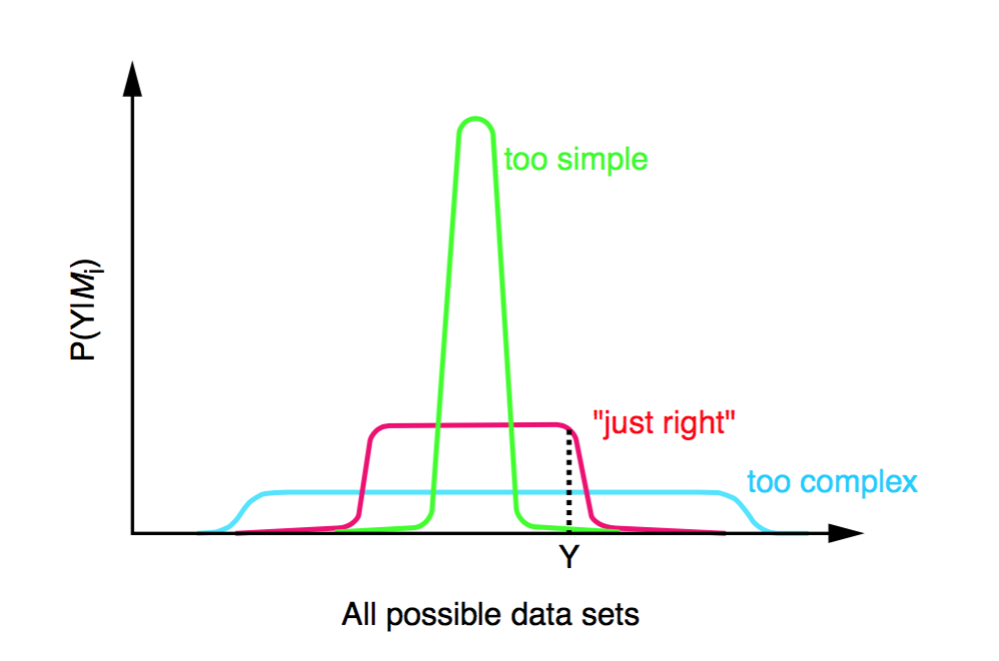
Prototype Use Case
We want to use Machine Learning (ML) to
Detect anomalous traffic flows that could be malicious
e.g., DDoS against the mapping infrastructure
Want to protect the Map Servers and Resolvers
and other system components that could benefit
Map-Registers, Map-Requests, Map-Replies
How might we do this?
Collect KPIs from the Map {Server,Resolver} and surrounding infrastructure
ETL the data
Use ML to Detect Anomalies
Remediate
Iterate
Proposal:
Occam’s Razor: Do the simplest thing first
Use a simple autoencoder to do binary classification

Slide 5
Agenda
What is the Use Case?
What Can We Do Today, And What Are The Challenges?
Discussion
Technical explanations/code
https://github.com/davidmeyer/ml
http://www.1-4-5.net/~dmm/ml

Slide 6
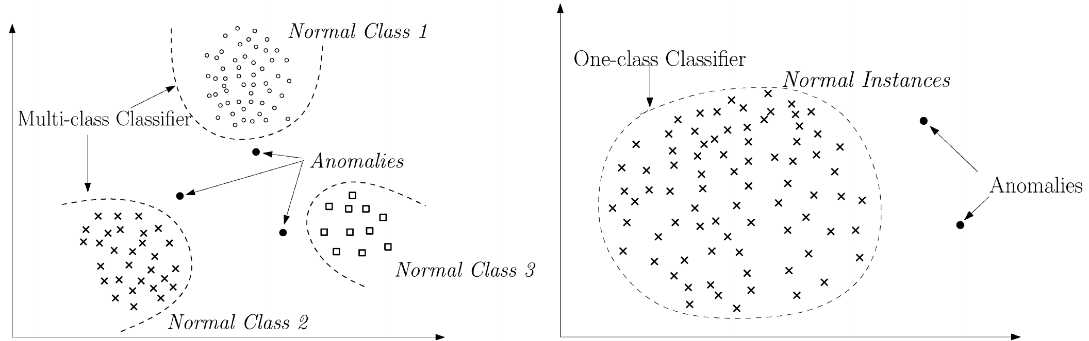
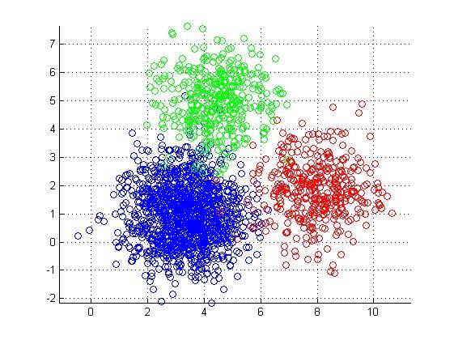
Briefly, What is Anomaly Detection?
What’s going on here?
Data don’t fit an explanation model
Impossible, assuming the model is correct
Data do not conform to some normal behavior
Clustering
- K-means
- K-NN
- …
PCA
Autoencoders
….
Dimension
Reduction
We assume that the anomalous data are generated by a different
process than our baseline → stationary distribution
Original slide courtesy Armin Wasicek
Notes:
1. A = { x | s(x) > t }
2. f(A) → e ∧ min_{e}( False Positives , …)

Slide 7
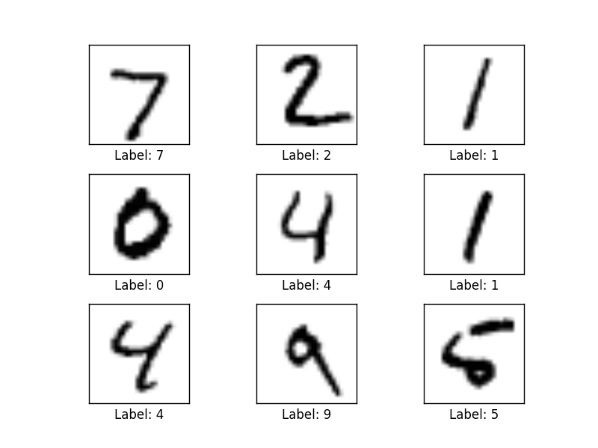
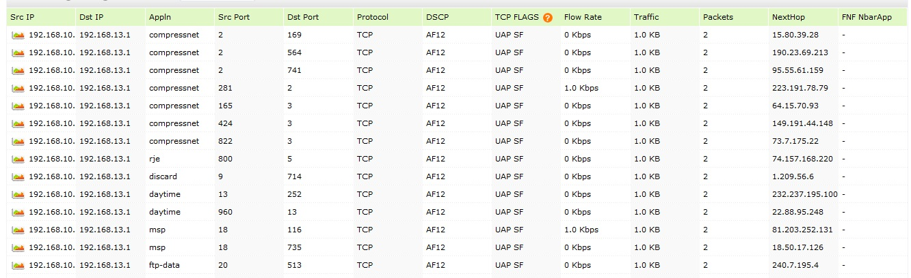
Autoencoder Example Detecting Anomalies in Handwritten Digits
MNIST: 28x28 Grayscale Handwritten Digit Dataset
Training set: 55000 images
Test set: 10000 images
Validation set: 5000 images
Features here are pixels (28x28 = 784)
I’m using MNIST here because you easily visualize what is going on. In our case, instead of the input being vectors of {0,1} we will have vectors of counters of map control messages, bandwidth, and other host based KPIs.
We can analyze mapping system data in the same way
Features here are
various counters
andother KPIs

Slide 8
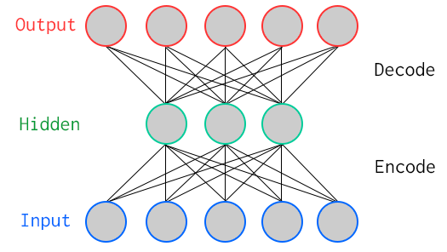
One Way To Learn To Recognize MNIST: Use An Autoencoder Special Kind of Neural Network
784
Artificial Neurons
100
Artificial Neurons
784
Key Characteristic: Hidden layer has fewer units than input/output → Compression
Goal: Minimize reconstruction (decode) error
How to define error (loss, cost)?
Binary classification: Threshold reconstruction error → normal/abnormal
Unsupervised learning

Slide 9
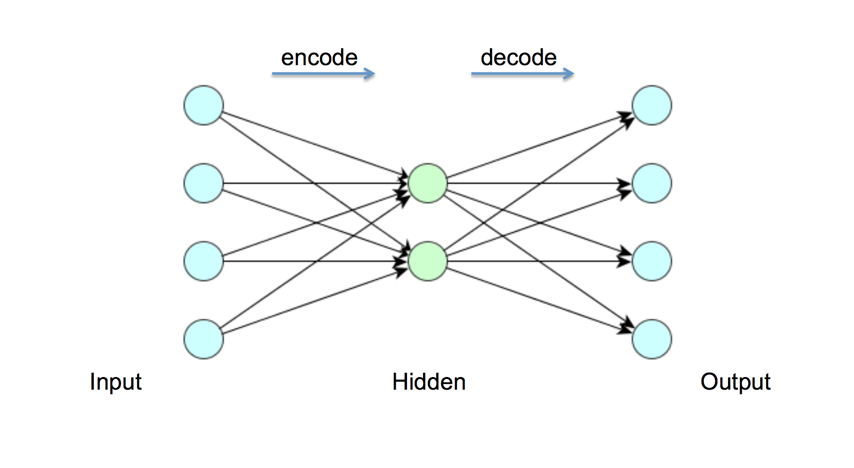
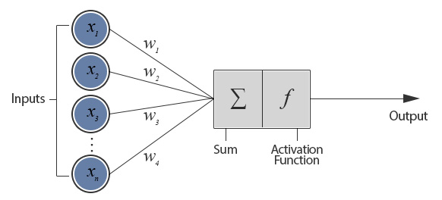
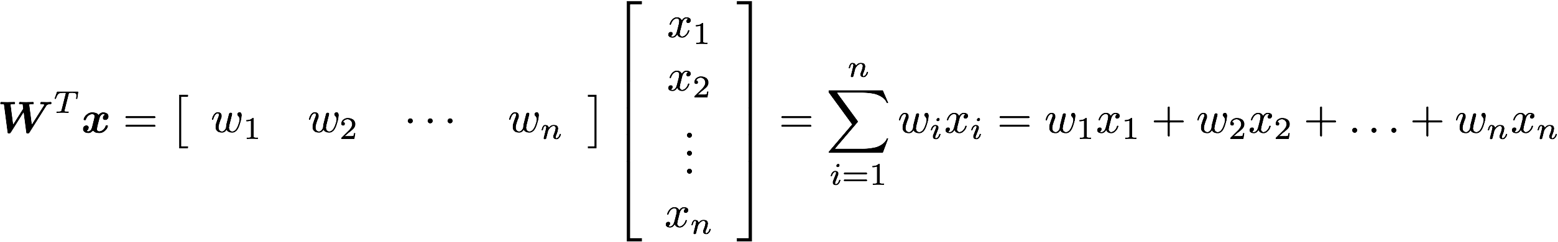
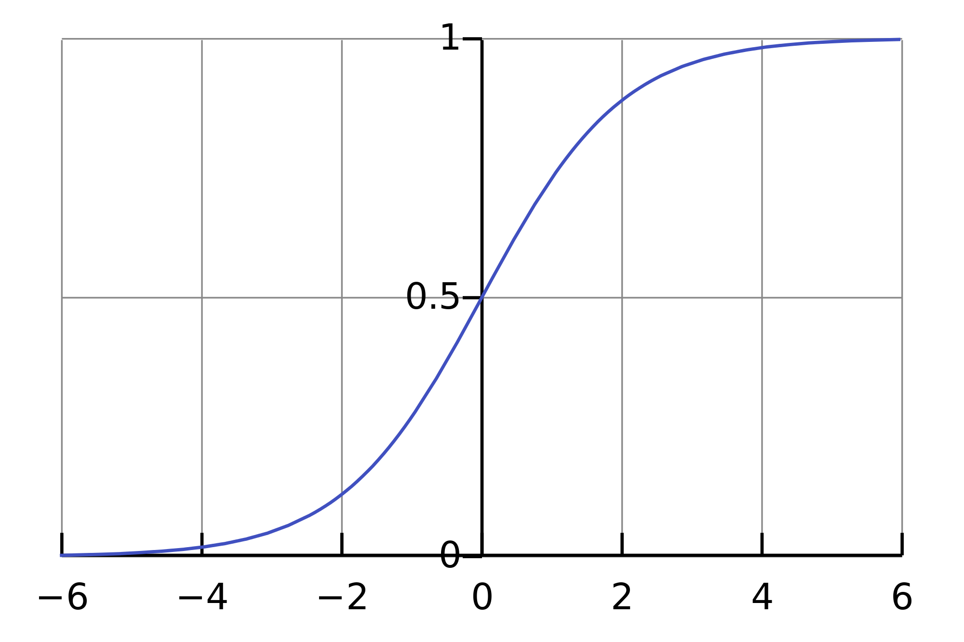
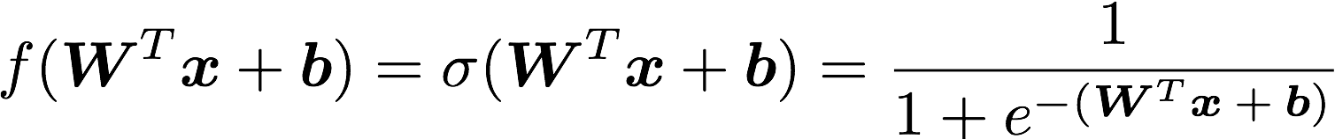
But First: What Does A Single Neuron Do?
Dot Product
784
100
784
BTW, how many parameters?
784x100 + 100x784 = 156800

Slide 10
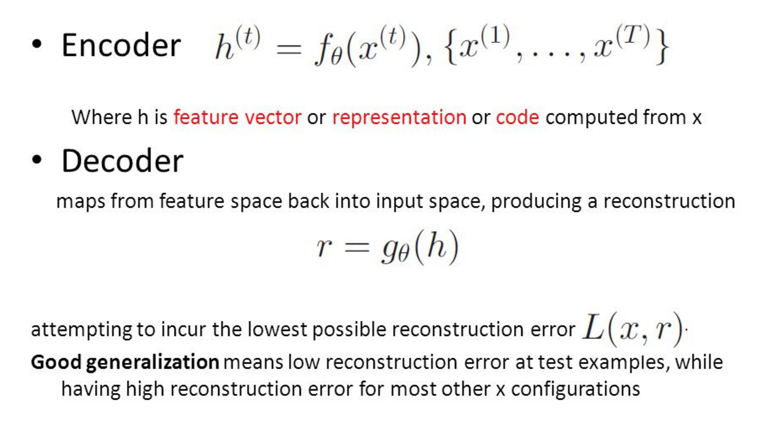
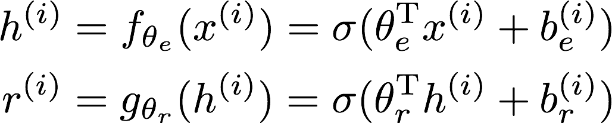
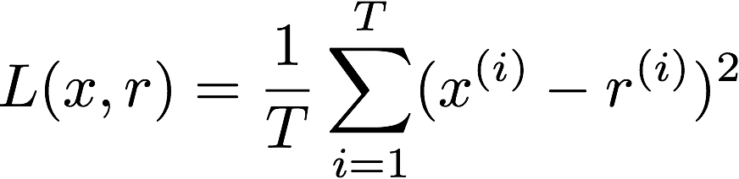
All Cool, But How Does The Autoencoder Actually Work?

Slide 11
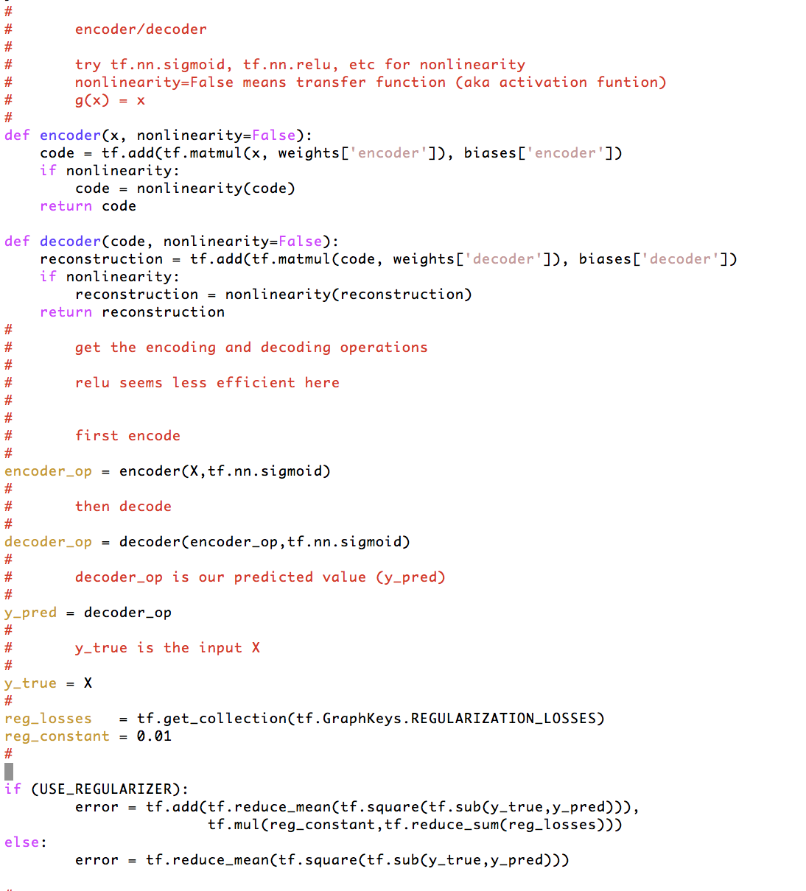
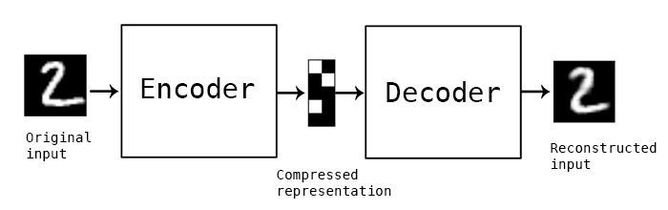
How Hard To Code This Up In Tensorflow?
https://github.com/davidmeyer/ml/blob/master/tensorflow/autoencoder.{py,ipynb}

Slide 12
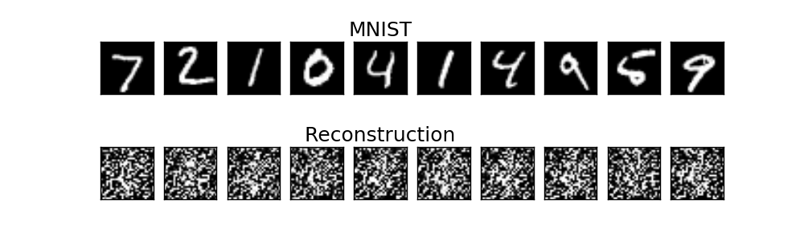
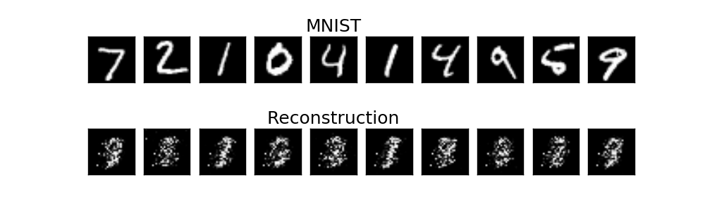
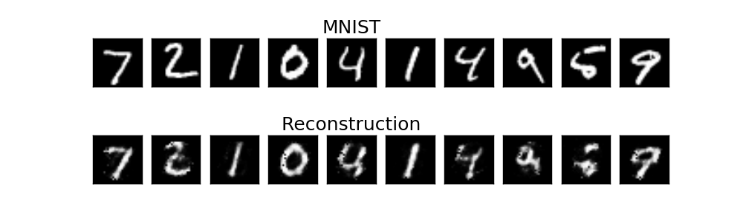
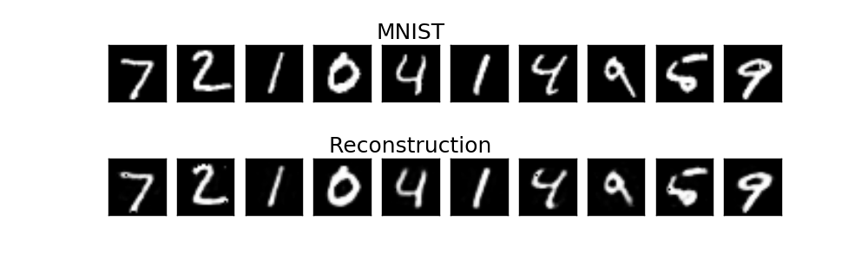
Autoencoder Output
1 example
10 examples
100 examples
1000 examples
After training, the AE gets low reconstruction error on digits from MNIST and high reconstruction error on everything else: It has learned to recognize MNIST

Slide 13
BTW, How Much Of This Has Been Applied To Networking?
Not too much. Many reasons:
Still early days
Diverse types of network data
Flows, logs, various KPIs, … with no obvious way to combine
Incomplete data sets, non-iid data data
Network data not designed for ML
Different models for different data types
Still active area of investigation
Occam’s Razor
Is there a useful “Theory of Network”?
Consider the problem of object recognition/conv nets
Transfer learning
Community challenges: Skill sets, proprietary data sets and use-cases, …
Concern about the probabilistic nature of ML

Slide 14
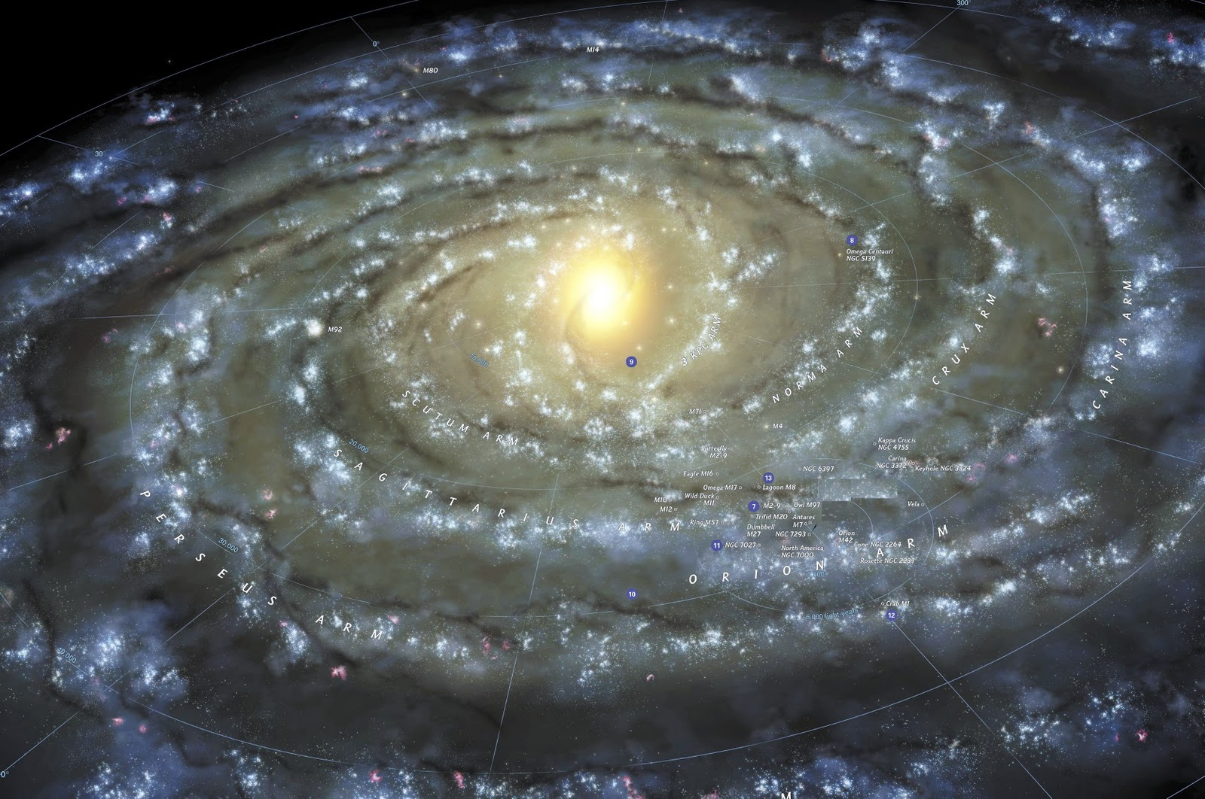
Next Steps
Build a prototype
Dino
Provide raw data from the LISP mapping system
dmm
process data into appropriate form
Use ML to detect anomalies
Classify anomaly types
Remediation
Frequency hopping idea
Iterate
Get feedback from group
Iterate (again)

Slide 15
Agenda
What is the Use Case?
What Can We Do Today, And What Are The Challenges?
Discussion
Technical explanations/code
https://github.com/davidmeyer/ml
http://www.1-4-5.net/~dmm/ml

Slide 16
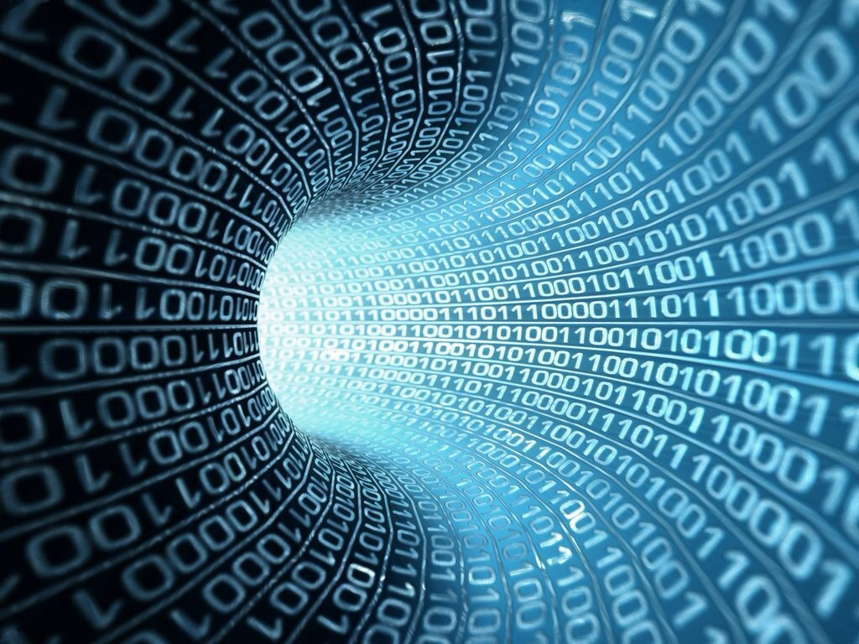
Q&A
Thank you
(have more questions/comments? dmm@1-4-5.net)

