Slide 1
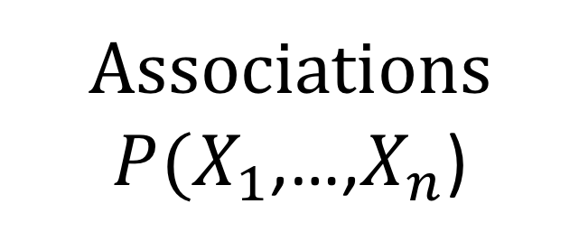
Causality
Associations
$P(X_{1}$,…,$X_{n}$)
Confounding
Endogenous
Selection

