Slide 1
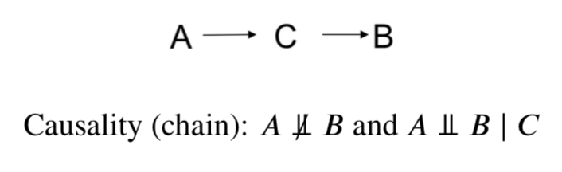
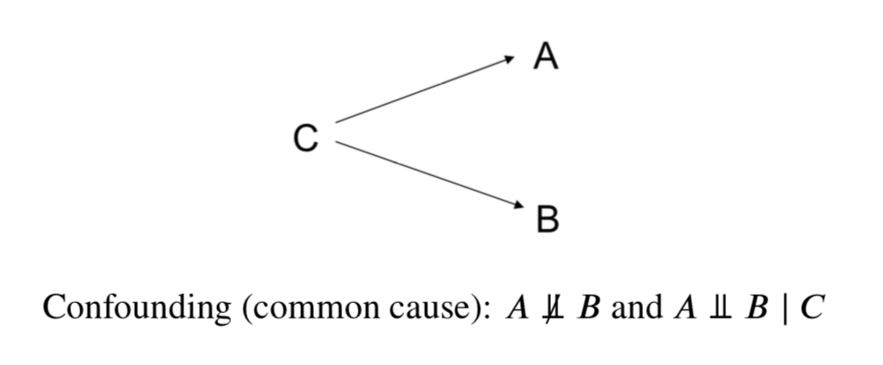
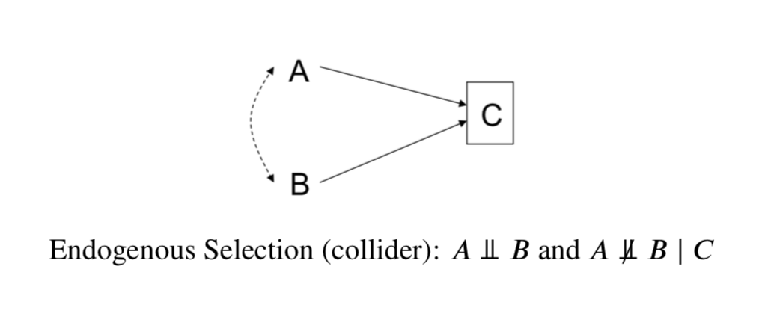
Causal (Markov) Graphs and Forms of Bias
Causality/Chain: A is causally related to B
Conditioning on C results in Overselection Bias
Common Cause/Confounder: A is not causally related to B
Conditioning on C shows causal relationship (zero here)
Not conditioning on C results in Confounding Bias
Common Effect/Collider: A is not causally related to B
Conditioning on C causes a spurious relationship between A and B
Conditioning on C results in Endogenous Selection Bias
Dotted line is relationship/bias induced by conditioning on C

