Slide 1
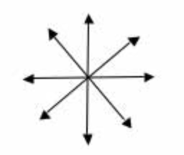
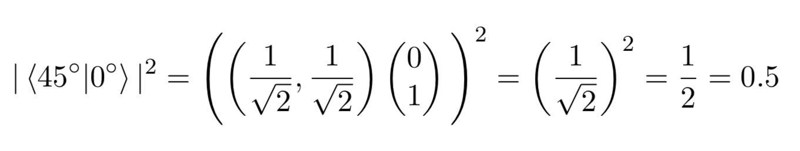
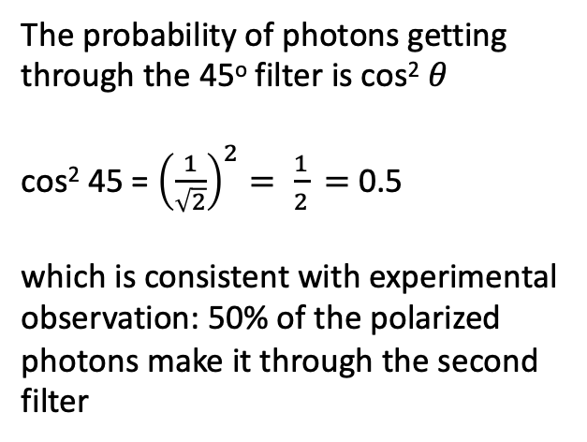


The probability of photons getting through the 45º filter is cos² 𝜃
cos² 45 = ${\left(\frac{1}{\sqrt{2}}\right)}^{2}= \frac{1}{2}$ $=$ 0.5
which is consistent with experimental observation: 50% of the polarized photons make it through the second filter
45º
$$\left(\begin{matrix}\frac{1}{\sqrt{2}} \\ \frac{1}{\sqrt{2}}\end{matrix}\right)$$
0º
Unpolarized light
$$\left(\begin{matrix}0 \\ 1\end{matrix}\right)$$

Slide 2
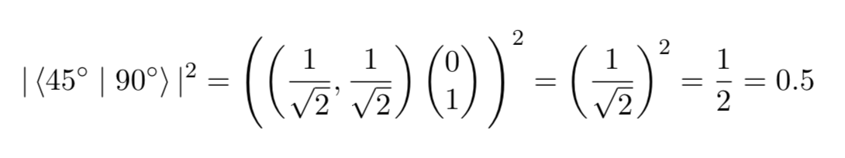
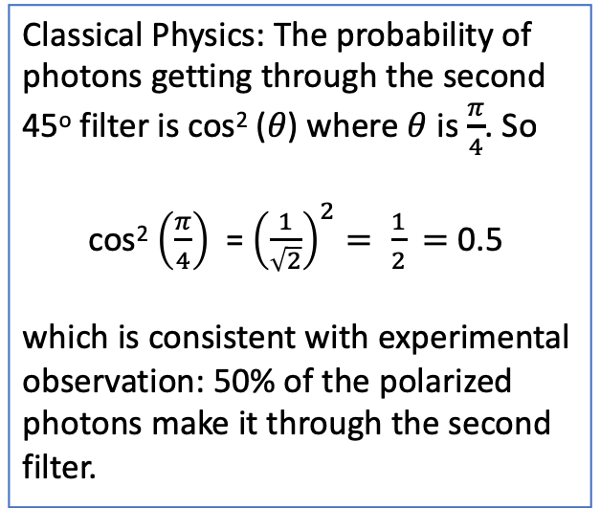

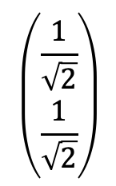
Classical Physics: The probability of photons getting through the second 45º filter is cos² (𝜃) where $θ$ is $\frac{π}{4}$. So
cos² $\left(\frac{π}{4}\right)$ = ${\left(\frac{1}{\sqrt{2}}\right)}^{2}= \frac{1}{2}$ $=$ 0.5
which is consistent with experimental observation: 50% of the polarized photons make it through the second filter.
45º
$$\left(\begin{matrix}\frac{1}{\sqrt{2}} \\ \frac{1}{\sqrt{2}}\end{matrix}\right)$$
90º
$$\left(\begin{matrix}0 \\ 1\end{matrix}\right)$$
Unpolarized light
In Dirac Notation

Slide 3
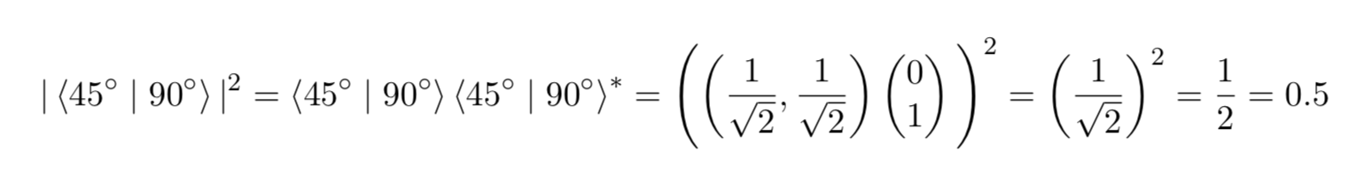
Classical Physics: The probability of photons getting through the second 45º filter is cos² (𝜃) where $θ$ is $\frac{π}{4}$. So
cos² $\left(\frac{π}{4}\right)$ = ${\left(\frac{1}{\sqrt{2}}\right)}^{2}= \frac{1}{2}$ $=$ 0.5
which is consistent with experimental observation: 50% of the polarized photons make it through the second filter.
45º
$$\left(\begin{matrix}\frac{1}{\sqrt{2}} \\ \frac{1}{\sqrt{2}}\end{matrix}\right)$$
90º
$$\left(\begin{matrix}0 \\ 1\end{matrix}\right)$$
Unpolarized light
In Dirac Notation

Slide 4
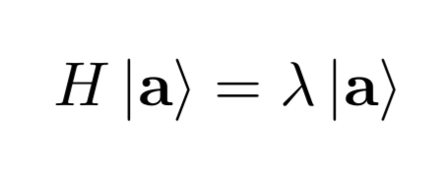
Hermitian
Matrix
Eigenvector
Eigenvalue
Math
Observable
Measurable
Experiment
System State
Result of
measurement
Physics

Slide 5
50%
Unpolarized light

