Slide 1
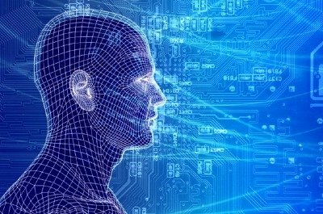
Machine Learning Study Group
David Meyer
05.15.2015
http://www.1-4-5.net/~dmm/talks/2015/05.15.2015.pptx

Slide 2
Agenda
Welcome, Goals and Objectives for the Study Group
ICLR wrap up
http://www.iclr.cc/doku.php?id=iclr2015:main
Upcoming events
https://www.re-work.co/events/deep-learning-boston-2015
http://icml.cc/2015/
Machine Learning: What is this all about?
Basics of Representation for Machine Learning
Next Sessions

Slide 3
Goals for This Talk (and the group)
Today: Kick off the study group
Active discussion
Learn together – co-teach ourselves
ML is deep and wide….always more to learn
Consider revenue generating/industry leading applications
Today: Give us a feeling and common language for some of the fundamental problems in machine learning
Ongoing: Build a foundation that we can use to teach each other about machine learning and its application to our use cases
Meta: Focus on both technical aspects of ML and use cases
Consider: http://www.mobileye.com/technology/
Others?

Slide 4
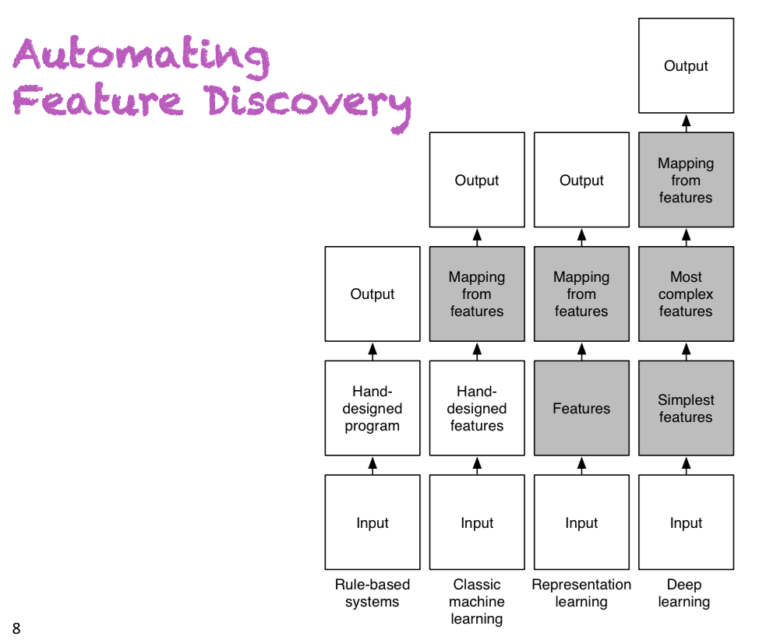
ICLR -- Context
Where the
excitement
is happening
Slide courtesy Yoshua Bengio

Slide 5
ICLR Summary
International Conference on Learning Representations
Third year
350+ people
Google, FB, Baidu, Apple, Yahoo!, Amazon, … (of course)
But also: AT&T, VZ, and NTT
Smaller startups
One of the premier ML conferences
Yoshua Bengio & Yann Lecun are the general chairs
NIPS and ICML are the other two (so go to one of these three)
Interesting organization
Oral presentation and poster sessions
Thurs - Sat

Slide 6
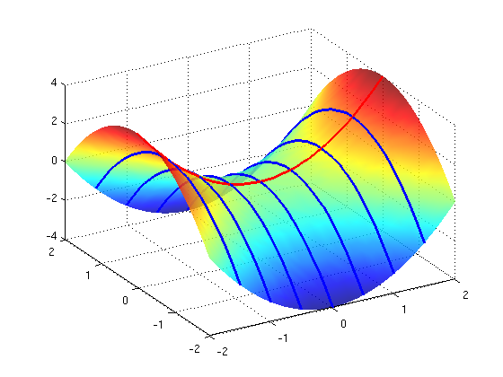
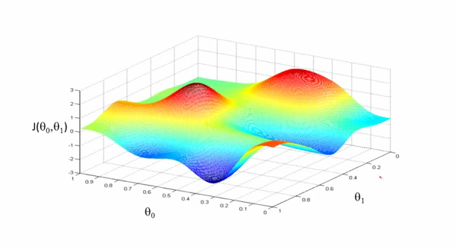
ICLR Highlights
The entire conference was great
A sample of the great talks at ICLR
Deep Reinforcement Learning
David Silver, Deepmind/Google
http://www.iclr.cc/lib/exe/fetch.php?media=iclr2015:silver-iclr2015.pdf
Qualitatively characterizing neural network optimization problems
Ian J. Goodfellow, Oriol Vinyals & Andrew M. Saxe, Google and Stanford
http://arxiv.org/pdf/1412.6544v5.pdf
Related: Dauphi, Y. et. al. “Identifying and attacking the saddle point problem in high-dimensional non-convex optimization”
http://arxiv.org/pdf/1406.2572v1.pdf
Memory Networks
Jason Weston, Sumit Chopra & Antoine Bordes, FaceBook
http://arxiv.org/pdf/1410.3916v9.pdf
Other Interesting Choices
http://developers.lyst.com/2015/05/08/iclr-2015/

Slide 7
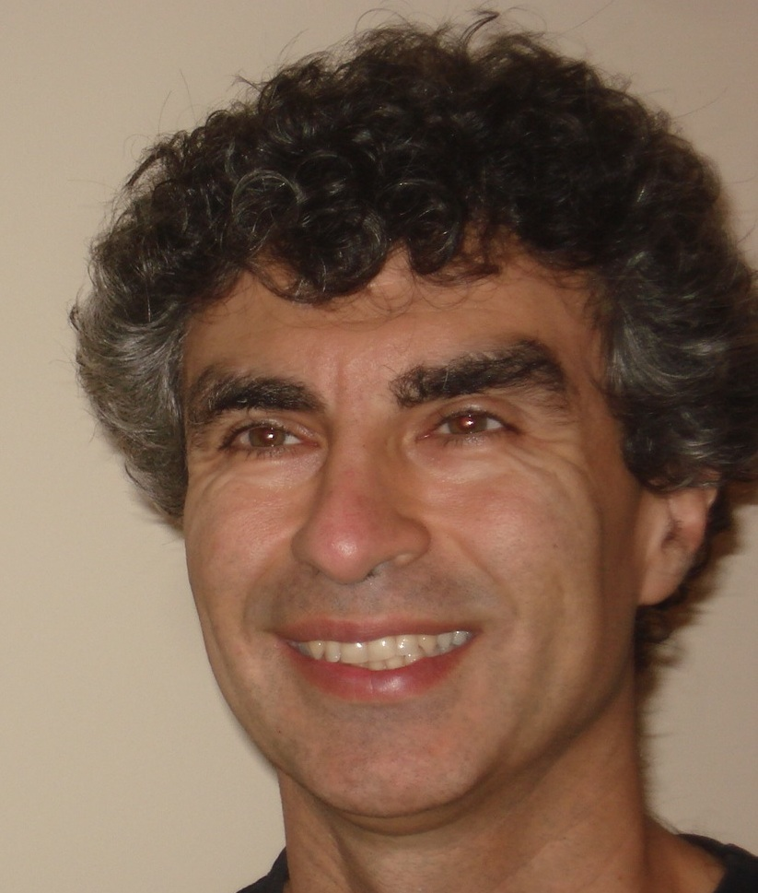
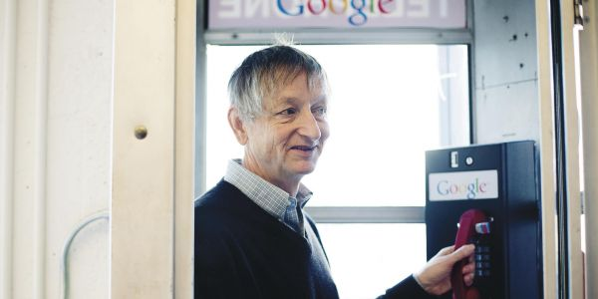

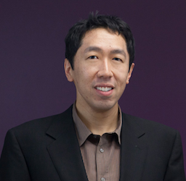
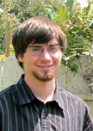
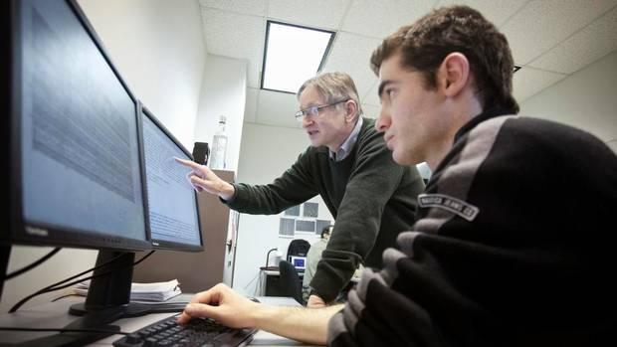
BTW, who are the main characters?
http://chronicle.com/article/The-Believers/190147

Slide 8
Agenda
Welcome, Goals and Objectives for the Study Group
ICLR wrap up
http://www.iclr.cc/doku.php?id=iclr2015:main
Upcoming events
https://www.re-work.co/events/deep-learning-boston-2015
http://icml.cc/2015/
Machine Learning: What is this all about?
Basics of Representation for Machine Learning
Next Sessions

Slide 9
Agenda
Welcome, Goals and Objectives for the Study Group
ICLR wrap up
http://www.iclr.cc/doku.php?id=iclr2015:main
Upcoming events
https://www.re-work.co/events/deep-learning-boston-2015
http://icml.cc/2015/
Machine Learning: What is this all about?
Basics of Representation for Machine Learning
Next Sessions

Slide 10
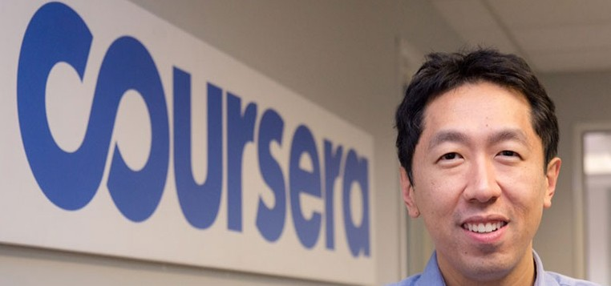
Before We Start What is the SOTA in Machine Learning?
“Building High-level Features Using Large Scale Unsupervised Learning”, Andrew Ng, et. al, 2012
http://arxiv.org/pdf/1112.6209.pdf
Training a deep neural network
Showed that it is possible to train neurons to be selective for high-level concepts using entirely unlabeled data
In particular, they trained a deep neural network that functions as detectors for faces, human bodies, and cat faces by training on random frames of YouTube videos (ImageNet¹). These neurons naturally capture complex invariances such as out-of-plane rotation, scale invariance, …
Details of the Model
Sparse deep auto-encoder (catch me later if you are interested what this is/how it works)
O(10⁹) connections
O(10⁷) 200x200 pixel images, 10³ machines, 16K cores
→ Input data in R⁴⁰⁰⁰⁰
Three days to train
15.8% accuracy categorizing 22K object classes
70% improvement over current results
Random guess achieves less than 0.005% accuracy for this dataset
Even newer: Google’s FaceNet results
http://arxiv.org/pdf/1503.03832.pdf
New record accuracy (99.63%) on the Labeled Faces in the Wild (LFW) dataset, 95.12% on the Youtube Faces dataset
Andrew Ng and his crew at Baidu have recently beat this record with their
(GPU based) Deep Speech system. See http://arxiv.org/abs/1412.5567
1 http://www.image-net.org/

Slide 11
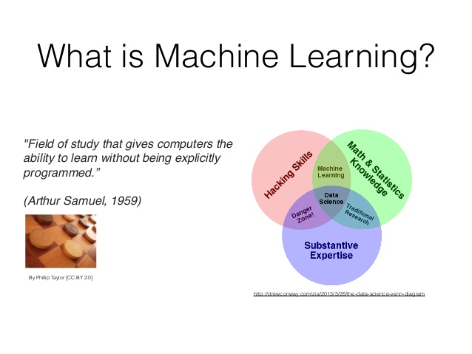

Slide 12
What is Machine Learning?
The complexity in traditional computer programming is in the code (programs that people write). In machine learning, algorithms (programs) are in principle simple and the complexity (structure) is in the data. Is there a way that we can automatically learn that structure? That is what is at the heart of machine learning.
-- Andrew Ng
That is, machine learning is the about the construction and study
of systems that can learn from data. This is very different than
traditional computer programming.

Slide 13
The Same Thing Said in Cartoon Form
Traditional Programming
Machine Learning
Data
Computer
Output
Program
Data
Computer
Program
Output

Slide 14
When Would We Use Machine Learning?
When patterns exists in our data
Even if we don’t know what they are
Or perhaps especially when we don’t know what they are
We can not pin down the functional relationships mathematically
Else we would just code up the algorithm
When we have lots of (unlabeled) data
Labeled training sets harder to come by
Data is of high-dimension
High dimension “features”
For example, network telemetry and/or sensor data
Want to “discover” lower-dimension representations
Dimension reduction
Aside: Machine Learning is heavily focused on implementability
Frequently using well know numerical optimization techniques
Lots of open source code available
Python/java/…: http://scikit-learn.org/stable/ (many others)
Spark/MLlib: https://spark.apache.org/docs/latest/mllib-guide.html
Languages (e.g., octave: https://www.gnu.org/software/octave/)
Theano (tensor libraries, GPUs): https://github.com/Theano/Theano
Caffe: http://caffe.berkeleyvision.org/
Newer: Torch: http://torch.ch/ (lua)
GPUs: https://developer.nvidia.com/deep-learning (others)

Slide 15
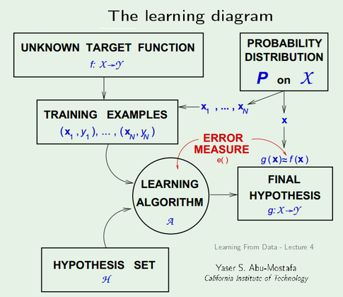
Machine Learning FlowChart (a bit more technical)

Slide 16
Ok, But What Exactly Is Machine Learning?
Machine Learning is a procedure that consists of estimating the model parameters so that the learned model (algorithm) can perform a specific task
Typically try estimate model parameters such that prediction error is minimized
4 Main Types of Machine Learning
Supervised
Unsupervised
Semi-supervised learning
Reinforcement learning
Supervised learning
Present the algorithm with a set of inputs and their corresponding outputs
Essentially have a “teacher” that tells you what each training example is
See how closely the actual outputs match the desired ones
Note generalization error (bias, variance)
Iteratively modify the parameters to better approximate the desired outputs (gradient descent)
Unsupervised
Algorithm learns internal representations and important features
So let’s take a closer look at these learning types

Slide 17
Supervised learning
You are given training data and “what each item is”
e.g., a set of images and corresponding descriptions (labels)
“this is a cat” or “this is a chair” (cat or chair is a label)
Training set consists of (x^{(i)},y^{(i)}) pairs, x^{(i)} is the input example, y^{(i)} is the label
You want to find f(x^{(i)}) = y^{(i)}, but you don’t know f
Another way to look at the training set: (x^{(i)},y^{(i)}) = (x^{(i)}, f(x^{(i)}))
Goal: accurately {predict,classify,compute} the label for previous unseen x
Learning comes down to finding a parameter set for your model that minimizes prediction error → learning is an optimization problem
There are many 10s (if not 10^2s or 10^3s) of supervised learning algorithms
These include: Artificial Neural Networks, Decision Trees, Ensembles (Bagging, Boosting, Random Forests, …), k-NN, Linear Regression, Naive Bayes, Logistic Regression (and other CRFs), Support Vector Machines (and other Large Margin Classifiers), …

Slide 18
Unsupervised learning
Basic idea: Discover unknown compositional structure in input data
Data clustering and dimension reduction
More generally: find the relationships/structure in the data set
No need for labeled data
The network itself finds the correlations in the data
Learning algorithms include (again, many algorithms)
K-Means Clustering
Auto-encoders/deep neural networks
Restricted Boltzmann Machines
Hopfield Networks
Sparse Encoders
…

Slide 19
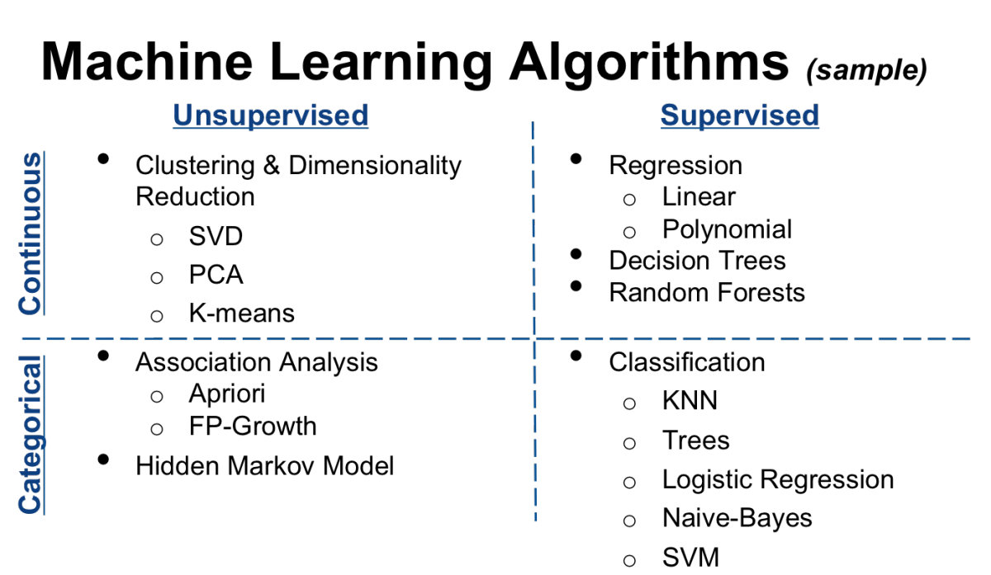
Sample ML Algorithms (there are 2^10s)
Thanks Varma!
Spark MLlib
Note that data are very similar to KDD CUP 1999
dataset: http://kdd.ics.uci.edu/databases/kddcup99/kddcup99.html

Slide 20
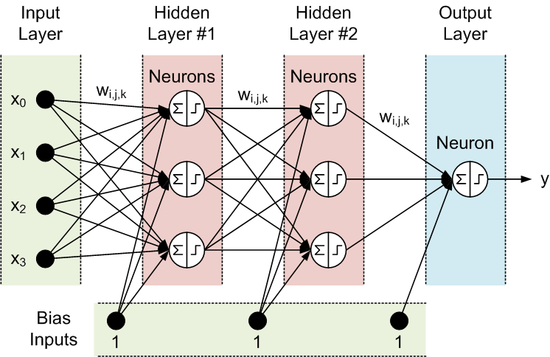
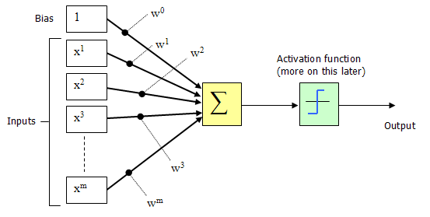
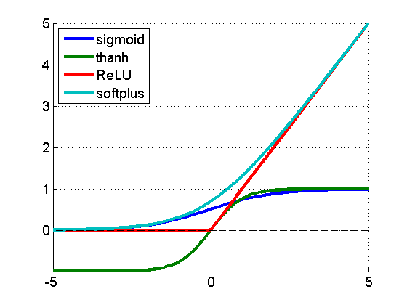
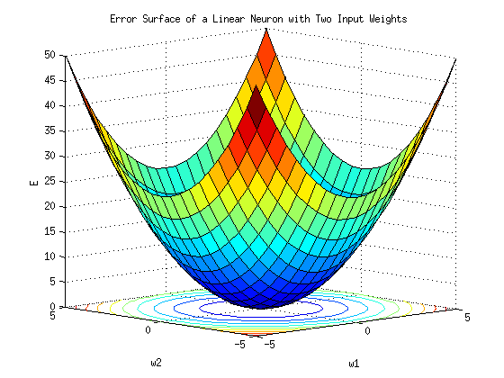

Notably Missing From The Previous Chart: Deep Feed Forward Neural Nets (most of the math I’m going to give you is on this slide ☺)
(x^{(i)},y^{(i)})
h_{θ}(x^{(i)})
Where do the weights come from?
Hypothesis
f(x^{(i)})
noncovex optimization
Forward Propagation
So what then is learning?
Learning is the adjusting of the weights w_{i,j} such that
the cost function J(θ) is minimized
Simple learning procedure: Back Propagation (of the error signal)

Slide 21
Ok, That’s Fine But What Are Our Observations, Goals, Assumptions?
What do we observe?
A bunch of raw data
Images, speech, network data, twitter feeds, …
What are our goals?
We want to recover the “Data Generating Distribution” (DGD)
The modeled DGD should generalize to unseen regions, instances
If we can do this we can predict, classify, regress, …
Note: Concept Drift, Adversaries, …
http://en.wikipedia.org/wiki/Concept_drift
Intriguing properties of neural networks
http://arxiv.org/pdf/1312.6199v4.pdf
What assumptions are we making?

Slide 22
What Assumptions are we making?
Key Concept: Prior Assumptions
Or just “priors”
So what is a prior?
Why do we need them?
And why do we call these assumptions “priors”?
Rest of this chat focuses on priors for ML
These questions are fundamental to what is known as Representation Learning and Machine Learning more generally

Slide 23
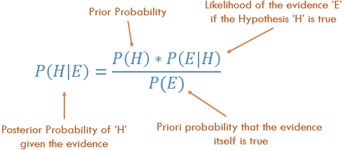
Priors and Bayes Theorem
In general, if the graph of a Probabilistic
Graphical Model (PGM) is a DAG, then it
is usually a Bayesian network. If the PGM’s
graph is undirected then it is a Markov network.
Of course there are further details, but these
are the two major families of graphical models.
Ignoring the Frequentist vs. Bayesian vs. Likelyhoodist arguments for a sec…
A “prior” is the probability that something is true before you see data. In
this context data is sometimes called “evidence”. For a nice review see
http://www.stat.ufl.edu/archived/casella/Talks/BayesRefresher.pdf

Slide 24
Priors for Machine Learning (not a complete list)
Smoothness
Smoothness assumes that the function f to be learned is such that x ≈ y generally implies f(x) ≈ f(y). This is most basic prior and is present in most machine learning, but is insufficient to get around the curse of dimensionality.
Manifold Hypothesis
The Manifold Hypothesis postulates that probability mass naturally concentrates near regions that have a much smaller dimensionality than the original space where the data lives.
Distributed Representation/Compositionality
Good representations are expressive, meaning that a reasonably-sized learned representation can capture a huge number of possible input configurations. Distributed representations have this property.
Multiple, Shared Underlying Explanatory Factors
Assumes that the data generating distribution is generated by different underlying factors, and for the most part what one learns about one factor generalizes in many configurations of the other factors.
Sparsity
Here for any given observation x, only a small fraction of the possible factors are relevant
Spatial and Temporal Coherence
Consecutive (from a sequence) or spatially nearby observations tend to be associated with the same value of relevant categorical concepts, or result in a small move on the surface of the high-density manifold. More generally, different factors change at different temporal and spatial scales, and many categorical concepts of interest change slowly.
See Bengio, Y. et. al., “Representation Learning: A Review and New Perspectives”, http://arxiv.org/pdf/1206.5538.pdf

Slide 25
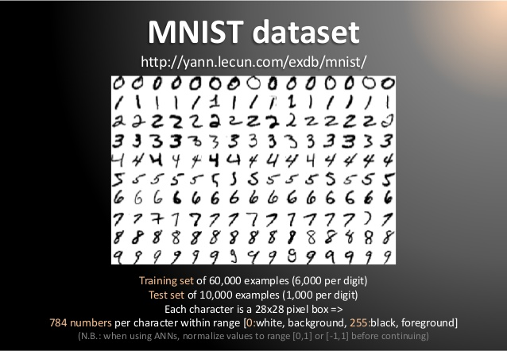
Aside: Dimensionality
Machine Learning is good at understanding the structure of high dimensional spaces
Humans aren’t ☺
What is a dimension?
Informally…
A direction in the input vector
Example: MNIST dataset
Mixed NIST dataset
Large database of handwritten digits, 0-9
28x28 images
784 dimensional input data (in pixel space)
Consider 4K TV → 4096x2160 = 8,847,360 dimensional pixel space

Slide 26
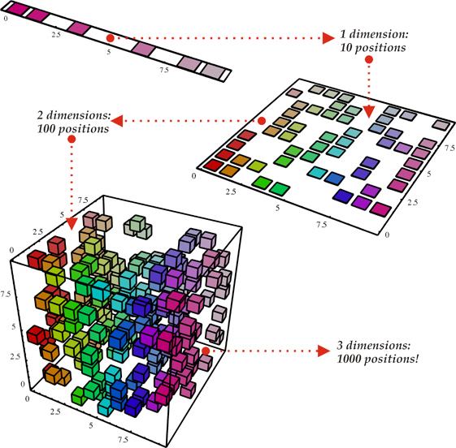
Why ML Is Hard The Curse Of Dimensionality
To generalize locally, you need representative examples from all relevant variations
There are an exponential number of variations
So local representations might not (don’t) scale
Classical Solution: Hope for a smooth enough target function, or make it smooth by handcrafting good features or kernels
Distributed Representations
Unsupervised Learning
(i). Space grows exponentially
(ii). Space is stretched, points
become equidistant

Slide 27
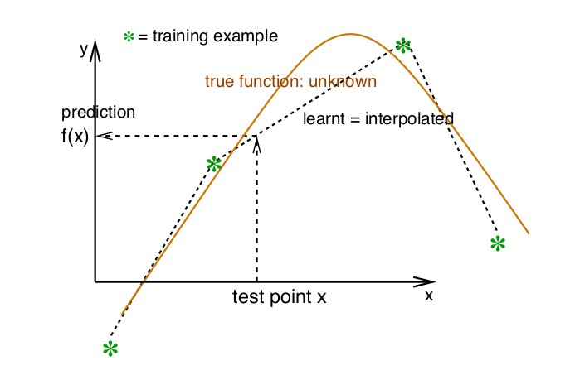
Ok, So What Is Smoothness?
Smoothness: The DGD is smooth or can be approximated by a
smooth function → if x is geometrically close to x’ then f(x) ≈ f(x’)

Slide 28
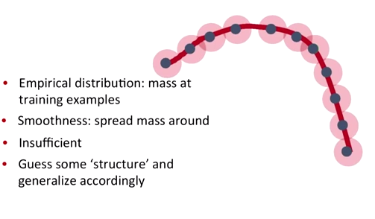
Smoothness, basically…
Although smoothness can be a useful assumption, it is insufficient to deal with the curse of dimensionality, because the number of such wrinkles (ups and downs in the function we are trying to learn) may grow exponentially with the number of relevant interacting factors, when the data are represented in raw input space.
Probability mass P(Y=c|X;θ)
This is where the Manifold Hypothesis comes in…

Slide 29
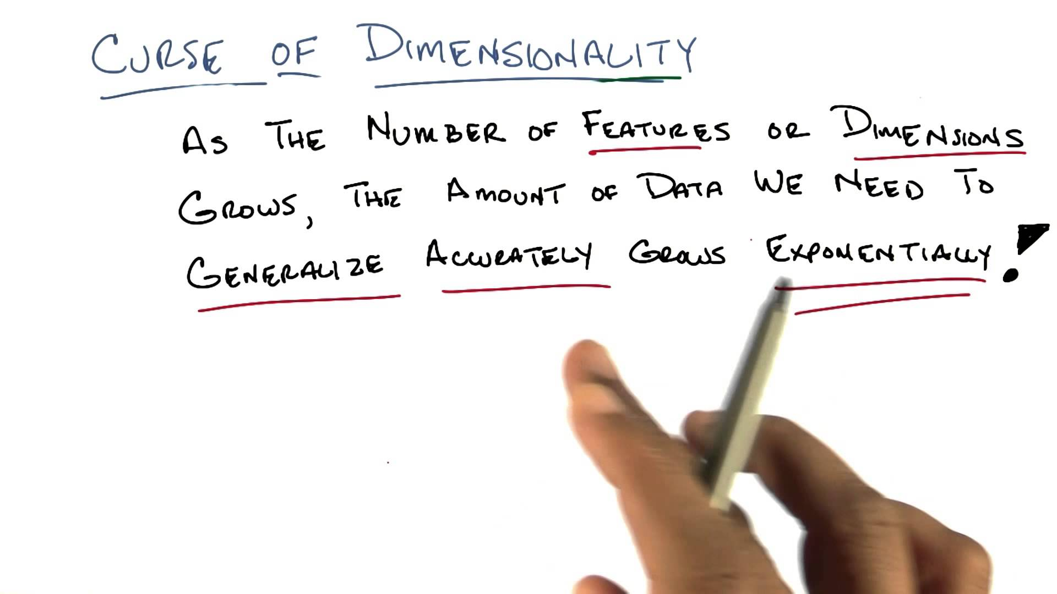
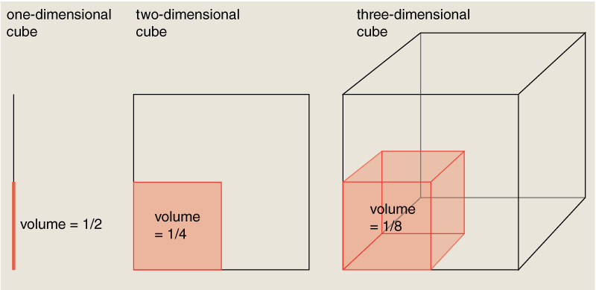
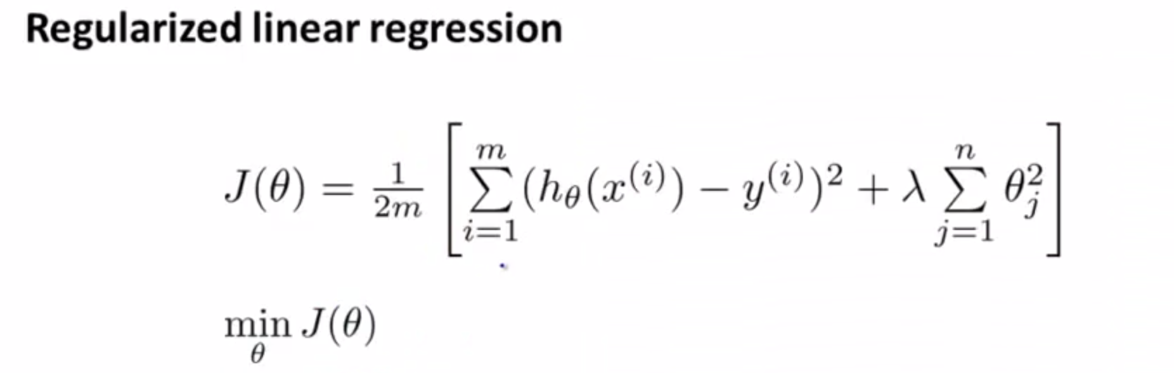
Curse of Dimensionality Redux
“distance”

Slide 30
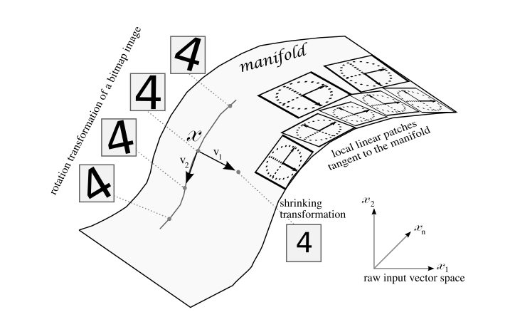
Manifold Hypothesis
BTW, you can demonstrate the MH to yourself
with a simple thought experiment on image data…
The Manifold Hypothesis states that natural data forms lower dimensional manifolds
in its embedding space. Why should this be? Well, it seems that there are both
theoretical and experimental reasons to suspect that the Manifold Hypothesis is true.
So if you believe that the MH is true, then the task of a machine learning classification
algorithm is fundamentally to separate a bunch of tangled up manifolds.

Slide 31
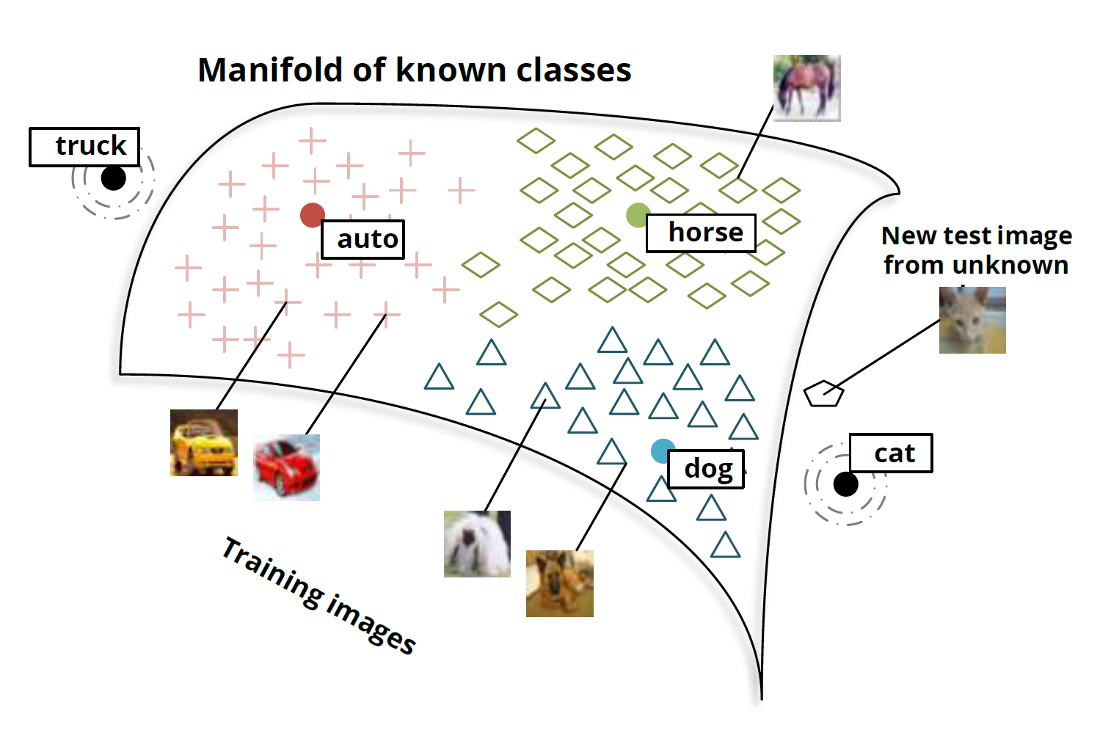
Manifolds and Classes

Slide 32
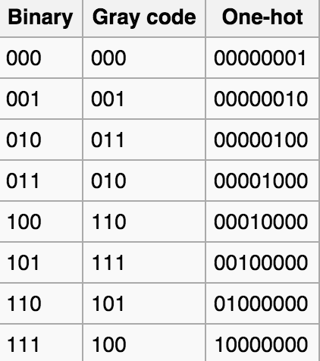
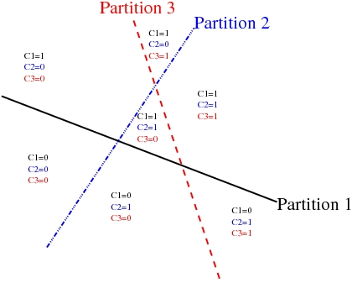
Distributed Representation/Compositionality
Compositionality is useful to describe the world around us efficiently. In a distributed representations (features) are meaningful by themselves
We can use a simple counting argument to help us assess the expressiveness of a model producing a representation: How many parameters does a model require compared to the number of input regions (or configurations) it can distinguish?
Non-distributed → # of distinguishable regions linear in # of parameters
Learners of one-hot representations, such as traditional clustering algorithms, Gaussian mixtures, nearest- neighbor algorithms, decision trees, or Gaussian SVMs all require O(N ) parameters (and/or O(N ) examples) to distinguish O(N) input regions.
Distributed → # of distinguishable regions grows about exponentially in # of parameters
Each parameter influences many regions, not just local neighbors
In a Distributed Representation k out of N representation elements or feature values can be independently varied, e.g., they are not mutually exclusive.
Each concept is represented by having k features being turned on or active, while each feature is involved in representing many concepts

Slide 33
Distributed Representations
RBMs, sparse coding, auto-encoders or multi-layer neural networks can all represent up to O(2^{k}) input regions using only O(N) parameters
Exponential Gain
Scales, fights the curse of dimensionality, …
There is also a connection to sparseness of a representation: k is the number of non-zero elements in a sparse representation
Sparseness?

Slide 34
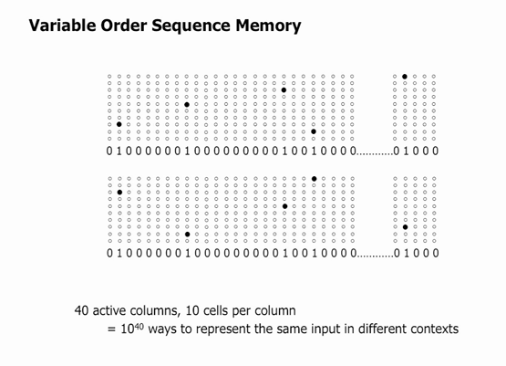
Brief Aside on Sparseness
In a sparse representation, for any observation x_{i} only a small fraction of the possible “features” are relevant
Sparse data can be represented by features that are either often zero or by the fact that most of the features are insensitive to small variations of x_{i}
VOSM graphic courtesy Jeff Hawkins/Numenta (http://numenta.com/)

Slide 35
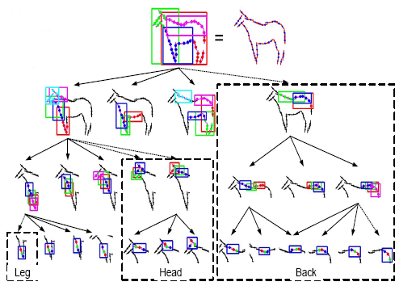
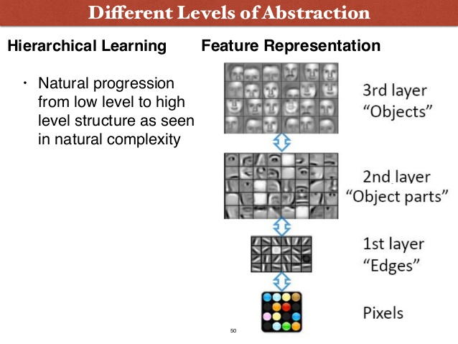
Hierarchical Representation Composing Distributed Representations
Drawing a Horse
Recognizing a Face

Slide 36
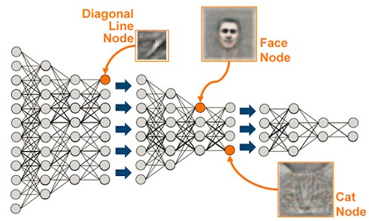
Typical Deep Image Processing

Slide 37
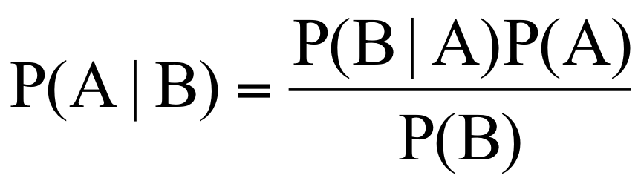
Shared Explanatory Factors
Here we are assuming that the data generating distribution is generated by different underlying factors, and for the most part what one learns about one factor generalizes in many configurations of the other factors
They compose and are hierarchical
Key here is that there are shared underlying explanatory factors, in particular between the prior and posterior distributions (P(A) and P(A|B)) of the DGD
Disentangling these shared factors is in large part what machine learning is all about
Lets take a look at an example: Convolutional Neural Networks (CNNs)

Slide 38
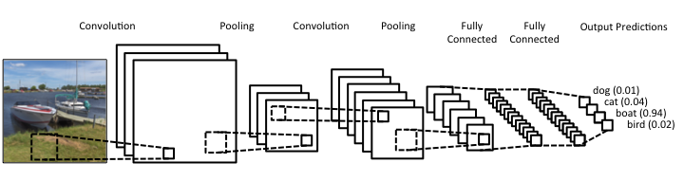
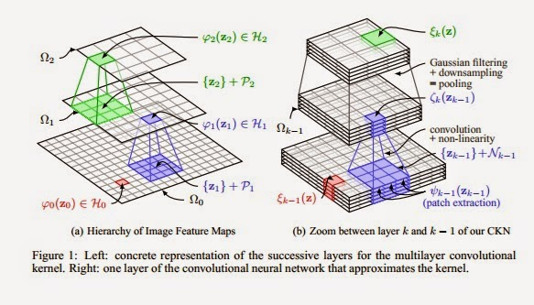
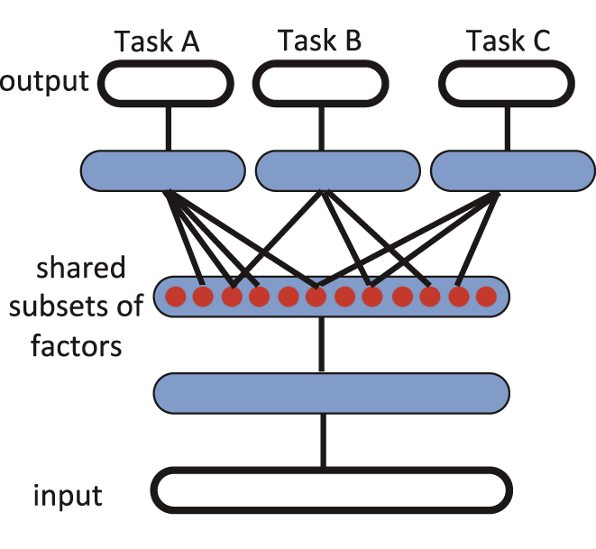
Convolutional Neural Nets (shared explanatory factors/parameters)
In Cartoon Form
See http://www.wired.com/2015/05/wolframs-image-rec-site-reflects-enormous-shift-ai/

Slide 39
Agenda
Welcome, Goals and Objectives for the Study Group
ICLR wrap up
http://www.iclr.cc/doku.php?id=iclr2015:main
Upcoming events
https://www.re-work.co/events/deep-learning-boston-2015
http://icml.cc/2015/
Machine Learning: What is this all about?
Basics of Representation for Machine Learning
Next Sessions

Slide 40
Next Sessions?
Vish on learnings from Andrew Ng’s Coursera ML course
Derick on the use of FPGrowth and K-Means from Spark MLlib on flow and meta data to predict application and network behavior
Varma on the design of a large scale streaming network data collection infrastructure
Others
What are people interested in?

