Slide 1
Monitoring: from research to operations
Christophe Diot and the IP group @ Sprintlabs
[cdiot|ipgroup]@sprintlabs.com
ipmon.sprintlabs.com

Slide 2
Needs for Monitoring
Management
  configuration, traffic engineering
  forecasting, provisioning, dimensioning
  traffic matrices
Diagnosis
  detect and report problems
Value-added services
  feedback to customers

Slide 3
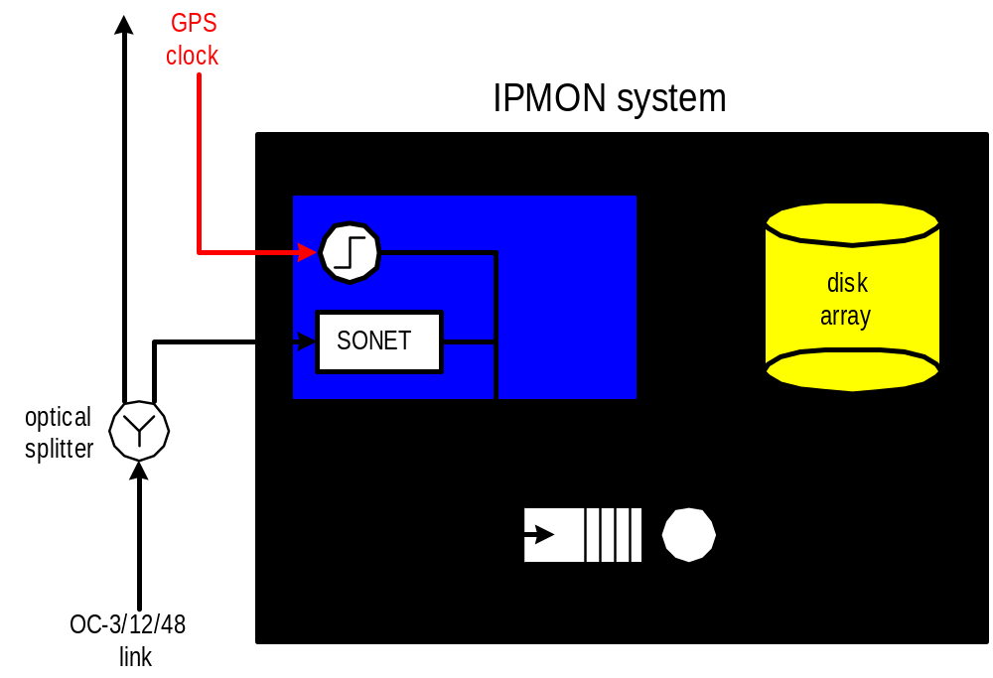
Monitoring System Architecture
90%
10%
Linux PC with multiple PCI buses
Notes:
The RAID disk array uses 3 18G disks. We use the parallelizing feature to access 3 disks at once. We don’t use the redundancy feature.
System architecture features:
large RAID disk array
Linux PC with multiple PCI buses
POS PCI network interface cards (DAG)

Slide 4
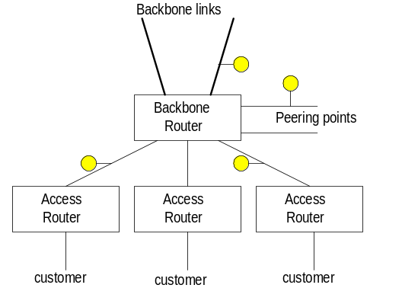
IPMON architecture
Analysis platform
(located @ sprintlabs)

Slide 5
What information is needed
Time-stamped IP headers
IS-IS and BGP information
Lower level alarms (if any)
SNMP
Router logs

Slide 6
Systematic approach
Continuously monitor each link
  Compute and export a small set of statistics (volume, peak, flows, out-of-sequence)
  Store packet traces for a limited amount of time
Query when more is needed
  SQL type queries
  Match routing information to packet trace

Slide 7
How to implement
Active monitoring does not solve all problems
OC-x MON approach is quite expensive and increases network complexity
Line cards would be optimal
  packet traces and routing information available
  must not affect forwarding performance

Slide 8
Implementation
Lookup
IP Address
Update
Header
Queue
Packet
IP Address
Next Hop
Address
Table
Buffer
Memory
Memory
(1 Gb=30s @ OC-192)
Monitoring
Engine

Slide 9
Potential problems
5 clock cycles at OC-192 between two 40 bytes packets
Query/Export might be heavy
Complexity for line cards
Memory
Centralized management

Slide 10
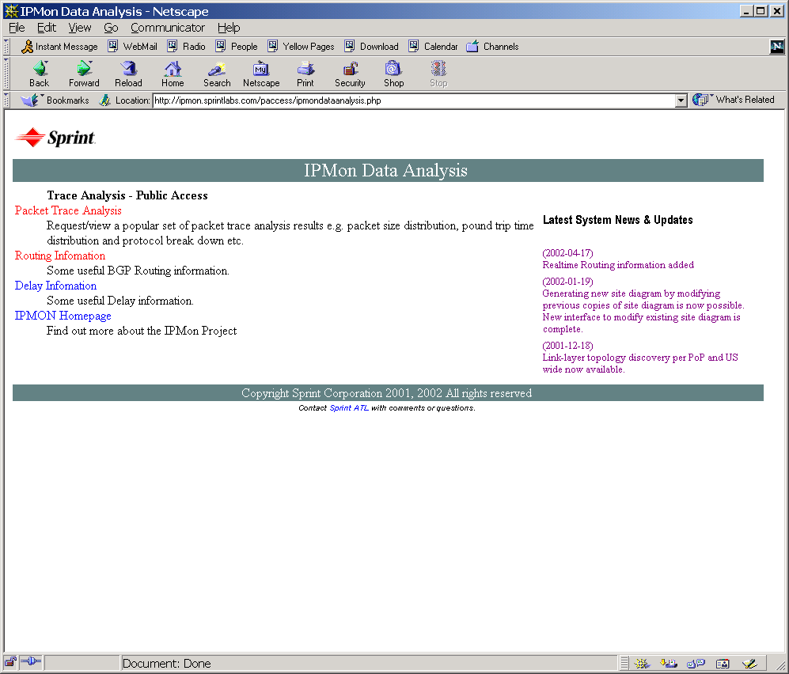
ipmon.sprintlabs.com (under construction)

Slide 11
To know more
ipmon.sprintlabs.com
Internet draft:
  draft-bhattacharyya-monitoring-sprint-00.txt
cdiot@sprintlabs.com

