Slide 1
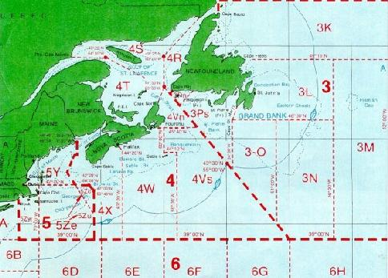
Perfect Storms, Internet Economics, and the Future of the Internet
David Meyer
NANOG 41
October 2007
http://www.1-4-5.net/~dmm/talks/NANOG41/perfect_storm

Slide 2
Agenda
Background and Context
So what is the “Perfect Storm”?
Three Pieces of the Puzzle
A Few Considerations
Discussion

Slide 3
Background & Context
I’d been spending a lot of time studying complexity
  http://www.1-4-5.net/~dmm/talks/NANOG26/complexity_panel
  RFC 3439
And looking at things like NGN and IMS
  http://www.1-4-5.net/~dmm/talks/NANOG33/ims

Slide 4
Background & Context
So I started wondering where all this is going
  And how technologies like IMS (or more generally, NGN) interacted with the Internet Architecture
  And what the implications of the growing number of policy-based networks really was
And in particular, I wondered about the implications of tying (perceived) high margin application revenue directly to the packet transport
  That is, can you really do that with the Internet architecture?
    And if you try, what happens (hint: complexity)?
  We’ll see why this is an interesting question in a moment

Slide 5
Background & Context
And as you might imagine (given my background/sensibilities), I was skeptical about what those technologies might mean for the Internet
In analyzing the space a bit, I proposed a scenario that became known as "Meyer's Telecommunications Perfect Storm", or TPS
The rest of this talk reviews the TPS scenario and its implications

Slide 6
What Exactly is the TPS?
TPS is based on the observation that the following three basic events could lead to a significant restructuring of our industry:
  Low margin yet profitable IP packet carriage businesses emerge/exist
  Access monopolies are weakened and/or cease to exist
  A set of peer-to-peer applications emerge that co-opt the incumbent’s revenue streams

Slide 7
What Exactly is the TPS?
So TPS is a set of observations about the current state/trajectory of the Internet
  TPS convolves economics, public policy, technology, and the Internet Architecture
TPS is based on properties of the Internet Architecture
  As we shall see, the key property of the architecture here is the end-to-end (e2e) principle
  We can argue (like everyone else) about what the e2e principle really says, but a good reference is
  http://www.chiappa.net/~jnc/tech/end_end.html

Slide 8
Key Feature of the e2e Principle
For our purposes here, the key aspect of the e2e principle is that it implies that
  IP packet carriage is a commodity business
I’ll just note here that this conclusion “may be considered controversial” by some
  And note that this doesn’t mean that there isn’t margin in say, 2547 (clearly there is); however, 2547 (and other VPN types) is really a small part of the overall traffic mix
So let’s look at each of the TPS events in a bit of detail

Slide 9
Event 1: Existence/Emergence of Low Margin yet Profitable Packet Carriage
The hypothesis here is that a direct consequence of the e2e principle is that Internet packet carriage is a commodity business.
  i.e., the IP architecture dictates that the high(er) margin value proposition is on the edge
  So if you’re going to be in the IP packet transport biz, you’re going to have to make your living in a low margin environment
Contrast with all of the activity around trying to provide high-margin packet transport, usually by attempting to tie application layer revenue directly to the packet transport. e.g., IMS/A-IMS.
  Not surprisingly, there is disagreement on this point
Ok, but what is the relationship between a commodity business and its margin structure?

Slide 10
Classic Commodities and Margin Structures
Classic commodity businesses are characterized by significant capital expenditures in their plants, low profit margins, and intense competition
  Sound familiar?
  And of course, capital has to be effectively available, otherwise up front CAPEX requirements can form a barrier to entry (e.g., submarine cables), and hence reduce/eliminate competition
And watch out - natural monopolies can also form
  This is case in which the incremental cost of incumbent capacity is significantly lower than the cost of new-entrant capacity, which can allow an incumbent to squeeze out competition

Slide 11
Commodities/Margin Structures
Another property of classic commodities is that frequently cited is that they have the property that the incremental cost of providing the good or service approaches zero
  Well, what is the incremental cost of forwarding a packet in the core of the Internet?
    Approaching zero
So the lack of differentiation in the core (QoS anyone) and intense competition has driven low margins, which combined with reduced plant costs has over time driven incremental costs towards zero

Slide 12
Commodities/Margin Structures
  So IP packet carriage is a classic commodity
    Well, we knew that from the e2e principle
  So we know that margins are going to naturally be thin
  Conclusion: SPs need to be profitable in a commodity (low margin) environment
  And importantly, the high-margin proposition isn’t in packet transport

Slide 13
Low Margin yet Profitable
What this is really all about is the convolution of the Internet technology with the economics of packet transport
  We want to simultaneously preserve the e2e nature of the Internet and have viable economics
  i.e., low margin yet profitable IP packet carriage
And BTW, in case you were wondering, we understand the economics of all of this about as well as we understand complexity
  So we need to encourage (multidisciplinary) research in this area

Slide 14
Event 2: Access Monopolies are Weakened/Cease to Exist
Say, due to the emergence of technologies like WiMAX
  Or just competition in the access
  and what about things like 700Mhz?
  and how about EU wide UMTS @ 2Mb/s?
Truth in advertising #1
  Some folks posit that competition in the access is effectively impossible due to its capital intensive nature, and thus access is a natural monopoly
Truth in advertising #2
  We still don't have a (inexpensive) wireless technology that is capable of delivering 100s (or even 10s) of HDTV channels

Slide 15
Weakened Access Monopolies -- Why this is important
Competition makes it much harder (impossible?) to profitably field policy-based access networks. But why?
Well, consider the cost of building/running one of these networks
  and given the complexity, its reliability
  and attendant cost to the consumer
And there is no way your SP is going to be able to innovate at the same rate as the entire Internet
  e2e principle (again)
Consider the success of AOL or other attempted "walled-garden" providers
  But then, what about IMS and the like?

Slide 16
Access Monopolies are Weakened/Cease to Exist
Implication of all of this:
  Policy-based networks cost more to build and operate, are less reliable, and are (ironically) less "service rich"
Why cost more? -- Complexity
Why less reliable? -- Complexity
Why less service rich? -- Stay tuned...

Slide 17
Access Monopolies are Weakened/Cease to Exist
So this is about the convolution of the Internet technology, access technologies, public policy
  Net Neutrality++;
Of course, access networks must also be profitable (under some models), so this is also about which business models are viable for access providers
  Alternatively, access networks may be be considered some sort of public infrastructure (such as roads)
  Debate on this one rages on, however...

Slide 18
Access Monopolies are Weakened/Cease to Exist
So the most basic question is --
How do we handle the next wave of access b/w requirements?
    say, for IPHDTV?
    and how will any required upgrades be funded?
    and which technologies?
Suffice it to say that there are real (and difficult) technology, business model, and public policy questions here

Slide 19
So Why Are Policy-Based Network Less Service Rich?
Suppose you’re a walled-garden (policy-based) SP....
If history is any kind of guide, innovation on the edge will force you (the walled garden provider) to let new services through...Why?
  Your customers will demand it (e.g., ports 80/443)
  This is part of the reason why the existence of competition in the access is a critical component of all of this
Once you let almost any port through, everything can then be tunneled over that port (courtesy of the Internet architecture)
  e.g., skype or any other OTT service (Joost, etc)
  plus encryption + anonimzation + lots of app developers

Slide 20
Why Less Service Rich?
And you can't really find this stuff with, say, a DPI engine
  Why? Well, because while you may be able to find the signature of, for example, encrypted voice (today), you basically have to block everything that you can't identify.
The implication is that most (all?) applications that are "over-the-top" must be treated by default logic
  So you either have to allow nothing (temporarily) or everything
Conclusion: You can't effectively stop over-the-top services
  If there is competition in the access, and...
  You effectively have “Carterphone” for end-user devices
YACAR (Yet Another Classic Arms Race)

Slide 21
Event 3: Applications Emerge That Target Incumbent Revenue Streams
The 3rd piece of this puzzle is that a set of p2p applications emerge that capture the incumbents’ revenue streams
    e2e principle, again (shocking)
  Key here: decentralized control
Starting with voice
  Large and easily co-opted revenue stream
  cf. Vonage (or what’s left of it), skype, Joost, etc...
  But also video, FMC, presence, IM, ...
Service bundling seems to be the current SP hedge against this effect

Slide 22
Applications Emerge that Target Incumbent Revenue Streams
So this is about a convolution of the Internet technology (notably its end-to-end nature and the creativity that unleashed) with traditional carrier architectures and business models
In particular, while traditional carrier networks were vertically integrated (the network was the application), the Internet is horizontally integrated
  This has the effect of making many of the services the vertically integrated networks provided into applications on the Internet
    Canonical example: Voice

Slide 23
Summary: What happens if we wind up with...
Low margin but profitable packet transport providers emerge/exist
  As implied by the e2e principle
No (or weakened) access monopolies
  Competition and/or new access technologies
Large scale co-opting of traditional service provider revenue streams
  p2p (or other) applications target traditional and future revenue streams

Slide 24
Summary, cont.
Does our industry restructure under such a scenario (and how)?
  We know such restructuring does happen (and can happen rapidly)
    Example: the recording industry
    It seems highly unlikely (to me anyway) that there were many recording industry exec’s sitting around thinking “hmmm, peer-to-peer networking, that’ll probably restructure my industry...”
And how much of the TPS is already out there?
  i.e., is this really “if”?
  and interestingly, I was listening to Jim Cramer....

Slide 25

June, 2006 Cover of Telecommunications Mag...

Slide 26
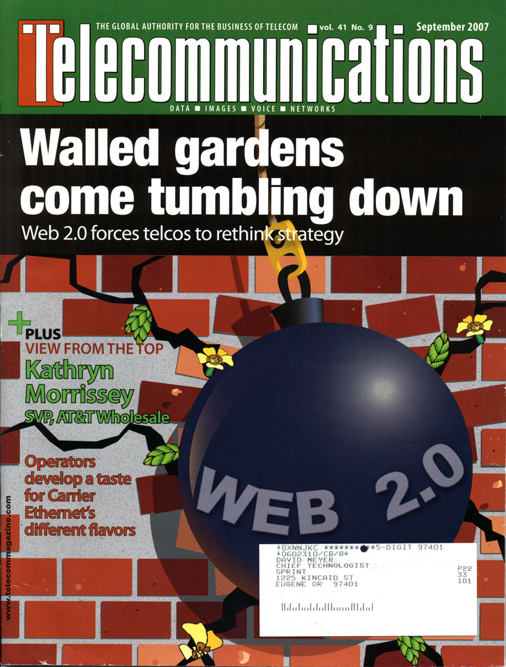
and Sept, 2007...

Slide 27
But There’s A Catch...
All of this analysis breaks down at the resource saturation point
  e.g., you’ve max’ed out your fiber, FIB, ...
  At that point you’re looking at non-linear cost
    Fiber builds, fork-lift upgrades,....
So we need economic models that both preserves the IP architecture and provide sufficient ROI to sustain the industry
And lest you think the b/w thing isn’t real...

Slide 28
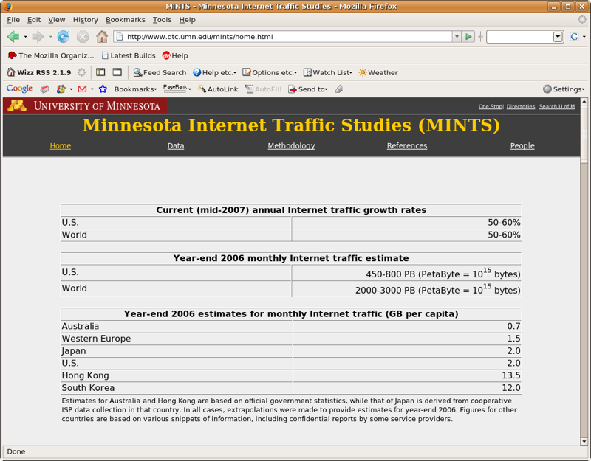

Slide 29
So OK, that’s all fine, but what’s an ISP to do?
Be realistic about the complexity-opex tradeoffs
  “Be Rational” -- Vijay Gill
  We need better tools here, as we have little or no analytic capability in this space
Keep in mind that the governmental intervention and/or regulation is the “trump card” here
Work with the vendors, standards orgs, and the open source community to build protocols and platforms that have the needed properties

Slide 30
What Should Vendors Be Doing?
First...listen to the SPs
But the problem remains thorny as vendors (like everyone) want to maintain margins
  Even if the perfect storm scenario materializes, vendors will able to preserve advantageous margin structures for some customers
However, if what evolves is the need for low margin interfaces, then vendors may need to hedge against their margin strategies
  Perhaps by simplifying things and riding the ethernet cost/performance curve
  BTW, could there be such a thing as a “disposable network”?

Slide 31
So Where To From Here?
All of this is just the scenario in which the e2e Internet that we all know and love continues to grow and thrive
  Contrast with the "value-added-transport" position
  And noting that everything is Over-the-Top on the Internet
Continued understanding of our evolving needs
  What is the effect of new bandwidth drivers like video?
  or having access speeds approach core speeds?
  or 2M to the handset
  or migration of TDM to packet
  ....

Slide 32
Are we really “post-TPS”?
A few opinions:
  “The Perfect Storm has already wiped out huge value in the market” -- Erik Cecil, on arch-econ@cookreport.com
  In his book “The Great Telecom Meltdown”, Fred Goldstein writes about the confluence of the three factors we’ve been talking about...
    ”This (confluence) fueled a perfect storm, a confluence of factors that fed on each other, in which the impact of the whole was far larger than the sum of its parts would otherwise have been.”

Slide 33
A Few Final Thoughts
There is a clear need for education in our community at large about these issues
  Where community includes SPs, enterprise operators, content providers, researchers, vendors, users of all kinds, regulators, ...
We need to encourage (i.e., fund) multidisciplinary research in this area
    Theory, data, and practice are all slim

Slide 34
Finally...
A bad outcome (tm) would be to find ourselves in a situation in which
  Service Providers can't be profitable enough to continue bandwidth upgrade cycles
  Service Providers then attempt to choke off innovation for (perceived) self-preservation
    via legislative/regulatory action, and/or by technical means
Obviously, we all want to avoid this outcome

Slide 35
Questions/Comments?
Thanks!

