Slide 1
Complex
Network Architecture
Reactions
Flow
Protein level
Application
Reactions
Error/flow control
John Doyle
Flow
Global
RNA level
Relay/MUX
John G Braun Professor
Control and Dynamical Systems
BioEngineering, Electrical Engineering
Caltech
E/F control
E/F control
Reactions
Local
Relay/MUX
Relay/MUX
Flow
DNA level
Physical

Slide 2
Doyle
Architecture of complex networks
Theory
Data
Analysis
Numerical
Experiments
Lab
Experiments
Field
Exercises
Real-World
Operations
First principles
Rigorous math
Algorithms
Proofs
Correct statistics
Only as good as underlying data
Simulation
Synthetic, clean data
Stylized
Controlled
Clean, real-world data
Semi-Controlled
Messy, real-world data
Unpredictable
After action reports in lieu of data

Slide 3
Essential ideas: Architecture
Robust yet fragile
Constraints that deconstrain
Question
Answer

Slide 4
A Layered View of HFN Architecture
Robust yet fragile?
Constraints that deconstrain?
HUMAN / COGNITIVE LAYER
The Conversation
Social/Cultural
Organizational
Political
Economic
TEXT
- email
- chat
- SMS
VOICE
- Push-to-talk
- Cellular
- VoIP
- Sat Phone
- Land Line
VIDEO/IMAGERY
- VTC
- GIS
- Layered Maps
SPECIALIZED
- Collaboration
- Sit Awareness
- Command/Control
- Integration/Fusion
“APPLICATION
LAYER”
WIRED
- DSL
- Cable
Layering?
WIRELESS LOCAL
- WiFi
- PAN
- MAN
WIRELESS LONG HAUL
- WiMAX
- Microwave
- HF over IP
REACHBACK
- Satellite Broadband
- VSAT
- BGAN
“NETWORK
LAYER”
POWER
- Fossil Fuel
- Renewable
HUMAN NEEDS
- Shelter
- Water
- Fuel
- Food
PHYSICAL SECURITY
- Force Protection
- Access
Authorization
OPERATIONS CENTER
- NetSec
- Command/Control
- Leadership
“PHYSICAL
LAYER”

Slide 5
Infrastructure networks?
Water
Waste
Food
Power
Transportation
Healthcare
Finance
All examples of “bad” architectures:
Unsustainable
Hard to fix
Where do we look for “good” examples?

Slide 6
Essential ideas: Architecture
Robust yet fragile
Constraints that deconstrain
Question
Answer
Simplest case studies
Internet
Bacteria

Slide 7
Successful architectures
Robust, evolvable
Universal, foundational
Accessible, familiar
Unresolved challenges
New theoretical frameworks
Boringly retro?
Simplest case studies
Internet
Bacteria

Slide 8
Universal, foundational
Techno-
sphere
Bio-
sphere
Internet
Bacteria

Slide 9
Universal, foundational
Techno-
sphere
Bio-
sphere
Spam
Viruses
Bacteria
Internet

Slide 10
Two lines of research:
Patch the existing Internet architecture so it handles its new roles
Real time
Control over (not just of) networks
Action in the physical world
Human collaborators and adversaries
Net-centric everything
Techno-
sphere
Internet

Slide 11
Two lines of research:
Patch the existing Internet architecture
Fundamentally rethink network architecture
Real time
Control over (not just of) networks
Action in the physical world
Human collaborators and adversaries
Net-centric everything
Techno-
sphere
Internet

Slide 12
Two lines of research:
Patch the existing Internet architecture
Fundamentally rethink network architecture
Techno-
sphere
Bio-
sphere
Case studies
Internet
Bacteria

Slide 13
Essential ideas: Architecture
Robust yet fragile*
Question
* Carlson

Slide 14
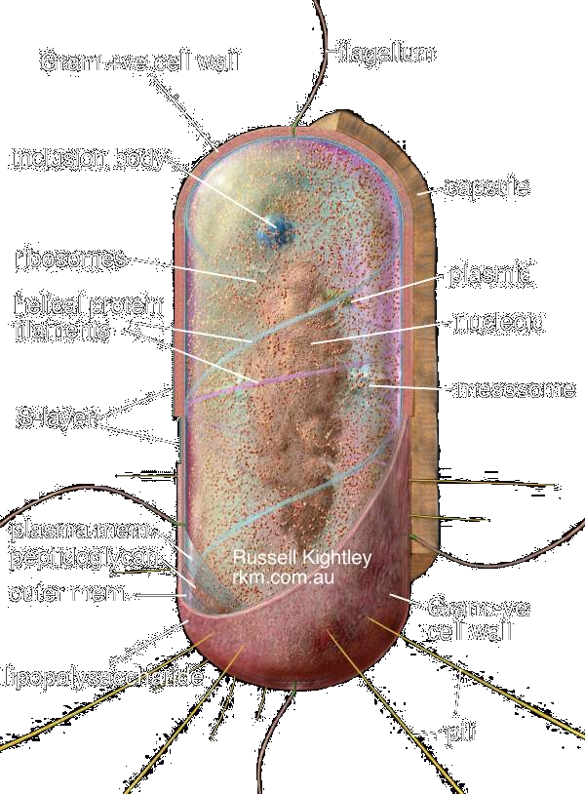
Systems requirements:
functional, efficient,
robust, evolvable
Sugars
Fatty acids
Catabolism
Precursors
Co-factors
Hard constraints:
Thermo (Carnot)
Info (Shannon)
Control (Bode)
Compute (Turing)
Protocols
Amino Acids
Carriers
Nucleotides
Genes
Proteins
Trans*
DNA
replication
Diverse
Universal
Control
Diverse
Constraints
Components and materials:
Energy, moieties

Slide 15
Hard limits.
No networks
Hard constraints:
Thermo (Carnot)
Info (Shannon)
Control (Bode)
Compute (Turing)
Assume different architectures a priori.
New unifications are encouraging, but not yet accessible

Slide 16
Cyber
Physical
Thermodynamics
Communications
Control
Computation
Thermodynamics
Communications
Control
Computation
Internet
Bacteria
Case studies

Slide 17
Robust Yet Fragile (RYF)
[a system] can have
[a property] robust for
[a set of perturbations]
Yet be fragile for
[a different property]
Or [a different perturbation]
Fragile
Robust
Proposition :
The RYF tradeoff is a hard limit that cannot be overcome.

Slide 18
Cyber
Physical
Physical
Thermodynamics
Communications
Control
Computation
Thermodynamics
Communications
Control
Computation
Fragile
Robust
Theorems :
RYF tradeoffs are hard limits

Slide 19
Robust yet fragile
Biology and advanced tech nets show extremes
Robust Yet Fragile
Simplicity and complexity
Unity and diversity
Evolvable and frozen
What makes this possible and/ or inevitable?
Architecture (= constraints)
Let’s dig deeper.

Slide 20
Essential ideas: Architecture
Constraints that deconstrain*
Answer
* Gerhart and Kirschner

Slide 21
Essential ideas: Architecture
Constraints that deconstrain*
Answer
Bad architecture:
Things are broken and you can’t fix it
Good architecture:
Things work and you don’t even notice

Slide 22
Systems requirements:
functional, efficient,
robust, evolvable
Protocols
Are there universal
architectures?
Components and materials:
Energy, moieties

Slide 23
Ancient network architecture:
“Bell-heads versus
Net-heads”
Layers (Net)
Operating systems
Pathways (Bell)
Phone systems

Slide 24
my
computer
web
server
Wireless
router
Optical router
HTTP
TCP
IP
Layering?
MAC
MAC
MAC
Switch
Pt to Pt
Pt to Pt
Physical

Slide 25
my
computer
web
server
Applications
HTTP
Browsing the web

Slide 26

The physical pathway
my
computer
web
server
Wireless
router
Optical router
Physical

Slide 27
my
computer
web
server
Applications
HTTP
Wireless
router
Optical router
Physical

Slide 28
my
computer
web
server
Applications
Diverse Applications
HTTP
Share?
Wireless
router
Optical router
Diverse Resources
Physical

Slide 29
Applications
Error/flow control
TCP
IP
Relaying/Multiplexing
(Routing)
Resources

Slide 30
Error/flow control
TCP
IP
Relaying/Multiplexing
(Routing)

Slide 31
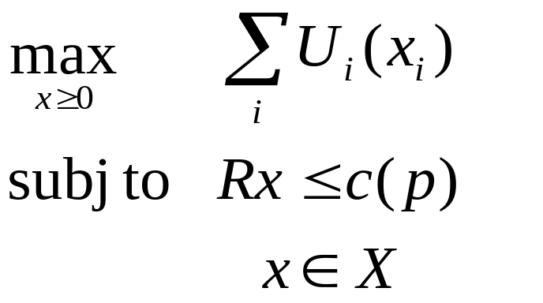
Applications
Error/flow
Control
Relay/MUX
Resources

Slide 32
Applications
diverse
and
changing
Resources

Slide 33
Fixed and universal
Error/flow
Control
Relay/MUX

Slide 34
Applications
Deconstrained
Constraints that deconstrain
Resources
Deconstrained
Gerhart and Kirschner

Slide 35
my
computer
Wireless
router
TCP
IP
Physical

Slide 36
my
computer
Wireless
router
TCP
IP
MAC
Switch
Physical

Slide 37
my
computer
Wireless
router
MAC
Error/flow control
Switch
Relaying/Multiplexing
Physical

Slide 38
Wireless
router
Applications
Error/flow control
MAC
Local
Switch
Relaying/Multiplexing
Resources

Slide 39
my
computer
Wireless
router
Differ in
Details
Scope
Error/flow control
TCP
Global
Relaying/Multiplexing
IP
MAC
Error/flow control
Switch
Local
Relaying/Multiplexing
Physical

Slide 40
web
server
Wireless
router
Optical router
TCP
IP
Physical

Slide 41
web
server
Wireless
router
Optical router
TCP
IP
MAC
Pt to Pt
Physical

Slide 42
web
server
Wireless
router
Optical router
Error/flow control
Global
TCP
Relay/MUX
IP
Error/flow control
MAC
Local
Relay/MUX
Pt to Pt
Physical

Slide 43
my
computer
web
server
Wireless
router
Optical router
HTTP
TCP
IP
MAC
MAC
MAC
Switch
Pt to Pt
Pt to Pt
Physical

Slide 44
Recursive control structure
Application
Global
Scope
Local
Local
Local
Physical

Slide 45
Recursive control structure
Application
Error/flow control
Relay/MUX
Physical

Slide 46
Recursive control structure
Application
Error/flow control
Recursion
Global
Relay/MUX
E/F control
E/F control
Local
Relay/MUX
Relay/MUX
Physical

Slide 47
Architecture is not graph topology.
Application
TCP
IP
Architecture facilitates arbitrary graphs.
Physical

Slide 48
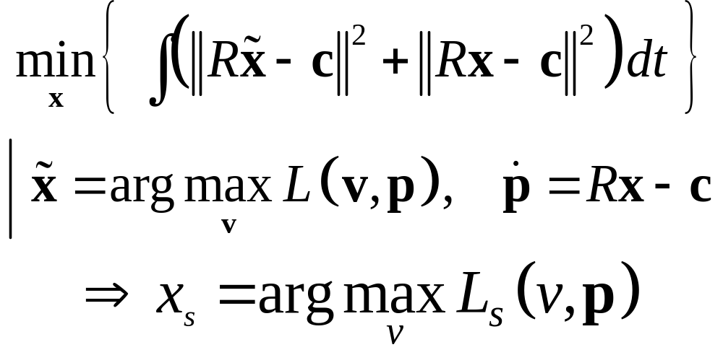
Constraints that deconstrain
Applications
Deconstrained
Generalizations
Optimization
Optimal control
Robust control
Game theory
Network coding
Resources
Deconstrained

Slide 49
Layering as optimization decomposition
Each layer is abstracted as an optimization problem
Operation of a layer is a distributed solution
Results of one problem (layer) are parameters of others
Operate at different timescales
Application: utility
application
transport
network
link
physical
Phy: power
IP: routing
Link: scheduling

Slide 50
Layering and optimization*
Each layer is abstracted as an optimization problem
Operation of a layer is a distributed solution
Results of one problem (layer) are parameters of others
Operate at different timescales
Application
Minimize response time, …
TCP/AQM
Maximize utility
IP
Minimize path cost
Link/MAC
Maximize throughput, …
Physical
Minimize SINR, maximize capacities, …
*Review from Lijun Chen and Javad Lavaei
Notes:
Optimization theory has played a major role in both designing and understanding network protocols. the design of each layer is usually abstracted as an optimization problem,
Since each layer receives well-defined services from the layer blow and provides well-defined services to the layer above, each layer is designed separately and evolves asynchronously. The design of each layer is usually abstracted as an optimization problem. For example, TCP can be seen as a distributed algorithm to solve utility maximization problem, intradomain routing is to solve minimum cost problem. The operation of a layer is a distributed solution to the corresponding optimization problem. For example, at the transport layer, congestion control is a distributed algorithm solving utility maximization problem. In the network layer, Bellman-Ford algorithm is a distributed algorithm to the minimum cost path problem. Different layers usually operate at different timescales and results of one layer are parameters of others. For example, in the utility maximization problem for congestion control, routing is a given, which means routing operates at a lower time-scale than congestion control..

Slide 51
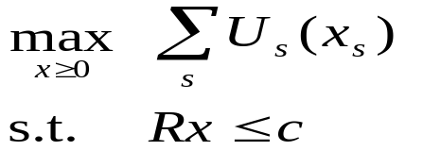
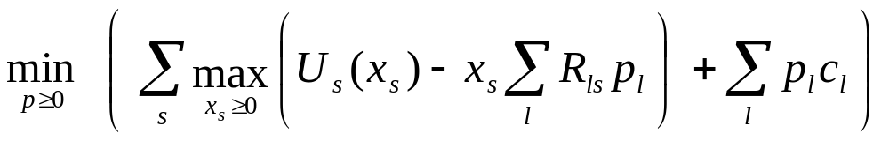
Protocol decomposition: TCP/AQM
my PC
router
source algorithm (TCP)
iterates on rates
link algorithm (AQM)
iterates on prices
TCP
AQM
Primal:
Dual
horizontal decomposition
TCP/AQM as distributed primal-dual algorithm over the network to maximize aggregate utility (Kelly ’98 , Low ’99, ’03)
Notes:
However, the main motivation to integrate various protocol layers into a unified optimization based framework is the duality of tcp congestion control, which says different TCP congestion control protocols can be seen as distributed primal-dual algorithm over the network to solve some utility maximization problem and its dual. Here is the utility maximization problem for network resource allocation. Xs is the tcp source sending rate, each source attains a utility usxs when sending at rate xs. Rx<=c is the rate constraint, which simply says that the aggregate source rate over a link should not exceed link capacity. We can obtain distributed solution to this problem by considering its dual. We see that the dual has a striking decomposition structure, can be solved by individual sources using only the congestion information along their paths. We call this horizontal decomposition, since it breaks down a centralized computation into distributed computation and control across geographically disparate network elements. Note that, In this utility maximization problem, the decision variable under control is the source sending rate. We can extend this utility maximization problem to include decision variables of other layers. Increasing capacity does not always improve its throughput. broke the world record for high speed data transfer.

Slide 52
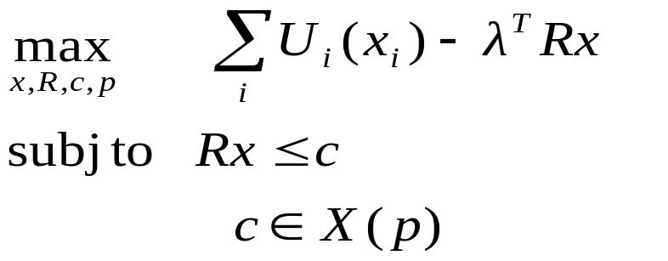
Generalized utility maximization
Objective function: user application needs and network cost
Constraints: restrictions on resource allocation (could be physical or economic)
Variables: Under the control of this design
Constants: Beyond the control of this design
Application utility
Network cost
Phy: power
IP: routing
Link: scheduling
Notes:
To be more specific, in this framework, we view the network as an optimization solver to solve a generalized utility maximization problem, where application needs and network cost form the objective to be optimized, and the restrictions in resource allocation are translated into the constraints of the optimization problem. Here is an example of generalized utility maximization problem.

Slide 53
Layering as optimization decomposition
Network generalized NUM
Layers sub-problems
Interface functions of primal/dual variables
Layering decomposition methods
Application
TCP/AQM
Vertical decomposition: into functional modules of different layers
Horizontal decomposition: into distributed computation and control
IP
Link/MAC
Physical
Notes:
Having formulated a generalized UM, we want to find a way to modularize and distribute the computation, such that different sub-problems correspond to functional modules of different layers. We call this process of breaking down a contralized computation into subproblems of different layer vertical decomposition. Within a layer, we want to further decompose the subproblem into distributed computation and control over geographically disparate network elements.
Different layers will correspond to different sub-problems, and the interfaces between various layers are functions of primal/dual variables. Also, note that, given the same optimization problem, we can derive distributed solutions by different ways. Different layering will correspond to different decomposition methods. can be used to study rigorously the performance tradeoff in protocol layering, as different ways to distribute a centralized computation.
This framework is promising to serve as a mathematical theory of network architecture and provide a top-down approach to design the protocol stack.

Slide 54
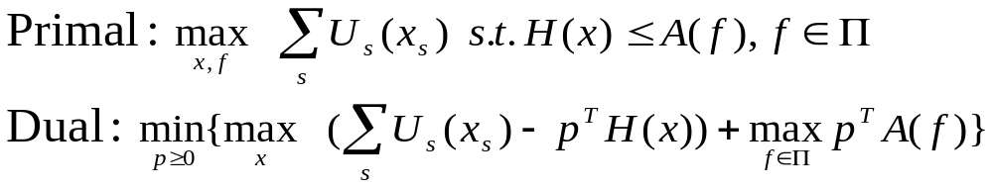
Case study I: Cross-layer congestion/routing/scheduling design
Rate constraint
Schedulability constraint
Rate control
Routing
Scheduling

Slide 55
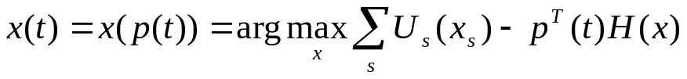

Cross-layer implementation
Rate control
Routing
Scheduling
Application
  Rate control:
  Routing:
  solved with rate control or scheduling
  Scheduling:
Transport
Network
Link/MAC
Physical
A Wi-Fi implementation by Warrier, Le and Rhee shows
significantly better performance than the current system.
Notes:
By relaxing the rate constraint, we obtain this Lagrangian dual. Here we introduce a lagrangian multiplier for each inequality constraint. This multiplier will be interpreted as the congestion price . Given p, the Lagrangian has a nice decomposition structure: it is the summation of two independent terms, in terms of source rates and link capacities respectively. from the first term, we get rate control, which is to adjust source rate according to congestion price, from this term we get scheduling according to congestion prices. Note that there does not exist a explicit routing component. Instead, the routing is implicitly solved with the rate control if the set of paths from which a source can choose is given, or solved with scheduling if no path is pre-specified for the source. This three components will interact through congestion price so as to achieve a global optimality
If there is multi-path here, we need to decide how much traffic to be transferred along each path. If no path is pre-specified, in scheduling we need to decide which source’s flow should go through which links.

Slide 56
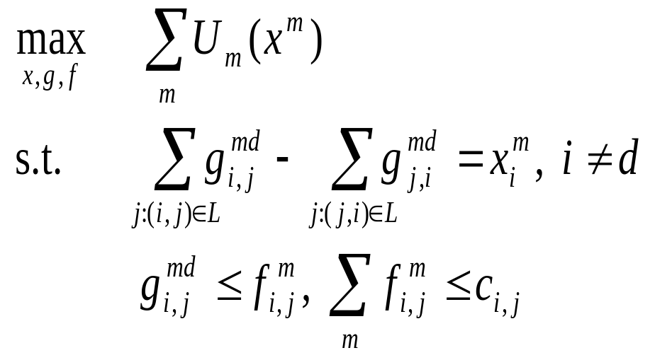

Case study II: Integrating network coding
Optimization based model for rate control: back-pressure based scheme
S
(1,1,1)
(1,1,1)
(1,0,1)
(1,1,0)
(1,1,0)
(1,1,1)
(1,0,1)
(1,1,0)
(1,0,1)
information
flow
physical
flow
d1
d2
coding subgraph
Constraint from NC
Notes:
Network coding is a novel data transmission strategy. It is fundamentally different from traditional routing based strategy. It extends the functionality of network nodes from storing and forwarding to performing algebraic operation on received data. Although there has been much recent research on network coding, fundamental questions remains on its practical implementation and extending the underlying idea to more general setting such as intersession nc and physical nc. Here I will discuss the integration of network coding with rate control. NC comes into action as a linear constraint.

Slide 57
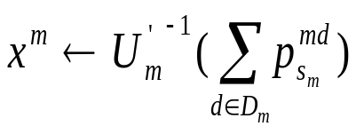
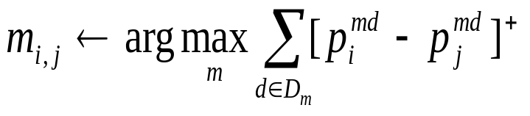
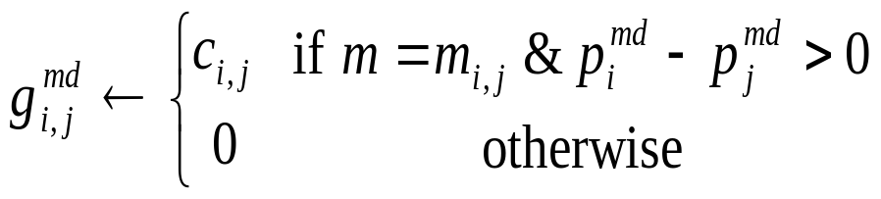
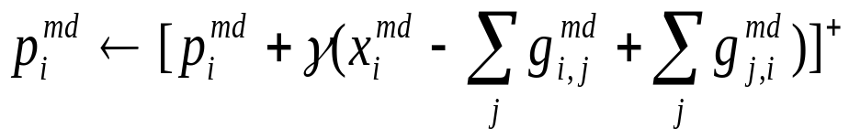
Case study II: Integrating network coding
Optimization based model for rate control: back-pressure based scheme
Backpressure
in congestion
Rate control
Session scheduling
Congestion price update

Slide 58





Other case studies
wireless scheduling
correlated data gathering in senor networks
0.5
0.2
compression/link aware
opportunistic routing
throughput-optimal scheduling
0.9
coded data
coding matrix
input data
s(t)=arg max{p_{s}(t)c_{s}(t)}
LZ coder
BS
MS
dual scheduling algorithm
distributed source coding (LZ+NC)
a new optimization approach to
inter-session network coding
physical network coding
A
A
b1
1
2
3
S₁
d₂
B
B
b1
b1+b2
forwarding
2
b1+b2
2
A
B
b2
b1+b2
1
2
3
S₂
d₁
A+B
b2
network coding
three sessions: (s₁;d₁), (s₂;d₂), (s₁,s₂;d₁,d₂)
Notes:
Here are some captures of other works, mainly with an optimization approach. First, wireless scheduling. Throughput-optimal scheduling
Is a hard problem for wireless ad hoc networks. We have proposed a low-complexity distributed approximation algorithm that achieves a performance of ½ in the worst case. We also proposed several distributed approximation algorithms for the network with broadcast advantage. Besides, based on our results on stability and optimality of dual subgradient algorithm with time-varying channel, we proposed a fair scheduling algorithm for generalized switches with interdependent, time-varying servers. This new scheduling algorithm provides a viable alternative to existing scheduling algorithms such proportional fair scheduler in Qualcom’s HDR. Second, correlated data gathering in wireless sensor networks. Data gathering is a common function of sensor networks. Correlated data gathering considers a scenario where data is sampled at a number of distributed correlated sources and needs to be transported to central base stations for further analysis. It involves in-network data compression and its interaction with routing. We have proposed distributed algorithms for lossless and lossy data gathering with correlated sources. We also proposed a novel opportunistic source coding and opportunistic routing scheme for correlated data gathering. With opportunistic routing and forwarding, our scheme reduces the number of retransmissions and improves reliability and throughput. By coupling routing with opportunistic compression, our scheme exploits diversity in data compression and path selection so as to route packets over paths with high compression and good link quality. Our scheme also provides a practical distributed source coding scheme that combines and takes advantage of both LZ code and network coding. Third, inter-session network coding. Intersession network coding is still in its infancy. We proposed a new optimization approach to intersession network coding, based on a general method that decomposes a set of unicast flows into a superposition of multicast flows and unicast flows. This two work involves designing practical protocols at packet level. Lastly, physical network coding. Here is a simple example. We have three wireless nodes. Nodes 1 and 2 cannot reach each other directly and need node 2 to relay data for each other.

Slide 59
Dual dynamics: TCP/AQM
my PC
router
source algorithm (TCP)
iterates on rates
link algorithm (AQM)
iterates on prices
TCP
AQM
Primal:
Dual
horizontal decomposition

Slide 60
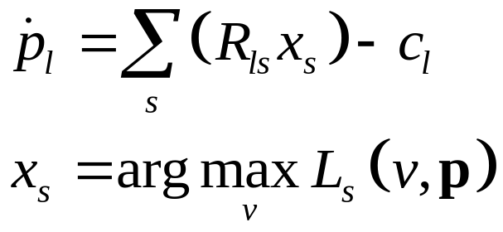
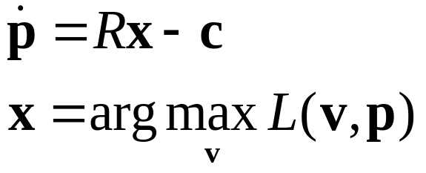
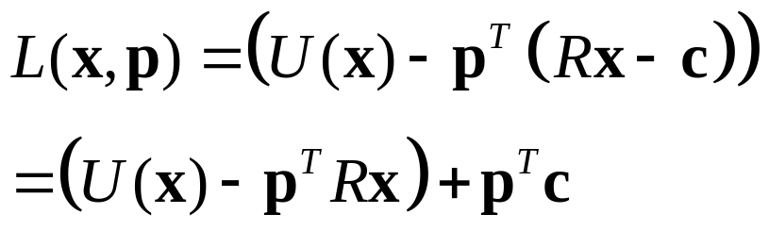
Dual dynamics
Controller is fully decentralized
Globally stable to optimal equilibrium
Generalizations to delays, other controllers
Vector notation

Slide 61
What else is this good for?
Controller is fully decentralized
Globally stable to optimal equilibrium
Generalizations to delays, other controllers
Views TCP as solving an optimization problem
Clarifies tradeoff at equilibrium
Generalizes to other strategies, other layers
Framework for cross layering

Slide 62
But are the dynamics optimal?
Controller is fully decentralized
Globally stable to optimal equilibrium
Generalizations to delays, other controllers
Optimal controller?
Dynamic tradeoffs?
Routing, other layers?
Framework for cross layering?

Slide 63
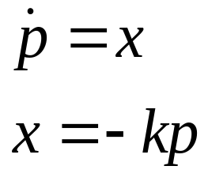
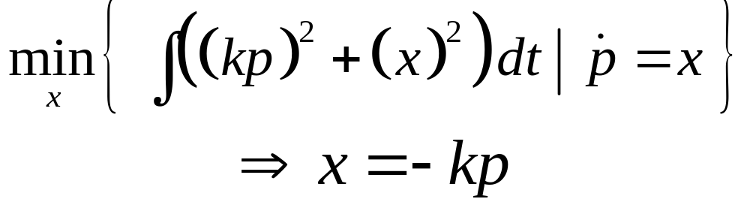
Inverse optimality toy example
What is this controller optimal for?
dynamics
controller
State weight
Control weight
dynamics
Optimal control

Slide 64
Inverse optimality review
What is this controller optimal for?
Integral quadratic penalty
Deviation from equilibrium
Balance state versus control penalty
Well-known and “ancient” literature
State weight
Control weight
dynamics
Optimal control

Slide 65
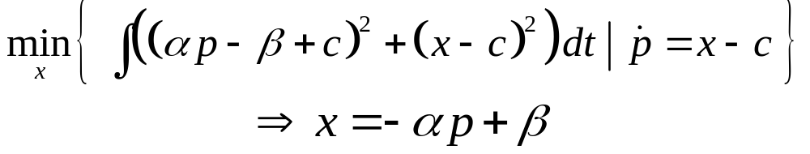
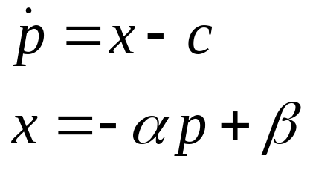
Simple change
State weight
Control weight
dynamics
Optimal control

Slide 66
What is this controller optimal for?
IQ penalty on deviation from equilibrium
Balance state versus control penalty

Slide 67
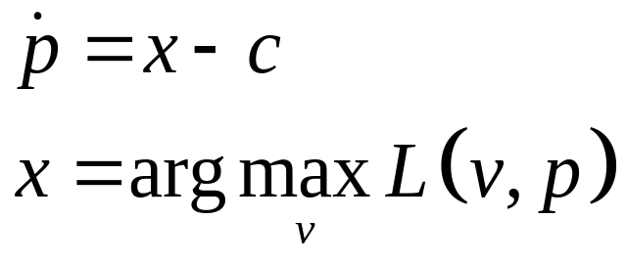
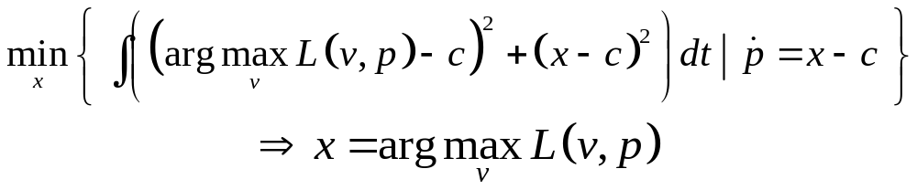
Simple change
Optimal control

Slide 68
What is this controller optimal for?
IQ penalty on deviation from equilibrium
Balance state versus control penalty
State weight
Control weight
dynamics
Optimal control

Slide 69
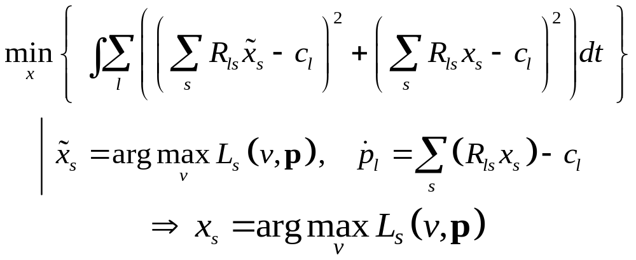
Network
Optimal control

Slide 70
Vector notation

Slide 71
What is this controller optimal for?
IQ penalty on deviation from equilibrium
Balance state versus control penalty
Optimal controller is decentralized
State weight
Control weight
dynamics

Slide 72
What else is this result good for?
Elegant proofs of stability
Clarifies the tradeoff in dynamics
Insights about joint congestion control and routing
Can derive more general control laws

Slide 73
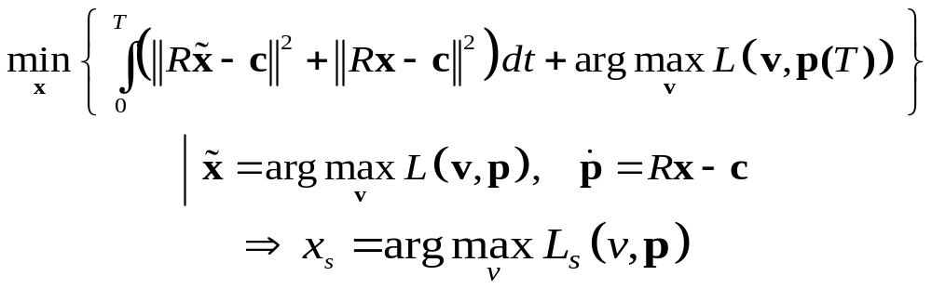
Finite horizon version
Terminal cost is lagrangian

Slide 74
An additional constraint: energy aware design
Energy has become a key issue in systems design
Tradeoff between energy usage and traditional performance metrics such as throughput and delay
Challenges:
  How to leverage existing energy aware technologies such as speed scaling
  What are fundamental limits on various tradeoffs
  The impact of energy aware design on the system architecture
Our current focus is on wireless networks
Notes:
For numerical experiments, we will consider only the game the this utility and payoff functions, and design medium access method according to the gradient play.

Slide 75





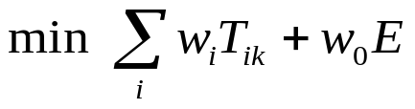

Case study: wireless downlink scheduling
1
“natural” speed scaling
B
N
Developed an online algorithm with a competitive ratio of
Extending to other scenarios such as time-varying channels and finite energy budget, etc.
weighted sum of response
time and energy
Notes:
For numerical experiments, we will consider only the game the this utility and payoff functions, and design medium access method according to the gradient play.

Slide 76
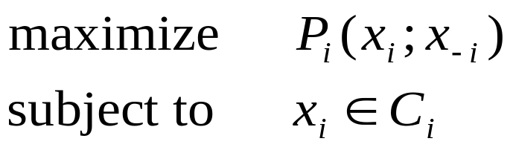
Generalization to game theory
Player i payoff function
Player i strategy space
Player i strategy
Developed to study strategic interactions
Provides a series of equilibrium solution concepts
Considers informational constraints explicitly
  Equilibria arise as a result of adaptation and learning, subject to informational constraint
Provides a basis for designing systems to achieve the given desired goals (e.g., mechanism design)
Notes:
The other and more general framework is game theory. Game theoretic models are inherently distributed, since the agents are independent decision makers. So, they are flexible in modeling various situations. They directly model/specify the behaviors of individual agents, so system-wide properties are ‘emergent’ behaviors. Game theory provides a series of equilibrium solution concepts, such as the Nash equilibrium and the dominant strategy equilibrium, that differ in assumptions about agents' computational (rationality) and informational constraints and thus are suitable for different situations. For example, the stable path problem for interdomain routing can be viewed as seeking a dominant strategy equilibrium. Game theoretic analysis also provides a basis for designing systems to achieve the given desired goals (such as to maximize aggregate utility), which is the scope of Mechanism Design
These equilibrium solution concepts are usually very strong concepts. For example,
as mentioned above, the Nash equilibrium assumes that agent strategies, payoffs and
rationality are common knowledge. This assumption usually does not hold in reality. Then you might ask why a Nash outcome will occur. One justification is that equilibria arise as a result of
adaptation or learning.
The study of mathematical models of strategic interaction between rational agents. This justification of equilibrium is particularly legitimate in network design and
control, as the network consists of distributed entities having limit information and almost all network algorithms and protocols are repeated (or iterative) and adaptive.
We can design network algorithms and protocols according to distributed strategy update mechanisms achieving various equilibria.

Slide 77
Game theory: Engineering perspective
Network agents are willing to cooperate, but only have limited information about the network state
  E.g., may not have access to the information/signaling required by an optimization-based design
  The best is to optimize some local or private objective and adjust its action based on limited information about the network state
Non-cooperative game can be used to model such a situation
  Let network agents behave 'selfishly' according to the game that is designed to guide individual agents to seek an equilibrium achieving the systemwide objective
Notes:
we thus advocate a complementary, engineering perspective to game-theoretic approach to network design. We envision a scenario where
network agents are willing to cooperate to achieve certain global optimality, but due to various
practical constraints such as limited bandwidth in wireless networks, network agents may not have
access to the information and signaling that is required by an optimization-based design. In such
a situation, the best an agent can do is to optimize some local or private objective and adjust its
action based on limited information about the network state. We use a non-cooperative game to
model such a situation, and let network agents behave 'selfishly' according to the game that is
designed to guide individual agents to seek an equilibrium achieving some systemwide performance
objective. You may argue that the incentive comes from limited information.

Slide 78
Game theory based decomposition
system-wide performance objective
design agent utility
and define game
must respect
informational
constraints
look for distributed
converging algorithm
protocol design:
protocols as distributed update
algorithms to achieve equilibira

Slide 79
Eco vs. Eng
Economic (traditional perspective): incentive is a hard constraint that must be taken into account in the design
  The agent utility is given
  Some possibility results exist
    Mechanism design
    Cooperative game
Engineering: the focus is on the implementation in practical systems
  Respect informational constraint of the system
  The challenge: to what extend we can program network agents to achieve desired systemwide objectives
Tradeoff among computational, informational, and incentive issues
Notes:
The main difference between economic and engineering perspectives is whether we can design or specify utility for network agents.

Slide 80


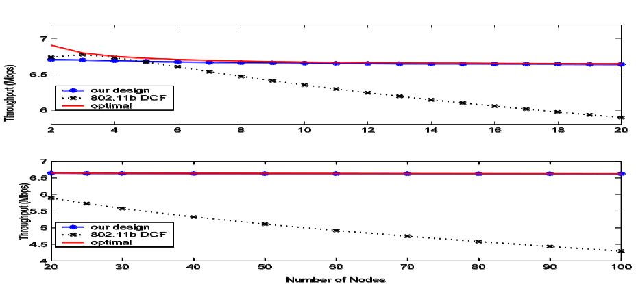
Case study: Throughput optimal channel access scheme
to achieve maximum throughput under weighted
fairness constraint
can be seen as an
axiomatic approach
utility
distributed converging algorithm

Slide 81
Biology versus the Internet
Similarities
Evolvable architecture
Robust yet fragile
Layering, modularity
Hourglass with bowties
Dynamics
Feedback
Distributed/decentralized
Not scale-free, edge-of-chaos, self-organized criticality, etc
Differences
Metabolism
Materials and energy
Autocatalytic feedback
Feedback complexity
Development and regeneration
>3B years of evolution
>4B

Slide 82
Biology versus the Internet
Similarities
Evolvable architecture
Robust yet fragile
Layering, modularity
Hourglass with bowties
Dynamics
Feedback
Distributed/decentralized
Not scale-free, edge-of-chaos, self-organized criticality, etc
Differences
Metabolism
Materials and energy
Autocatalytic feedback
Feedback complexity
Development and regeneration
>3B years of evolution

Slide 83
Control of the Internet
Packets
source
receiver
control
packets

Slide 84
signaling
gene expression
metabolism
lineage
source
receiver
Biological pathways

Slide 85
signaling
gene expression
metabolism
lineage
source
receiver
control
energy
More complex feedback
materials

Slide 86
source
receiver
control
energy
materials
Autocatalytic feedback

Slide 87
signaling
gene expression
metabolism
lineage
source
What theory is relevant to these more complex feedback systems?
receiver
control
energy
More complex feedback
materials

Slide 88
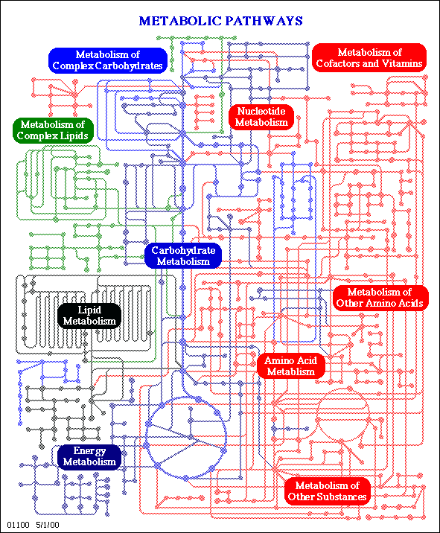
Network architecture?
Layers?
Pathways
“Central dogma”
Metabolic pathways
DNA
RNA
Protein

Slide 89
Metabolism
Catabolism
Sugars
Amino Acids
Precursors
Nucleotides
Fatty acids
Co-factors
Carriers
energy
materials

Slide 90
Core metabolism
Catabolism
Sugars
Amino Acids
Precursors
Nucleotides
Fatty acids
Co-factors
Carriers
Inside every cell (≈10³⁰)

Slide 91
Bacterial cell
Environment
Autocatalytic feedback
Environment
Core metabolism
Sugars
Fatty acids
Nutrients
Catabolism
Precursors
Co-factors
Amino Acids
Genes
Proteins
Nucleotides
Carriers
Trans*
DNA
replication
Huge
Variety
Huge
Variety

Slide 92
Same
12
in all
cells
Taxis and
transport
Core metabolism
Sugars
Catabolism
Amino Acids
Nutrients
Precursors
Nucleotides
Fatty acids
Co-factors
≈100
same
in all
organisms
Carriers
Huge
Variety
Same
8
in all
cells

Slide 93
Taxis and
transport
12
Autocatalytic feedback
Polymerization
and complex
assembly
Core metabolism
Sugars
Fatty acids
Nutrients
Catabolism
Precursors
Co-factors
Amino Acids
Genes
Proteins
Nucleotides
Carriers
8
≈100
Trans*
Huge
Variety
DNA
replication
≈10⁴ to ≈ ∞
in one
organisms

Slide 94
Autocatalytic feedback
Few polymerases
Highly conserved
Polymerization
and complex
assembly
Genes
Proteins
Trans*
DNA
replication
≈10⁴ to ≈ ∞
in one
organisms
Huge
Variety

Slide 95
Polymerization
and complex
assembly
The bowtie architecture of the cell.
Autocatalytic feedback
Taxis and
transport
Proteins
Core metabolism
Catabolism
Sugars
Amino Acids
Nutrients
Precursors
Nucleotides
Trans*
Regulation
& control
Fatty acids
Genes
Carriers
Co-factors
DNA
replication
Reactions
Regulation & control
Flow/error
Carriers
Proteins
Need a more coherent cartoon to visualize how these fit together.
Translation
The hourglass architecture of the cell.
Reactions
Flow/error
RNA level
Transcription
Reactions
Flow/error
DNA level

Slide 96
Catabolism
Precursors
Carriers

Slide 97
Catabolism
Gly
G1P
G6P
F6P
F1-6BP
Gly3p
ATP
13BPG
3PG
TCA
Oxa
2PG
PEP
Pyr
ACA
NADH
Cit

Slide 98
Gly
G1P
G6P
F6P
F1-6BP
Gly3p
13BPG
3PG
TCA
Oxa
2PG
PEP
Pyr
ACA
Cit

Slide 99
Gly
G1P
G6P
Precursors
F6P
metabolites
F1-6BP
Gly3p
13BPG
3PG
TCA
Oxa
2PG
PEP
Pyr
ACA
Cit

Slide 100
Gly
G1P
G6P
Enzymatically catalyzed reactions
F6P
F1-6BP
Gly3p
13BPG
3PG
TCA
Oxa
2PG
PEP
Pyr
ACA
Cit

Slide 101
Gly
Autocatalytic
G1P
G6P
Precursors
F6P
F1-6BP
Gly3p
Carriers
ATP
13BPG
3PG
TCA
Oxa
2PG
PEP
Pyr
ACA
NADH
Cit

Slide 102
Gly
Autocatalytic
G1P
Rest of cell
G6P
F6P
consumed
F1-6BP
Gly3p
ATP
13BPG
produced
3PG
TCA
Oxa
2PG
PEP
Pyr
ACA
NADH
Cit

Slide 103
Gly
G1P
Reactions
G6P
Control?
F6P
F1-6BP
Carriers
Proteins
Gly3p
ATP
13BPG
3PG
TCA
Oxa
2PG
PEP
Pyr
ACA
NADH
Cit

Slide 104
Gly
G1P
G6P
Control
F6P
F1-6BP
Gly3p
ATP
13BPG
3PG
TCA
Oxa
2PG
PEP
Pyr
ACA
NADH
Cit

Slide 105
Gly
G1P
G6P
F6P
F1-6BP
Gly3p
13BPG
3PG
TCA
Oxa
2PG
PEP
Pyr
ACA
Cit

Slide 106
If we drew the feedback loops the diagram would be unreadable.
Gly
G1P
G6P
F6P
F1-6BP
Gly3p
ATP
13BPG
3PG
TCA
Oxa
2PG
PEP
Pyr
ACA
NADH
Cit

Slide 107
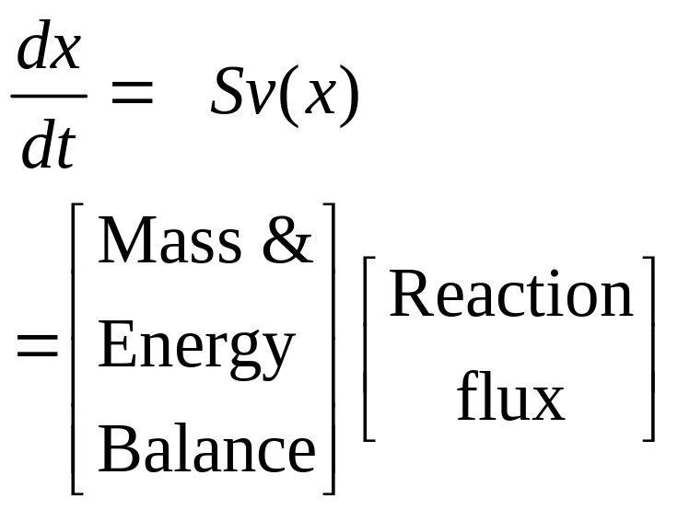
Gly
S
G1P
G6P
F6P
F1-6BP
Stoichiometry matrix
Gly3p
ATP
13BPG
3PG
TCA
Oxa
2PG
PEP
Pyr
ACA
NADH
Cit

Slide 108
Gly
G1P
G6P
F6P
F1-6BP
Gly3p
Regulation of enzyme levels by transcription/translation/degradation
13BPG
3PG
TCA
Oxa
2PG
PEP
Pyr
ACA
Cit
level

Slide 109
Gly
G1P
G6P
F6P
F1-6BP
Error/flow
Gly3p
Allosteric regulation of enzymes
ATP
13BPG
3PG
TCA
Oxa
2PG
PEP
Pyr
ACA
NADH
Cit

Slide 110
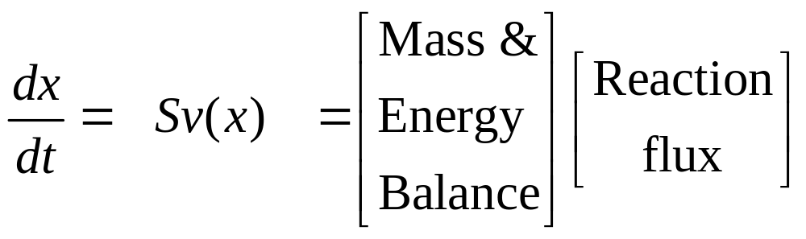
Gly
G1P
G6P
Reaction
F6P
F1-6BP
Error/flow
Gly3p
ATP
Level
13BPG
3PG
TCA
Oxa
2PG
PEP
Pyr
ACA
NADH
Cit

Slide 111
Gly
G1P
Reactions
G6P
Flow/error
F6P
F1-6BP
Protein level
Gly3p
ATP
13BPG
3PG
TCA
Oxa
2PG
PEP
Pyr
ACA
NADH
Cit

Slide 112
Gly
Fast response
G1P
Reactions
G6P
Flow/error
F6P
Layered architecture
F1-6BP
Protein level
Gly3p
ATP
Slow
13BPG
3PG
TCA
Oxa
2PG
PEP
Pyr
ACA
NADH
Cit

Slide 113
Reactions
Flow/error
Protein level
Reactions
Flow/error
RNA level
Reactions
Flow/error
DNA level

Slide 114
Reactions
Protein
Flow/error
Protein level
Translation
Reactions
RNA
Flow/error
RNA level
Transcription
Reactions
DNA
Flow/error
DNA level

Slide 115
Reactions
Flow/error
Protein level
Translation
Recursion
Flow/error
RNA level
Transcription
Flow/error
DNA level

Slide 116
Reactions
Flow/error
Protein level
Scope
RNA
React
React
React
Flow
Flow
Flow
DNA
DNA
DNA

Slide 117
Diverse Reactions
DNA
DNA
DNA
Diverse Genomes

Slide 118
Diverse Reactions
Flow/error
Protein level
Conserved core control
Reactions
Flow/error
Translation
RNA level
Reactions
Transcription
Flow/error
DNA
DNA
DNA
Diverse Genomes

Slide 119
Flow/error
Protein level
Translation
Reactions
Flow/error
RNA level
Transcription
Reactions
Flow/error

Slide 120
Reactions
Flow/error
Protein level
Gly
G1P
G6P
F6P
F1-6BP
Gly3p
ATP
13BPG
3PG
TCA
Oxa
2PG
PEP
Pyr
ACA
NADH
Cit

Slide 121
Reactions
Flow/error
Reactions
Protein level
Flow/error
Carriers
Proteins
Gly
Layering revisited
G1P
G6P
F6P
F1-6BP
Gly3p
ATP
More complete picture
13BPG
3PG
TCA
Oxa
2PG
PEP
Pyr
ACA
NADH
Cit

Slide 122
Catabolism
Sugars
Amino Acids
Precursors
Nucleotides
Fatty acids
Co-factors
Carriers
Flow/error
Protein level
RNA
DNA

Slide 123
Biosynthesis
Sugars
Amino Acids
Precursors
Nucleotides
Fatty acids
Co-factors
RNA
DNA

Slide 124
Sugars
Biosynthesis
Fatty acids
Precursors
Co-factors
Amino Acids
Nucleotides
RNA
Transc.
xRNA
RNA level/ Transcription rate
RNAp
Gene
DNA level

Slide 125
Precursors
Catabolism
AA
AA
Nucl.
RNA
Transc.
xRNA
RNAp
Gene

Slide 126
Precursors
Catabolism
AA
AA
transl.
Enzymes
Nucl.
tRNA
Ribosome
ncRNA
mRNA
RNA
Transc.
xRNA
RNAp
Gene

Slide 127
“Central dogma”
Protein
AA
transl.
Protein
RNA
Ribosome
Transc.
RNA
Transc.
mRNA
Flow
DNA
RNAp
Gene

Slide 128
Autocatalysis everywhere
Precursors
Catabolism
AA
AA
transl.
Proteins
Nucl.
tRNA
Ribosome
All the enzymes are made from (mostly) proteins and (some) RNA.
transc.
RNA
xRNA
RNAp

Slide 129
This is just charging and discharging
Rest of cell
G6P
consumption
= discharging
F6P
F1-6BP
Gly3p
ATP
13BPG
charging
3PG
2PG
PEP
Pyr

Slide 130

The carrier (AMP) must be synthesized
Catabolism
Sugars
Amino Acids
Nucleotides
Precursors
Fatty acids
Co-factors
Carriers

Slide 131
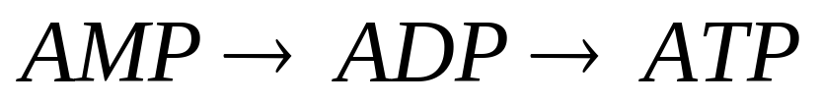
The carrier (AMP) must be synthesized
And then “charged” with energy (P added)
Precursors
Nucleotides
Before it can be used as an energy source in the cell
Carriers
Think of AMP as a battery, and ATP as the charged battery. There are two autocatalytic processes requiring the feedback of resources:
manufacturing the “battery,” and
then repeatedly charging/using the “battery”

Slide 132
The carrier (AMP) must be synthesized
Nucl.
Precursors
AMP level
Protein level
AA
trans.
Protein
Protein level/
Translation rate
AA
The amino acids must be synthesized
The protein must be made

Slide 133
We know what’s going on here, but it’s hard to draw the layers neatly.
The carrier (AMP) must be both synthesized, and then charged in a controlled way.
The protein must be both synthesized and then its form and activity controlled.
The carrier must be “charged” with energy (P added) in a controlled manner
Flow/error
AMP level
Protein level
Protein
Protein level/
Translation rate

Slide 134
Rest of cell
ATP supplies energy to all layers
G6P
F6P
F1-6BP
ATP
Gly3p
13BPG
3PG
2PG
PEP
Pyr
Flow/error
A*P
AMP level
Protein level
RNA
DNA

Slide 135
RNA
DNA
ATP
cell
Flow/error
A*P
AMP level
Protein level
Lots of ways to draw this.
RNA
DNA

Slide 136
Precursors
Catabolism
AA
AA
transl.
Enzymes
Nucl.
tRNA
Layered
transc.
RNA
xRNA

Slide 137
S
reactions
P
Reaction rate
Enz1
reaction3
Enz2
Enzyme form/activity
Enzyme level/
Translation rate
tRNA
AA
trans.
Enzymes
RNA form/activity
ncRNA
mRNA
RNA level/ Transcription rate
RNA
Transc.
xRNA
Gene
RNAp
Ribosome

Slide 138
reactions
products
reaction3
Control?
Proteins
trans.
ncRNA
Transc.
All products feedback everywhere

Slide 139
Recursive control structure
Reactions
Flow
Protein level
Application
Reactions
Error/flow control
Flow
Global
RNA level
Relay/MUX
E/F control
E/F control
Reactions
Local
Relay/MUX
Relay/MUX
Flow
DNA level
Physical

Slide 140
Fragility example: Viruses
Reactions
Viral
proteins
Flow
Protein level
Viruses exploit the universal bowtie/hourglass structure to hijack the cell machinery.
Reactions
Flow
RNA level
Reactions
Viral
genes
Flow
DNA level

Slide 141
Reactions
Reactions
Flow/error
Flow/error
Carriers
Proteins
Protein level
Gly
Layering revisited
G1P
G6P
F6P
F1-6BP
Gly3p
ATP
More complete picture ?
13BPG
3PG
TCA
Oxa
2PG
PEP
Pyr
ACA
NADH
Cit

Slide 142
Reactions
Flow/error
Carriers
Proteins
“Power supply”
Translation
Reactions
Flow/error
RNA level
This is a “database” of instructions
Transcription
Reactions
Flow/error
DNA level

Slide 143
Applications
my
computer
router
server
Operating
System
Reactions
application
Hardware
TCP
Flow/error
Instructions
IP
Logical
MAC
MAC
Carriers
Proteins
Circuit
Circuit
Circuit
Switch
Pt to Pt
Physical
Physical
Translation
Reactions
?
What are the additional layers?
Flow/error
?
RNA level
?
Where is the power supply?
Where are the designs and processes that produce the chips, PCs, routers, etc?
Transcription
Reactions
Flow/error
DNA level

Slide 144
fan-in
of diverse
inputs
universal carriers
fan-out
of diverse
outputs
Bowties: flows within layers
Diverse
function
Essential ideas
Universal
Control
Robust yet fragile
Constraints that deconstrain
Diverse
components

Slide 145
fan-in
of diverse
inputs
fan-out
of diverse
outputs
Diverse
function
Highly robust
Diverse
Evolvable
Deconstrained
Diverse
components
Robust yet fragile
Constraints that deconstrain

Slide 146
universal carriers
Highly fragile
Universal
Frozen
Constrained
Universal
Control
Robust yet fragile
Constraints that deconstrain

Slide 147
fan-in
of diverse
inputs
universal carriers
fan-out
of diverse
outputs
Bowties: flows within layers
Diverse
function
Essential ideas
Universal
Control
Robust yet fragile
Constraints that deconstrain
Diverse
components

Slide 148
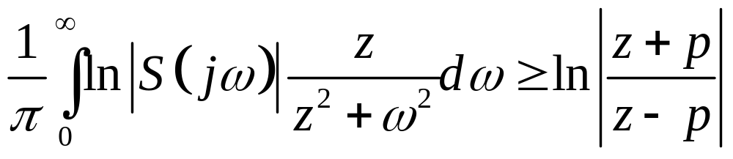
What theory is relevant to these more complex feedback systems?
signaling
gene expression
metabolism
lineage
source
receiver
control
More complex feedback
energy
materials

Slide 149
[a system] can have
[a property] robust for
[a set of perturbations]
Fragile
Yet be fragile for
[a different property]
Robust
Or [a different perturbation]
Robust yet fragile = fragile robustness

Slide 150
[a system] can have
[a property] robust for
[a set of perturbations]
Apply recursively
[a property]
[ property] = robust for
[one set of perturbations]
fragile for
[another property] or
[another set of perturbations]
[a perturbation]
Robust yet fragile = fragile robustness

Slide 151
[a system] can have
[a property] robust for
[a set of perturbations]
Fragile
Some fragilities are inevitable in robust complex systems.
Robust
But if robustness/fragility are conserved, what does it mean for a system to be robust or fragile?

Slide 152
Emergent
Fragile
Some fragilities are inevitable in robust complex systems.
Robust
But if robustness/fragility are conserved, what does it mean for a system to be robust or fragile?
Robust systems systematically manage this tradeoff.
Fragile systems waste robustness.

Slide 153
Gly
G1P
G6P
F6P
F1-6BP
Gly3p
ATP
13BPG
3PG
TCA
Oxa
2PG
PEP
Pyr
ACA
NADH
Cit

Slide 154
Gly
G1P
G6P
F6P
F6P
F1-6BP
F1-6BP
Gly3p
Gly3p
ATP
ATP
13BPG
13BPG
3PG
3PG
TCA
Oxa
2PG
PEP
Pyr
ACA
NADH
Cit

Slide 155
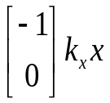
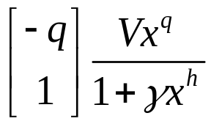
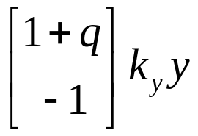
Autocatalytic
x
Control
y
F6P
F1-6BP
Gly3p
ATP
13BPG
3PG

Slide 156
Autocatalytic
x
Control
y
_{F6P}
F1-6BP
Gly3p
ATP
13BPG
_{3PG}

Slide 157
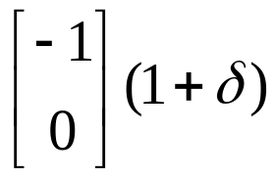
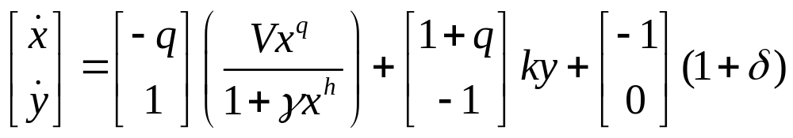
Autocatalytic
x
Control
y
Autocatalytic
Control

Slide 158
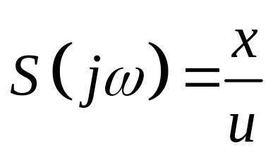
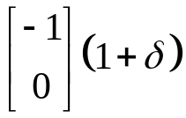

Control theory cartoon
output=x
Controller
+
input
x
y
Caution: mixed cartoon

Slide 159
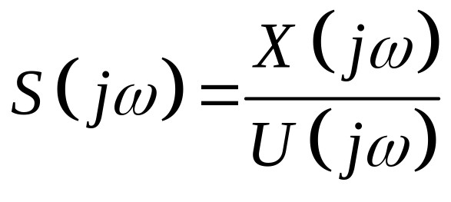
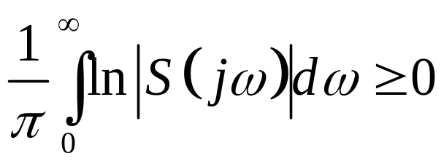
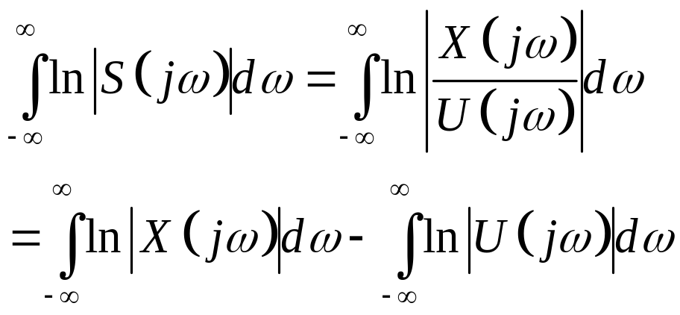
Hard limits
output=x
C
Plant
+
Entropy rates

Slide 160
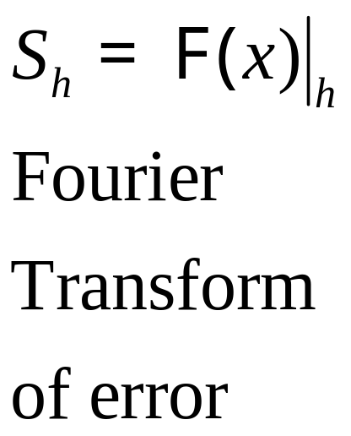
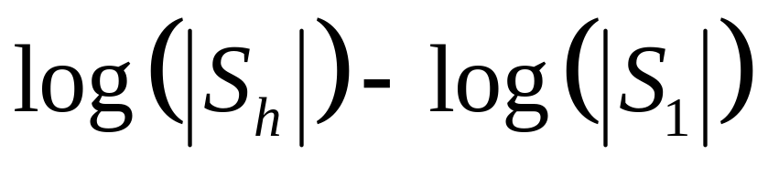
1.05
Ideal
[ATP]
1
h >>1
0.95
Time response
0.9
0.85
h = 1
0.8
0
5
10
15
20
Time (minutes)
0.8
0.6
h >>1
Spectrum
0.4
0.2
h = 1
Log(|Sn/S0|)
0
-0.2
-0.4
-0.6
-0.8
0
2
4
6
8
10
Frequency

Slide 161
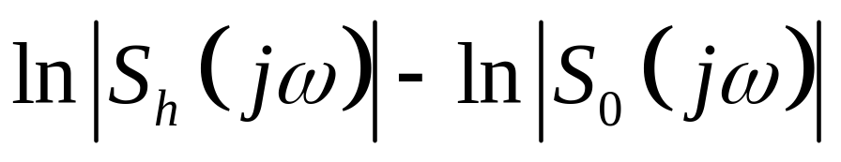
1.05
[ATP]
1
h >> 1
0.95
Time response
0.9
Yet fragile
0.85
h = 1
0.8
0
5
10
15
20
Time (minutes)
0.8
Robust
0.6
h >>1
Spectrum
0.4
0.2
h = 1
Log(Sn/S0)
0
-0.2
-0.4
-0.6
-0.8
0
2
4
6
8
10
Frequency

Slide 162
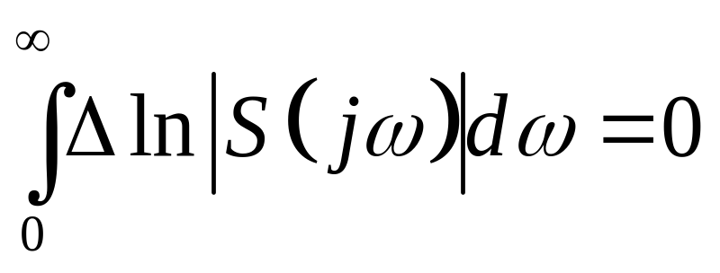
Yet fragile
0.8
Robust
0.6
h = 3
0.4
0.2
h = 0
Log(Sn/S0)
0
-0.2
-0.4
-0.6
-0.8
0
2
4
6
8
10
Frequency

Slide 163
[a system] can have
[a property] robust for
[a set of perturbations]
Fragile
Yet be fragile for
[a different property]
Robust
Or [a different perturbation]
Robust yet fragile = fragile robustness

Slide 164
Hard limits
output=x
C
Note: Nature doesn’t care much about entropy rates.
Plant
+
Entropy rates

Slide 165
1.05
[ATP]
1
h >> 1
0.95
Time response
0.9
Yet fragile
0.85
h = 1
0.8
0
5
10
15
20
Note: Nature cares more about this tradeoff.
Time (minutes)
0.8
Robust
0.6
h >>1
Spectrum
0.4
0.2
h = 1
Log(Sn/S0)
0
-0.2
-0.4
-0.6
-0.8
0
2
4
6
8
10
Frequency

Slide 166
output=x
C
Plant
+
The plant can make this tradeoff worse.

Slide 167
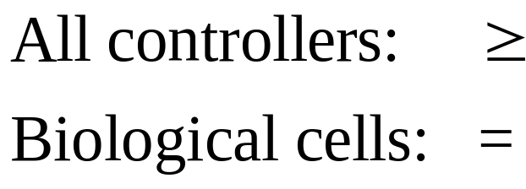
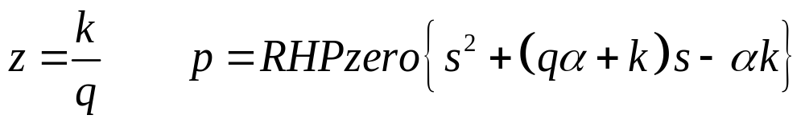
output=x
C
Plant
+

Slide 168
output=x
C
Plant
+
Small z is bad.

Slide 169
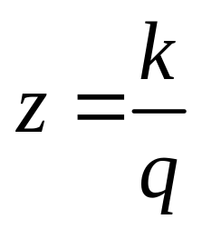
Small z is bad
(oscillations and crashes)
Small z =
small k and/or
large q
Efficiency =
small k and/or
large q
Correctly predicts conditions with “glycolytic oscillations”

Slide 170
Hard limits
output=x
C
Plant
+
Entropy rates

Slide 171

output=x
Plant
+
Controller

Slide 172
output=x
Plant
Channel
+
Controller
Sensor+
Channel

Slide 173
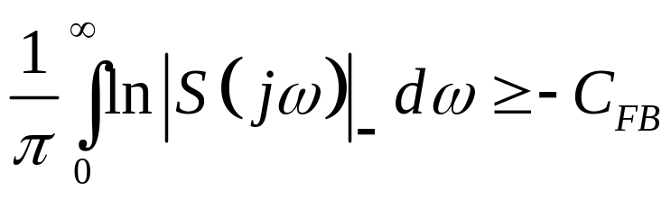

Hurts
output=x
Helps
Plant
+
Channel
Controller
Sensor+
Channel

Slide 174
 | Small | Large
Robust | Simple | Organized
Fragile | Chaocritical | Irreducible
Taxonomy covers standard usages
Unified picture
Can make the definitions more precise
Have “hand crafted” theorems in every major complexity class (but lack a unified theory)

Slide 175
Academic stovepipes
EE, CS, ME, MS, APh, ChE, Bio, Geo, Eco, …
Apps
Apps
Apps
Apps
Tools/
tech
Apps
Tools/
tech
Tools/
tech
Tools/
tech
Tools/
tech

Slide 176
Diverse applications
Apps
Apps
Apps
Apps
Apps
Funding twine
Tools/
tech
Tools/
tech
Tools/
tech
Tools/
tech
Tools/
tech
“Multidisciplinary cross-sterilization”

Slide 177
Diverse applications
Layering academia?
?????
Diverse resources
Apps
Apps
Apps
Apps
Tools/
tech
Tools/
tech
Apps
Tools/
tech
Tools/
tech
Tools/
tech

Slide 178
End
What follows are additional details on the glycolysis fragility example.

Slide 179
Autocatalytic
x
Control
y
Autocatalytic
Control

Slide 180



x
produced
y
consumed

Slide 181
x
rate
y

Slide 182
x
rate
y
level
More enzyme

Slide 183


Autocatalytic
x
Control
y
consumed
produced

Slide 184
Autocatalytic
x
Control
y
rate
form/activity

Slide 185
Autocatalytic
x
Layered control
Control
y
rate
form/activity
level

Slide 186
Autocatalytic
x
Layered control
Control
y
rate
Fast response
form/activity
level
Slow

Slide 187

x
consumed

Slide 188



stable
x
w
y

Slide 189
Autocatalytic
x
y

Slide 190
Autocatalytic
x
Control
y

Slide 191

Autocatalytic
x
Control
y

