Slide 1
Architectural Musings on SDN (“and now for something completely different…”)
David Meyer
CTO and Chief Scientist, Brocade
Director, Advanced Technology Center, University of Oregon
I2 Member Meeting 2013
dmm@{brocade.com,uoregon.edu,1-4-5.net,…}

Slide 2
Agenda
Architectural Features that Enable System Scalability and Evolvability
A Quick Tour Through the SDN Design Space
Panel

Slide 3
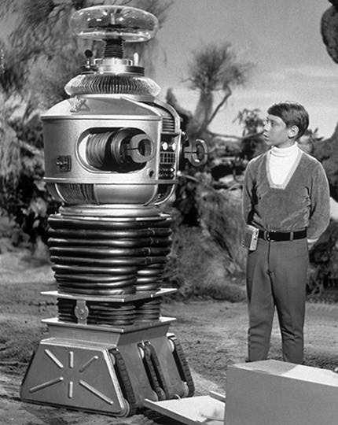
Danger Will Robinson!!!
This talk is intended to be controversial/provocative
(and maybe a bit “sciencey”)

Slide 4
What are Scalability and Evolvability?
Scalability is robustness to changes to the size and complexity of a system as a whole
Evolvability is robustness of lineages to changes on long time scales
Other system features cast as robustness
Reliability is robustness to component failures
Efficiency is robustness to resource scarcity
Modularity is robustness to component rearrangements

Slide 5
OK, Fine. But What is Robustness?
Definition: A [property] of a [system] is robust if it is [invariant] with respect to a [set of perturbations], up to some limit
Fragility is the opposite of robustness
If you're fragile you depend on 2nd order effects (acceleration) and the curve is concave
Catch me later if you’d like to chat further about this…
A system can have a property that is robust to one set of perturbations and yet fragile for a different property and/or perturbation → the system is Robust Yet Fragile (RYF-complex) [0]
Or the system may collapse if it experiences perturbations above a certain threshold (K-fragile)
Example: A possible RYF tradeoff is that a system with high efficiency (i.e., using minimal system resources) might be unreliable (i.e., fragile to component failure) or hard to evolve
[0] http://www.istar.upenn.edu/osw/white paper/John Doyle White Paper.pdf

Slide 6
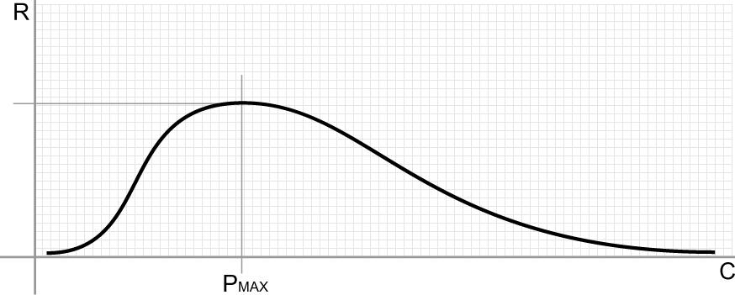
Robustness vs. Complexity Systems View
Domain of the Robust
Domain of the fragile
What this curve is telling us iis that a system needs complexity to achieve robustness
(wrt some feature to some perturbation), but like everything else, too much of
of a good thing….

Slide 7
Ok, but what is Complexity?
“In our view, however, complexity is most succinctly discussed in terms of functionality and its robustness. Specifically, we argue that complexity in highly organized systems arises primarily from design strategies intended to create robustness to uncertainty in their environments and component parts.” [AldersonDoyle2010]

Slide 8
BTW, This Might Be Obvious But…
Networks are incredibly general and expressive structures
Networks are extremely common in nature
Immune systems, energy metabolism, transportation systems, Internet, macro economies, forest ecology, the main sequence (stellar evolution), galactic structures, ….
So it comes as no surprise that we study, for example, biological systems in our attempts to get a deeper understanding of complexity and the architectures that provide for scalability, evolvability, and the like
Ok, this is cool, but what are the key architectural takeaways from this work for us ?
where us \in {ops, engineering, architects …}

Slide 9
Key Architectural Takeaways
What we have learned is that there are fundamental architectural building blocks found in systems that scale and are evolvable. These include
Bowtie architectures
RYF complexity
Massively distributed, robust control loops
Contrast optimal control loops and hop-by-hop control
Highly layered
But with layer violations
Protocol Based Architectures (PBAs)
Degeneracy

Slide 10
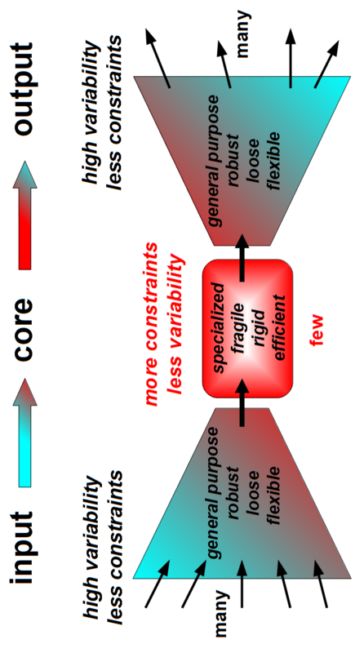
Bowties 101 Constraints that Deconstrain
For example, the reactions and metabolites of core
metabolism, e.g., ATP metabolism, Krebs/Citric Acid
cycle signaling networks, …
See, e.g., Doyle, et. al., “Architecture, Constraints, and Behavior”, http://www.pnas.org/content/108/suppl.3/15624.full

Slide 11
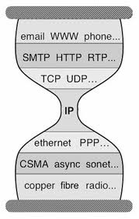
But Wait a Second Anything Look Familiar?
Bowtie Architecture
Hourglass Architecture

Slide 12
The SDN Design Space
Service Layers
Apps
Apps
May be repeated
(stacked or recursive)
…
Control and Orchestration
(overly simplified view)
DP/SDN
Properties:
-- Complete Separation of CP and DP
-- (“Logically”) Centralized Control
-- Open Interface/programmable Data Plane
-- Examples: OF, ForCES, various control platforms
CP/SDN
Properties:
-- Retains existing (distributed) Control Planes
-- Programmable control plane
-- Network aware applications
Explicitly *not* e.g., learning switch
-- Examples: PCE, I2RS, vendor SDKs
OL/SDN
Properties:
-- Retains existing (simplified) Control Planes
-- Programmable overlay control plane
-- May use OF to program vSwitches
-- Examples: Various Overlay technologies
Physical and Virtual Resources
(CSN)
Notes:
OF/SDN is a polar architectural design point; complete separation of control and data planes
CP/SDN is adds programmability in an incremental way to conventional control planes; some targeted separation (e.g., PCE)/centralization
OL/SDN (Overlay/SDN) retains the control plane architecture of CP/SDN but adds a new, logically centralized control plane (“over” CP/SDN)

Slide 13
Putting it all Together
Open Loop Control + s/w + Moore’s Law → Randomness, Uncertainty, and Volatility
OL/SDN
CP/SDN
OF/SDN
OF/SDN proposes a new architectural waist (not exactly sure where)
CP/SDN makes existing control planes programmable
OL/SDN is an application from the perspective of the Internet’s waist

Slide 14
Finally…What I Hope To Achieve
I hope to convince you that uncertainty and
volatility are the “coin of the realm” of the
future, why this is the case, how SDN (and
the rise of software in general) is accelerating
this effect, and finally, what we might do
to take advantage of it.¹
1 s/take advantage of/survive/ -- @smd

Slide 15
Q&A
Thanks!

