Slide 1
OpenDaylight Hydrogen Release
Sept 2, 2013

Slide 2

Where is this talk going?
What is SDN?
What is OpenDaylight?
Who is OpenDaylight?
Hydrogen Simultaneous Release Plan
Projects in Hydrogen
Proposed Release Vehicles

Slide 3
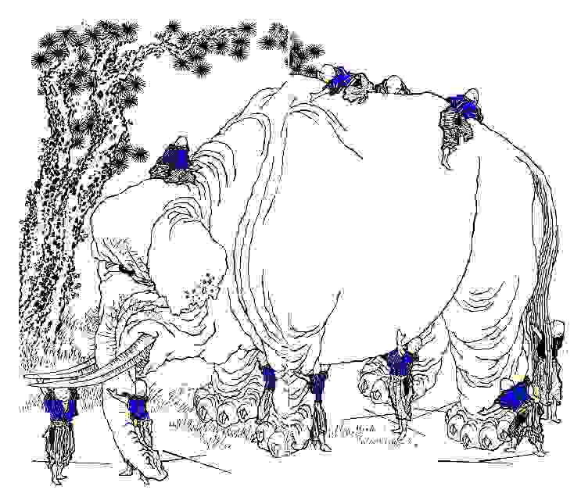
What is SDN?
SDN

Slide 4
What is SDN?
SDN: Software Defined Networking
Many things to many people…
  Network virtualization in the cloud
  Dynamic service chains for subscribers in SP
  Dynamic traffic engineering
  Dynamic network configuration
  Network Function Virtualization
  Many other use cases
Networking is a mind-blowingly diverse domain

Slide 5
What is SDN?
… but some commonalities
  Bringing Programmability to the Network
  Radically increase flexibility
  Move from configuration time to software time
Lots of different good ideas on how to do it
Everybody is still figuring it out – evolvability is key
  There are lots of ways to skin the cat
  Right tool for the job
Need a general evolvable platform that recognizes the diversity of needs and approaches

Slide 6
What is OpenDaylight?
OpenDaylight is community that is building:
  An evolvable SDN platform capable of handling diverse use cases and approaches
  Common abstractions of capabilities NorthBound people can program to
  Intermediation of those capabilities to multiple Southbound implementations
  Programmable Network services
  Network Applications
  Whatever the hell else we need to make it all work ☺

Slide 7
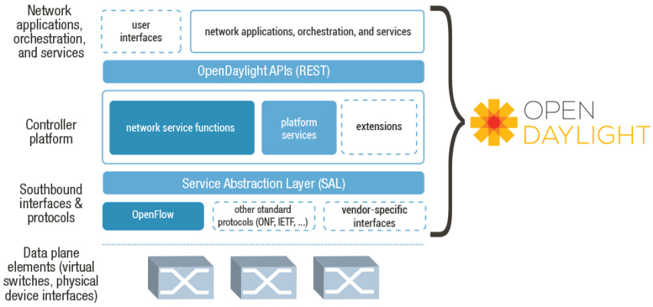
Project Framework

Slide 8
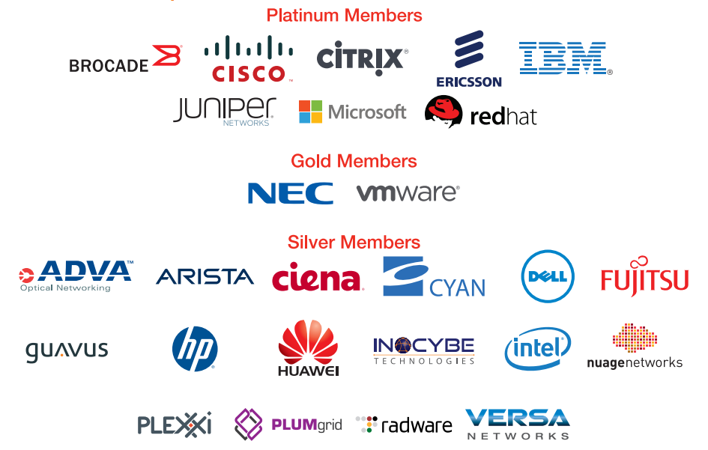
Who is OpenDaylight?
(the corporate view)

Slide 9
Who is OpenDaylight?
(really)
Like any Open Source Project, OpenDaylight primarily consists of those who show up to do the work.
  Currently commits from over 70 contributors from many different organizations (and unaffiliated individuals) and growing
    Running around 100 commits per week and accelerating
  Strong integration and testing community

Slide 10
What is OpenDaylight Delivering
OpenDaylight is multi-project
  12 currently
  Expect 2 more next week
But we still want to deliver a coherent ‘thing’
So to flock together, we are delivering a Simultaneous Release
CodeName: Hydrogen
Due Date: Dec 9, 2013

Slide 11
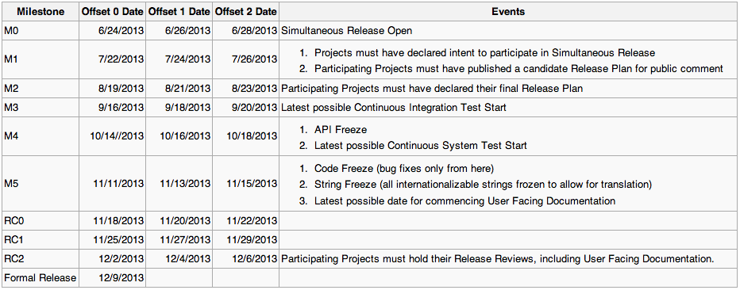

Simultaneous Release Plan

Slide 12

Projects in the Simultaneous Release
Controller
VTN
OpenDove
Affinity Management Service
LISP Mapping Service
Yang Tools
Defense4All
BGP-LS/PCEP
OpenFlow Protocol
OpenFlow SB Plugin
OVSDB
SNMP4SDN

Slide 13
Controller
Contributed by Cisco
Includes:
  Base OSGI Framework
  HA,Clustering
  Service Abstraction Layer (SAL)
  OF 1.0 SB Plugin
  ND API
  Hosttracker
Includes(cont) :
  Stats Manager
  GUI
  Topology Manager
  and more…
Controller Release Plan

Slide 14
Controller

Slide 15
VTN
Contributed by NEC
Existing NEC Virtual Tenant Network Technology
Virtualizes network for multiple tenants
  vBridge, vRouter
VTN Release Plan

Slide 16
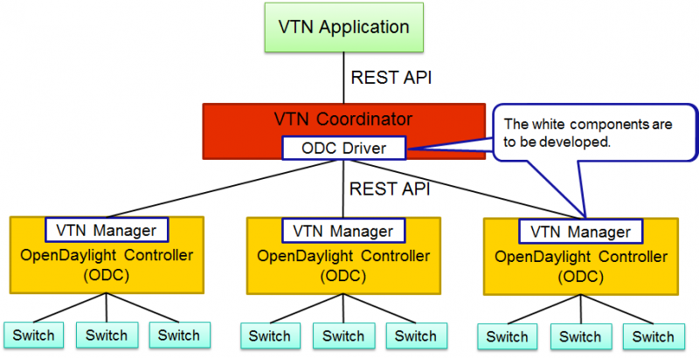
VTN

Slide 17
OpenDOVE
Contributed by IBM
Virtualizes Network using VXLAN
Uses custom control plane instead of multicast
OpenDove Release Plan

Slide 18
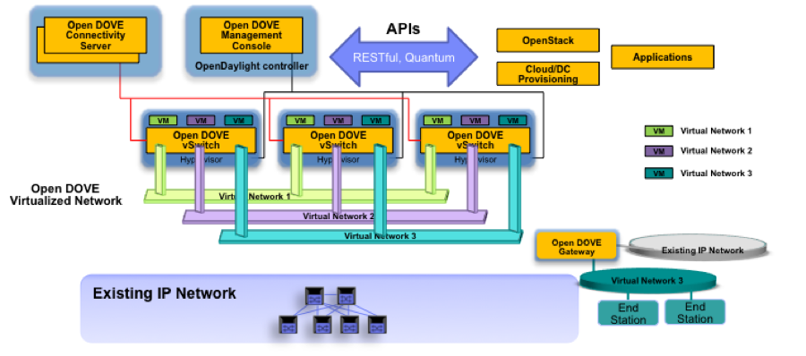
OpenDove

Slide 19
Affinity Management Service
Examples:
  Hop Count Sensitive
  Isolate
  Encrypt
  Class of Service
Contributed by Plexxi
Service for storing Affinity Information
Affinity Information allows association of metadata about workload
Affinity Release Plan

Slide 20
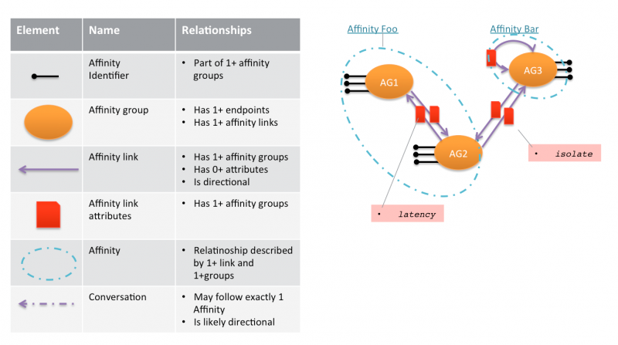
Affinity Management Service

Slide 21
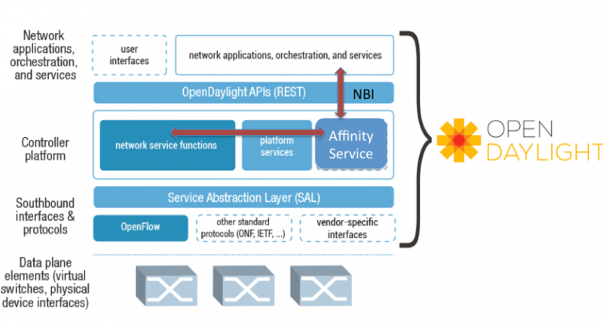
Affinity Management Service

Slide 22
LISP Mapping Service
Contributed by Contextream with Cisco
Programmable LISP Mapping Service
May include functions to:
  Associate users to flows
  Chain service flows
LISP Release Plan

Slide 23
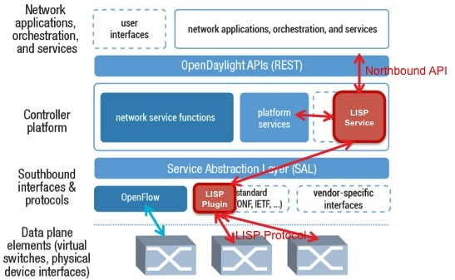
LISP Mapping Service

Slide 24
Yang Tools
Contributed by Cisco
Provides tooling to build Java bindings in yang from yang models
Supporting tooling for Model Driven SAL
Yang Tools Release Plan

Slide 25
Defense4All
Contributed by Radware
Provides DDOS detection and mitgation
Designed to allow plugging in additional detection and mitigation strategies
Defense4All Release Plan

Slide 26
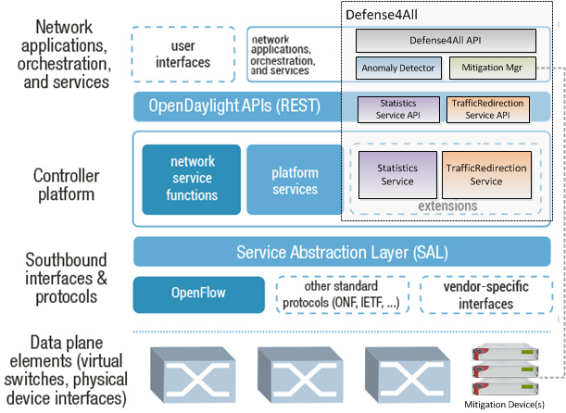
Defense4All

Slide 27
BGP-LS/PCEP
Contributed by Cisco
Provides support for discovering topology via BGP-LS
Provides support for path programming via PCEP
BGP-LS/PCEP Release Plan

Slide 28
OpenFlow Protocol Library
Contributed by Pantheon
Provides OpenFlow Protocol Stack for OF 1.0, 1.3+
  Supports extensibility from 3rd party bundles
    Vendor actions
    Vendor Matches
OpenFlow Proto Lib Release Plan

Slide 29
OpenFlow SouthBound Plugin
Joint project between IBM/Ericsson/Cisco
Provides OF 1.0, 1.3+ Southbound plugin for Controller
  Based on OF Protocol Library project
OpenFlow Plugin Release Plan

Slide 30
OVSDB
Contributed by Individuals at University of Kentucky
Allows Controller to configure OVS using OVSDB
OVSDB Release Plan

Slide 31
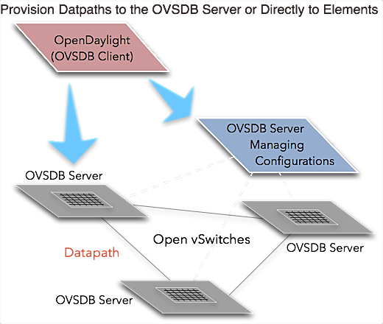
OVSDB

Slide 32
SNMP4SDN
Contributed by ITRI
Allows Controller to carry out some configuration tasks via SNMP
SNMP4SDN Release Plan

Slide 33
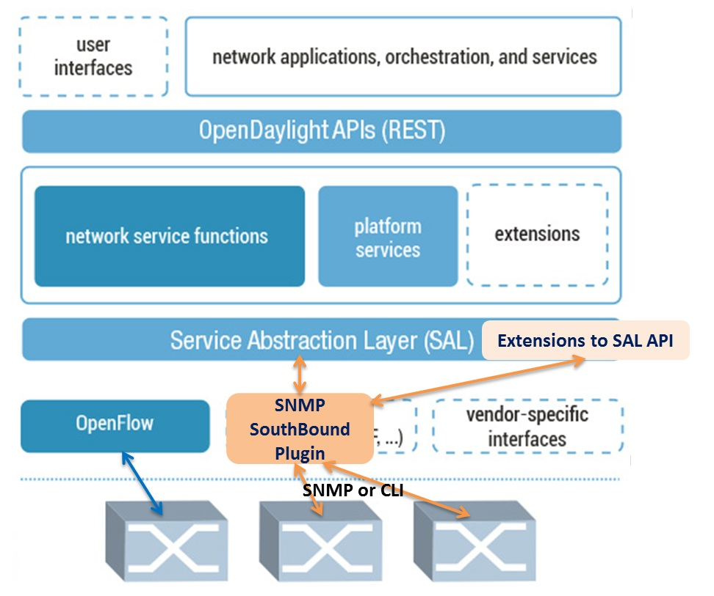
SNMP4SDN

Slide 34

OpenStack Integration
OpenDaylight exposes a single common OpenStack Service Northbound
  API exposed matches Neutron API precisely
  Different implementations plug in under it, in ODL, as provides
OpenDaylight OpenStack Neutron Plugin simply passes through
Improves evovability
OpenDaylight OpenStack
Neutron Plugin
OpenDaylight APIs (REST)
OpenStack Service
VTN Provider
DOVE Provider
Other Provider

Slide 35

Hydrogen Release
Management
GUI/CLI
VTN Coordinator
DDoS Protection
OpenStack
Neutron
Network Applications Orchestration & Services
OpenDaylight APIs (REST)
Base Network Service Functions
Affinity Service
OpenStack Service
Topology Mgr
Stats Mgr
Switch Mgr
Host Tracker
Shortest Path Forwarding
Network
Config
Controller Platform
LISP Service
VTN Manager
DOVE Mgr
Service Abstraction Layer (SAL)
(plug-in mgr., capability abstractions, flow programming, inventory, …)
OpenFlow
NETCONF
OVSDB
SNMP
BGP-LS
PCEP
LISP
Southbound Interfaces
& Protocol Plugins
1.0
1.3
OpenFlow Enabled Devices
Open vSwitches
Additional Virtual & Physical Devices
Data Plane Elements
(Virtual Switches,
Physical Device Interfaces)
VTN: Virtual Tenant Network
DOVE: Distributed Overlay Virtual Ethernet
DDoS: Distributed Denial Of Service
LISP: Locator/Identifier Separation Protocol
OVSDB: Open vSwitch DataBase Protocol
BGP: Border Gateway Protocol
PCEP: Path Computation Element Communication Protocol
SNMP: Simple Network Management Protocol

Slide 36
Proposed Hydrogen Release Vehicles
Release Vehicles and their contents are still being finalized
Current proposal:
  Base Edition
  Virtualization Edition
  Service Provider Edition

Slide 37
Base Edition
Management
GUI/CLI
Network Applications Orchestration & Services
OpenDaylight APIs (REST)
Base Network Service Functions
Topology Mgr
Stats Mgr
Switch Mgr
Host Tracker
Shortest Path Forwarding
Network
Config
Controller Platform
Service Abstraction Layer (SAL)
(plug-in mgr., capability abstractions, flow programming, inventory, …)
OpenFlow
NETCONF
Southbound Interfaces
& Protocol Plugins
1.0
1.3
OpenFlow Enabled Devices
Open vSwitches
Additional Virtual & Physical Devices
Data Plane Elements
(Virtual Switches,
Physical Device Interfaces)
VTN: Virtual Tenant Network
DOVE: Distributed Overlay Virtual Ethernet
DDoS: Distributed Denial Of Service
LISP: Locator/Identifier Separation Protocol
OVSDB: Open vSwitch DataBase Protocol
BGP: Border Gateway Protocol
PCEP: Path Computation Element Communication Protocol
SNMP: Simple Network Management Protocol

Slide 38








Virtualization Edition
Management
GUI/CLI
VTN Coordinator
DDoS Protection
OpenStack
Neutron
Network Applications Orchestration & Services
OpenDaylight APIs (REST)
Base Network Service Functions
Affinity Service
OpenStack Service
Topology Mgr
Stats Mgr
Switch Mgr
Host Tracker
Shortest Path Forwarding
Network
Config
Controller Platform
VTN Manager
DOVE Mgr
Service Abstraction Layer (SAL)
(plug-in mgr., capability abstractions, flow programming, inventory, …)
OpenFlow
NETCONF
OVSDB
Southbound Interfaces
& Protocol Plugins
1.0
1.3
OpenFlow Enabled Devices
Open vSwitches
Additional Virtual & Physical Devices
Data Plane Elements
(Virtual Switches,
Physical Device Interfaces)
VTN: Virtual Tenant Network
DOVE: Distributed Overlay Virtual Ethernet
DDoS: Distributed Denial Of Service
LISP: Locator/Identifier Separation Protocol
OVSDB: Open vSwitch DataBase Protocol
BGP: Border Gateway Protocol
PCEP: Path Computation Element Communication Protocol
SNMP: Simple Network Management Protocol

Slide 39






Service Provider Edition
Management
GUI/CLI
DDoS Protection
Network Applications Orchestration & Services
OpenDaylight APIs (REST)
Base Network Service Functions
Affinity Service
LISP Service
Topology Mgr
Stats Mgr
Switch Mgr
Host Tracker
Shortest Path Forwarding
Network
Config
Controller Platform
Service Abstraction Layer (SAL)
(plug-in mgr., capability abstractions, flow programming, inventory, …)
OpenFlow
NETCONF
SNMP
BGP-LS
PCEP
LISP
Southbound Interfaces
& Protocol Plugins
1.0
1.3
OpenFlow Enabled Devices
Open vSwitches
Additional Virtual & Physical Devices
Data Plane Elements
(Virtual Switches,
Physical Device Interfaces)
VTN: Virtual Tenant Network
DOVE: Distributed Overlay Virtual Ethernet
DDoS: Distributed Denial Of Service
LISP: Locator/Identifier Separation Protocol
OVSDB: Open vSwitch DataBase Protocol
BGP: Border Gateway Protocol
PCEP: Path Computation Element Communication Protocol
SNMP: Simple Network Management Protocol

Slide 40
Call to Action
OpenDaylight is open to everyone, not just corporate members
Join the mailing lists
Join the IRC channel
Bring patches
Bring project proposals
Kick the tires

Slide 41



Resources
More information and to join:
  wiki.opendaylight.org
Keep informed and join the conversation
  IRC: #opendaylight on Freenode
  Open mailing lists: lists.opendaylight.org
  @openDaylightSDN
  #OpenDaylight

