Slide 1
Networking, SDN, and OpenFlow: An Architectural Perspective
David Meyer
CTO and Chief Scientist, Brocade
Director, Advanced Technology Center, University of Oregon
March 2013
dmm@{brocade.com,uoregon.edu,1-4-5.net,…}

Slide 2
Agenda
A Brief History of the (OF/SDN) Universe
What is Today’s OpenFlow?
What is the OpenFlow/SDN Architecture?
Thinking Architecture: Thin waists and hourglasses
Tomorrow’s OpenFlow/SDN Architecture?
Summary

Slide 3
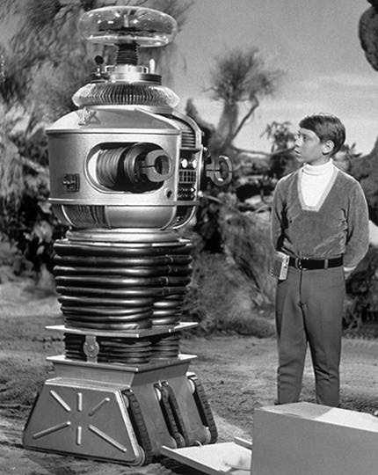
Danger Will Robinson!!!
This talk is intended to be controversial/provocative
(and maybe a bit “sciencey”)

Slide 4
A Brief History of the OF/SDN Universe
Problem statement: Network architects, engineers and operators are being presented with the following challenge:
Provide state of the art network infrastructure and services while minimizing TCO
SDN Hypothesis: It is the lack of ability to innovate in the underlying network coupled with the lack of proper network abstractions results in the inability to keep pace with user requirements and to keep TCO under control.
Requirements stated informally, out of band, statically, …
Better done by machine
Obviously we need programmatic automation of config, monitoring, management, …
For the most part true, but do we need to change the architecture to solve this?
Hold that question…
So given this hypothesis, what was the problem?

Slide 5
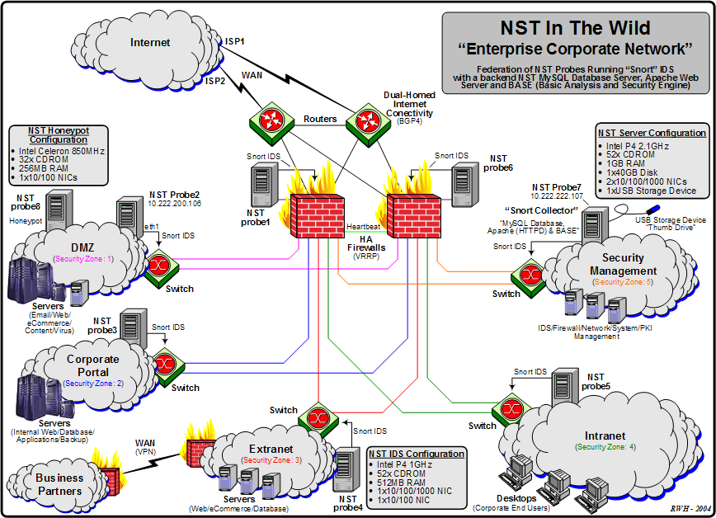
Maybe this is the problem?
Notes:
(i). Every device is different; no common way of thinking about the data plane
(ii). Myopic view (box view vs network view)
(iii). Configuration and policy deeply intertwined → network is database of record and the like

Slide 6
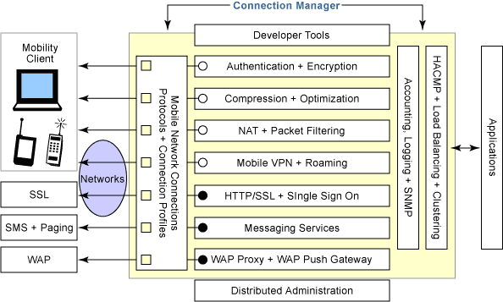
Or This?
Many protocols, many touch points, few open interfaces or abstractions,..
Network is Fragile, but is that the problem? BTW, what is fragility/robustness?

Slide 7
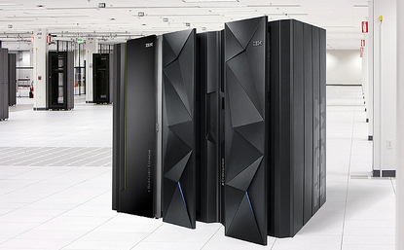
History: How Did We Get Here?
Basically, everything networking was too vertically integrated, tightly coupled, non-standard.
Goes without saying that this made the job of the network researcher almost impossible
(before the era of overlays).
Question: Does the OF/SDN architecture map to the break down of vertical integration in
the compute world?

Slide 8
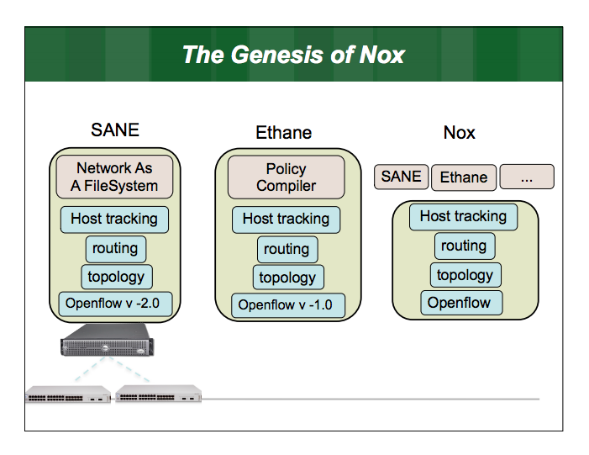
(in)SANE
Slide courtesy Martin Cassado

Slide 9
OpenFlow Switch, v 1.0 (Gates 104 Crew)
“Flowmods at run-time”
Flow Table
Rule
Action
Stats
Packet + byte counters
Forward packet to port(s)
Encapsulate and forward to controller
Drop packet
Send to normal processing pipeline
Switch
Port
MAC
src
MAC
dst
Eth
type
VLAN
ID
IP
Src
IP
Dst
IP
Prot
TCP
sport
TCP
dport
+ mask
So question: Is this (architecturally) the same thing as the break-down of vertical
integration in the compute world?

Slide 10























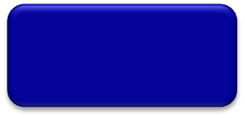
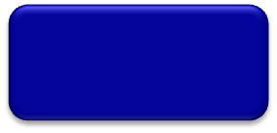
Trend (?)
App
App
App
App
App
App
Controller 1
Controller
2
Windows
(OS)
Linux
Mac
OS
Controller 1
Controller
2
Windows
(OS)
Linux
Mac
OS
NOX
(Network OS)
Network OS
Windows
(OS)
Linux
Mac
OS
Virtualization layer
Virtualization or “Slicing”
x86
(Computer)
OpenFlow
Computer Industry
Network Industry
Simple common stable hardware substrate below+ programmability + strong isolation model + competition above = Result : faster innovation
Slide Courtesy Rob Sherwood
Notes:
10

Slide 11
Well…OF/SDN Architecture
App
App
“NB API”
App
App
App
OpenFlow Controller
Control plane
Data plane
OpenFlow Protocol
Simple Packet Forwarding Hardware
Simple Packet Forwarding Hardware
Simple Packet Forwarding Hardware
Simple Packet Forwarding Hardware
Simple Packet Forwarding Hardware
Separation of Control and Data Planes
Open Interface to Data Plane
(logically) Centralized Control (?)
Graphic courtesy Nick Mckeown
11
Notes:
Switches, routers and other middleboxes are dumbed down
The key is to have a standardized control interface that speaks directly to hardware

Slide 12
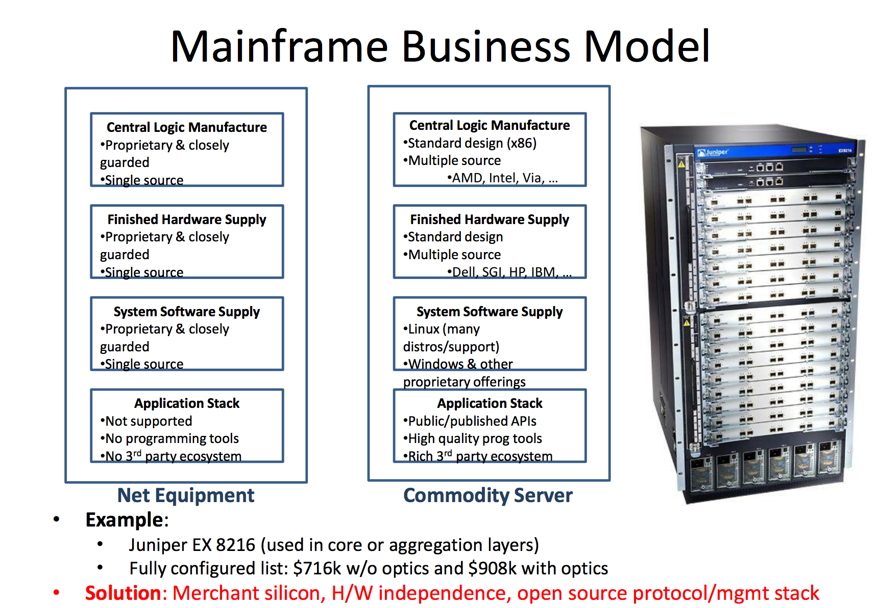
So Same as What Happened in Compute?
Doesn’t Look Like It
Graphic courtesy James Hamilton,
http://mvdirona.com/jrh/TalksAndPapers/JamesHamilton_POA20101026_External.pdf

Slide 13
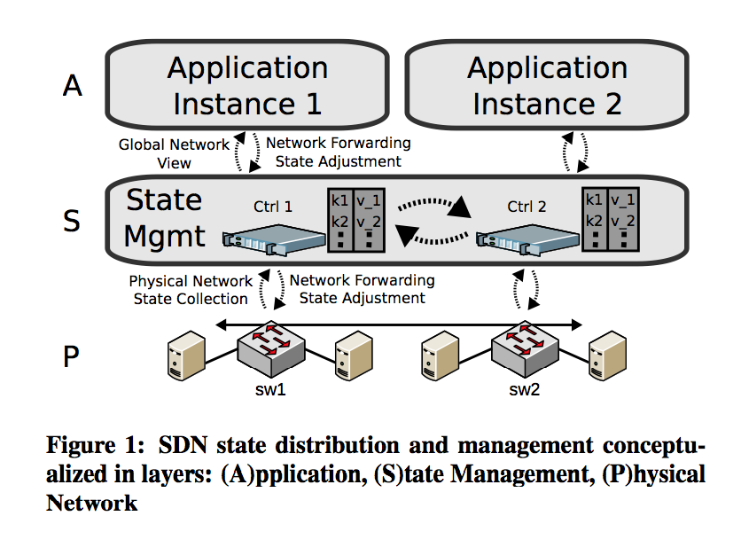
BTW, Logically Centralized? (hint: logically centralized means distributed)
Key Observation: Logically centralized → distributed system → tradeoffs between
control plane convergence and state consistency model. Note that this is beyond
the responsiveness lower bound: Ω(RTT(switch, controller)+ppt(switch)+ppt(controller))
Graphic courtesy Levin, D., et. al., “Logically Centralized? State Distribution Trade-offs in Software Deﬁned Networks?”,
HotSDN 2012, http://conferences.sigcomm.org/sigcomm/2012/paper/hotsdn/p1.pdf

Slide 14
BTW, Nothing New Under The Sun…
Separation of control and data planes is not a new idea. Examples include:
SS7
Ipsilon Flow Switching
Centralized flow based control, ATM link layer
GSMP (RFC 3292)
AT&T SDN
Centralized control and provisioning of SDH/TDM networks
A similar thing happened in TDM voice to VOIP transition
Softswitch → Controller
Media gateway → Switch
H.248 → Device interface
Note 2nd order effect: This was really about circuit2packet
ForCES
Separation of control and data planes
RFC 3746 (and many others)
…

Slide 15
So Reality: What Is OpenFlow?
A Switch Model
Match-Action Tables (MAT)
How many, How they are connected, table attributes, etc
Per-flow counters
An Application Layer Protocol
Binary wire protocol, messages and state machine that allow programming of the MAT
A Transport Protocol
TLS, TCP, ..
OF says nothing about how a given forwarding target implements the switch model
→ OF is an Abstract Switch Model
As we’ll see later, I argue that OF is built on the wrong set of abstractions

Slide 16
Thinking Architecture/Complexity (Bowties and RYF-Complexity)
Notes:
(i). Every device is different; no common way of thinking about the data plane
(ii). Myopic view (box view vs network view)
(iii). Configuration and policy deeply intertwined → network is database of record and the like

Slide 17
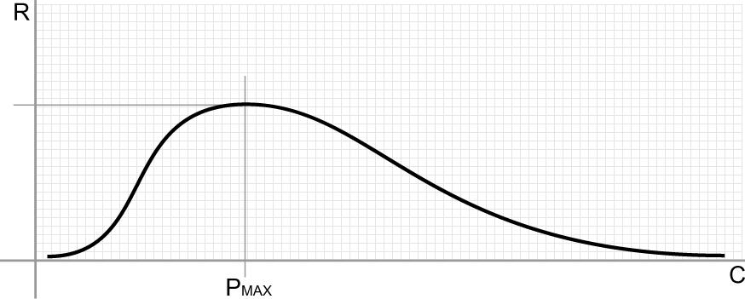
Robustness vs. Complexity Systems View
Domain of the Robust
Domain of the fragile
Increasing number of policies, protocols, configurations and interactions
Can we characterize the Robust and the Fragile?

Slide 18
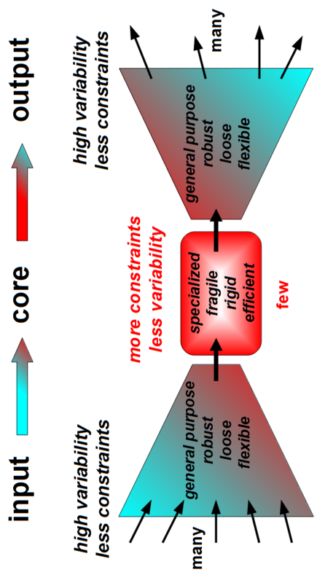
Thin Waists 101: The Bowtie Architecture Ideas from Systems Biology Constraints that Deconstrain
For example, the reactions and metabolites of core
metabolism, e.g., ATP metabolism, Krebs/Citric Acid
cycle signaling networks, …
See, e.g., Doyle, et. al., “Architecture, Constraints, and Behavior”, http://www.pnas.org/content/108/suppl.3/15624.full

Slide 19
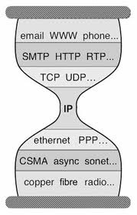
But Wait a Second Anything Look Familiar?
Bowtie Architecture
Hourglass Architecture

Slide 20
So Where Does OF/SDN Fit?
Maybe here?

Slide 21
Robustness and Fragility
Definition: A [property] of a [system] is robust if it is [invariant] with respect to a [set of perturbations], up to some limit
Fragility is the opposite of robustness
If you're fragile you depend on 2nd order effects (acceleration)
A bit more on this in a sec…
A system can have a property that is robust to one set of perturbations and yet fragile for a different property and/or perturbation → the system is Robust Yet Fragile (RYF-complex) [0]
Or the system may collapse if it experiences perturbations above a certain threshold (K-fragile)
Example: A possible RYF tradeoff is that a system with high efficiency (i.e., using minimal system resources) might be unreliable (i.e., fragile to component failure) or hard to evolve
[0] http://www.istar.upenn.edu/osw/white paper/John Doyle White Paper.pdf

Slide 22
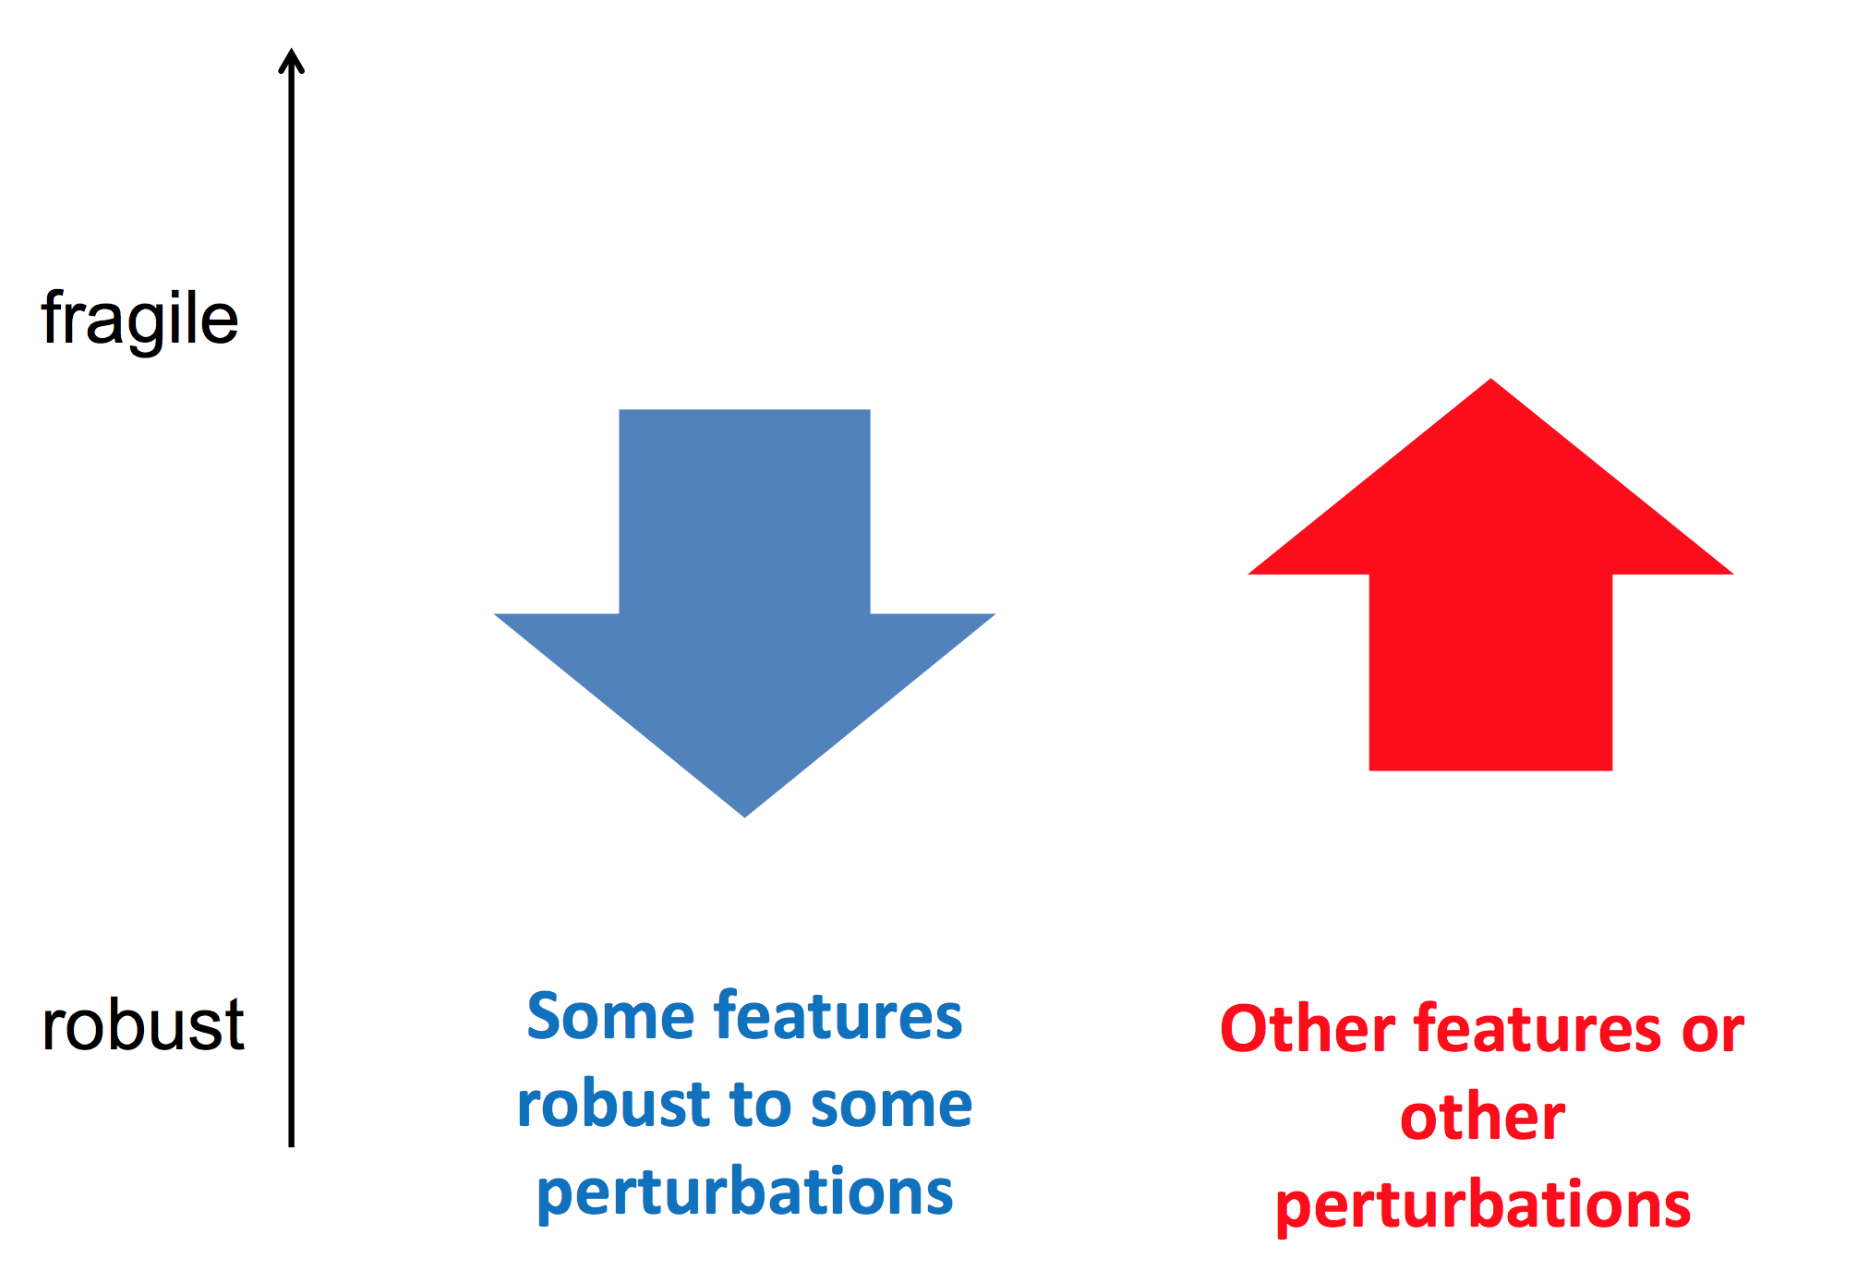
RYF?

Slide 23
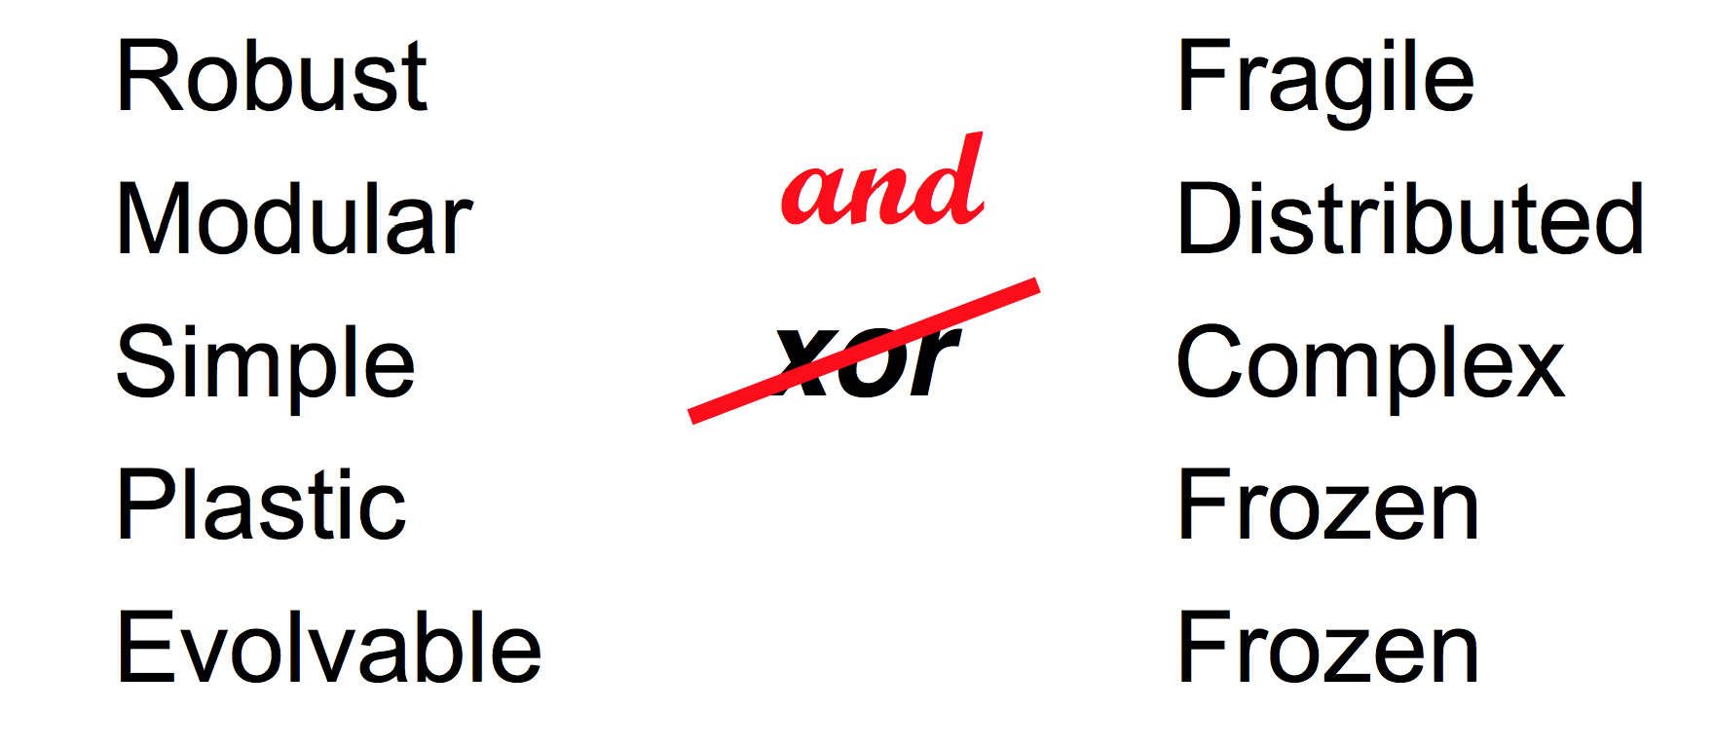
RYF Tradeoffs

Slide 24
Key Architectural Takeaways
The fundamental architectural building blocks of systems that scale and are evolvable include
Bowties/hourglasses architectures with RYF complexity
Massively distributed with robust control loops
Highly layered
Protocol Based Architecture (PBA)
Degeneracy
OF/SDN?
Centralized (at least “logically”)
Delayered
“Protocol Agnostic”
Non-degenerate
In fact, consider NfV in this context…

Slide 25
Review: OF Version 1.0
Redirect to Controller
Encapsulate packet to controller
Flow Table
(TCAM)
Apply actions
Packet
Forward with
edits
Too simple:
Feature/functionality
Expressiveness/Lossy Abstractions
Drop

Slide 26
OK, Fast Forward to Today: OF 1.1+
Why this design?
Combinatoric explosion(s) s/a routes*policies in single table
However, intractable complexity: O(n!) paths
c ≈ a^{(2^l)} + α
where a = number of actions in a given table, l = width of match field, and
α all the factors I didn’t consider (e.g., table size, meta-data, group tables)
Too complex/brittle
Algorithmic complexity
What is a flow?
Not naturally implementable on ASIC h/w
Breaks new reasoning systems
No fixes for lossy abstractions (next slide)
Architectural questions
So question: Is the flow-based
abstraction “right” for general
network programmability?

Slide 27
Lossy OF Abstractions
Problem: Current versions of OF do not work well on ASIC forwarding targets
Why? Basically, the simple abstraction of setting forwarding table entries looses too much information about the application developer's intent, making it difficult (or impossible) to leverage switch features to deliver scalable and efficient end-to-end implementations
Issues with the 1.X Abstractions
Information Loss
Controller to switch
Information Leakage
Switch to controller
Weak Control Plane to Data Plane Abstraction
Combinatorial State Explosion
Data Plane Driven Control Events
Weak Indirection Infrastructure
Time Sensitive Periodic Messaging
Multiple Control Engines
Weak Extensibility
Missing Primitives
OF 1.X abstractions are “lossy” and as such can’t take advantage of ASIC features
As a result a controller must include platform specific code → brittle implementations
Specifies too much of “how” the switch should operate (as opposed to “what” it should be doing)

Slide 28
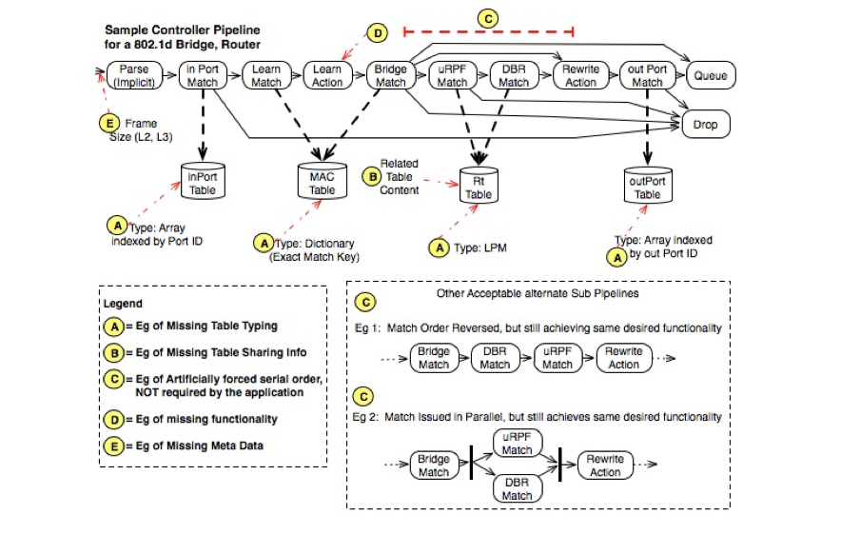
Lossy OF Abstractions
Graphic courtesy Dan Cohn

Slide 29
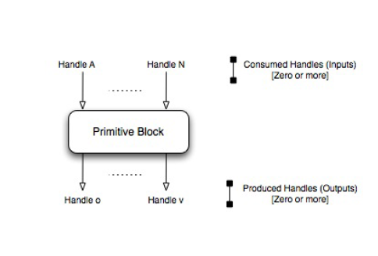
History of a Solution Google OF 2.0 Proposal
Google proposal was a producer/consumer DAG model
Just like today’s OF 1.1+ only richer
OF 1.1+ can only express an implicit linear “DAG” table organization (with conditionals)
Google model can express Conditional, Serial, Parallel and Speculative pipelines
OF 1.1+ has a restricted set of primitives (basically flow_mods)
Producer/Consumer relationship between primitive “blocks”
“blocks” built up from rich set of primitives (example on next slide)
Expresses the ordering constrains (if any) to the target
Conveys the minimum set of constrains

Slide 30
Example: Shared Table Primitives (pseudo-code)
primitive TABLEDEF (Name = "MACTable",
TableShared = TRUE,
TableType = ExactMatch,
SearchKey = {{(VlanID, 12), (MACAddress, 48)}, /* bridging */
{(PortID, 8), (VlanID, 12), (MACAddress, 48)}}, /* learning */
TableRsult = {BridgingResult,LearningResult},
TableSize = MacTableSize);
Then to match against such a table for a learning bridge you'd have a primitive operation like:
primitive TABLEOPS_MATCH(MatchName = LearningBridgeMatch,
TABLE = "MACTable",
consumes(PortID, VLANID, MACSrcAddress),
SearchKeyMap = {((PortID:PortID),
(Vlan:VlanID),
(MACAddress:MACSrcAddress))},
produces(LearningHit),
ResultMap = {(LearningResult:LearningHit)});

Slide 31
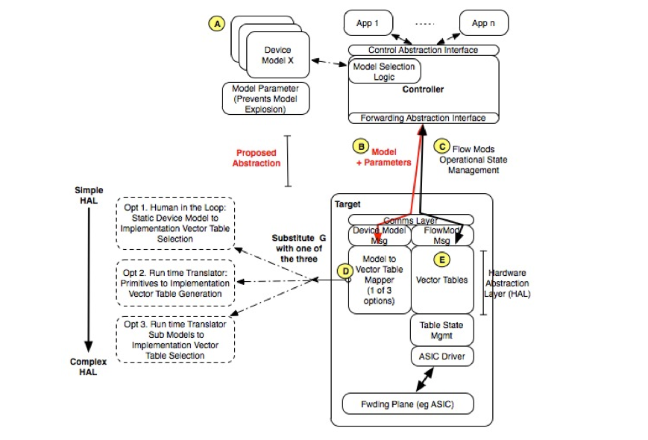
Putting it All Together
Google OF 2.0 Model
Graphic courtesy Dan Cohn

Slide 32
Beautiful idea, but….
Was seen as too dynamic/futuristic by the ONF TAG
A “dumbed down” version was proposed
Basically less dynamic
No runtime composition of models
No language to express primitives and their compositions
Small set of pre-defined models
Was still seen as too ambitious
Current ONF direction is to add “table typing” to OF 1.3+
The capability to constrain a table to be one of exact match, wildcard, LPM, …
Along with Table Type Patterns (TTPs)
A graph plus properties/constraints representing how tables are connected, …
This is the work of the Forwarding Abstractions Working Group
BTW, isn’t this converging on ForCES?
And why hasn’t ForCES succeeded?

Slide 33
Summary
Only OF 1.0 “widely” implemented
Widely a relative term
A few new software implementations of 1.3
e.g., LINC, others
See http://www.flowfowarding.org
OF 1.1+ not widely implemented in h/w
Only know of a few implementations
Most h/w implementations on NPU-like h/w, so really s/w
ONF direction “could” yield something
“table typing” could be a part of a solution
Getting the abstractions right is the key
And of course, getting the abstractions right is one of the hardest parts of all of this
Many open questions remain regarding architecture/scalability
Both of OF itself and of the OF/SDN architecture
Bowties, RYF systems
What about other network programmability architectures?
→ Emerging SDN Continuum

Slide 34
Future (now): The SDN Continuum
Service Layers
Apps
Apps
May be repeated
(stacked or recursive)
…
Control and Orchestration
(overly simplified view)
DP/SDN
Properties:
-- Complete Separation of CP and DP
-- Open Interface/programmable Data Plane
-- Examples: OF, ForCES, various control platforms
-- Initially: Applications program the network
CP/SDN
Properties:
-- Retains existing (distributed) Control Planes
-- Programmable control plane
-- Network aware applications
Explicitly *not* e.g., learning switch
-- Examples: PCE, I2RS, vendor SDKs
OL/SDN
Properties:
-- Retains existing (simplified) Control Planes
-- Programmable overlay control plane
-- Examples: Various Overlay technologies
-- May use OF to program flows in vSwitch
Physical and Virtual Resources
(CSN)
Notes:
OF/SDN is a polar architectural design point; complete separation of control and data planes
CP/SDN is adds programmability in an incremental way to conventional control planes; some targeted separation (e.g., PCE)/centralization
OL/SDN (Overlay/SDN) retains the control plane architecture of CP/SDN but adds a new, logically centralized control plane (“over” CP/SDN)

Slide 35
Q&A
Thanks!

