Slide 1

Data Literacy
An easy Introduction to the concepts data literacy

Slide 2
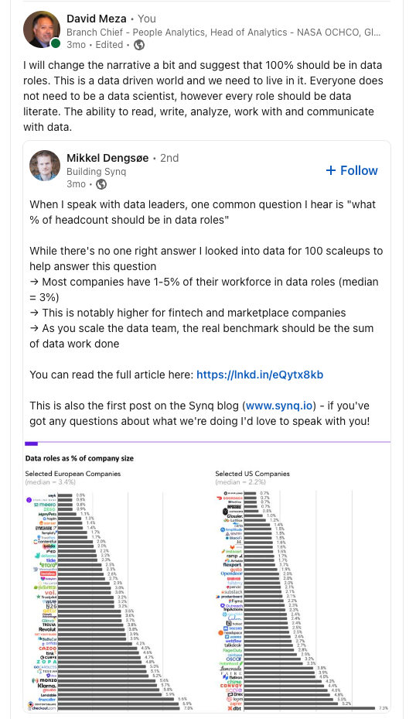
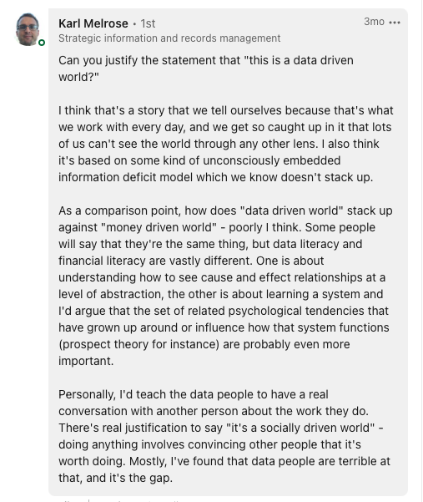
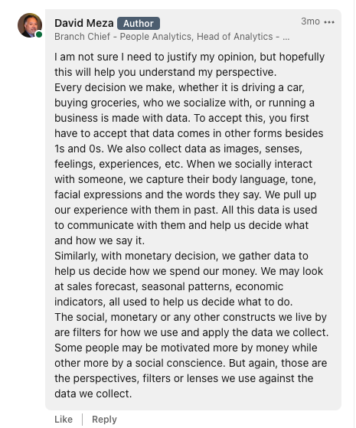
What % of headcount should be in data roles?

Slide 3
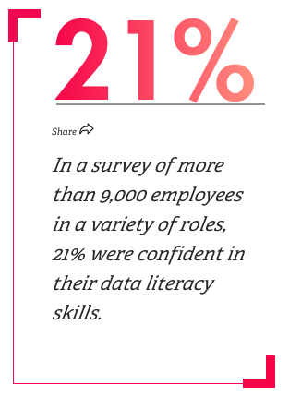
Data Literacy
A recent Gartner survey of chief data officers found that poor data literacy is one of the top three barriers in building strong data and analytics teams.
Know what data literacy is — acknowledging that it’s different for everyone
MIT professor Catherine D’Ignazio and research scientist Rahul Bhargava describe data literacy in a paper as the ability to:
read data, which means understanding what data is and the aspects of the world it represents.
work with data, including creating, acquiring, cleaning, and managing it.
analyze data, which involves filtering, sorting, aggregating, comparing, and performing other analytic operations on it.
argue with data, which means using data to support a larger narrative that is intended to communicate some message or story to a particular audience.
Communicate
Source: https://mitsloan.mit.edu/ideas-made-to-matter/how-to-build-data-literacy-your-company

Slide 4
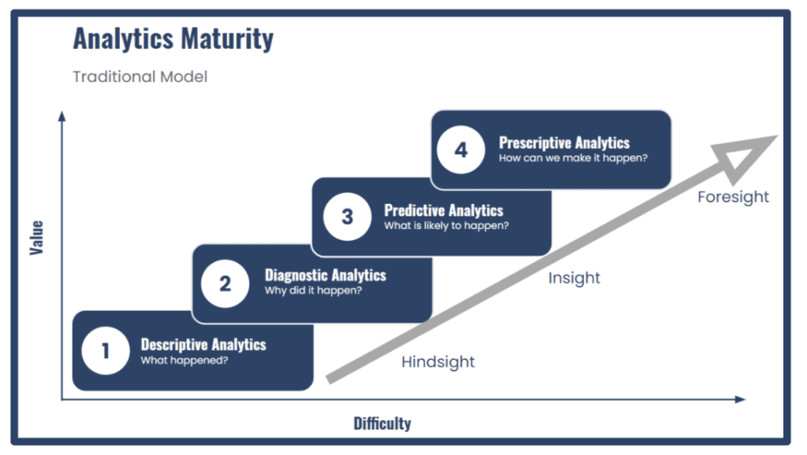
4 levels of ANALYTICS
Descriptive– What happened?
used to describe the basic features of the data in a study.
used to present quantitative descriptions in a manageable form.
Diagnostic – Why did this happen?
using data to determine the causes of trends and correlations between variables.
hypothesis testing, the difference between correlation and causation.
Predictive – What might happen in the future?
trying to reach conclusions that extend beyond the immediate data alone.
make inferences from our data to more general conditions.
Prescriptive – What should we do next?
takes into account all possible factors in a scenario and suggests actionable takeaways.
especially useful when making data-driven decisions.

Slide 5
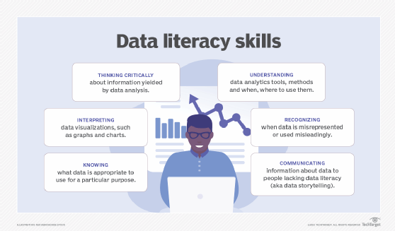
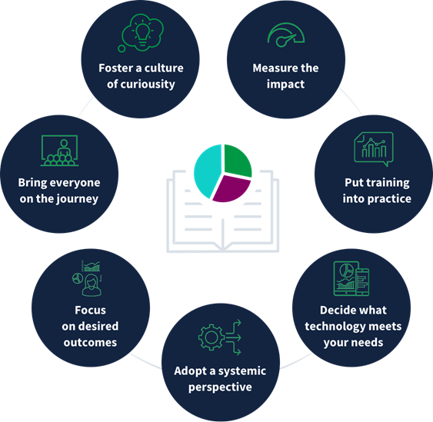
Data literacy – why it matters and Benefits

Slide 6
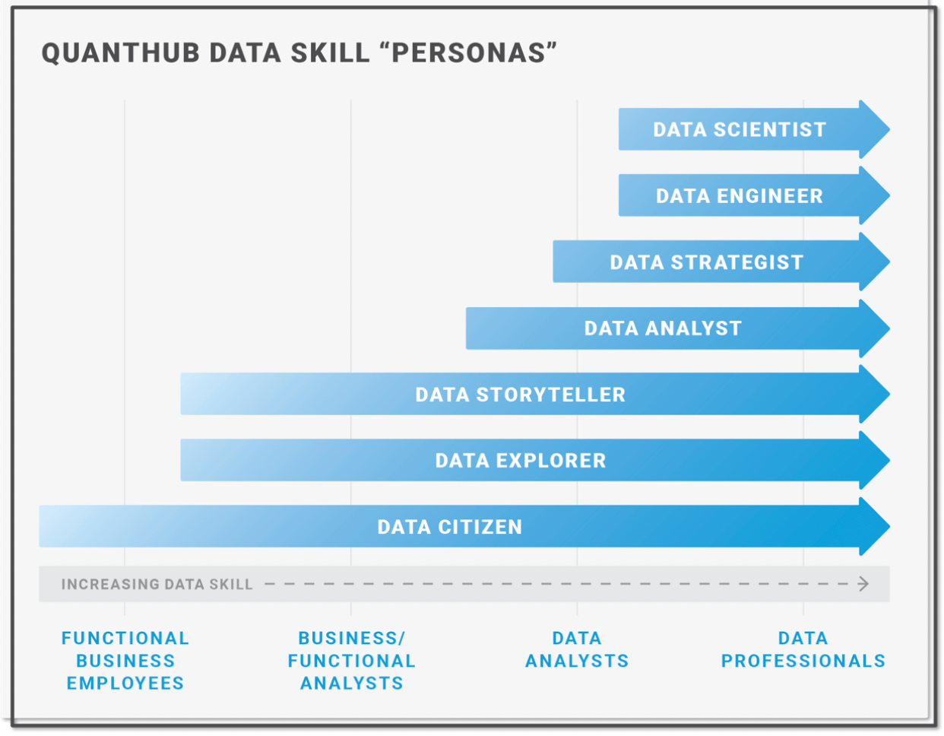
Assessing your data literacy
Basic skills:
To what degree can employees understand statistical operations such as correlations or averages?
Can they interpret data correctly?
Do they have the ability to read graphs?
Are employees able to choose the best graphs for presenting data to others?
Intermediate skills:
Can managers develop a proposal based on concrete, accurate and relevant numerical analysis and trends supported by data?
Advanced skills:
Can a Data Scientist present the output of their machine learning algorithms in a way that fosters data-driven decisions throughout the organization?
Can product managers propose new features and functions by analyzing customer segments and usage data?

Slide 7
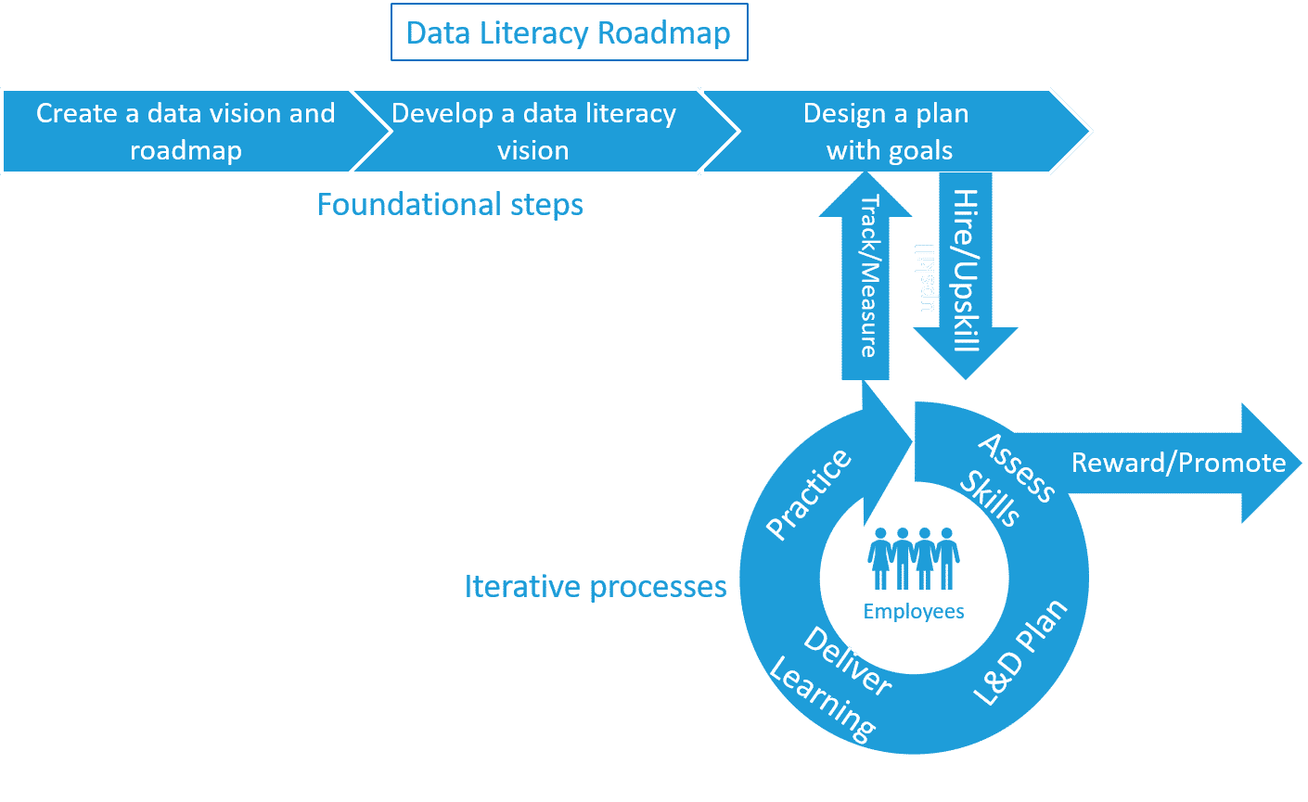
Develop a Vison for data literacy
Upper management support and vision for creating data literacy is the key to creating a data-driven culture. The C-suite must collaborate with Human Resources on its vision for data literacy and define it clearly as it applies to talent management.
A data literacy vision should detail desirable skills, abilities, and the level of literacy required for different business units and roles.

Slide 8
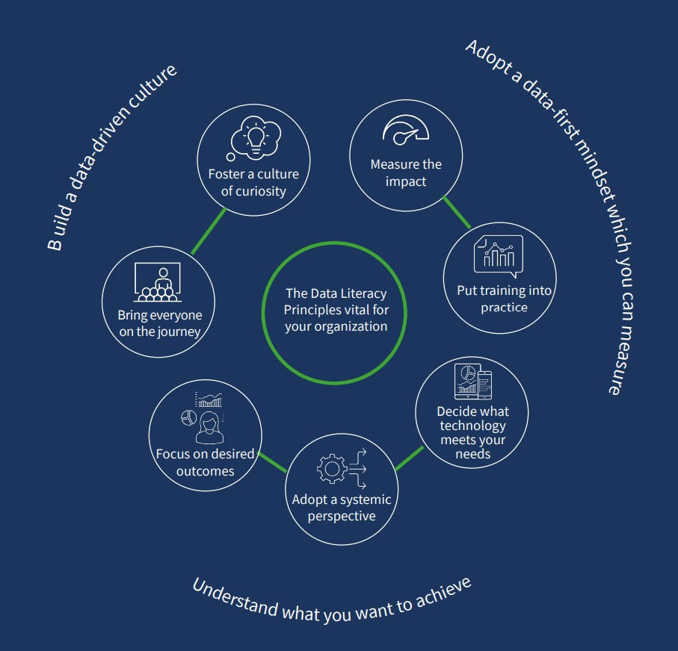
DATA LITERACY CAPABILITIES
Only 24% of business decision-makers from junior level managers up to the C-suite feel confident
in their ability to understand, work with, and communicate using data.
Create individual and team data literacy learning and development plans
Create data literacy delivery modules
Provide opportunities to practice and reward data literacy skills
Track, measure, rinse and repeat

Slide 9
Data literacy mindset
Curiosity
We can break down overall data, filter it, start to get answers and generate more questions.
What is causing my KPI to fall?
Why is my churn so high?
How can I improve engagement?
Creativity
The ability to transcend traditional ideas, rules, patterns, relationships and to create meaningful new ideas, forms, methods, interpretations, and originality.
Get insight from diverse groups.
Critical Thinking
Disciplined thinking that is clear, rational, open-minded, and informed by evidence.
Observe
Gather input
Strategize
Communication
We mentioned above, data literacy requires communication. Communication is the act of transferring information from one place, person or group to another.
But it is also about story telling with data ……….. plan it out

Slide 10
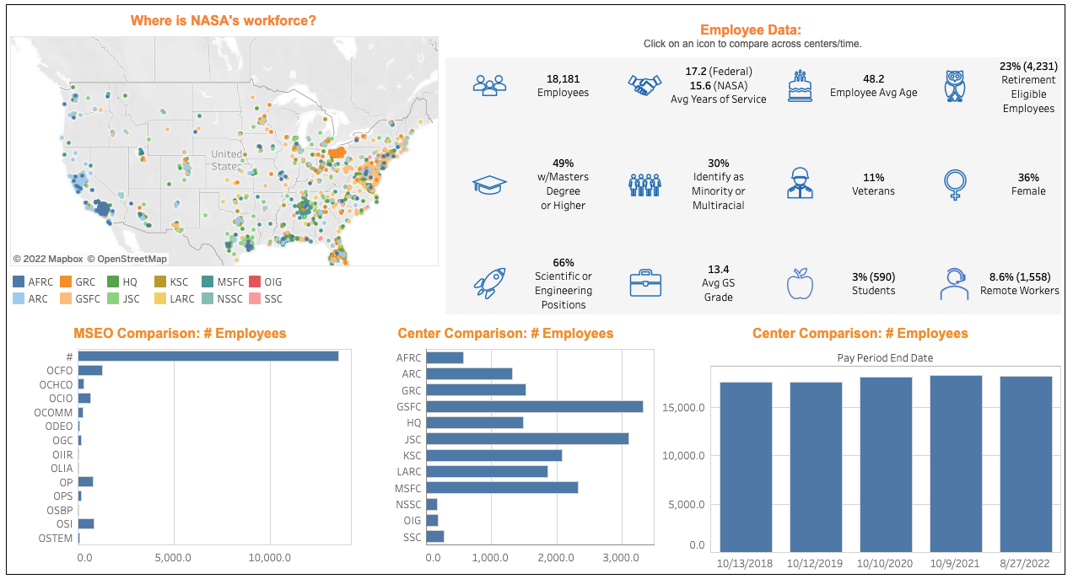
Data literacy – descriptive: the what (explore)
Descriptive statistics turn the data into something more understandable than raw data but data visualization goes further than that and creates a visual which quickly tells a story.
Everyone in the organization should be comfortable working with descriptive data

Slide 11
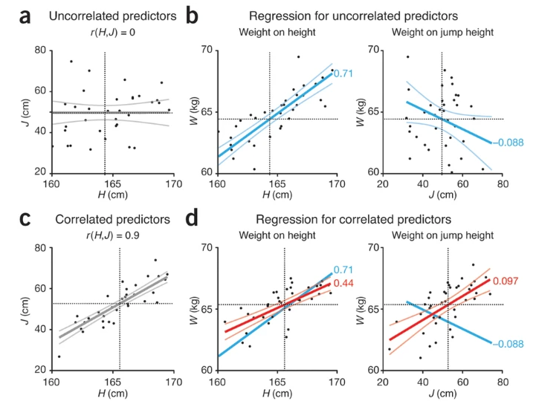
Data literacy – diagnostic: the why (explain)
Diagnostic analytics is a form of advanced analytics that examines data or content to answer the question, "Why did it happen?" It is characterized by techniques such as drill-down, data discovery, data mining and correlations
Anyone in the organization who wants to improve processes and practices. You do not need to know how to do the diagnostic analysis, however you should understand the results.

Slide 12
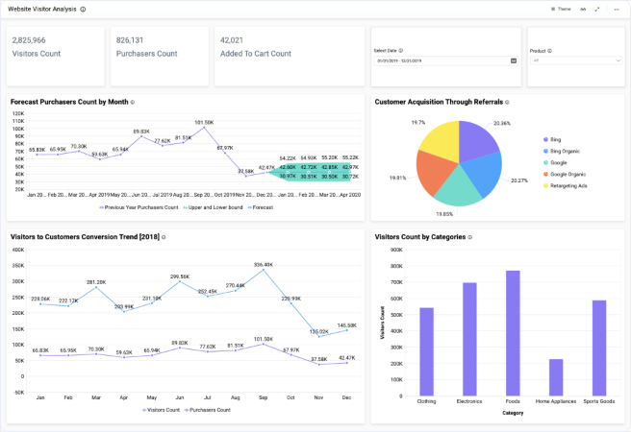
Data literacy – prediction: what + Why
Predictive analytics is the use of statistics and modeling techniques to determine future performance based on current and historical data
Every persona should be able to explain the concepts. Specific persona do the analysis.

Slide 13
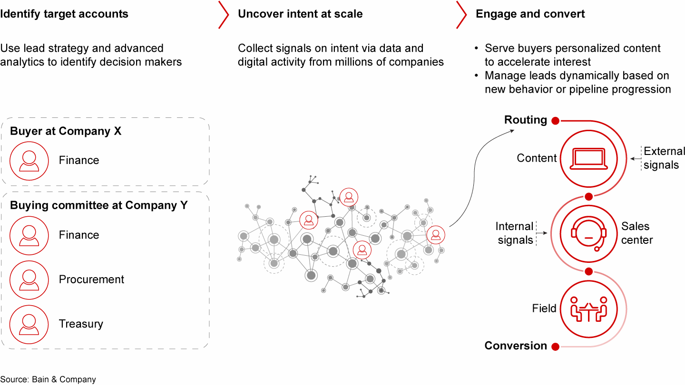
Data literacy – prescriptive: data driven decisions
Prescriptive analytics is the process of using data to determine an optimal course of action. By considering all relevant factors, this type of analysis yields recommendations for next steps.
Managers and Business leaders at all levels should be able to use prescriptive analysis to make decisions.

Slide 14

Thank you
Serves as the Head of Analytics and Branch Chief of People Analytics for NASA's Office of Human Capital. He previously served as Chief Knowledge Architect at NASA Johnson Space Center (JSC). During his tenure, he has worked in all aspects of the Information Technology field developing and deploying several IT systems in use at JSC. His desire to improve IT processes and systems lead him to earn a Master's certificates in Project Management and Six Sigma in addition to becoming a NASA certified Lean Six Sigma Master Black Belt. Mr. Meza is conducting research in People Analytics, Automatic Classification algorithms, entity tagging, topic modeling, data driven visualization and text to graph pipelines

