Slide 1
Sentiment Analysis of American States by Topic
Natural Language Processing of Tweets from the Last 7 Days Using Python
David Gutierrez
University of Illinois at Urbana-Champaign
CS410: Text Information Systems

Slide 2
Overview
Individual team (NetID: davidmg4)
Goal: Conduct a working sentiment analysis based on ”Quality of Life” topics for all 50 states using Twitter data to get a nearly-real time view of each state’s qualities from real users.
Topics chosen:
Government
Weather
Economy
Nature
Lifestyle
GitHub repo: https://github.com/davidmg4/CourseProject

Slide 3
Workflow
Apply for Twitter developer account
Install and implement Tweepy API for scraping Tweet data in Python
Write each to a CSV file with state and topic tags
Clean tweets to prepare for Natural Language Processing (remove non-text data, stop words, etc.)
Conduct analysis using Pandas Dataframe data structures and TextBlob’s sentiment analysis algorithm
Include mean for each category and average them an ‘overall score’ for view in summary CSV file as well as an interactive HTML file

Slide 4
Resources
Tweepy (Twitter API)
Pandas (Dataframes)
NLTK (Stopwords)
Textblob (Sentiment Analysis)
JSON/JQuery/Ajax (Web Features)
Bootstrap (Web Formatting)

Slide 5
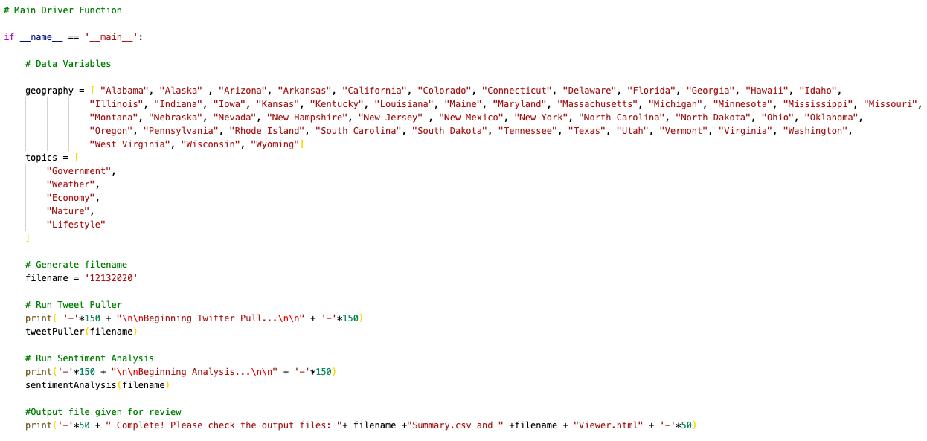
Step 1: Setup

Slide 6
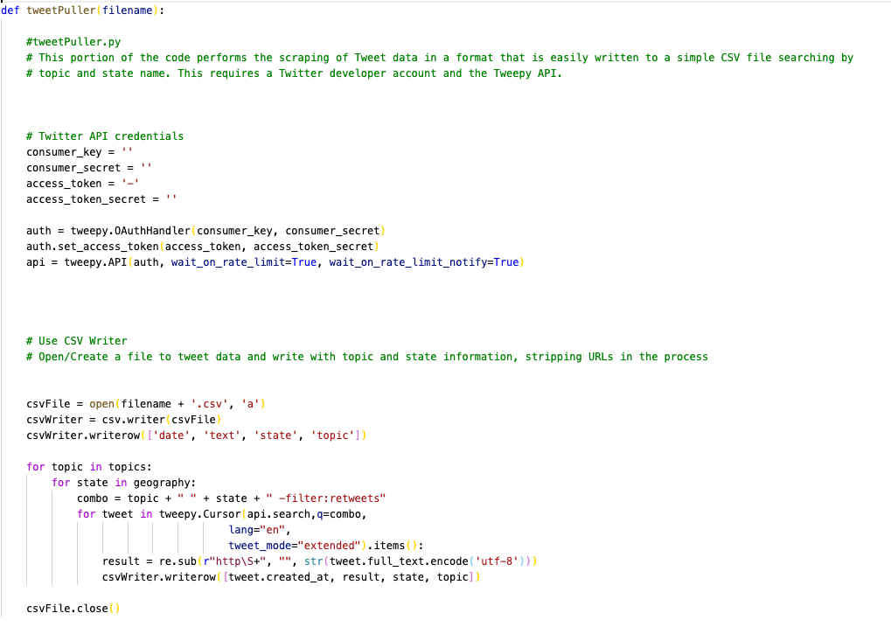
Step 2: Tweet Scraping

Slide 7
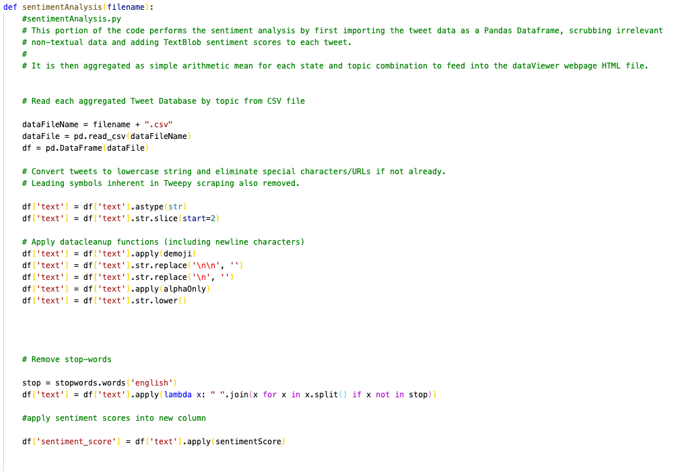
Step 3: NLP and Analysis

Slide 8
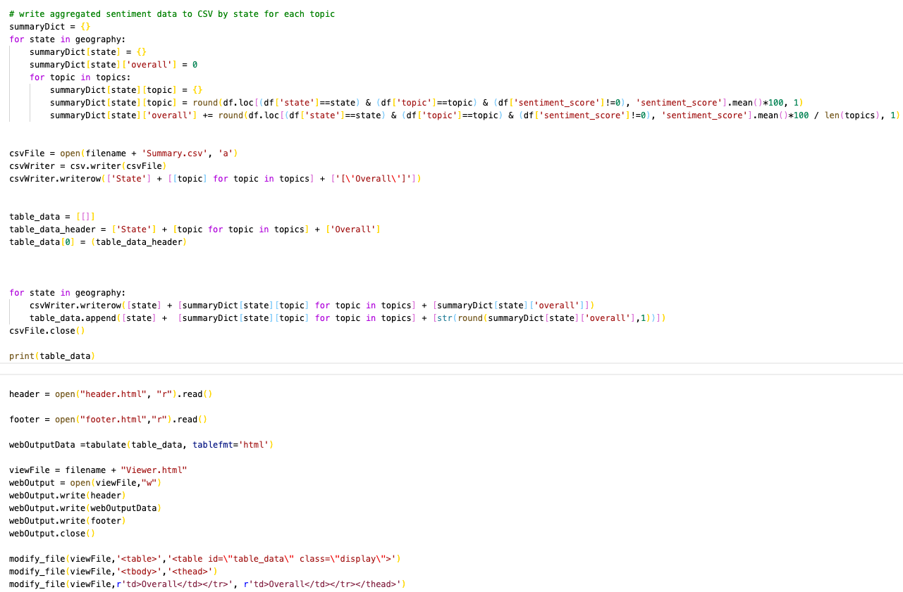
Step 3: NLP and Analysis (cont’d)

Slide 9
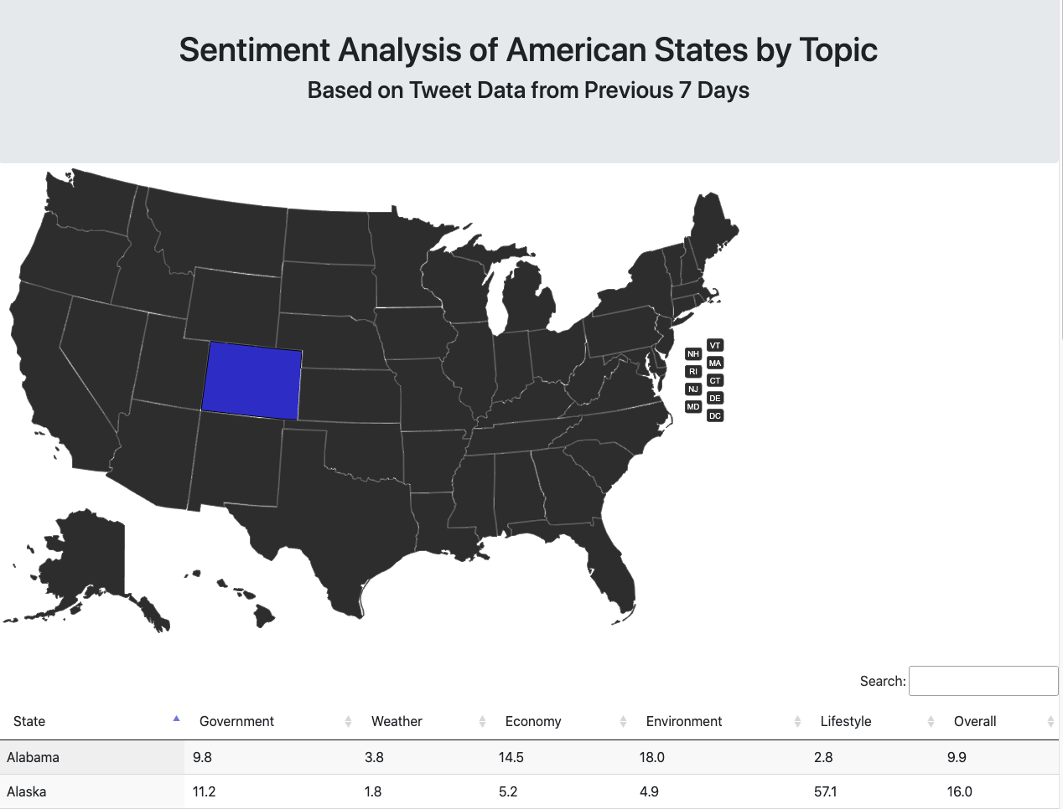
Results

Slide 10
Results
Good template for folks who are indecisive about where they might want to move or travel
Allows for ranking and filtering of resultant data
Novel use of NLP for practical data and a “finger on the pulse” of social media users
More context information would be useful, but still robust enough for most users

Slide 11
Limitations
Most limitations of this project are specific to Twitter, subject to further study:
Free/educational developer account limited to tweet data from the last 7 to 10 days
Tweepy API rate limits cause lengthy delays in scraping time
Tweets by and large not geotagged for a specific location so including the state name was next-best-option
Sentiments only make sense on a relative scale – subject to fluctuation by type of users in the system as well as data availability limitations (e.g. not many tweets in/about North Dakota)
Ideal case is to have a real time stream of Twitter data analysis uploaded to the web with histogram data

Slide 12
Conclusion
Demonstrates a functional workflow for taking topic and context data to generate non-text data
Provides useable data interaction to compare and rank states based on topic sentiment as well as overall score
Easily adapted for other topics and/or geographies
Potential for even more data visualization and interactivity in the future

Slide 13
Lessons Learned
Many readily available libraries and packages for NLP in Python
Robust tools for reading and writing to CSV files
Ability to craft and aggregate HTML code/documents from simple Python scripts
Analysis only limited by quality of data (and processing time)
Had a lot of fun!

