Slide 1
SAVE BLOOD Once blood is collected, it needs to be preserved. There is still wastage of 20 per cent of the blood collected.

Slide 2
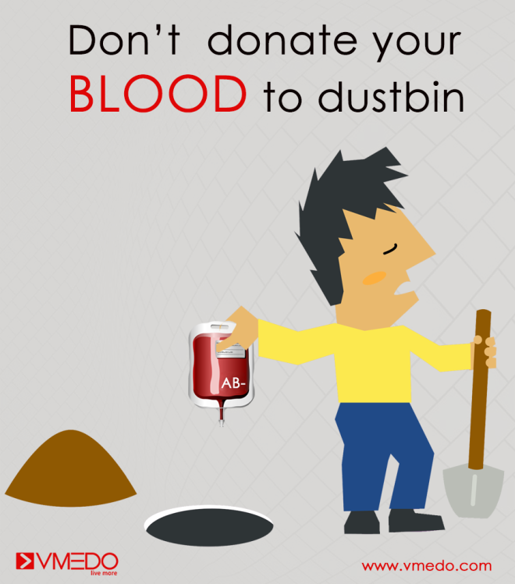


Slide 3
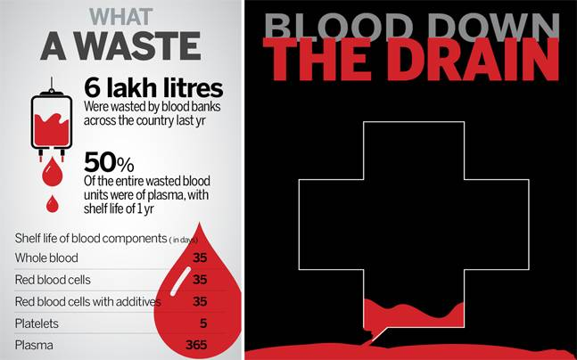

Slide 4
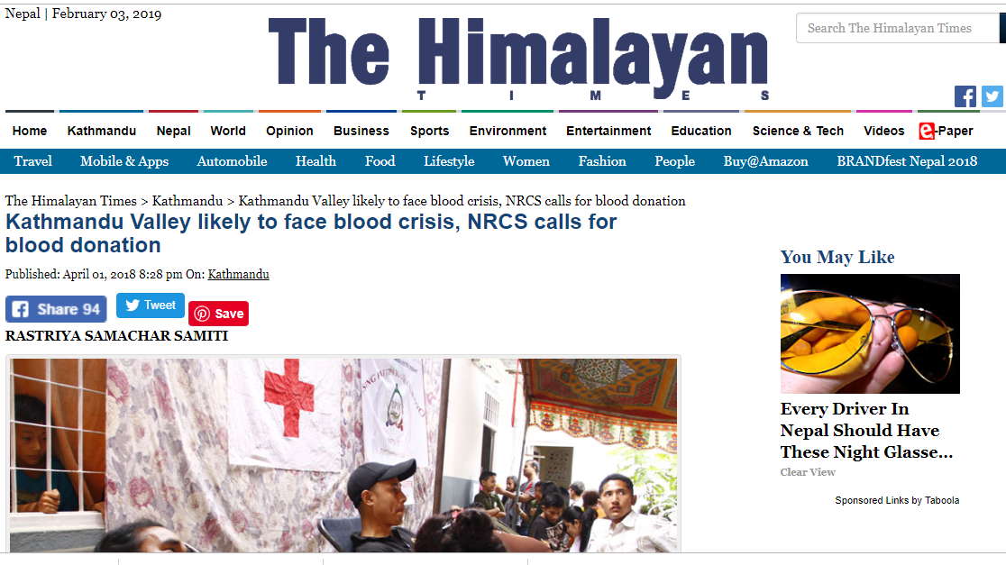
THE OTHER TALE

Slide 5
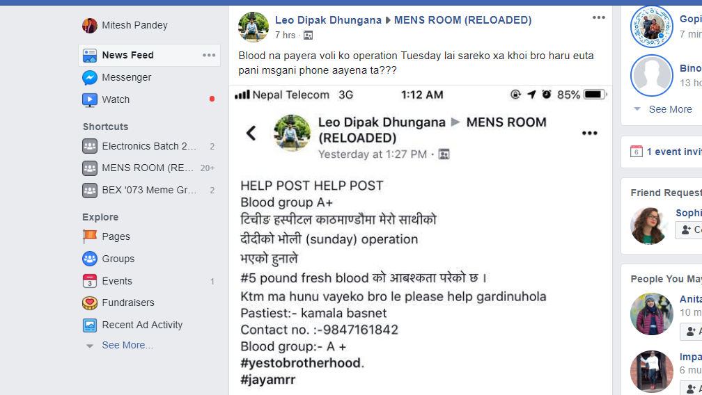

Slide 6



Slide 7

Raktadaan

Slide 8

FLOW DIAGRAM

Slide 9
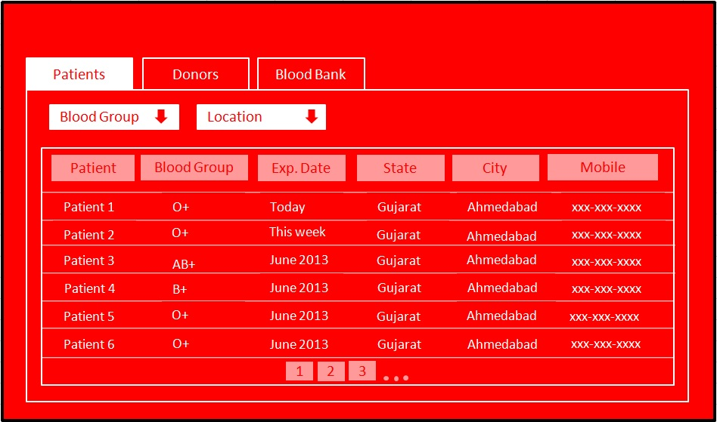
PROBLEMS OF PREVIOUS ATTEMPTS
Donors were simply saved in a database with their fixed location. It didn’t make any attempt to update the donor’s will to donate.

Slide 10

Privacy Concern was the major issue as donor’s full identity was openly displayed.
This resulted to increase in prank calls and issues of sexual abuse.

Slide 11

Didn’t provide enough motive for the donors to donate.

Slide 12
What WE INTRODUCED ??
Donors were now stored with their recent GPS data(not exact) . An additional privilege is provided to either turn on or off their current will to donate.
This approach helped receiver to accurately track the donor.

Slide 13
Donor details were hidden ,only their location is accessible in map. And if a receiver wants to contact the donor, the call is to be made through app.
PRIVACY PROLEM SOLVED

Slide 14



A credit based system is set up in app which is termed as ‘RESPECT’. Respect is earned by donor if he donates the blood.
RESPECT POINTS
Health services coupons
RESPECT POINTS

Slide 15


ADDITIONAL FEATURES
IN-APP CHAT FOR VERIFIED ACCOUNTS
SMART AMBULANCE TRACKING : A HASSLE FREE SYSTEM WHERE ONE CAN SEARCH FREE AMBULANCES AROUND THEM

Slide 16
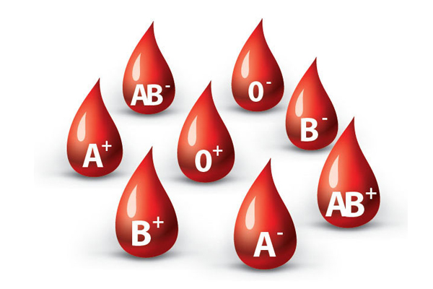
ADDITIONAL FEATURES
INFORMATION REGARDING BLOOD BANKS NEAR THEM
INFORMATION ON VARIOUS ACTIVITIES REGARDING HEALTH AROUND THEM

Slide 17




OUR STACK
Latest Technologies That Drive Our System

Slide 18




PAYBACK ANALYSIS
Around Nrs. 5,00,000 in total
INVESTMENT
Estimated Cost: Around Nrs. 2,00,000
Estimated Cost: Around Nrs. 1,00,000
Mass Marketing
Estimated Cost: Around Nrs. 1,00,000
Parnership with hospitals,NTC,NCELL
Estimated Cost: Around Nrs. 1,00,000

Slide 19
PAYBACK ANALYSIS
From ambulance services:
Rs 3000/month for 1 hospital ambulances
Total revenue = Rs 60,000/month (suppose 20 hospitals enrolled)
From hospitals advertisement:
Rs 3000/month for 1 hostipal per month
Total revenue= Rs 60,000/ month
From health related adds from NGOS and INGOS:
Rs 3000/month for 1 organization(suppose 20 enrolled) Total revenue=Rs 60,000/month

Slide 20
PAYBACK ANALYSIS
Month | 0 | 3 | 6 | 9 | 12
Initial Fund(Investment) | Rs 5,00,000 | - | - | - | -
Expense of system for Functioning | - | Rs 1,50,000 | Rs 3,00,000 | Rs 4,50,000 | Rs 6,00,000
Profit from the system | - | Profit/mont*3 =Rs 2,50,500 | Profit/month*6 =Rs 5,01,000 | Profit/month*9 =Rs 7,51,500 | Profit/month*12 =Rs 10,02,000
Net Cash Flow for the month | - Rs 5,00,000 | -Rs 2,50,495 | Rs 1000 (profit) | Rs 2,51,500 | Rs 5,02,000

Slide 21
PAYBACK ANALYSIS

Slide 22
Why would hospitals and others organizations choose our medium for advertisement and information flow rather than all those printed means (like newspaper), and other social media sites like facebook,instagram,etc ?
First coming to the preference of internet medias over printed ones is pretty clear.
Stats show there is very low probability that people from age 20-40 living in a city like Kathmandu would not use their smartphones connected to internet once a day. Youths are engaged in internet than anything else. So this would be the best platform for the information flow among the youths.
Secondly coming to the preference of our app over famous social sites is that people like and believe something that is more converged and specific. Like our app is more related to health and is for that purpose only, people will automatically have more belief over our adds than those all time popping
adds in facebook and instagram.

