Slide 1


One Texas Monthly Update
February 2026

Slide 2
Agenda
1. Review current measures
2. Regional account focus
3. Initiative updates
4. Calendar planning
5. Discussion

Slide 3
Personal Measures
Large accounts ($2M+) that have doubled: 0
Medium accounts ($750K+) that have doubled: 0
New Anchors from pursuit: 0
New Key from pursuit (stretch): 0
Partner Co-sell influenced: $0
C-Suite connections added
Awareness 1: 12
Awareness 2: 2
Awareness 3: 0
Awareness 4+: 0
Speaking Engagements Completed: 4

Slide 4
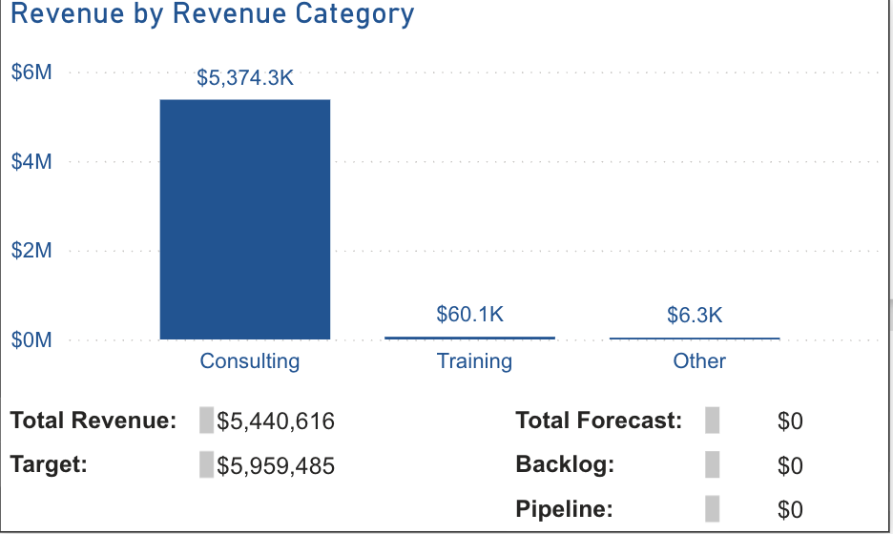
Measures
Top Line Growth (above $73M): -9%
Partner Co-sell influenced: $0
Lead Revenue Generated (personal): $0
New Anchors from pursuit: 0
New Key from pursuit (stretch): 0
C-Suite connections added (personal)
Awareness 1: 12
Awareness 2: 2
Awareness 3: 0
Awareness 4+: 0
Speaking Completed (personal): 4

Slide 5
Regional Account Focus
Autodesk
Insperity
Intuit
PriceSmart
Siemens
Marriott
Kirby Corp
Expedia
Masimo
Constellation
McKesson
7-Eleven
Wendy’s
Schwab
ORIX
AT&T
Builders First Source
CBRE
Tenet
Texas Instruments

Slide 6
Initiative Updates
Dallas Wins
2 new logos: Ways2Well, Simpson Strong-Tie
NRG Energy $3M opportunity advancing
Wendy’s $13.9M extension in pipeline
Dallas Challenges
GTM pipeline $34K vs $7.5M target – needs acceleration
F500 coverage 11/36 – gap in enterprise penetration
South Texas Wins
Austin revenue +10.3% YoY in 2025 ($21.1M)
Austin: 8 logos, 2 anchors in 2025
Houston: Siemens Industry anchor landed
South Texas Challenges
Houston revenue -6.4% YoY in 2025 ($18.3M)
Pipeline rebuild needed across South Texas
"The Improving Edge" Podcast
Guests scheduled – recording started
Planning next 10 episodes

Slide 7
Partner Momentum
Confluent -> Improving -> 8 Accounts
Confluent Seller | Improving Seller | Account(s) | Status / Next Step
Rob Ogbah Strategic AE | David O’Hara | CBRE | CBRE preso Mar 3 Dev Event agenda drafted PS Work planned
Arean Asgariani Sr. Enterprise AE | Diana Stevens VP Sales | American Airlines | Connected Feb 20 Diana wants 3-way meeting
Kevin Collin Sr. Enterprise AE | Diana Stevens VP Sales | McKesson Toyota | Follow-up sent Feb 20 Awaiting response
David Nanson & Surain Asokaraj | Stephen Johnson VP Sales | NRG Halliburton | NRG — active AI SDLC proposal Halliburton — confidential POC
Stuart Maynard Enterprise AE | Stephen Johnson VP Sales | Insperity | Intro made Feb 17 Maynard ready to sync
Dante Lanza Regional Sales Dir | David/Ehren/Nick | Account Review | Deep-dive meeting scheduled

Slide 8
Calendar
DRC Executive Hands-On Workshop
Dallas – TBD (April)
CEO Breakfast Roundtable
Dallas – April 21 or 23
Convergence AI
Dallas – March 30 & 31
Microsoft AI Tour
Houston – May 28
Leave a Legacy
Houston – Q2
Rodeo Cookoff
Houston – February 27
South by Southwest
Austin – March 12–18
Gateway to Innovation
St. Louis – April 16

Slide 9
Showcase
NRG – AI Deep Learning Proposal

Slide 10
Sales Updates
Key Pipeline Opportunities
NRG Energy – $3.0M (Cloud Infrastructure)
Wendy’s – $13.9M (Extension, 80% probability)
Rayburn Electric – $3.5M (Data & AI)
Envestnet – $3.6M (Application Dev)
Toyota – $2.0M (Cloud/AI)
Schwab – $1.4M (Active)
New Logos (2026)
Dallas: Ways2Well, Simpson Strong-Tie
Partner Activity
Confluent co-sell deals in motion – no revenue claimable yet
Microsoft partner engagement – account overlap analysis due Feb 25
Discussion
Pipeline acceleration strategies
F500 coverage plan
South Texas pipeline rebuild

