Slide 1
Related Work

Slide 2
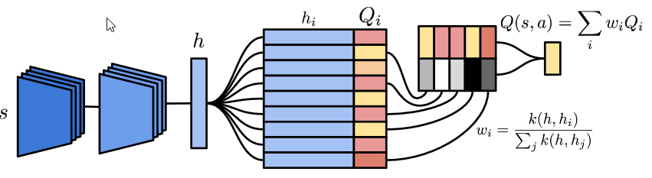
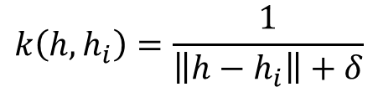
Neural Episodic Control
Differentiable neural dictionary
1 dictionary per class (actions)
Write
Append key value pair if not exists
Overwrite oldest if DND is full
Update value if key exists
Update keys, values via backprop
Read
Kernel smoothing over 50 nearest neighbors
Result: More data efficient at the beginning (faster learning)
Falls behind after 20M /40M frames
$$k\left(h, h_{i}\right)=\frac{1}{\left\|h−h_{i}\right\|+δ}$$

Slide 3
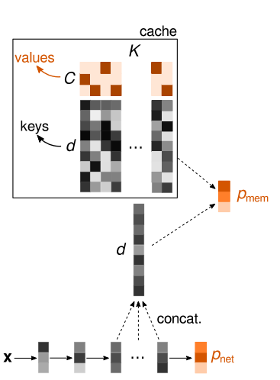
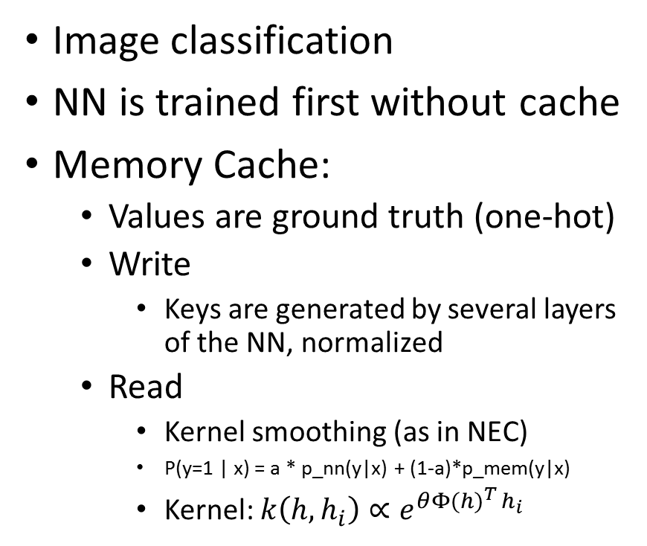
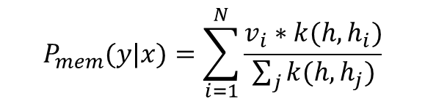
Simple Cache
$$P_{mem}(y|x)=\sum_{i=1}^{N}{\frac{v_{i}∗k(h,h_{i})}{\sum_{j}{k(h,h_{j})}}}$$
Image classification
NN is trained first without cache
Memory Cache:
Values are ground truth (one-hot)
Write
Keys are generated by several layers of the NN, normalized
Read
Kernel smoothing (as in NEC)
P(y=1 | x) = a * p_nn(y|x) + (1-a)*p_mem(y|x)
Kernel: $k\left(h, h_{i}\right)∝e^{{θΦ(h)}^{T }h_{i}}$
K: Memory size
d: Key size
C: Number of classes
Notes:
They first train the neural network
Then, they pass the complete training data or a fraction of it through the network and store the output of some layer
Concatentate that output and store it as keys using the ground truth of that particular instance as Value
→ Memory is built after training!

Slide 4

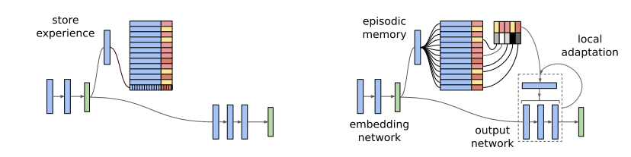


Further work
Memory Based Parameter Adaptation
Write:
Key, value = Network output, ground truth
Overwrite oldest key
Read:
K nearest neighbor search on keys
Training :
Testing: using the context of the memory produced by KNN on keys
Learning to remember rare events
One-shot learning
Normalized keys
Values are the ground truth
Query: outputs value of nearest neighbor using cosine similarity
Extra customized memory loss for updating the keys
If prediction was correct:
Update using the loss function
If prediction was false:
Add new key value pair to memory
$$f(x, γ)$$
$$g(x, θ)$$

