Slide 1
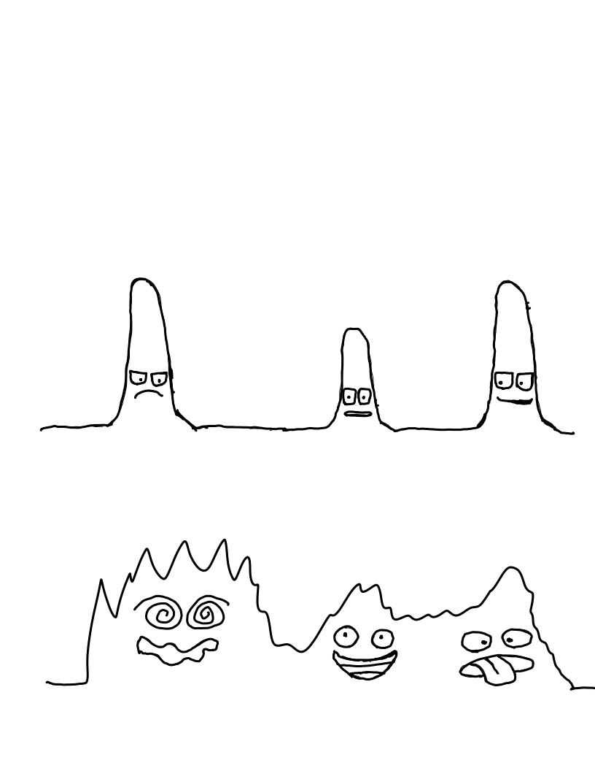
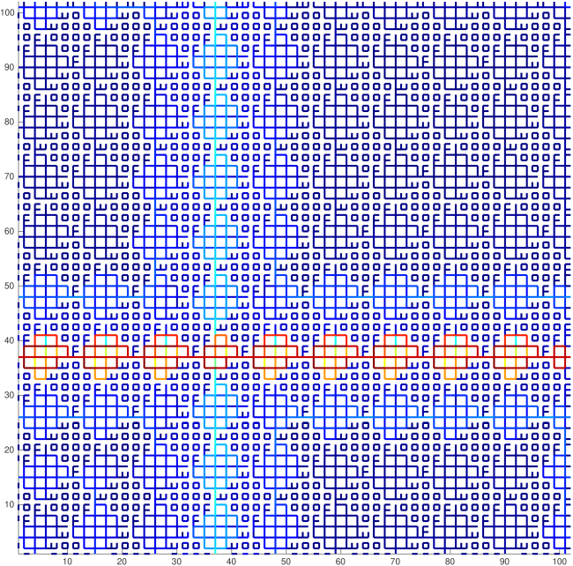
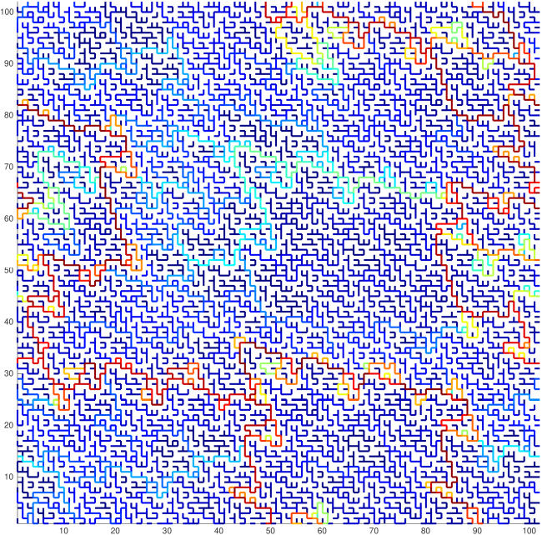


Order to Disorder in Quasiperiodic Systems
David Morison*, N. Benjamin Murphy**,
Elena Cherkaev**, Kenneth M. Golden**
* Department of Physics & Astronomy, University of Utah
** Department of Mathematics, University of Utah
Presented at 2020 Annual Meeting
of the APS Four Corners Section

Slide 2

Order to Disorder in Quasiperiodic Systems
David Morison*, N. Benjamin Murphy**,
Elena Cherkaev**, Kenneth M. Golden**
* Department of Physics & Astronomy, University of Utah
** Department of Mathematics, University of Utah
Presented at 2020 Annual Meeting
of the APS Four Corners Section

Slide 3
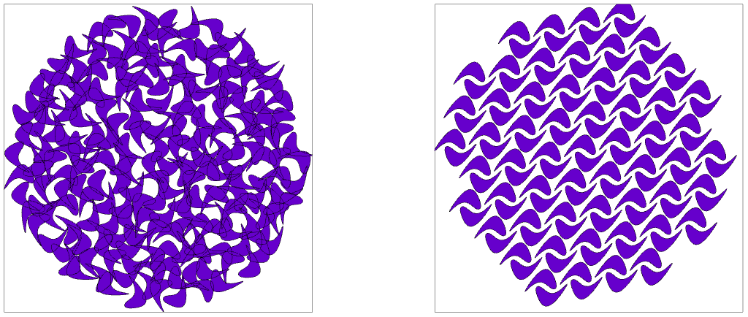
Materials Science Before the 80’s
Disordered
Periodic
Amorphous, Glass Like
Crystalline, Translational Symmetry

Slide 4
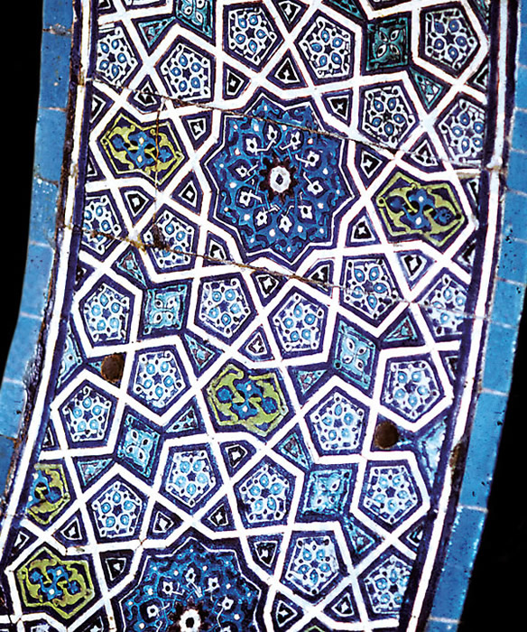
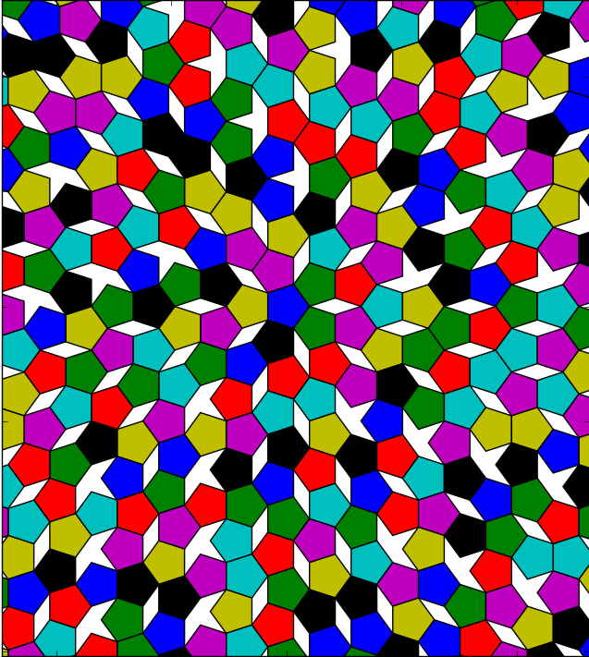
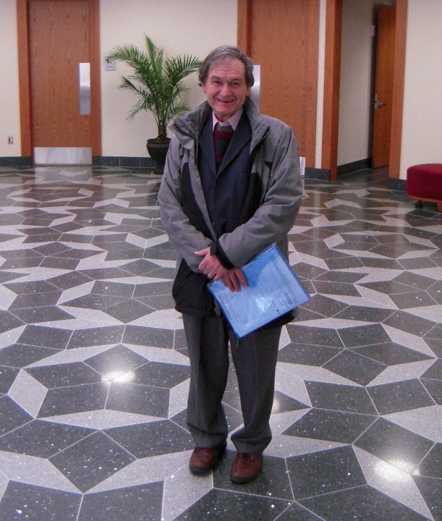
Quasiperiodic Tilings are for Art and Math, Not for Materials Science?
Green Mosque in Bursa, Turkey 2D tiling with pentagons and gaps Roger Penrose

Slide 5
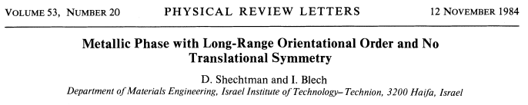
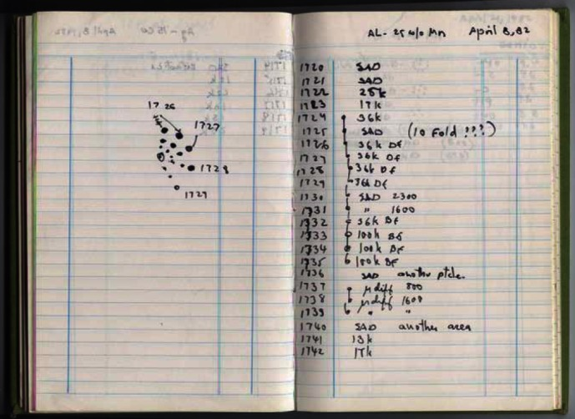
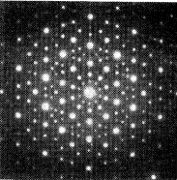
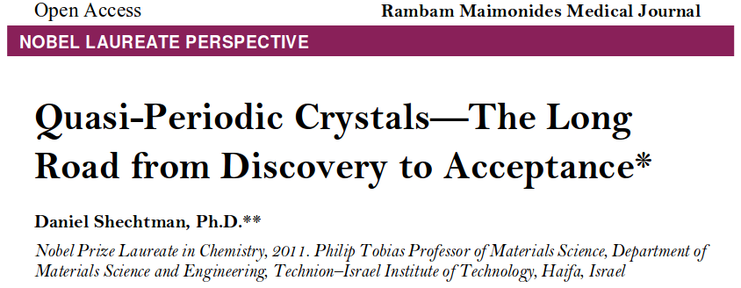
Experimental Discovery
TEM Diffraction pattern
For an AlMg alloy
Notice ten fold symmetry

Slide 6
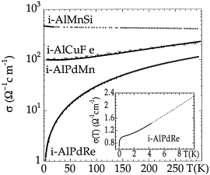
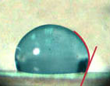
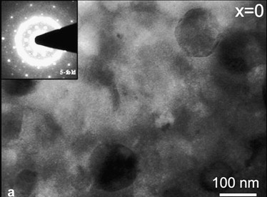
Discovery of Novel Properties in Molecular Quasicrystals
Low Electrical Conductivity
Low Thermal Conductivity
Mechanically Hard
Small Coefficient of Friction
an insulating
aluminum alloy
C Berger, C. et al.
Physica B:
Condensed Matter
(2000)
water beading more
strongly on a quasicrystal
coating, than on Teflon
Made by Professor Orest Symko
hard alloy
quasicrystal
inclusions
Singh. et al.
Intermetallics
(2010)

Slide 7
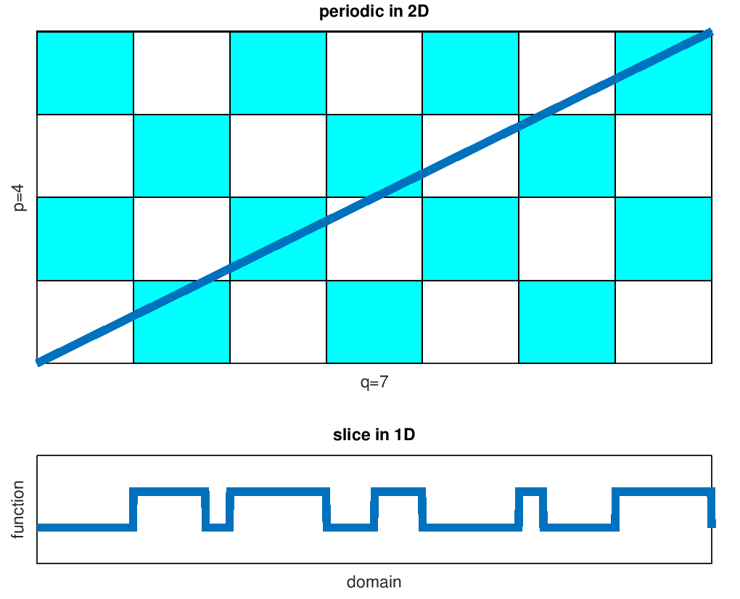
Interesting Transport in Idealized Quasiperiodic systems
Golden, K. et al.
Journal of Statistical Physics
(1990)
1-D
Golden, K. et al. Classical Transport
in Modulated Structures
Phys. Rev. Lett. (1985)
n-D

Slide 8
Is there an inherent connection between quasiperiodic geometry and material properties?
In a Stieltjes integral, the relationship between microgeometry and bulk properties is distilled into a spectral representation.

Slide 9
Classical not Quantum
We assume that our system is
adequately described classically
without recourse to the
Schrödinger equation.
yes ≥ nanometers or 10³ atoms ≥ no
Permittivity

Slide 10
Effective Complex Permittivity of a Two Phase Composite in the Quasistatic (Long Wavelength) Limit
What is the effective permittivity of a material with periodic, quasiperiodic or random microgeometry?
Homogenization
Microscale
Macroscale

Slide 11
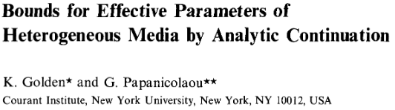
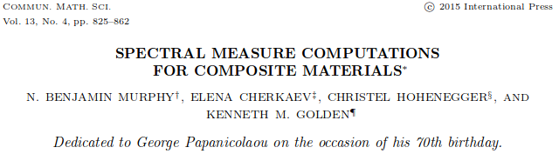

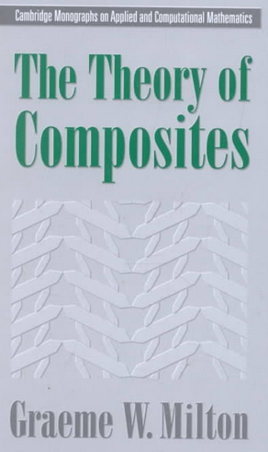
Relating Composite Geometry to Homogenized Properties
1873 Maxwell: effective conductivity of a dilute suspension of spheres
1906 Einstein: effective viscosity of a dilute suspension of rigid spheres in a fluid
D. Bergman, Physics Reports, 1978
D. Bergman, Phys. Rev. Lett. 1980
Communications in Mathematical Physics
1983
G. Milton, Appl. Phys. Lett. 1980
G. Milton, J. Appl. Phys. 1981
2002
Comm. Math. Sci.
2015
2012

Slide 12

Effective Complex Permittivity of a Two Phase Composite in the Quasistatic (Long Wavelength) Limit
ϵ*
ϵ*
ϵ*
Effective permitivity is a tensor but
we simply discuss the isotropic case.
ϵ*

Slide 13
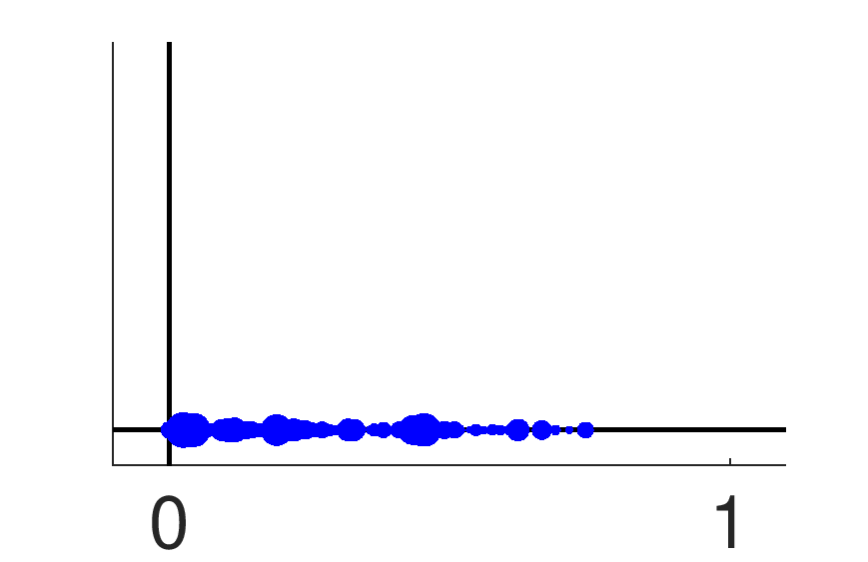
Stieltjes Integral Representation
Microgeometry
Relevant Physics and
Boundary Conditions
Imaginary
Γ and χ are projection operators
all eigenvectors real and [0,1]
Real
Material Properties

Slide 14
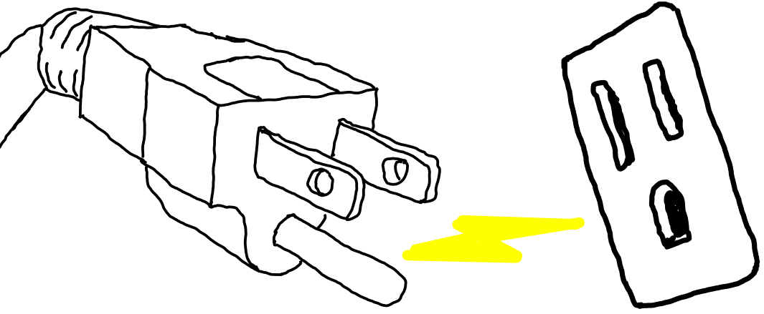
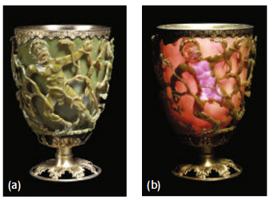
Eigenvalues of χΓχ Correspond to
Resonances of the Composite Geometry
In the discrete case the
Stieltjes integral becomes
a summation.
resonance
Connected Conductor
ideal conductor
ideal insulator
resonance
Imaginary
Surface Plasmon Resonance
good metal
vacuum
Real
resonance
0
1

Slide 15
Quasiperiodic in this Context of Materials Science
"...any solid having an essentially discrete diffraction diagram."
International Union of Crystallography
The term "quasicrystal” should simply be regarded
as an abbreviation for “quasiperiodic crystal,"
Ron Lifshitz arXiv 2000
Trial Microgeometry
Deterministic
Non-periodic
Repeated Building Blocks

Slide 16
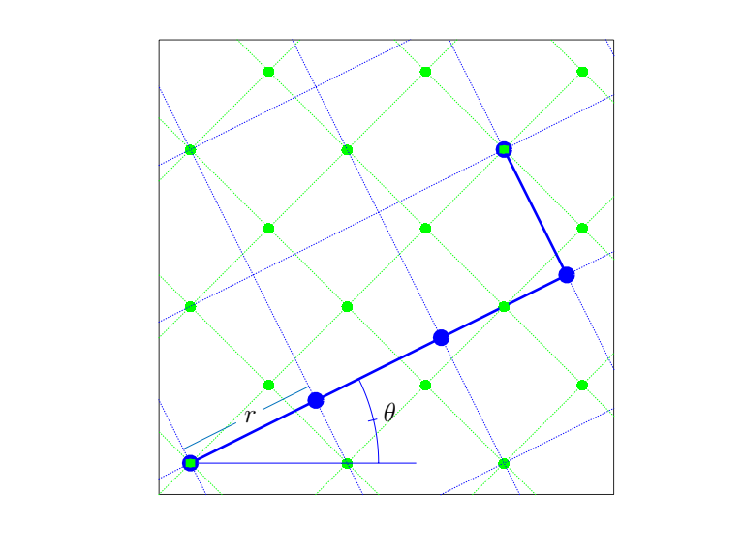
Moiré Pattern Based Trial Geometry

Slide 17
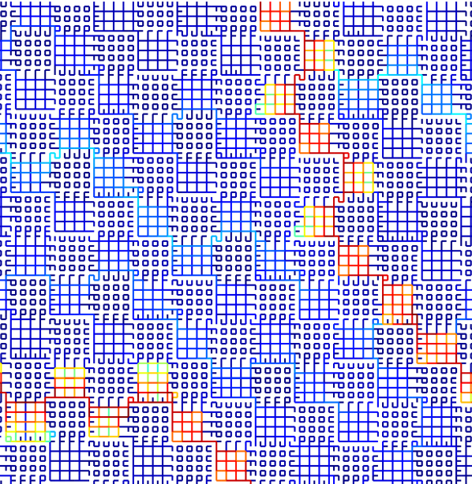
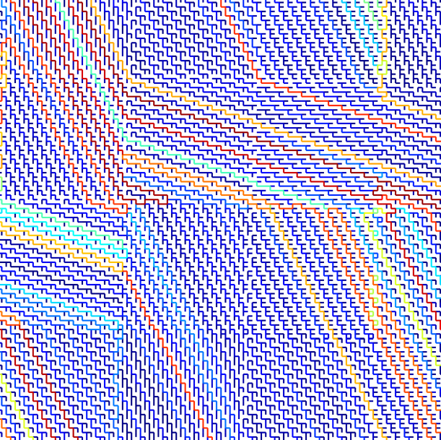
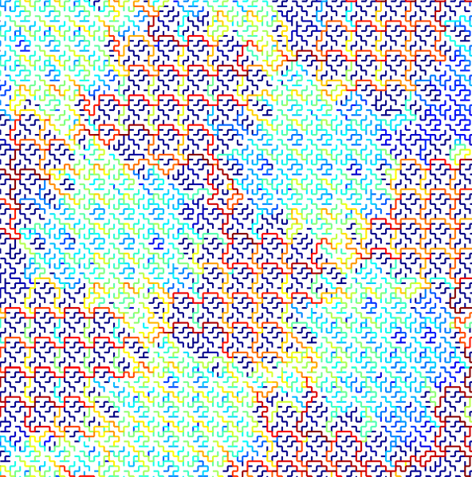
Wide Variety of Microgeometry

Slide 18
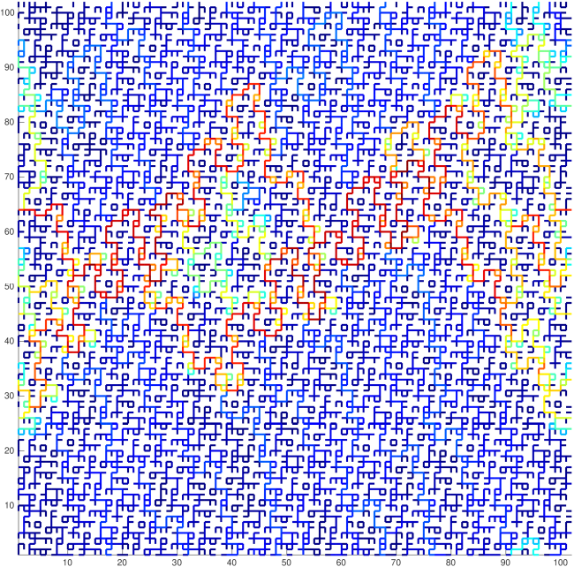
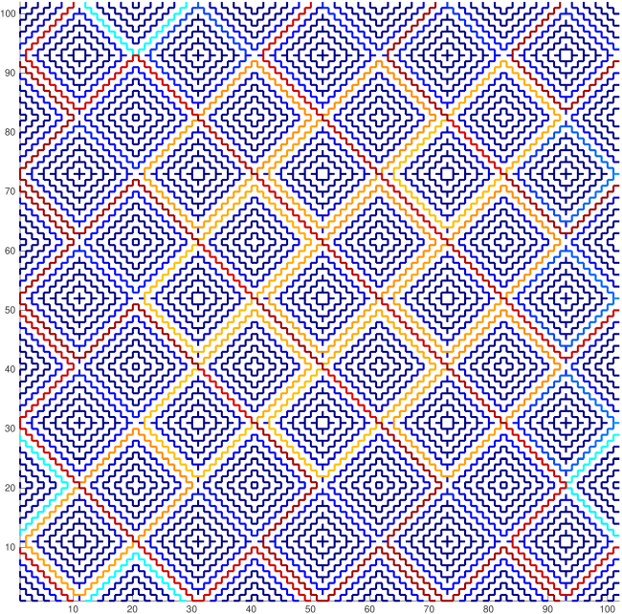
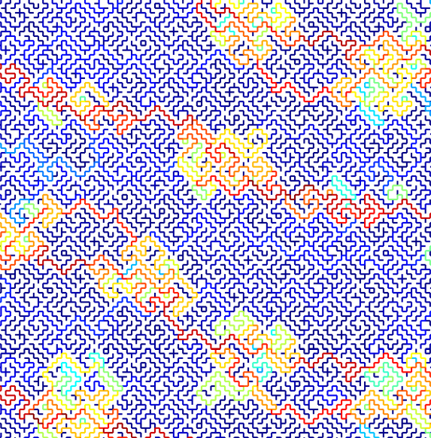
Wide Variety of Microgeometry

Slide 19
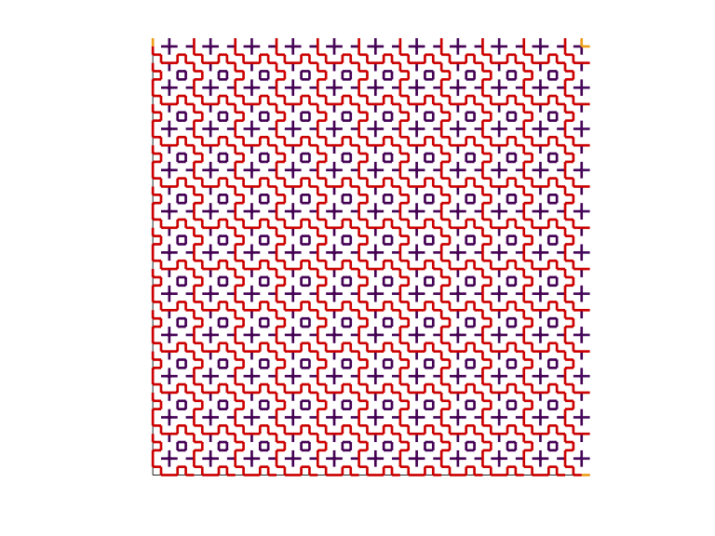
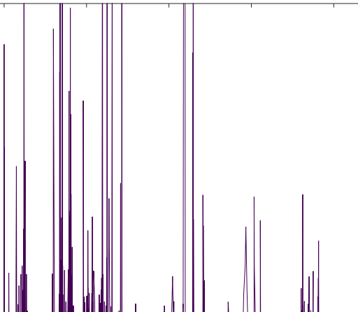
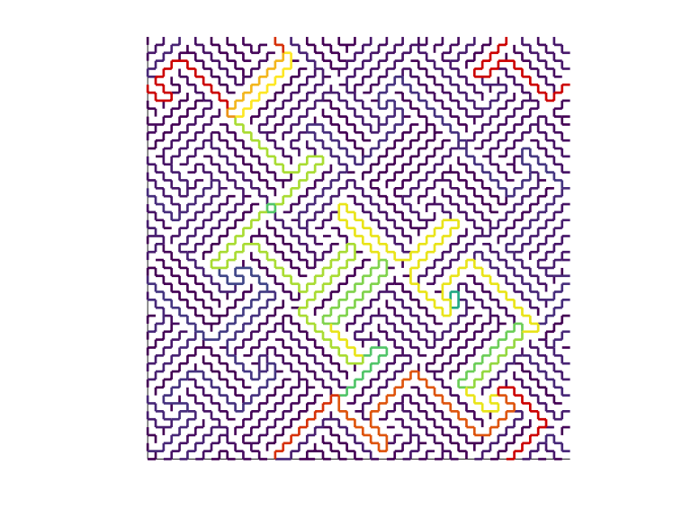
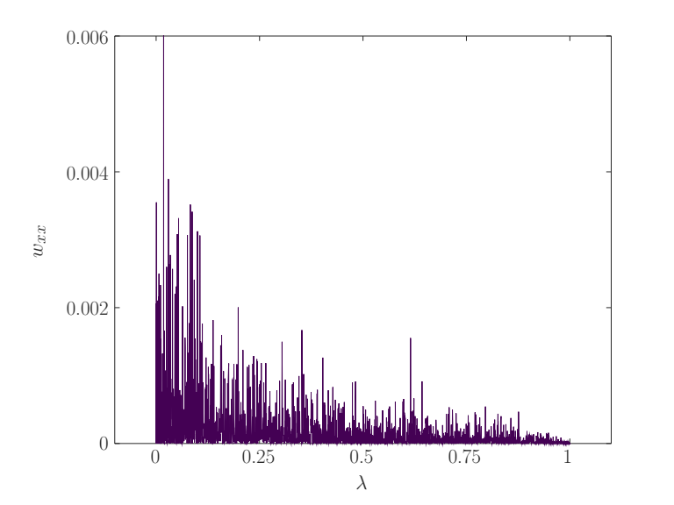
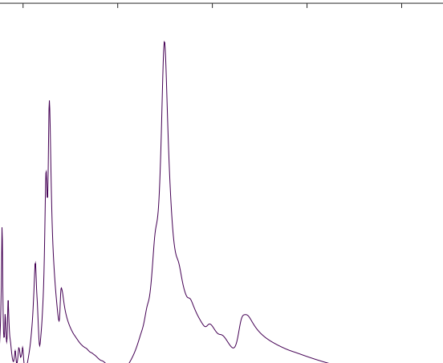
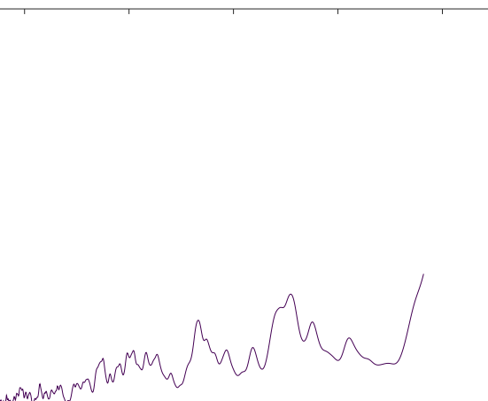
Periodic vs Aperiodic
Dramatically Different Material Properties
Optical dielectric
function of gold
Olomon 2012
Phys. Rev. B

Slide 20
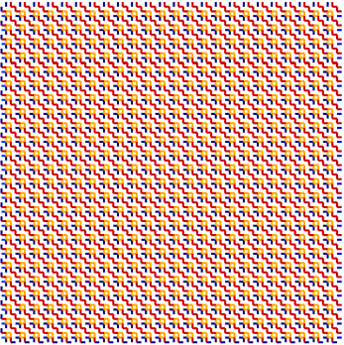
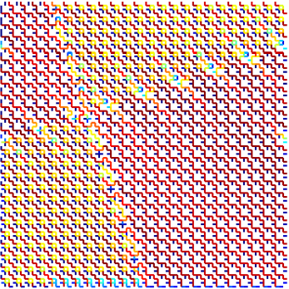
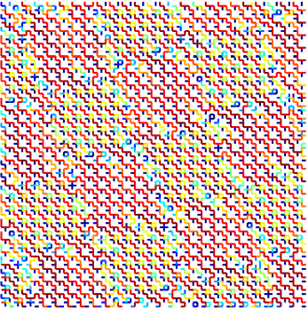
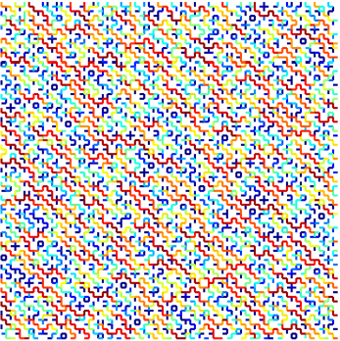
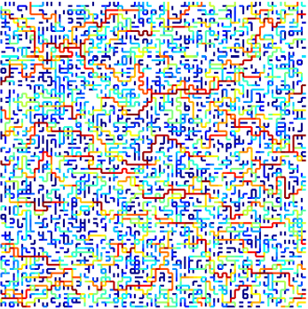
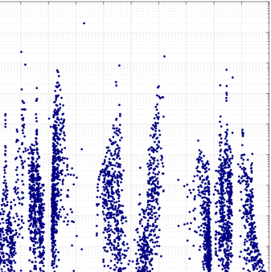
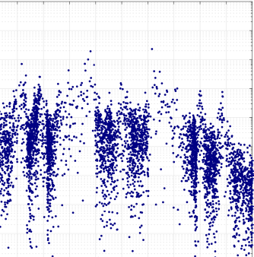
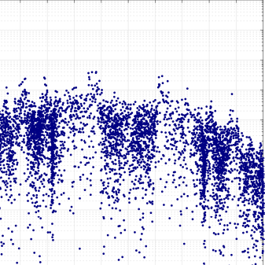
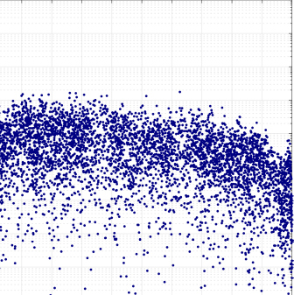
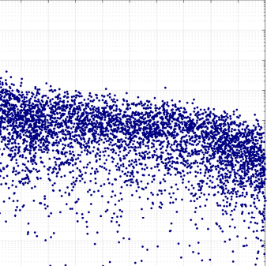
A Parameterized Transition

Slide 21

A Parameterized Transition
The inverse participation ration (IPR) summarizes the extended or localized nature of eigenvectors or distributions.

Slide 22
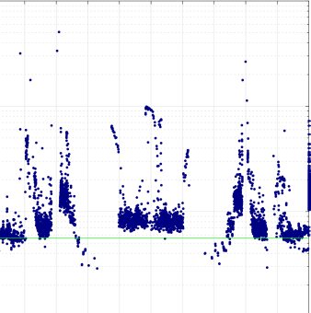
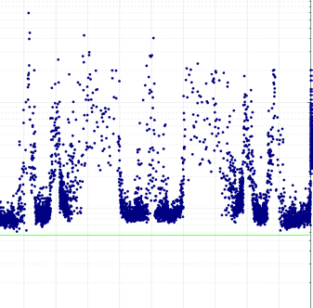
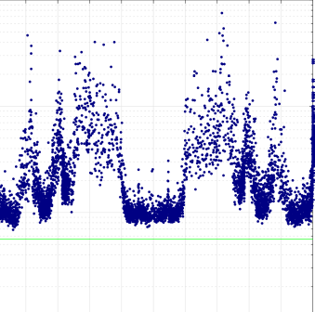
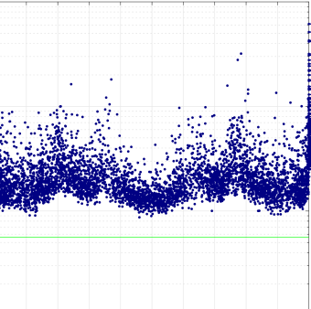
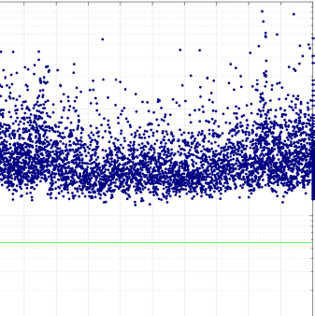



A Parameterized Transition

Slide 23
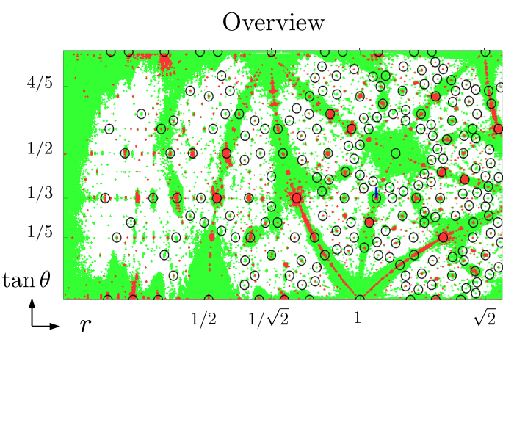
resonances AND
very extended states
resonances XOR
very extended states
random like
material properties
Scenic
Overview
black circles indicate
short period system geometry
We were here.

Slide 24

Scenic
Overview

Slide 25

Scenic
Overview

Slide 26

Thank you for your time!

