Slide 1
Week 4 Project
Rio Olympic medals

Slide 2
Project Brief
Design a web app which allows the medal results for the Rio Olympics to be searched and displayed.
The app should allow a search of results by country, athlete and event.
It should return the number of gold, silver and bronze medals won by a country and the points tally where gold is worth 5 points, silver is worth 3 points and bronze is worth 1 point.
Additional required functionality is the ability to add nations, to add athletes to nations and to add the medal won by the athlete.
Supplementary functionality
update and delete the athlete, event and country entries.
search and list the event medalists
output results in JSON

Slide 3
Planning and Research
https://www.rio2016.com/en/countries
Whiteboard Data Structure
Trello Board
Pseudocode
File Structure

Slide 4
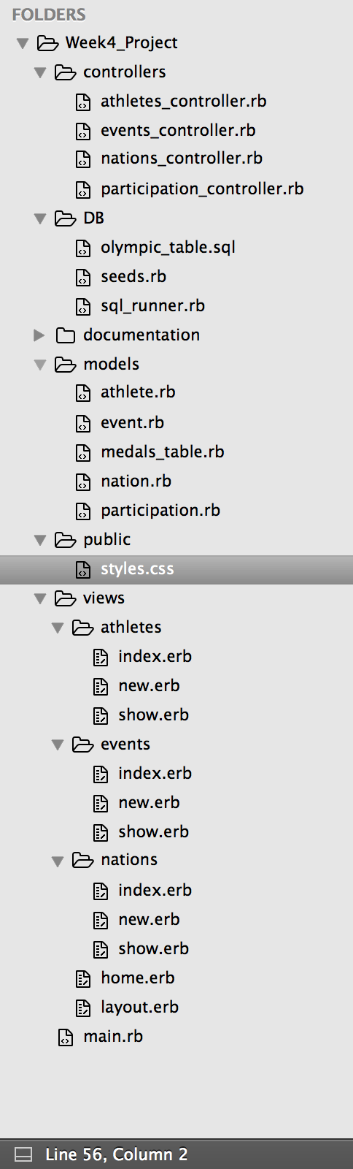
Whiteboard Data Planning

Slide 5
User Story - Paul
Paul has found a temporary data input job at Rio Olympic HQ, just until his underwear modelling career kicks off…
He has been tasked with populating and searching the database with details from the games.
He needs a home page with athlete, event and nation options.
From the home page he needs to be able to search a nations athletes, refine by event and add new countries/athletes/events.
Ideally he would like to be able to see the results of the medals in a table– sadly he will be disappointed by the first release functionality…

Slide 6
Time Management

Slide 7
Results…..Brace yourself

Slide 8
Learning
Aim for me was to understand the fundamentals in preparation for Java
More in depth planning particularly around data usage and manipulation
Ask for help more often and earlier
Don’t copy a load of code over and populate files with things you know should be there – build as needed so you understand what's going on!
More logical approach to coding - seemed a bit sporadic. – Get lost easily with this approach
Practice CSS!!!

