Slide 1

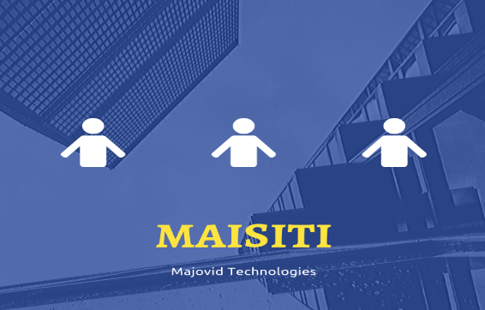
Maisity

Slide 2
Main idea
MaiSity is a platform to help citizens stay updated with the latest information in their city, helping them to consult information and make arrangements at any time and place, designed especially for people who are not familiar with technology.

Slide 3
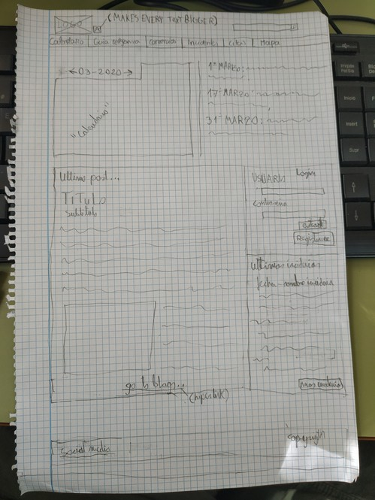
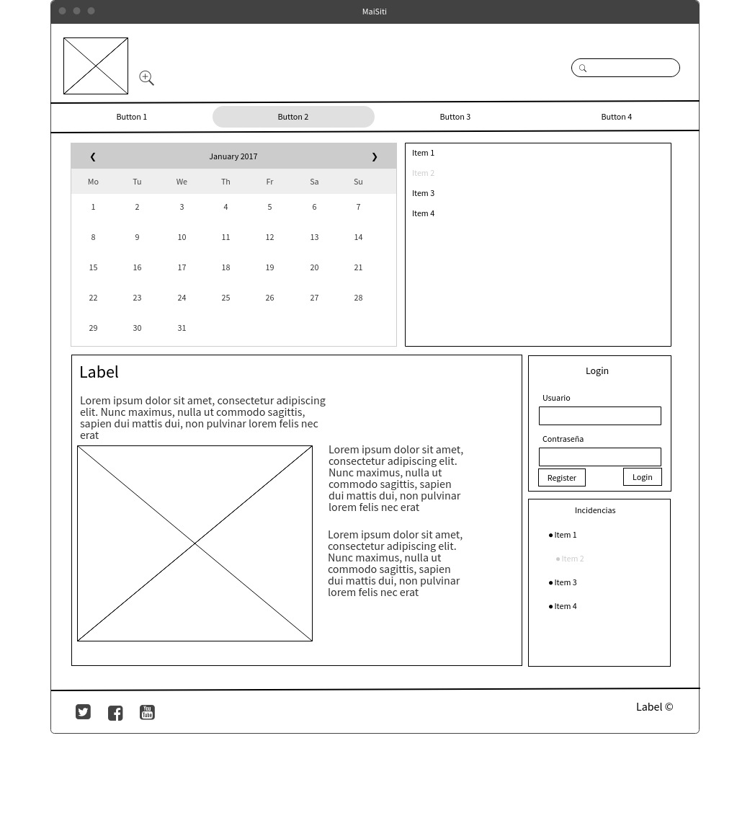
Designing

Slide 4
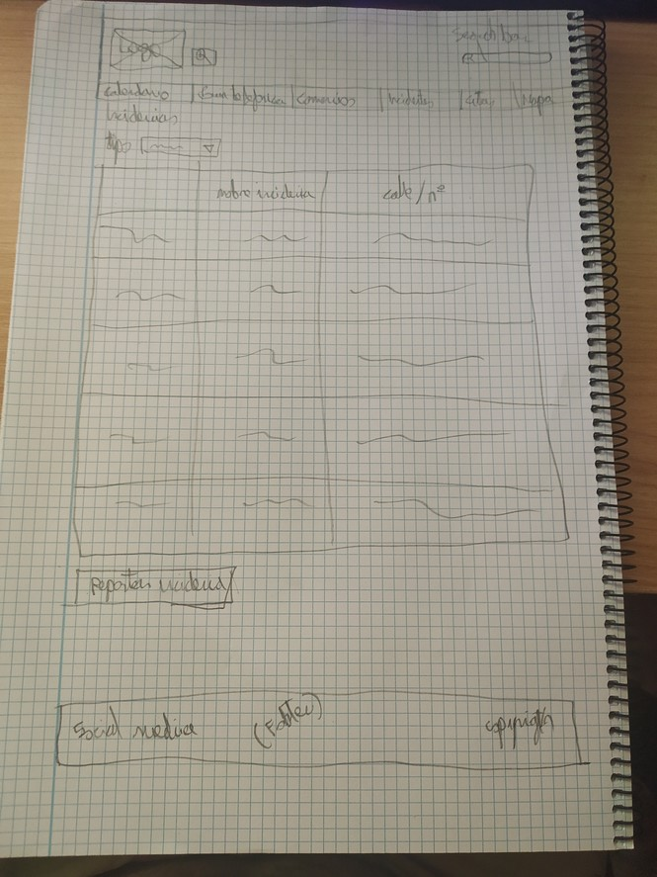
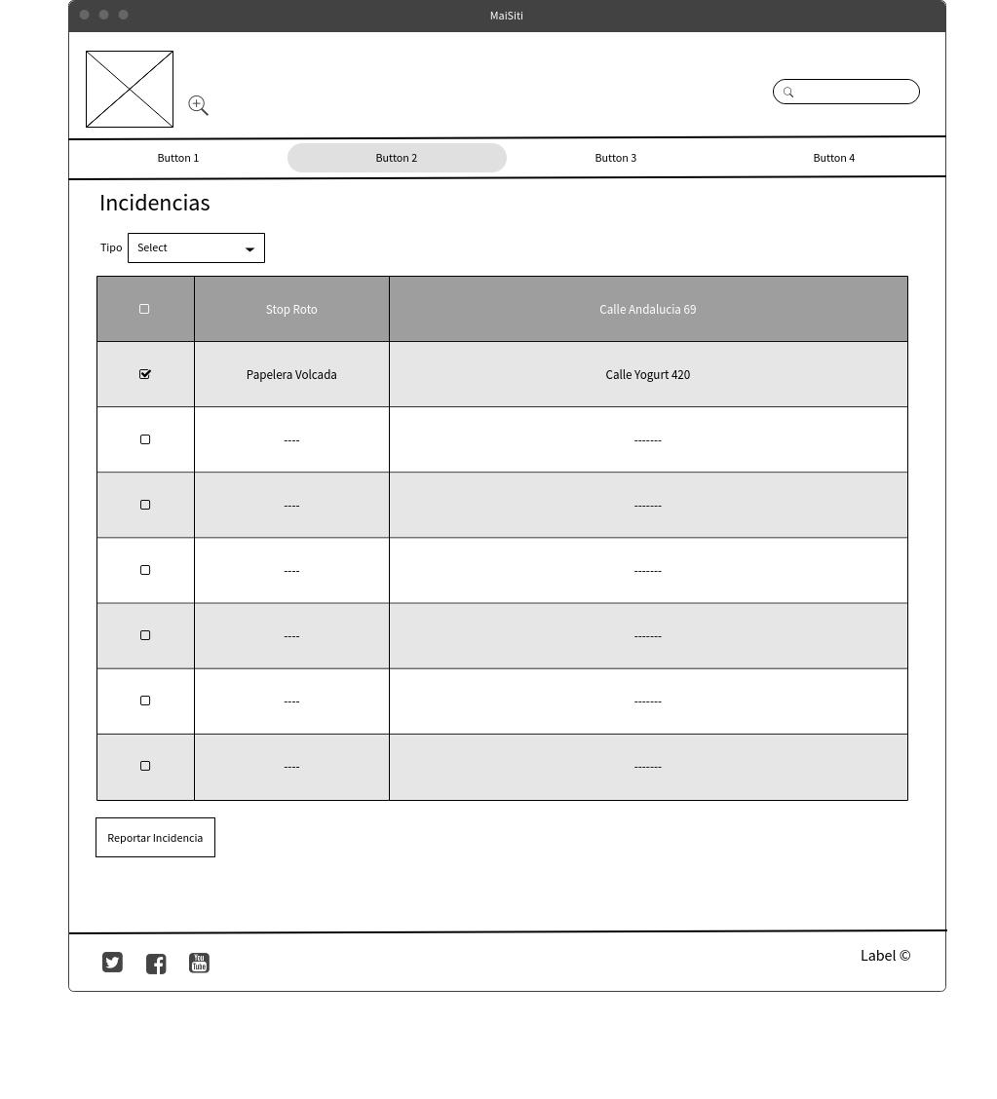
Designing 2

Slide 5
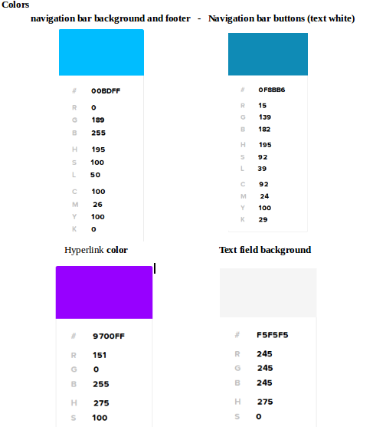

Slide 6
Other
Font
Titles: Roboto mono.
Subtitles: Roboto slab.
Text: Roboto Condensed
Footer and navigation var: Oswald
Icons
Corresponding Social Media icons on the footer.
The icon of a magnifier with a plus inside on the navigation bar for increasing the font size all over the page.
The logo is an icon that takes you to the home page on click.
The magnifier on the search bar that tells you it’s for searching text.
Navigation and interactions
The home page is a resume of the latest events on the page, the last blog post, the last calendar events, the last reports… When the user uses the navigation bar, it takes him to a detailed version of whatever he clicked, like the full details of the calendar, or the full details of the reports. There is a button next to the logo that increases the font size for those who can’t read well or doesn’t know how to zoom.
Each image and button has an informative text that tells what is it, the colors of the page have been thought so diatonic people can see the text, for example, the navigation bar buttons are blue, but the text is white, so that color is never confusing. The logo takes you to the home page on click. And the navigation bar follows you if you scroll down.

Slide 7
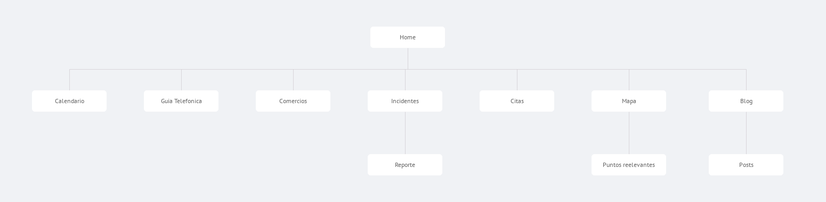
Navigation map

Slide 8
The end
Brought to you by MoJaVid Technologies.

