Slide 1
CHECKPOINT 1
DAVID SCARIN, FRANCISCO SILVA, TOMAS AZEVEDO
PA2_DS3_GA

Slide 2

Dataset
Airline Passenger Satisfaction Dataset
This dataset contains an airline passenger satisfaction survey. What factors are highly correlated to a satisfied (or dissatisfied) passenger?
Target Variable:
Satisfaction: Airline satisfaction level(Satisfaction, neutral or dissatisfaction)
Problem Type:
Multi-class classification problem
Characteristics:
129880 observations
24 features

Slide 3
Pre-modelling
Airline Passenger Satisfaction Dataset
Applying methods for interpretable ML, describing the data, setting baseline expectations, trying to find instances that are representative of the data through maximum mean discrepancy (MMD)
Techniques:
EDA (Exploratory Data Analysis) and Visualization
Prototypes through data summarization: MMD2-Critic

Slide 4
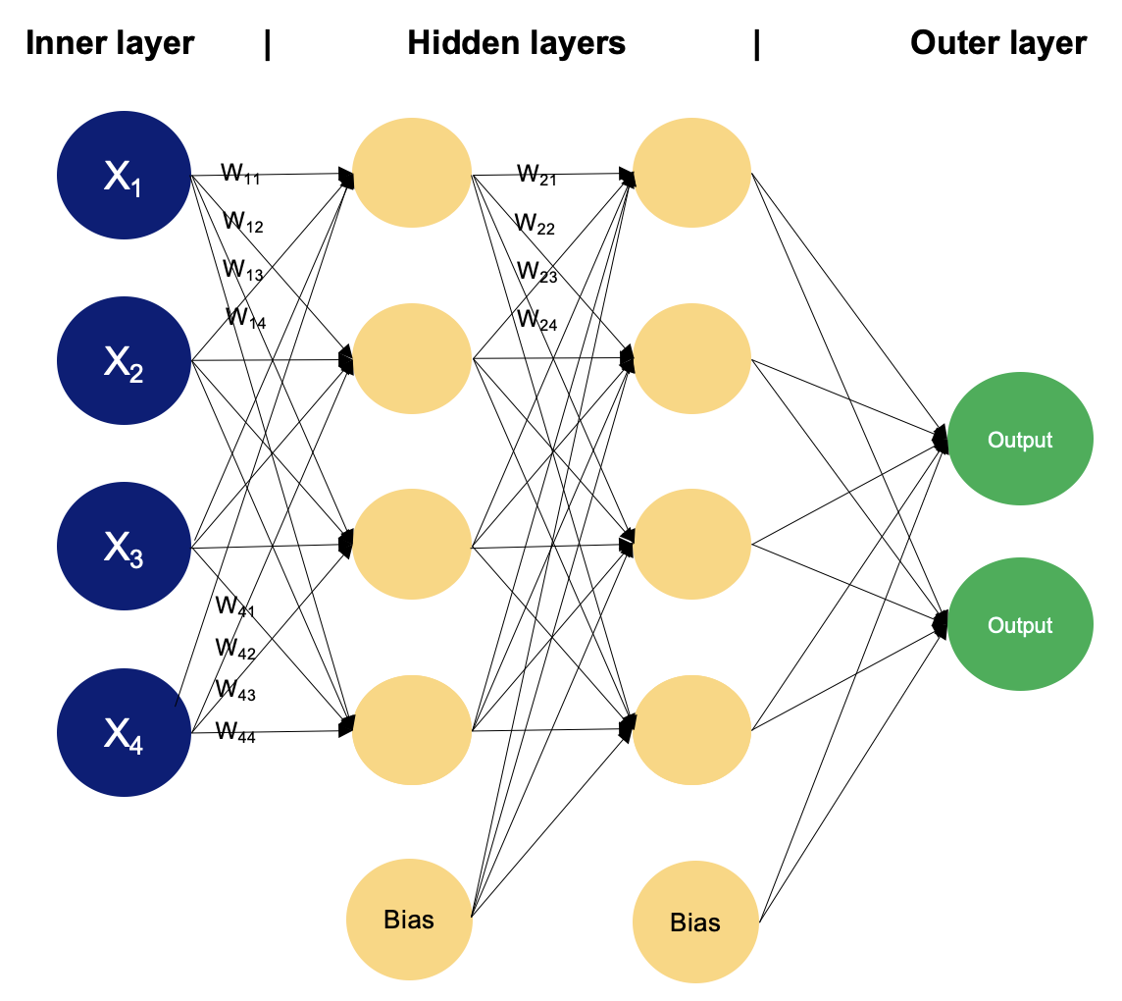
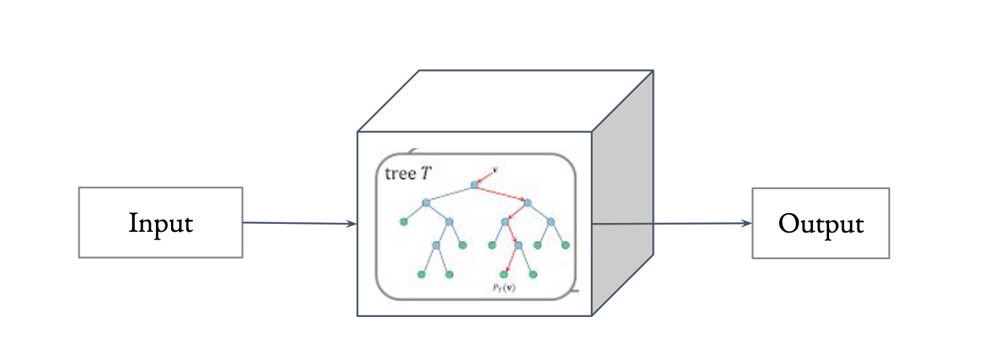
IN-MODELLING
Airline Passenger Satisfaction Dataset
Applying supervised multi-class classification learning models to the dataset; White Box / Black Box models,
Black Box:
MLP (Multi-Layer Perceptron)
White Box:
Decision Tree
Other rule learners (ILP?)

Slide 5
BIBLIOGRAPHY
Airline Passenger Satisfaction Dataset
Molnar, C. (2024) Interpretable Machine Learning: A Guide For Making Black Box Models Explainable, Leanpub, 2022. ISBN: 979-8411463330 (https://christophm.github.io/interpretable-ml-book/)
Belle, V., Papantonis, I. (2021). Principles and Practice of Explainable Machine Learning. Frontiers in Big Data, 4, 688969. https://doi.org/10.3389/fdata.2021.688969
Class Documentation TAAC 2024, Rita Ribeiro, Pedro Ferreira
Marques-Silva, Joao. "Logic-based explainability in machine learning." Reasoning Web. Causality, Explanations and Declarative Knowledge: 18th International Summer School 2022, Berlin, Germany, September 27–30, 2022, Tutorial Lectures. Cham: Springer Nature Switzerland, 2023. 24-104.

