Slide 1

MySQL
Basics

Slide 2
Hello!
I am Dave Stokes
I am MySQL Community Manager and have been using MySQL for over 20 years.
@Stoker david.stokes @oracle.com
Slides at slideshare.net/davidmstokes and github.com/davidmstokes/tutorials

Slide 3
MySQL is a relational database & a NoSQL JSON Document Database
Community Edition – Free to use
Enterprise Edition – Starts at $5K/4 core CPU before discounts
You MUST buy a license if you ship MYSQL with your product
GNU Public Licenses Version 2

Slide 4
0.Data
How do ‘we’ remember

Slide 5
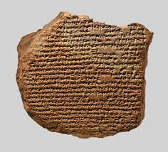

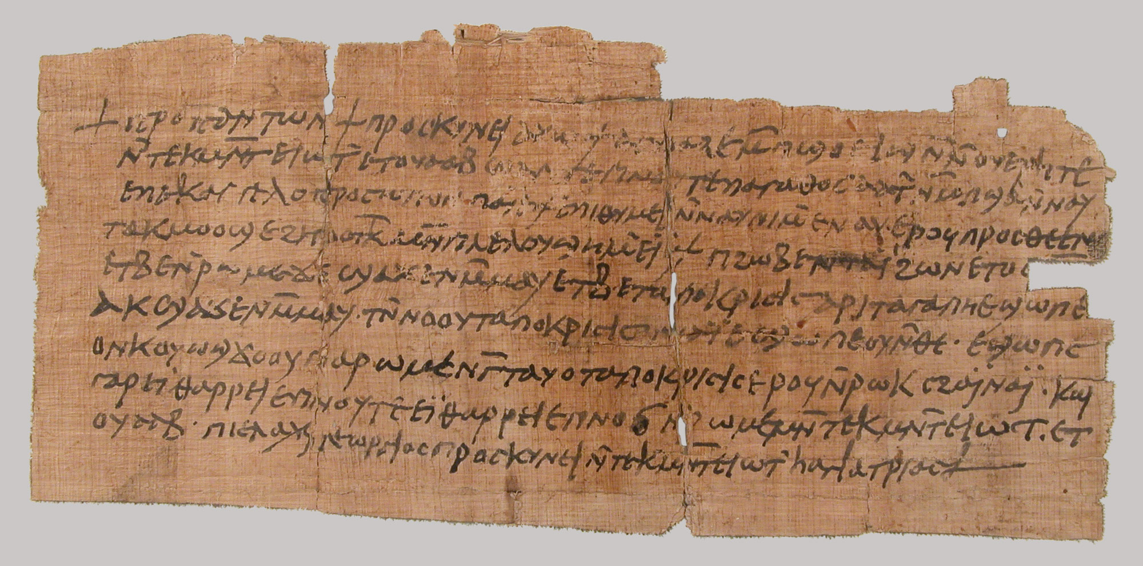

Recording information

Slide 6
Relational Databases
Data is split up into tables
Tables can have relations
  customer_id column in customer data and order data for common operations
Rich number of operations that can be performed on the data

Slide 7
Structured query language (SQL)
Kinda of like English (does not always make sense)
VERBS
  SELECT to ask questions
  INSERT to add data
  DELETE to remove data
  UPDATE to, well, update data
SELECT name, phone FROM friends WHERE name = ‘Dave’;

Slide 8
POP Quiz -- SQL Verbs
How do you pick out data?
How do you correct data?
How do you add data?
How do you remove data?
X
X
X
X

Slide 9
POP Quiz -- SQL Verbs
How do you pick out data?
How do you correct data?
How do you add data?
How do you remove data?
SELECT
X
X
X

Slide 10
POP Quiz -- SQL Verbs
How do you pick out data?
How do you correct data?
How do you add data?
How do you remove data?
SELECT
UPDATE
X
X

Slide 11
POP Quiz -- SQL Verbs
How do you pick out data?
How do you correct data?
How do you add data?
How do you remove data?
SELECT
UPDATE
INSERT
X

Slide 12
POP Quiz -- SQL Verbs
How do you pick out data?
How do you correct data?
How do you add data?
How do you remove data?
SELECT
UPDATE
INSERT
DELETE

Slide 13
How did you do?

Slide 14
Data stored in rows within a table
Tables have rows of data
Tables made up of columns
Similar to a spreadsheet
Multiple tables per schema
Database/schema often used interchangeably in MySQL
You can have multiple schemas per server
Column A | Column B
data | data
data | data

Slide 15
1.Installation
Choices - choices

Slide 16
Not actually installing software
If you have a copy of the MySQL server and a client program please feel free to follow along. But there are too many variable to get everyone up and running in the allotted time.

Slide 17
https://dev.mysql.com/downloads
Linux
  Apt Repo for Debian based systems
  YUM repo for Redhat-ish systems
  Binaries
Mac OS
Windows
  Installer
  Binaries
Source Code
Docker

Slide 18
Make sure it is MySQL
Some Linux distributions switched to MariaDB, a fork of MySQL created when Oracle took over MySQL and will NOT give you MySQL when you ask for it. MariaDB is not a drop in replacement for MySQL and lacks many features that you may want that are in MySQL only.

Slide 19
Using the MySQL apt repo
https://dev.mysql.com/doc/mysql-apt-repo-quick-guide/en/
Go to the download page for the MySQL APT repository at https://dev.mysql.com/downloads/repo/apt/
shell> sudo dpkg -i mysql-apt-config_w.x.y-z_all.deb
shell> sudo apt-get update
shell> sudo apt-get install mysql-server
shell> sudo service mysql start

Slide 20
Using the MySQL RPM repo
Go to the download page for MySQL Yum repository at https://dev.mysql.com/downloads/repo/yum/
shell> sudo rpm -Uvh mysql80-community-release-el6-n.noarch.rpm
shell> sudo yum install mysql-community-server
shell> sudo systemctl start mysqld.service

Slide 21
Other installation notes
Refer to the MySQL documentation at https://dev.mysql.com for help with your installation
The MySQL demo databases are found at https://dev.mysql.com/doc/index-other.html
You may want the mysql cli client (mysql), mysql shell (mysqlsh), and MySQL Workbench => please drop by MySQL table in expo area for a demo!!

Slide 22
2. Communicating with the MySQL server
Choices - choices

Slide 23


Most people think as the database residing on a server somewhere in a computer room (or the cloud) and the client as a laptop or desktop computer.
This is called the client server model of computing.
BTW databases run just fine on laptops too !

Slide 24
I recommend installing you favorite Linux on an older laptop and using the MySQL Repositories to learn MySQL

Slide 25
Starting the server
The mysqld program (MySQL Daemon) runs in the background on your Linux system. It normally listens on port 3306 (and the new NoSQL service listens on port 33060) for programs wanting to communicate with it
The command line program to talk to the mysqld daemon is named mysql
$ mysql –u user -p
PASSWORD: ********

Slide 26
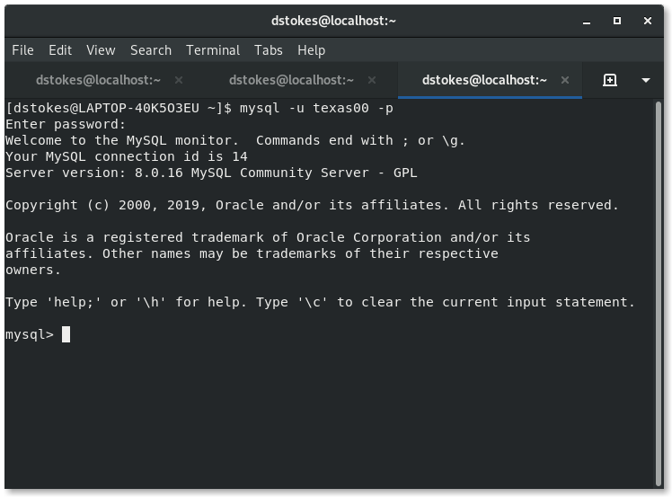
The mysql client Example
mysql - cli program
-u texas00 - user
-p - ask for password

Slide 27
The new MySQl Shell or mysqlsh
MySQL 8.0 has another shell named mysqlsh
$ mysqlsh
Features
  Command completion
  Improved help facility
  Three modes – JavaScript, Python & SQL
  Utility functions for admin work
    Check for server upgrade, JSON bulk loader, Cluster Administration

Slide 28
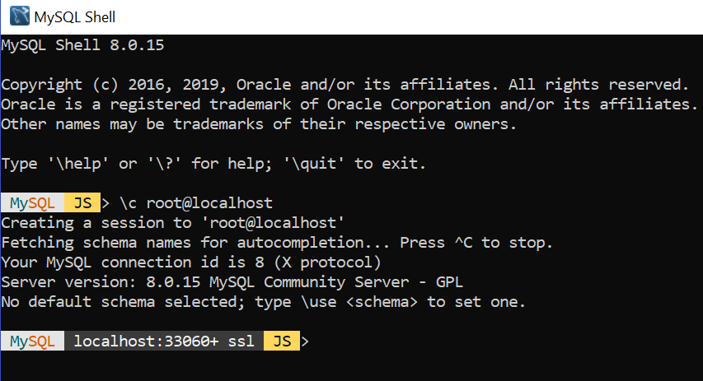
mysqlsh

Slide 29
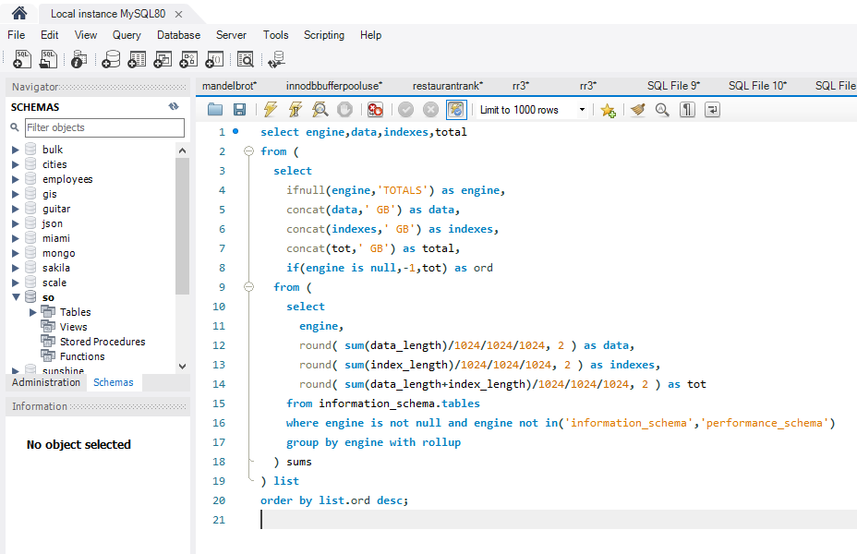
MySQL Workbench

Slide 30
3. First Data Set
Simple sample data

Slide 31
World data
Used for MySQL documentation, tutorials, training, etcetera
Out of date data but still useful for illustration purposes
Download from https://dev.mysql.com/doc/index-other.html
Extract the data with $gunzip world.sql.gz
$mysql u root –p < world.sql
This has already been done in demo accounts
But documented for those using the notes later!

Slide 32
Explanation
mysql –u root –p < world.sql
  mysql is the name of the cli program
  -u root tells server we want to use the account as the user root
  -p is used if the account has a password and the password will be asked from you
  < world.sql the < command on the Linux shell redirects input from the file named world.sql into the mysql cli program

Slide 33
The use command
The MySQL server can support many databases (proper term is schemas) and need to be told which one you want to use. We just created a schema named world when we loaded data.
$ mysql –u <account> –p
Password: ******
mysql> USE world;
Database changed;
mysql>

Slide 34
Uppercase/Lowercase
The MySQL server is case insensitive for commands if your operating system is also case insensitive. For illustration SQL commands will be in UPPERCASE and the stuff you need to type is in bold.
$ mysql –u root –p
Password: ******
mysql> USE world;
Database changed
mysql> SHOW SCHEMAS;

Slide 35
So what do we have???
mysql> SHOW TABLES;
+-----------------+
| Tables_in_world |
+-----------------+
| city |
| country |
| countrylanguage |
+-----------------+
3 rows in set (0.01 sec)
mysql>

Slide 36
So what do we have???
mysql> SHOW TABLES;
+-----------------+
| Tables_in_world |
+-----------------+
| city |
| country |
| countrylanguage |
+-----------------+
3 rows in set (0.01 sec)
mysql>
We have three tables – city, country, and countrylanguage – in our schema that can be queried (ask for information) for data.

Slide 37
QUICK quiz
In a relational database,
the data is organized within _________
and the data is kept in _______

Slide 38
QUICK quiz
In a relational database,
the data is organized within SCHEMAS (or databases)
and the data is kept in TABLES

Slide 39
4.Structured Query Language
How to ask a database questions

Slide 40
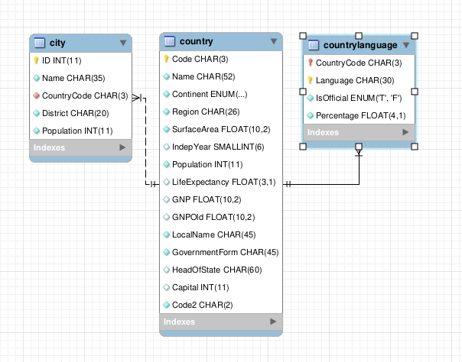
Entity Relationship Map of world schema

Slide 41
the city and countrycode tables have been set up with a CountryCode column to relate to the code column in the countrytable’s

Slide 42
SQL or structured query language
Designed in the 1970s
  Minimize data duplication
  Set theory and relational calculus
  When disks and memory were EXPENSIVE
  Still used today extensively
Divided into two parts
  Data Definition Language or DDL
    What the data looks like (Integer, Text, JSON, Geometry, …)
  Data Manipulation Language
    Looking at the data or DML

Slide 43
The basic commands -> Think verbs (action words)
SELECT
  Get data from a table
INSERT
  Put data into the table
UPDATE
  Change data in a table
DELETE
  Remove data in a table
We covered these ‘verbs’ earlier and they are the core of most queries that you will ever write.

Slide 44
Our First query
mysql> SELECT * FROM city LIMIT 1;
SELECT – ask server for data
* - Wildcard for all columns in a row of data
FROM city - the name of the table we want to use
(case must match)
LIMIT 1 – We want a maximum of one row of data
; - Tells the server we are done with this command and it can be run.

Slide 45
Wildcards:
* = all columns in a table
% = Matches 1 or more characters
%name matches
first_name and last_name

Slide 46
Our First query
mysql> SELECT * FROM city LIMIT 1;
+----+-------+-------------+----------+------------+
| ID | Name | CountryCode | District | Population |
+----+-------+-------------+----------+------------+
| 1 | Kabul | AFG | Kabol | 1780000 |
+----+-------+-------------+----------+------------+
1 row in set (0.25 sec)
mysql>

Slide 47
Our First query
mysql> SELECT * FROM city LIMIT 1;
+----+-------+-------------+----------+------------+
| ID | Name | CountryCode | District | Population |
+----+-------+-------------+----------+------------+
| 1 | Kabul | AFG | Kabol | 1780000 |
+----+-------+-------------+----------+------------+
1 row in set (0.25 sec)
mysql>
The first record has the fields ID, Name, CountryCode, District, and Population fields for the city of Kabul

Slide 48
Our First query
mysql> SELECT * FROM city LIMIT 1;
+----+-------+-------------+----------+------------+
| ID | Name | CountryCode | District | Population |
+----+-------+-------------+----------+------------+
| 1 | Kabul | AFG | Kabol | 1780000 |
+----+-------+-------------+----------+------------+
1 row in set (0.25 sec)
mysql>
Note that some columns are numbers only and some are alphanumeric

Slide 49
Experiment
What happens if you do not use LIMIT 1 ???

Slide 50
Experiment
What happens if you do not use LIMIT 1 ???
You get to see 4079 rows!

Slide 51
What if we want to get more specific?
We only want the city name
And those cities need to be in Texas
* We will cheat and assume that somehow we know that cities in Texas are designated by having the district column = Texas

Slide 52
The query
mysql> SELECT name FROM city WHERE DISTRICT = 'Texas';

Slide 53
The query –Also acceptable
mysql> SELECT name
FROM city
WHERE DISTRICT = 'Texas';
Readability is VERY important and you may prefer to break the query up over several lines.

Slide 54
The query
mysql> SELECT name FROM city WHERE DISTRICT = 'Texas';
SELECT name - Ask for the name column data
FROM city - The table with the data
WHERE - Specify constraints
DISTRICT = ‘Texas’ - The constraint
; - Done with the query

Slide 55
The output
+----------------+
| name |
+----------------+
| Houston |
| Dallas |
| San Antonio |
| Austin |
| El Paso |
| Fort Worth |
| Arlington |
| Corpus Christi |
| Plano |
| Garland |
| Lubbock |
| Irving |
| Laredo |
| Amarillo |
| Brownsville |
| Pasadena |
| Grand Prairie |
| Mesquite |
| Abilene |
| Beaumont |
| Waco |
| Carrollton |
| McAllen |
| Wichita Falls |
| Midland |
| Odessa |
+----------------+
26 rows in set (0.00 sec)

Slide 56
The output
+----------------+
| name |
+----------------+
| Houston |
| Dallas |
| San Antonio |
| Austin |
| El Paso |
| Fort Worth |
| Arlington |
| Corpus Christi |
| Plano |
| Garland |
| Lubbock |
| Irving |
| Laredo |
| Amarillo |
| Brownsville |
| Pasadena |
| Grand Prairie |
| Mesquite |
| Abilene |
| Beaumont |
| Waco |
| Carrollton |
| McAllen |
| Wichita Falls |
| Midland |
| Odessa |
+----------------+
26 rows in set (0.00 sec)
26 Cities in the table with the District = ‘Texas’!
Note they are not sorted alphabetically *
* Usually there is no guarantee on the order of the data returned from the server

Slide 57
WHERE -- The clause to narrow down your search
The WHERE clause in a SQL query is used to narrow down the query to the specific record(s).
WHERE age > 21
WHERE customer_id = 26378 AND amount_due > 0
WHERE seat_row BETWEEN 2 AND 3

Slide 58
Sort by the name of the city
SELECT name
FROM city AS city_name
WHERE DISTRICT = 'Texas'
ORDER BY name;
FROM city AS city_name tells the server we want to alias the name column as refer to is as city_name
ORDER BY name tells the server we want the results SORTED by the column name

Slide 59
The output
+----------------+
| name |
+----------------+
| Abilene |
| Amarillo |
| Arlington |
| Austin |
| Beaumont |
| Brownsville |
| Carrollton |
| Corpus Christi |
| Dallas |
| El Paso |
| Fort Worth |
| Garland |
| Grand Prairie |
| Houston |
| Irving |
| Laredo |
| Lubbock |
| McAllen |
| Mesquite |
| Midland |
| Odessa |
| Pasadena |
| Plano |
| San Antonio |
| Waco |
| Wichita Falls |
+----------------+

Slide 60
Experiment
What happens if you use ORDER BY name DESC???

Slide 61
Experiment
What happens if you use ORDER BY name DESC???
The results are sorted in DESCending order, W-A

Slide 62
5. JOINing tables
How to get data from two tables (or more)

Slide 63
Normalizing data
Splitting up the various pieces of data into separate tables is called normalizing. So the details on a customer are kept in a customer table and their order information is stored in a order table.
So by using the customer ID number from the customer table, yoy can look up their orders on the order table
SELECT * FROM orders
WHERE customer_id = 35882;

Slide 64
Relational tables
Data is ‘normalized’ to group similar information together
Different tables hold different sets of information
  The world schema has three tables
    City information – city
    Country information – country
    Country languages - countrylanguage

Slide 65
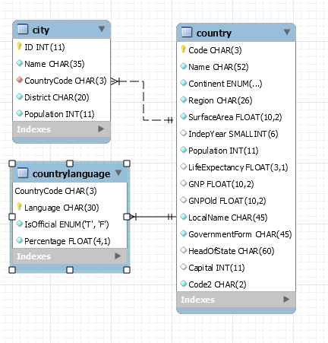
Someone has set up the tables so that they link through a column that is in all three of the schemas!
Both the city and countrylangauge tables have columns named CountryCode that match up with the Code column in the country table.
World Schema Entity Relationship Map

Slide 66
Keys between tables
country Table
code
countrylanguage table
countrycode
city table
countrycode
We can cross reference data in different tables with a column that have a common value or values

Slide 67
Keys between tables
country Table
code
= ‘USA’
(1 entry)
countrylanguage table
countrycode = ‘USA’
(1 or more entry)
city table
countrycode = ‘USA’
(1 or more entry
If we wanted to find all the records that mention ‘USA’ we would find one record in the country table and one or more entries in the city and countryinfo tables.

Slide 68
JOINing two tables together
mysql> SELECT City.name,
Country.name AS Country
FROM City
JOIN Country on
(City.countrycode = Country.code)
WHERE City.name = 'Irving';
+--------+---------------+
| name | Country |
+--------+---------------+
| Irving | United States |
+--------+---------------+
1 row in set (0.00 sec)
mysql>

Slide 69
JOINing two tables together
mysql> SELECT City.name, - ask for the name from city
Country.name AS Country - ask for the name from country
FROM City ‘alias’ name as Country
JOIN Country on - match the two tables
(City.countrycode = Country.code)
WHERE City.name = 'Irving'; - for the record that matches
+--------+---------------+ the city of Irving
| name | Country |
+--------+---------------+
| Irving | United States |
+--------+---------------+
1 row in set (0.00 sec)
mysql>

Slide 70
Joins can be complex
Joins let you drill down precisely to the desired information

Slide 71
Complex Example – you can work up to this!!
SELECT
CONCAT(customer.last_name, ', ', customer.first_name) AS customer,
address.phone,
film.title
FROM rental
INNER JOIN customer ON rental.customer_id = customer.customer_id
INNER JOIN address ON customer.address_id = address.address_id
INNER JOIN inventory ON rental.inventory_id = inventory.inventory_id
INNER JOIN film ON inventory.film_id = film.film_id
WHERE rental.return_date IS NULL
AND
rental_date + INTERVAL film.rental_duration DAY < CURRENT_DATE() LIMIT 5;

Slide 72

Write your
Own queries

Slide 73
Break number one
Fifteen minutes and no more please!!

Slide 74
6. Data Definition Language
Creating your own table

Slide 75
CREATE TABLE
mysql> CREATE TABLE foo (
-> id INT,
-> name CHAR(20)
-> );
Query OK, 0 rows affected (0.07 sec)
mysql>

Slide 76
CREATE TABLE
mysql> CREATE TABLE foo (
-> id INT,
-> name CHAR(20)
-> );
Query OK, 0 rows affected (0.07 sec)
mysql>
This creates a table named foo that has two columns – id for integer data, and
name for character data.

Slide 77
Data types
MySQL has several types of data to meet you needs
Numeric
Character (usually a-zA-Z & special characters like @#&!)
Date/Time
String
JSON documents
Spatial (Graphic Information, think GPS)
We will deal only with INT and CHAR() types (for now)

Slide 78
The next few slides are for illustration
Do not worry of these details are too much for now
I just want to show that there are many different types of data that can be stored in a database

Slide 79
Numeric
Type | Storage (BYTES) | Minimum Singed Value | Minimum Unsigned Value | Maximum Signed Value | Maximum Unsigned Value
TINYINT | 1 | -128 | 0 | 127 | 366
SMALLINT | 2 | -32768 | 0 | 32767 | 65535
MEDIUMINT | 3 | -8388608 | 0 | 8388607 | 16777215
INT | 4 | -2147483648 | 0 | 2147483647 | 4294967295
BIGINT | 8 | -263 | 0 | 263-1 | 264-1

Slide 80
Textual
CHAR(n) – Holds characters A-Za-z0-9!@#$%^&*() plus more
VARCHAR(n) – Variable length version, extra space need to note length
Where n is the number of character to be held.

Slide 81
CREATE TABLE - revisited
mysql> CREATE TABLE foo (
-> id INT,
-> name CHAR(10)
-> );
Query OK, 0 rows affected (0.07 sec)
mysql>
This is an example of the Data Definition Language (DDL) to create a table. The table has two columns – id & name – to store data.

Slide 82
What happens if a name is longer than 10 characters?

Slide 83
What happens if a name is longer than 10 characters?
mysql> INSERT INTO foo (id,name) VALUES (1,'ThisNameIsTooLong');
ERROR 1406 (22001): Data too long for column 'name' at row 1

Slide 84
INSERT INTO foo (id,name) VALUES (1,‘Dave');
INSERT – the action we want to perform
INTO foo – where the data is going – a TABLE named ‘foo’
(id,name) – specify the columns to be filled
VALUES - ‘What comes next is the data we want to store in ‘foo’
(1,’Dave’) - the data
; - designates ‘end of query’

Slide 85
Let’s add some data
mysql> INSERT INTO foo (id,name) VALUES (1,'Dave');
Query OK, 1 row affected (0.01 sec)

Slide 86
Let’s add some data
mysql> INSERT INTO foo (id,name) VALUES (1,'Dave');
Query OK, 1 row affected (0.01 sec)
mysql> SELECT id, name FROM foo;
+------+------+
| id | name |
+------+------+
| 1 | Dave |
+------+------+
1 row in set (0.00 sec)
mysql>

Slide 87
Let’s add some data
mysql> INSERT INTO foo (id,name) VALUES (1,'Dave');
Query OK, 1 row affected (0.01 sec)
mysql> SELECT id, name FROM foo;
+------+------+
| id | name |
+------+------+
| 1 | Dave |
+------+------+
1 row in set (0.00 sec)
mysql>

Slide 88
EXERCISE -> Follow along
Start your MySQL Client
Create a schema named ‘texas’
msqyl>CREATE SCHEMA texas;
‘Point’ to that schema
mysql>USE texas;
Create table from previous slide
Input some data using your name or nickname (under 10 characters and your lucky number
mysql> CREATE TABLE foo (
-> id INT,
-> name CHAR(20)
-> );

Slide 89
Inputting data
INSERT INTO foo (id,name) VALUES (1,'Dave');
INSERT INTO – The action we want to do
foo - the table we want to store data
(id,name) - the data fields
VALUES - tells server data is next
(1,'Dave'); - the actual data

Slide 90
Looking at the data we just stored
SELECT id, name FROM foo;
SELECT id FROM foo;
SELECT name FROM foo;
SELECT name, id FROM foo;
SELECT * FROM foo; -- * is a wildcard

Slide 91
What we have learned, command wise
INSERT
SELECT
CREATE schema
CREATE table
USE schema
SHOW SCHEMAS;

Slide 92
Modify the table by adding another column
mysql> ALTER TABLE foo ADD COLUMN zip char(5);
Query OK, 0 rows affected (0.07 sec)
Records: 0 Duplicates: 0 Warnings: 0

Slide 93
Why a char over an INTEGER?
Unless you specify most numeric values will truncate leading zeros so it is often better to have data such as zipcodes that WILL HAVE leading zeros as characters to ensure you keep those leading zeros!
Stuff Alex Trebeck Will Not EVER ask ME

Slide 94
ALTER TABLE foo ADD COLUMN zip char(5);
ALTER TABLE -- Task to be done, adding column
foo -- The name of table to ALTER
ADD COLUMN -- What action to be done
zip -- Name of the new column
char(5) -- What type of data needed
; -- ; is the end of query

Slide 95
Create a second table
And add a PRIMARY key

Slide 96
PEts!
What if you wanted to track pets in your neighborhood?
What information would you want to keep?
Name
Type
Owner
?

Slide 97
Normalize data
Name -- How many characters do we need to save names?
How about for the other fields?

Slide 98
Create table
CREATE TABLE pets (
);
Here is where we define that columns we need to store the data we want to keep!

Slide 99
Switch to demo screen
For those of you downloading the slides, this part of the tutorial is a live demo of creating the table for the pets data.

Slide 100
Indexes also know as a key
Without an index the entire database/file needs to be read to find the data, pronounced ‘s l o w’!
An index on a column lets you go directly to the matching column(s)
By default, MySQL wants an index and will create one for you if you do not have one
  And it usually picks one that you do not want
  And its pick may not be the best for performance
  So pick you own column or columns to index

Slide 101
CREATE TABLE pets2 (
id INTEGER AUTO_INCREMENT PRIMARY KEY,
name CHAR(25),
type CHAR(20),
breed CHAR(25),
owner CHAR(30),
contact CHAR(50));
Query OK, 0 rows affected (0.0618 sec)

Slide 102
CREATE TABLE pets2 (
id INTEGER AUTO_INCREMENT PRIMARY KEY,
name CHAR(25),
type CHAR(20),
breed CHAR(25),
owner CHAR(30),
contact CHAR(50));
Query OK, 0 rows affected (0.0618 sec)

Slide 103
What is PRIMARy KEY?
The primary key is the main index on a table
Hopefully this is a column that you will want/need to search on later

Slide 104
What is AUTO_INCReMENT?
Every time you add a record to a table with an autoincrement column, the number is AUTOMATICALLY incremented
When inserting data either do not name that column
Or pass a NULL for the value

Slide 105
mysql>INSERT INTO pets2 (id,name)
VALUES (NULL,'Bob'), (NULL,'Kitty');
Query OK, 2 rows affected (0.0139 sec)
Records: 2 Duplicates: 0 Warnings: 0
mysql> SELECT id,name FROM pets2;
+----+-------+
| id | name |
+----+-------+
| 1 | Bob |
| 2 | Kitty |
+----+-------+
2 rows in set (0.0004 sec)
The server automatically assigned the values for the id column.

Slide 107
CREATE TABLE timekeeper (x INT AUTO_INCREMENT PRIMARY KEY,
ts TIMESTAMP DEFAULT CURRENT_TIMESTAMP ON UPDATE CURRENT_TIMESTAMP, dt DATETIME DEFAULT CURRENT_TIMESTAMP ON UPDATE CURRENT_TIMESTAMP
);
Query OK, 0 rows affected (0.0421 sec)

Slide 108
INSERT INTO timekeeper (x) VALUES (NULL);
Query OK, 1 row affected (0.0068 sec)
SELECT * FROM timekeeper;
+---+---------------------+---------------------+
| x | ts | dt |
+---+---------------------+---------------------+
| 1 | 2019-05-18 09:35:16 | 2019-05-18 09:35:16 |
+---+---------------------+---------------------+
1 row in set (0.0005 sec)

Slide 109
ALTER TABLE timekeeper ADD COLUMN y INT DEFAULT 0;
UPDATE timekeeper SET y=1 WHERE x=1;
Query OK, 1 row affected (0.0089 sec)
Rows matched: 1 Changed: 1 Warnings: 0
SELECT * FROM timekeeper;
+---+---------------------+---------------------+---+
| x | ts | dt | y |
+---+---------------------+---------------------+---+
| 1 | 2019-05-18 09:38:22 | 2019-05-18 09:38:22 | 1 |
+---+---------------------+---------------------+---+
1 row in set (0.0006 sec)
Note the time changed from 9:35 to 9:38

Slide 110
Differences between datestamp and time stamp
DATETIME values is
'1000-01-01 00:00:00.000000' to '9999-12-31 23:59:59.999999',
TIMESTAMP values is
'1970-01-01 00:00:01.000000' to '2038-01-19 03:14:07.999999'

Slide 111
General Q&A

Slide 112
Where to learn more
Software
Download MySQL Server, MySQL Workbench, and test data
Books
Go to Half-Price Books and find a book on MySQL
Or go online -> google ‘mysql intro’
And look at www.mysql.com

Slide 113

There is a big demand for DBAs and Devs that know Databases
A complex idea can be conveyed with just a single still image, namely making it possible to absorb large amounts of data quickly.

Slide 114
“You learn more database concepts by ‘breaking things’ and learning how to fix them then by just reading the manual”

Slide 115
Data Concepts
Some other things that novices will run into that need some extra explanation

Slide 116
Transactions
Think: Bank taking funds from Customer A to pay Customer B
TRANSACTION
Does Customer A have enough funds to cover?
Place holds on the accounts for Customer A & Customer B to keep other transactions from interfering with this transaction
Withdraw MONEY from Customer A
Deposit MONEY into Customer B’s account
Remove holds on both account

Slide 117
Locking records
Records are LOCKed to keep others from changing values in row
Others will have to wait for locks to be released (called BLOCKING)
You can lock records in many ways
  SHARED
  EXCLUSIVE

Slide 118
Thanks!
Any questions?
You can find me at @stoker david.stokes @oracle.com
Slideshare.net/davidmstokes

