Slide 1

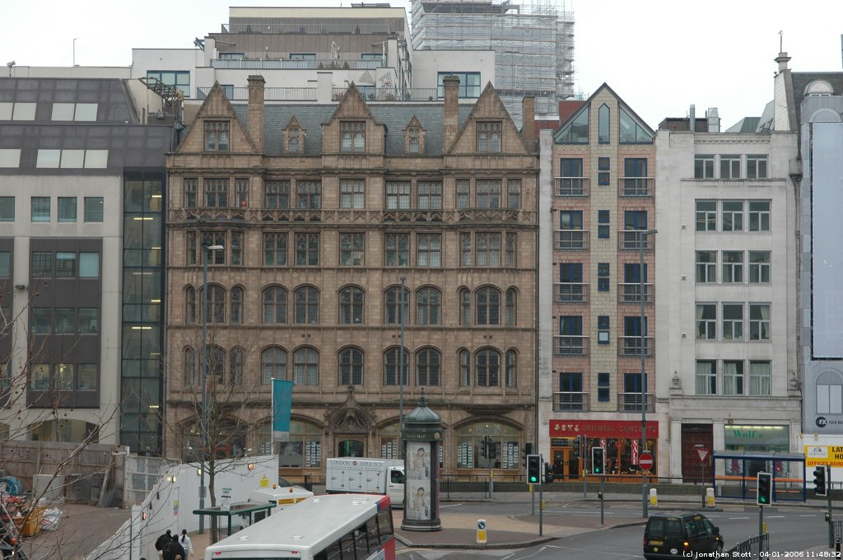
Lakota East High School
Gorillas

Slide 2
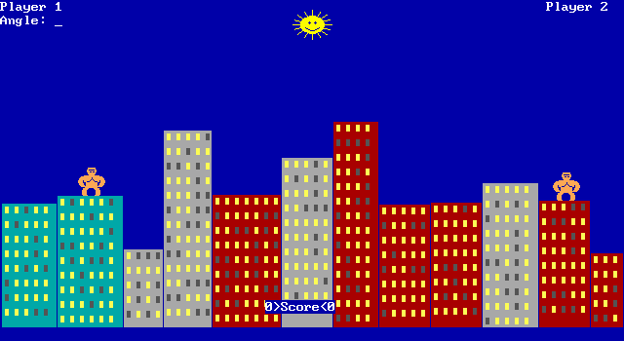
The old QBASIC Version

