Slide 1
Analysis of Employee Attrition and Salary
David George

Slide 2
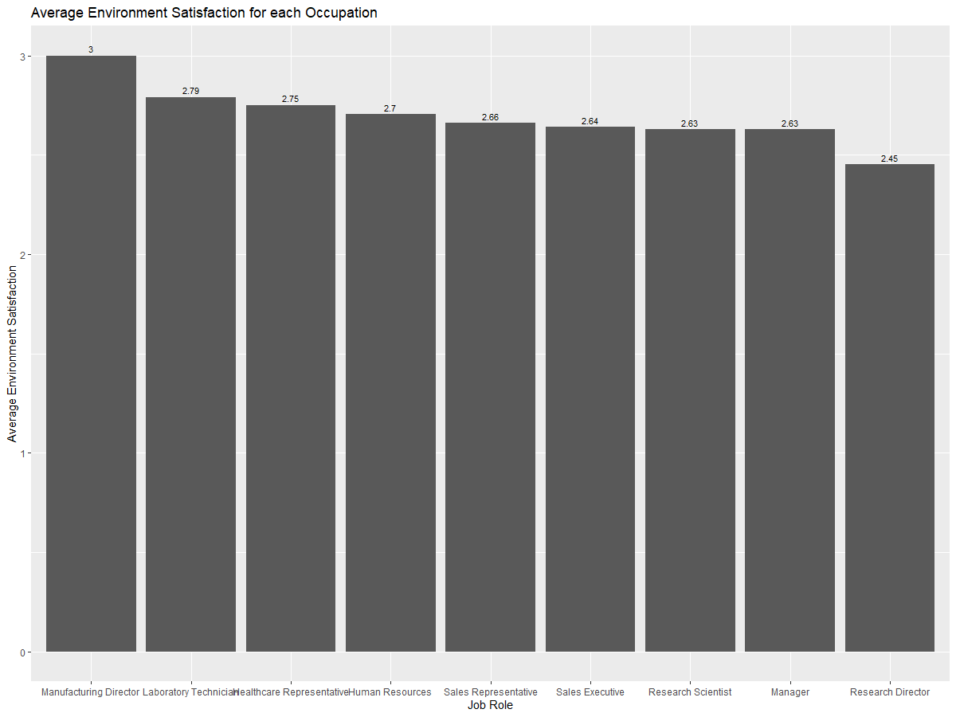
Job Roles with Highest Average Environment Satisfaction
Highest: Manufacturing Director
Lowest: Research Director

Slide 3
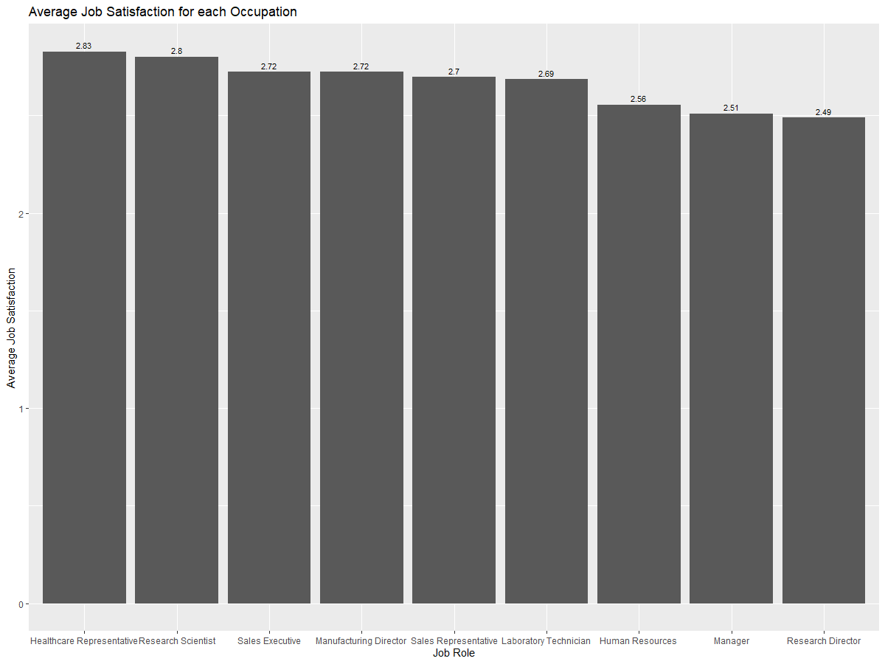
Highest Average Job Satisfaction
Highest: Healthcare Representative
Lowest: Research Director

Slide 4
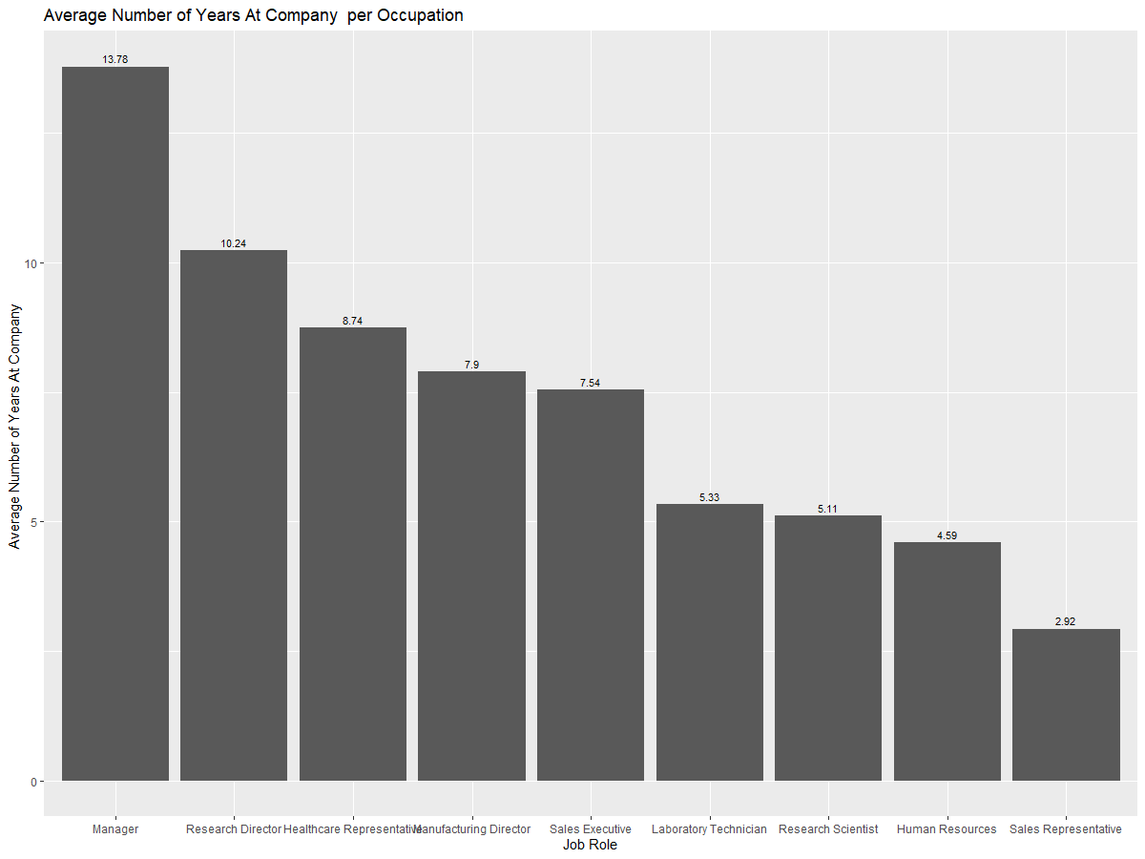
Job Roles with Highest Average Number of Years at the Company
Highest: Manager
Lowest: Sales Representative

Slide 5
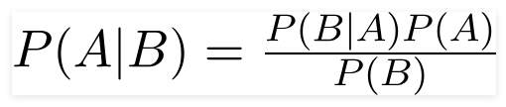
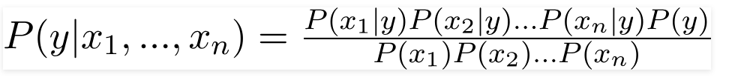
Classifying Attrition
Naïve Bayes Classifier: probability of event A occurring given that event B has occurred.
For many events x1,…xn:

Slide 6
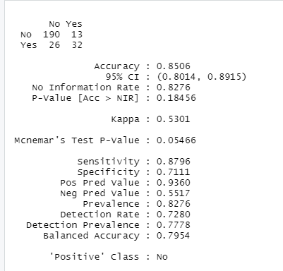
Classifying Attrition Cont.
Split 70% into training set and 30% into test set
Confusion Matrix and Statistics:

Slide 7
Predicting Yearly Salary
Linear Regression
Manually Dropped variables: Employee Count, Over18, StandardHours, MonthlyIncome
Used stepwise selection to dropped additional variables that were insignificant.
Split 70% into training set and 30% into test set

Slide 8
Predicting Yearly Salary Cont.
Variable included in model:
JobLevel
JobRole
TotalWorkingYears
BusinessTravel
DistanceFromHome
YearsWithCurrManager
YearsSinceLastPromotion
Root Mean Squared Error on training set: $12310
Root Mean Squared Predicted Error on test set: $12083.09
R^2: 95.13%

Slide 9
Thank you!
Questions?
Contact davidg@mail.smu.edu

