Slide 1
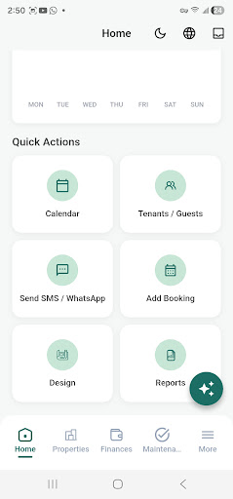
HostBora
Early access · 200+ landlords
Property management that stays clear
From guest nights to monthly rent.
One trustworthy app for short-stay hosting and long-term rentals — bookings, tenants, payments, staff, expenses and reports.
BnB + Rent
TZS-ready
Offline-friendly
Two workspaces
Local currency
Works on the go
Android & iOS · App v1.2.3
HostBora · hostbora.co.tz
1
Notes:
HostBora is a property management app built for landlords and property managers in Tanzania and East Africa. It handles both short-stay BnB hosting and long-term rentals in a single app.

Slide 2

THE PROBLEM
Rent is being managed in screenshots and notebooks
Most landlords track money across three or four disconnected places. Nothing reconciles, and nothing is easy to prove.
M-Pesa screenshots
Payment proof lives in a gallery, not in a ledger.
WhatsApp threads
Tenant promises and repair requests get buried.
Handwritten notebooks
HostBora replaces that chaos with one clear record per property.
Arrears and expenses are recalculated by hand.
HostBora · hostbora.co.tz
2
Notes:
Open with the pain the audience already recognises: payment proof in the phone gallery, conversations in WhatsApp, and arrears worked out by hand.

Slide 3
WHAT HOSTBORA DOES
Four things, handled in one place
Income, operations, people and records — the same four jobs every landlord and manager repeats every month.
Income
People
Operations
Records
Rent, bookings, deposits and every expense recorded in TZS.
Tenants, guests and staff with clear roles and history.
Tasks, reminders, cleaning, maintenance and check-ins.
Leases, IDs, receipts and reports ready when needed.
2
TZS
Offline
workspaces — BnB and Rent
first-class currency and mobile money
capture now, sync when back online
HostBora · hostbora.co.tz
3
Notes:
Frame the product around four repeating jobs rather than a long feature list. The band underneath states the three things that make it fit East Africa: dual workspaces, TZS-first money, and offline capture.

Slide 4
BNB + RENT
Two workspaces, one app
Switch whenever you need to — the same properties, with flows tuned to how that property earns.
BnB
Rent
Short-stay hosting
Long-term rentals
Nightly bookings, guest turnover, cleaning schedules and hospitality-style income. Ideal for furnished apartments, guest houses and holiday lets.
Monthly leases, tenant records, rent collection and building-level expenses. Built for landlords and managers with recurring income.
▪ Booking calendar with check-in and check-out
▪ Guest payments and per-stay expenses
▪ Operations tuned for fast turnover
▪ Tenants, units and lease tracking
▪ Rent payments and arrears visibility
▪ Staff, utilities and building costs
HostBora · hostbora.co.tz
4
Notes:
This is the main structural difference from single-purpose tools: one portfolio, two operating modes. A landlord can run a guest house and a block of flats without buying two products.

Slide 5
DAILY TOOLKIT
Everything landlords and managers need daily
Payments & expenses
Rentals & tenants
Staff & tasks
Record rent, guest income and costs in TZS — M-Pesa, Tigo Pesa, Airtel Money.
List units, track leases and keep tenant details tidy across the portfolio.
Assign cleaners, guards or maintenance with due dates and clear status.
Reminders
BnB & long-term rent
Reports & profitability
Stay ahead of renewals, check-ins, payment follow-ups and routine chores.
Run nightly bookings and monthly leases from the same portfolio.
See income against spend per property, with summaries you can act on.
Smart access
Document vault
Calendar sync
Coordinate digital locks and guest entry — fewer handoffs at check-in.
Keep leases, IDs, manuals and tax records in clearly named folders.
Link external calendars to cut double bookings and align blocked dates.
HostBora · hostbora.co.tz
5
Notes:
The full toolkit at a glance. Payments is highlighted because it is the first thing new users adopt — everything else builds on a trustworthy money record.

Slide 6
MONEY
Payments, expenses and profitability
Record income the way it actually arrives, then see what each property really earns.
▪ Mobile money first — M-Pesa, Tigo Pesa, Airtel Money
▪ Rent and guest income in one ledger, priced in TZS
▪ Log expenses against the property that incurred them
▪ Arrears and outstanding balances stay visible
▪ Reports that summarise income against spend
Income vs expenses per month
Illustrative portfolio view, TZS millions
Why it matters
A verifiable money trail — every shilling traced to a property, a tenant and a date.
HostBora · hostbora.co.tz
6
Notes:
Money is the reason landlords keep using the app. Stress mobile-money capture, then the payoff: per-property profitability instead of a single blended figure. The chart is illustrative, not live data.

Slide 7
PEOPLE & OPERATIONS
Tenants, staff and everyday operations
Tenants & guests
Staff & tasks
Reminders
▪ Units, leases, renewal dates
▪ Contacts and payment history
▪ Residency tracking
▪ Cleaners, guards, maintenance
▪ Assign work with due dates
▪ Status you can follow up
▪ Lease renewals, check-ins
▪ Payment follow-ups
▪ Recurring chores
Every chase, repair and renewal leaves a record — so owners can see the work, not just the outcome.
HostBora · hostbora.co.tz
7
Notes:
Operations are where trust is won with owners and tenants. The point to land: the app produces proof of work, which is what an owner actually wants to see at month end.

Slide 8
RECORDS & ACCESS
Paperwork and entry, without the hunt
Document vault
Smart access
Calendar sync
Leases, IDs, manuals, receipts and tax records in clearly named folders — per property, ready when an agent, auditor or bank asks.
Coordinate digital locks and guest entry where supported, so check-in does not depend on someone handing over a key.
Link external booking calendars to reduce double bookings and keep blocked dates aligned across channels.
One folder per property. Nothing lives only on someone's phone.
Leases & IDs
Receipts
Tax records
named per unit
matched to expenses
ready at year end
HostBora · hostbora.co.tz
8
Notes:
Records are the least exciting feature and the most reassuring one. Tie it to real moments: a bank asking for a lease, or an auditor asking for receipts.

Slide 9
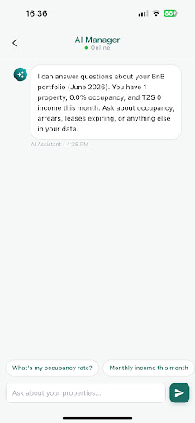
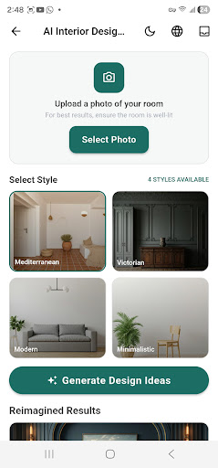
ASSISTANCE
AI Manager and design tools
Ask questions about the portfolio in plain language, and help owners picture what a unit could become.
AI Manager
Ask about occupancy, arrears, income this month or leases expiring — answered from your own data.
AI interior design
Upload a photo of a room and generate styled concepts to guide refurbishment and listing photos.
Available on the Ultra plan, alongside smart locks and entry logs.
HostBora · hostbora.co.tz
9
Notes:
These are the differentiating features. AI Manager turns the data the user already entered into answers; design tools help with vacant or tired units. Both sit on the Ultra tier.

Slide 10
WHO IT'S FOR
Made for people who run properties
Whether you own one unit or manage a growing portfolio across Dar, Arusha or beyond.
Landlords
Property managers
Hosts & operators
Own apartments, houses or blocks. See rent collected, vacancies and cost per unit without juggling notebooks.
Oversee multiple owners or buildings with staff workflows, expenses and reports your clients can trust.
Run BnB or mixed portfolios — boutique stays to serviced apartments — with bookings and operations in sync.
Same properties, same records — whether you manage them yourself or someone manages them for you.
HostBora · hostbora.co.tz
10
Notes:
Three buyer types. Note that owners and managers share one data model, which is what makes owner reporting possible later.

Slide 11

TRUST
Built for how you work in East Africa
Professional, dependable and respectful of local realities — not a generic import.
Works offline
1
Keep recording payments, notes and tasks when connectivity dips — everything syncs when you are back online.
TZS-friendly
2
Think in Tanzanian shillings and the mobile money you already use, not a foreign-currency mindset.
Security & privacy
3
Data encrypted in transit and at rest, hosted to international standards. Your property and tenant data stay yours.
HostBora · hostbora.co.tz
11
Notes:
Close the credibility gap. Offline capture and TZS-native money handling are the two things generic imports get wrong; security is the answer to the tenant-data question.

Slide 12
PRICING
Free while in early access
Every feature, no card, no commitment. Choose a tier when billing begins — we notify you first.
Most popular
Starter
Pro
Ultra
19,000
49,000
99,000
TZS / month
TZS / month
TZS / month
For solo hosts getting organised.
For growing portfolios and small teams.
For operators and managers at scale.
▪ Up to 3 properties
▪ BnB or Rent workspace
▪ Payments, expenses, reminders
▪ Basic reports
▪ Up to 10 properties
▪ Staff, tasks, calendar sync
▪ Document vault, advanced reports
▪ SMS / WhatsApp add-on
▪ Unlimited properties
▪ Smart locks and entry logs
▪ AI Manager and design tools
▪ Priority support
Download free on Google Play and the App Store
hostbora.co.tz · WhatsApp us
HostBora · hostbora.co.tz
12
Notes:
Planned rates in Tanzanian shillings; mobile money will be supported at billing. Finish on the free early-access offer and a single next step: download the app.

