Slide 1


TalkerShip
Rania Glass, David Neary, Eris He
HackGT 2015

Slide 2
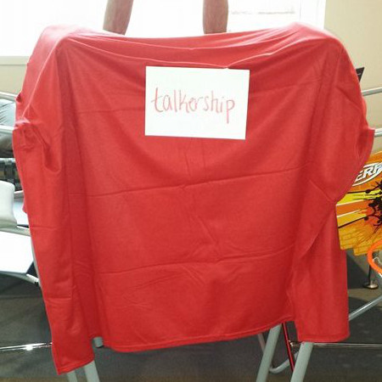
Why TalkerShip?
Improve communications between individuals
Better relationships by maintaining contact
Smooth integration with Facebook API
User-oriented experience

Slide 3
Technical Talk
Web app developed with JavaScript and jQuery
Integrates Facebook API to login and pull friend information
Express server with Socket.IO node
Hosted on Cloud9
GitHub repo: https://github.com/rania-glass/talkership

Slide 4
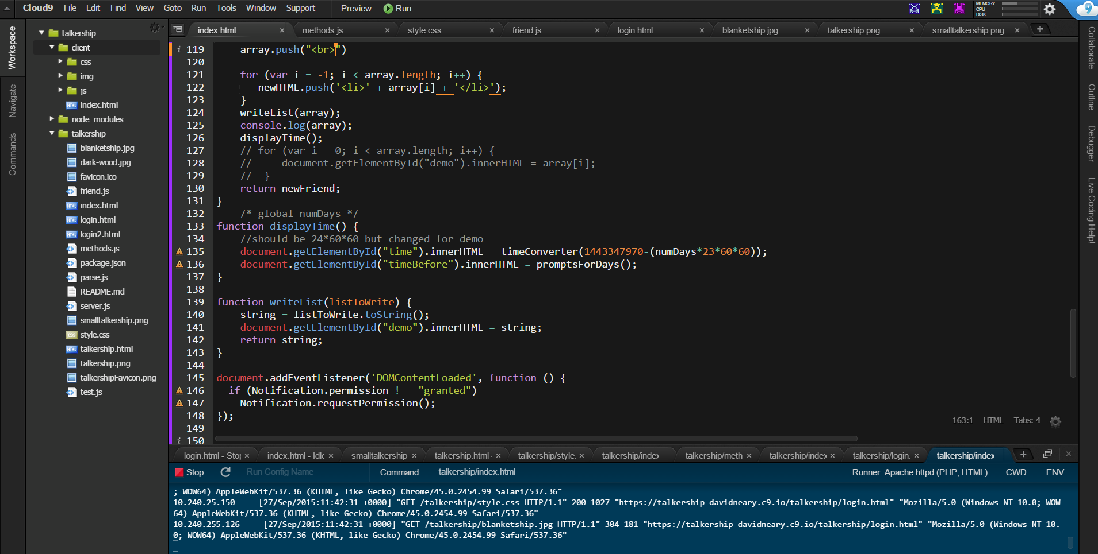
Development Example

Slide 5
Pie Chart Example

Slide 6
Line Chart Example

Slide 7
Area Chart Example

Slide 8
Demo Title
demo
Name
Title
Group

Slide 9
Video Title
video

Slide 10
Partner Title
partner
Name
Title
Company

Slide 11
Customer Title
customer
Name
Title
Company

Slide 12
Announcement Title
announcing

