Slide 1
Project 3: Machine Learning for Price Prediction
Robin Hawkins, David Lin, Neil Mudjer, Adam Roberts

Slide 2
OHE has some significant shortcomings
OHE representation produces very high dimensionality, this causes an increase in the model’s training and serving time and memory consumption.
OHE can easily cause a model to overfit the data.
OHE can’t handle categories that weren’t in the training data (like new URLs, new device types etc), this can be problematic in domains that change all the time.
“
”
https://blog.myyellowroad.com/using-categorical-data-in-machine-learning-with-python-from-dummy-variables-to-deep-category-66041f734512

Slide 3
Why and Where to Apply Feature Scaling?
“
The algorithms which use Euclidean Distance measure are sensitive to Magnitudes. Feature scaling helps to weigh all the features equally.
If a feature in the dataset is big in scale compared to others, then in algorithms it needs to be normalized.
Examples of Algorithms where Feature Scaling matters
K-Means
K-Nearest-Neighbours
Principal Component Analysis (PCA)
Gradient Descent
Examples of algorithms not/less affected by scaling:
Naive Bayes
Linear Discriminant Analysis
Tree-Based models.
Essentially, non-distance based algorithms are less affected by feature scaling
”
https://www.geeksforgeeks.org/python-how-and-where-to-apply-feature-scaling/

Slide 4
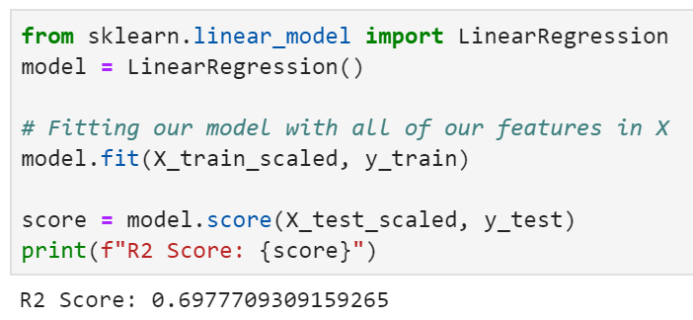
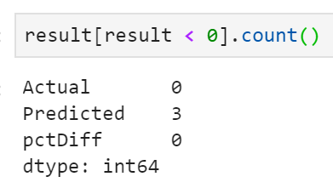
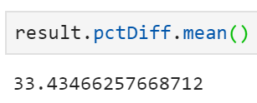
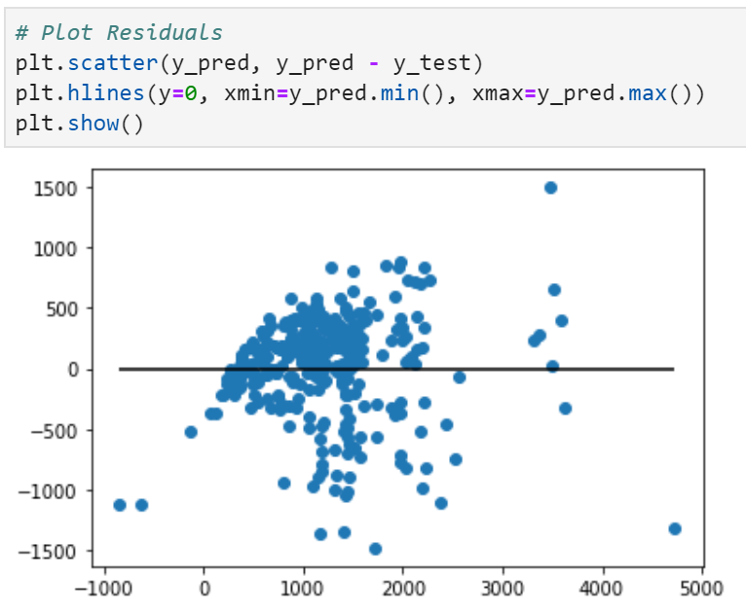
#1 Linear regression WITH OHE and WITH Scaling
pctDiff =
(Predicted Price – Actual Price)
Actual Price
Then we evaluate the mean of the abs(pctDiff) values

Slide 5
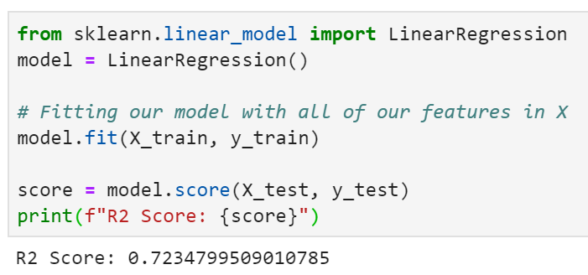
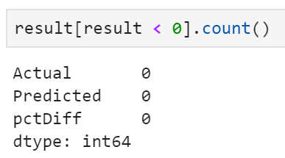
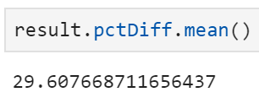
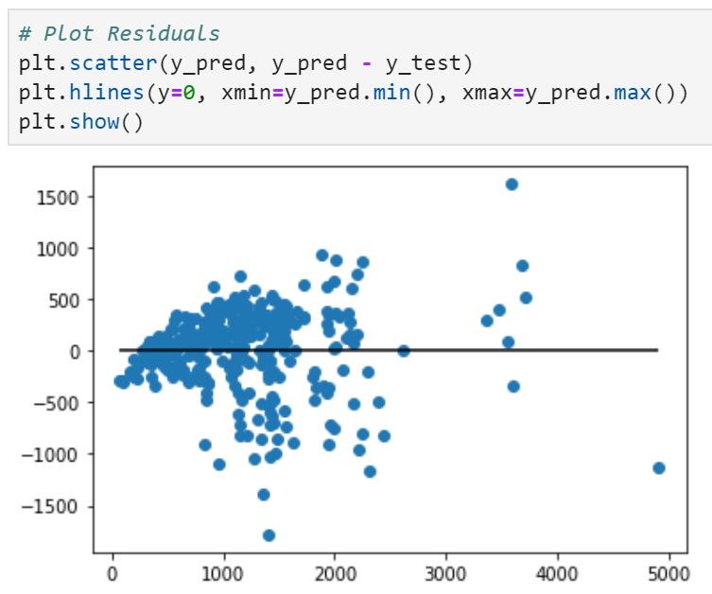
#2 Linear regression WITH OHE but WITHOUT Scaling

Slide 6
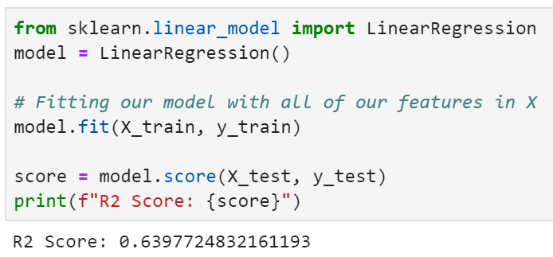
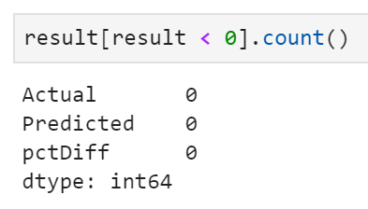
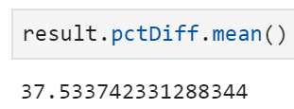
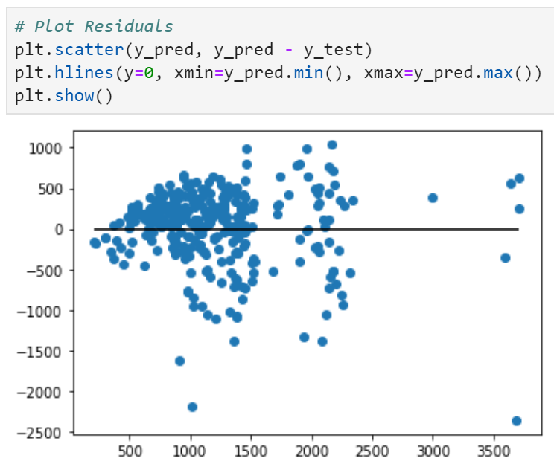
#3 Linear regression WITHOUT OHE (retain only continuous features) but WITH Scaling
Examples of continuous variables:
Weight
RAM
CPU
Inches
Examples of categoricals:
Brand
Operating System
Memory Structure, e.g., SSD, HDD
GPU company

Slide 7
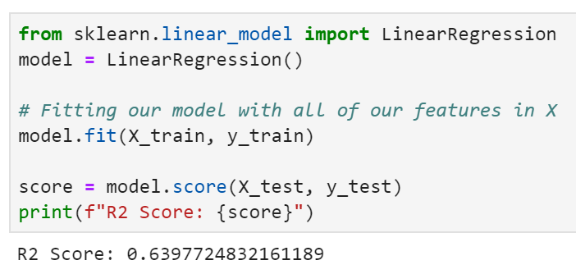
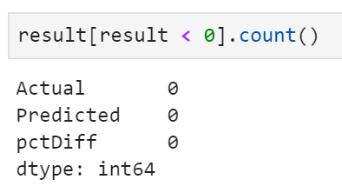
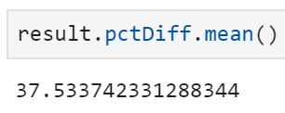
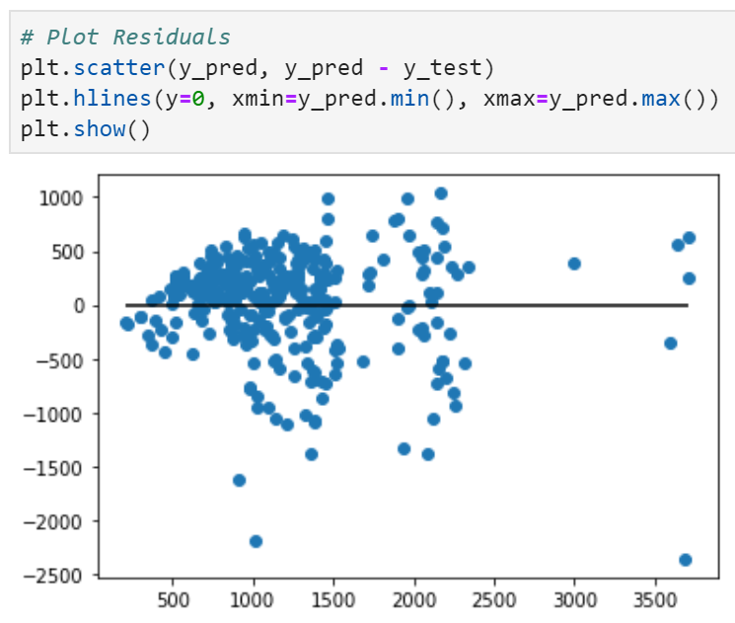
#4 Linear regression - WITHOUT OHE (retain only continuous features) and WITHOUT Scaling

Slide 8
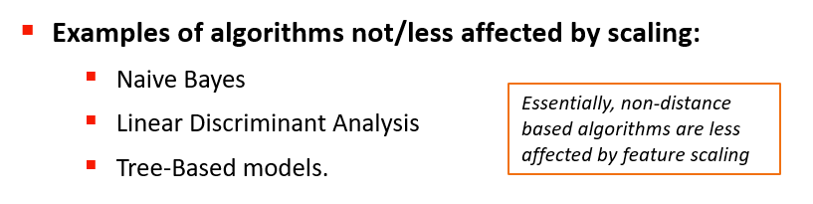
 | OHE – Yes | OHE – No
Scaling of variable – Yes | LR Features = 42 R2 Score = 0.698 pctDiff = 33.4% RFR Features = 42 pctDiff = 20.0% | LR Features = 5 R2 Score = 0.640 pctDiff = 37.5% RFR Features = 5 pctDiff = 22.9%
Scaling of variables - No | LR Features = 42 R2 Score = 0.723 pctDiff = 29.6% RFR Features = 42 pctDiff = 20.0% | LR Features = 5 R2 Score = 0.640 pctDiff = 37.5% RFR Features = 5 pctDiff = 22.9%
LR = Linear Regression
RFR = Random Forest Regressor
“
Scaling doesn’t affect algorithms that weigh each feature independently (Perlas, 2020)
”
RFR parameters used:
n_estimators = 100 random_state = 42
https://www.geeksforgeeks.org/python-how-and-where-to-apply-feature-scaling/
Notes:
Having more features helped (i.e., with OHE)
RFR seems to be immune to the scaling
Turns out that linear regression model should also NOT be affected by scaling (refer to Kevin’s quotes)

Slide 9
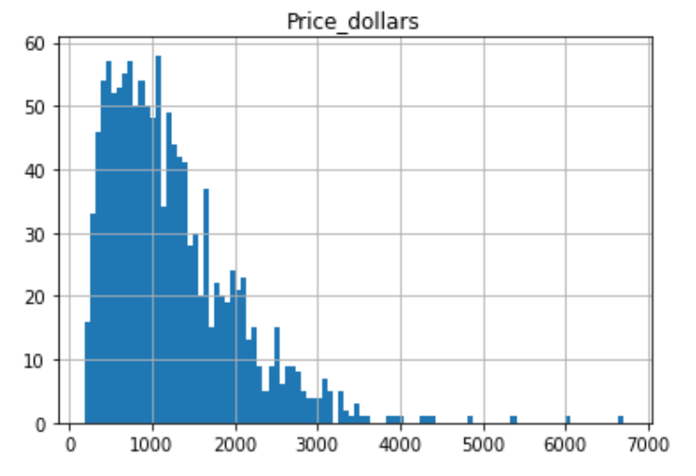
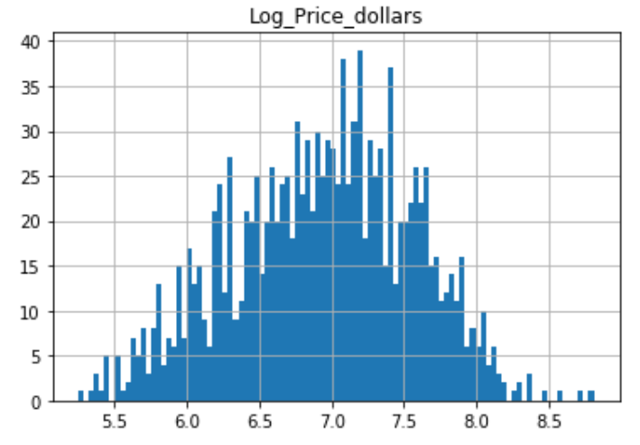
Transforming Skewed Data for Machine Learning
Log (Price) prior to training and testing
https://medium.com/@ODSC/transforming-skewed-data-for-machine-learning-90e6cc364b0

Slide 10
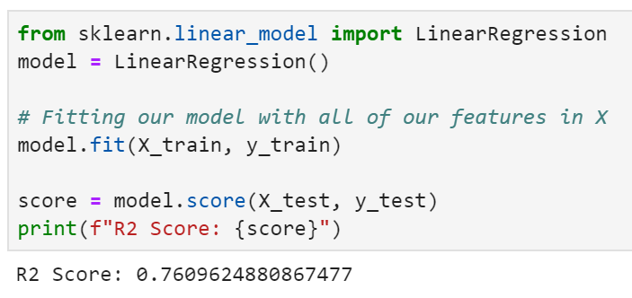
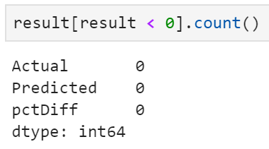
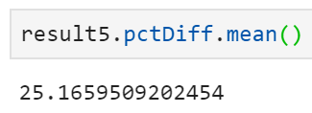
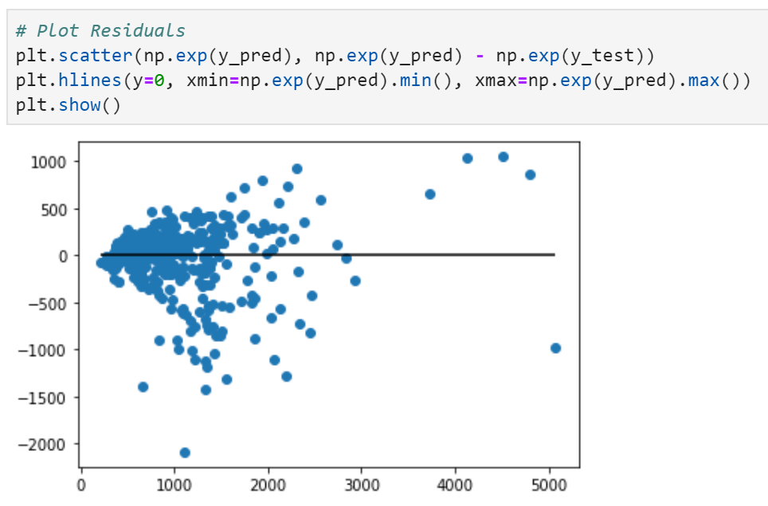
#5 Linear regression - After log transformation (Price); WITH OHE but WITHOUT Scaling

Slide 11

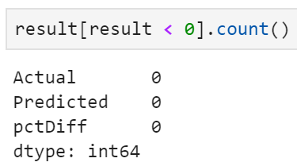
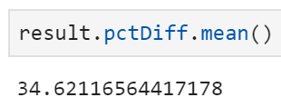
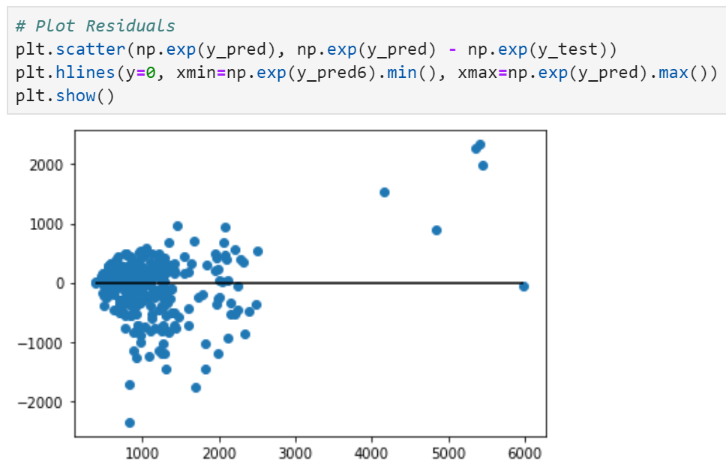
#6 Linear regression - After log transformation (Price); WITHOUT OHE and WITHOUT Scaling

Slide 12
Non-log-transformed price
Log-transformed price
 | OHE – Yes | OHE – No
Scaling of variable – Yes | LR Features = 42 R2 Score = 0.698 pctDiff = 33.4% RFR Features = 42 pctDiff = 20.0% | LR Features = 5 R2 Score = 0.640 pctDiff = 37.5% RFR Features = 5 pctDiff = 22.9%
Scaling of variables - No | LR Features = 42 R2 Score = 0.723 pctDiff = 29.6% RFR Features = 42 pctDiff = 20.0% | LR Features = 5 R2 Score = 0.640 pctDiff = 37.5% RFR Features = 5 pctDiff = 22.9%
 | OHE – Yes | OHE – No
Scaling of variable – Yes
Scaling of variables - No | LR Features = 42 R2 Score = 0.761 pctDiff = 25.2% RFR Features = 42 pctDiff = 18.7% | LR Features = 5 R2 Score = 0.608 pctDiff = 34.6% RFR Features = 5 pctDiff = 21.5%
RFR parameters used:
n_estimators = 100, random_state = 42
Log-transformation appears to improve the performance of our models

Slide 13
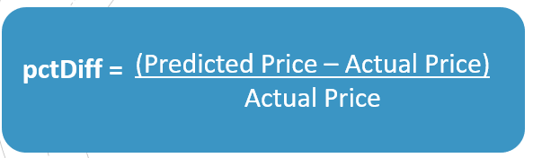
Final Setup
Data Prep
Log transformation of price
OHE & no scaling
ML algorithms:
Linear Regression
Random Forest Regressor
Neural Network
Performance metric (“accuracy”)
Mean of the absolute percentage differences between the predicted and the actual price
Continuous var: 6
Categorical var from OHE: 36
Training data: 80% (n=976)
Testing data: 20% (n=326)
Model | Overall “Accuracy”
Linear Regression | 25.2%
Random Forest Regressor | 18.7%
Neural Network | 19.5%

Slide 14
And now, for the demo…
TEST set data only!

