Slide 1
Movie Trends
Adam, David, neil, robin

Slide 2

Methodology
Wikipedia sourced for top movies from 1998 to 2018.
The OMDB API used to pull datapoints for each movie.
Rating (R, PG-13, PG, G)
Run-time
Critic Rating
Release Date
Box Office
Movie Genre
Records were found for 2,792 total movies that included desired datapoints.
Other economic measures were brought in from public sources to compare to overall box office performance.

Slide 3
Summary
Economic Factors
Critic Score
Genre
Content Rating (R, PG-13, PG, G)
Seasons
Run-time

Slide 4
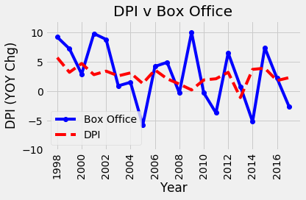
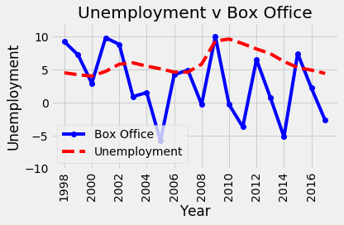
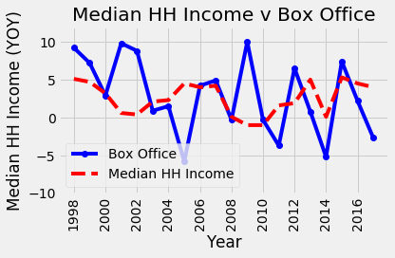
Economic factors
Hypothesis: Total boxoffice success is tied to economic indicators, like disposable income, unemployment, and median HH income.
Null Hypothesis: Movie boxoffice success is not dependent on disposable income, unemployment, or median HH income
Null hypothesis: While there are some years that DPI has a minor correlation,
it is likely other factors are driving box office success.
Sources: Box Office Mojo, an IMDB company, Organisation for Economic Co-operation and Development, Bureau of Labor Statistics
Notes:
There are some minor periods where DPI moves in the same direction as total box office revenue growth, it is not always the case (Ex: 2009 where DPI was low but YOY box office revenue was very high).

Slide 5
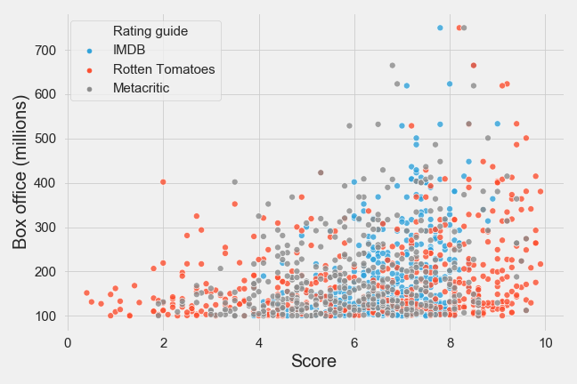
Box office vs. movie score
Hypothesis: Box office correlates strongly with movie scores
There is generally a weak correlation between the box office ($ millions) and the movie score based on different rating guides
IMDB scores (based on audience votes) correlate slightly better to the box office than Rotten Tomatoes or Metacritic scores, both of which are based more on critics’ reviews
 | All movies | Movie with box office ≥100 mil
Comparison (Y vs. X) | Pearson | Pearson
Box office (millions) vs. Average score | 0.217 | 0.328
Box office (millions) vs. IMDB score | 0.238 | 0.337
Box office (millions) vs. Rotten Tomatoes score | 0.205 | 0.308
Box office (millions) vs. Metacritic score | 0.190 | 0.310
Representative figure based on movies that made ≥ 100 millions in box office (n = 421)
Notes:
For the sake of simplicity, the figure is based on movies that made at least 100 million dollars in the box office (n=421)

Slide 6
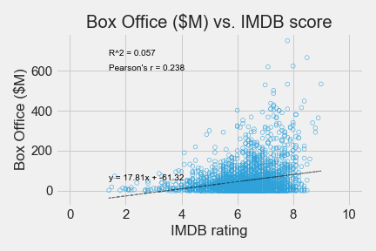
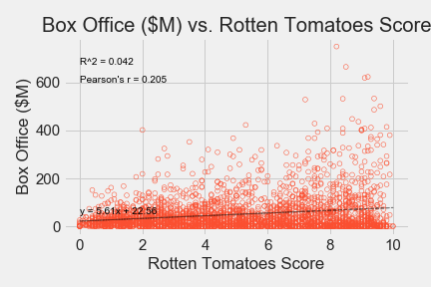
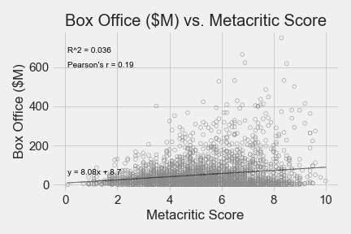
Box office vs. movie score
 | All movies | Movie with box office ≥100 mil
Comparison (Y vs. X) | Pearson | Pearson
Box office (millions) vs. Average score | 0.217 | 0.328
Box office (millions) vs. IMDB score | 0.238 | 0.337
Box office (millions) vs. Rotten Tomatoes score | 0.205 | 0.308
Box office (millions) vs. Metacritic score | 0.190 | 0.310

Slide 7
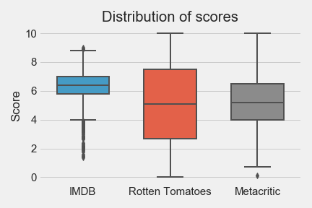
Distribution of scores
Hypothesis: On average audience members give better movie scores than critics, i.e., rotten tomatoes and metacritic
The average score for movies is significantly higher for IMDB, compare to Rotten Tomatoes and Metacritic
The spread of the score appears to be tighter for IMDB compare to Rotten Tomatoes and Metacritic
ANOVA: p-value=1.70x10⁻¹³³
Score | Min | 25th pctl | Median | 75th pctl | Max
IMDB | 1.4 | 5.8 | 6.4 | 7.0 | 9.0
Rotten Tomatoes (RT) | 0.0 | 2.7 | 5.1 | 7.5 | 10.0
Metacritic (MC) | 0.1 | 4.0 | 5.2 | 6.5 | 10.0
T-test
IMDB vs. RT: p-value = 8.6e-101
RT vs. MC: p-value = 0.015
IMDB vs. MC: p-value = 4.2e-157
Notes:
Spread of the majority of the IMDB scores is smaller compare to the spread of the RT and MC scores

Slide 8
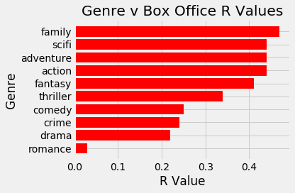
Movie Genres
Hypothesis: Correlation of critic score to box office success matters more for certain genres.
Null Hypothesis: There is no difference in correlation to critic ratings and box office success for various genres.
Methodology Note:
Genres are not mutually exclusive for individual films, as they may have more than one genre (Ex: Romantic Comedy). As such, each genre was evaluated individually and includes all films that have that genre listed within its list of genres.
Hypothesis: Some genres have a much better correlation of critic score to box office success
Source: OMDB, IMDB critic scores

Slide 9
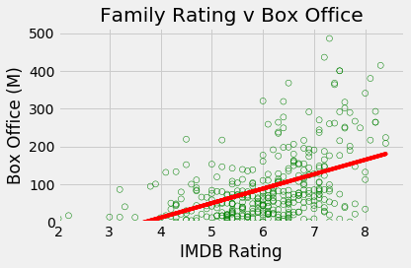
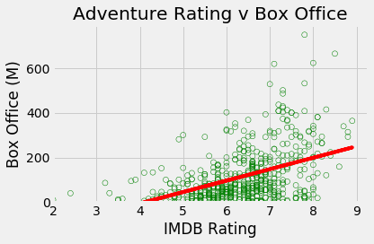
Movie Genres
Higher Correlation
Movies with a family, sci-fi, action, or adventure genre have a higher relationship of box office success when receiving higher critic scores.
Source: OMDB, IMDB critic scores

Slide 10
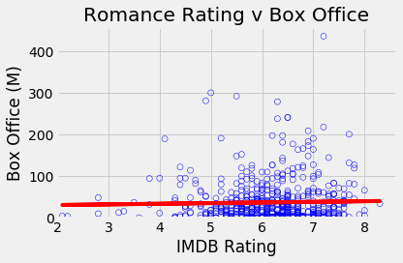
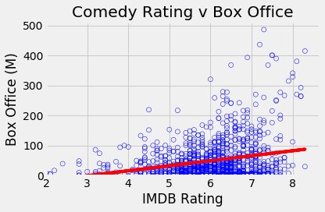
Movie Genres
Lower Correlation
Genres like romance and comedy have a much lower correlation of critic score to box office success. Perhaps other factors matter more for these films (Ex: actors, budget, etc)
Source: OMDB, IMDB critic scores

Slide 11
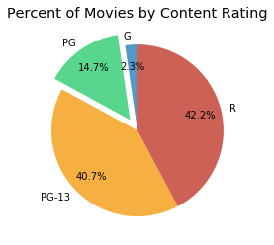
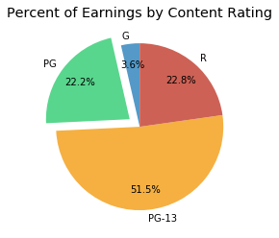
Movie Earnings By content Rating
Hypothesis: PG/PG-13 movies will account for the largest portion of box office earnings.
Null Hypothesis: Content Rating has no impact on box office earnings.
Content Rating | % of Movies | % of Earnings | Performance
G | 2.3 | 3.6 | 155.6%
PG | 14.7 | 22.2 | 150.4%
PG-13 | 40.7 | 51.5 | 126.4%
R | 42.2 | 22.8 | 53.9%
Source: OMDB

Slide 12
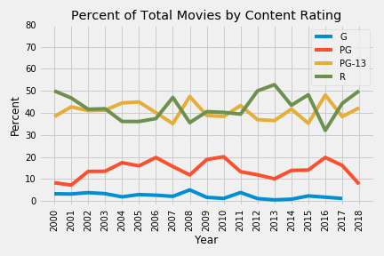
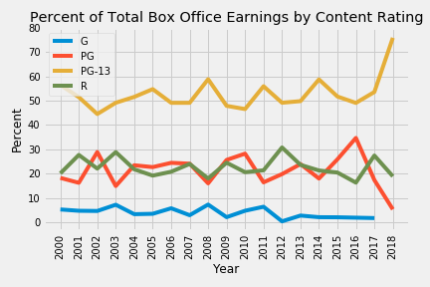
Earnings by content rating: time series
ANOVA | P-Value
Percent of Movies | 2.00E-38
ANOVA | P-Value
Percent of Earnings | 1.47E-44

Slide 13
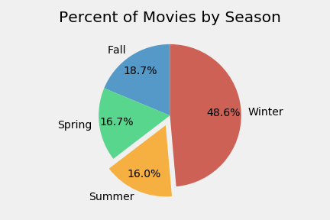
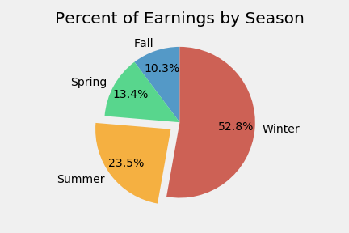
Movie Earnings By SEASON
Hypothesis: Summer movies have a higher average box office per movie than other seasons.
Null Hypothesis: There are no seasonal trends for box office success.
Season | % of Movies | % of Earnings | Performance
Fall | 18.7 | 10.3 | 54.8%
Winter | 48.6 | 52.8 | 108.7%
Spring | 16.7 | 13.4 | 80.4%
Summer | 16.0 | 23.5 | 146.9%
Source: OMDB

Slide 14
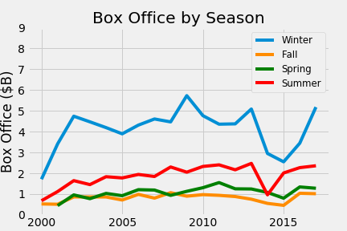
Earnings by SEASON: time series
ANOVA | Earnings By Season
P-Value | 1.38E-26
Source: OMDB

Slide 15
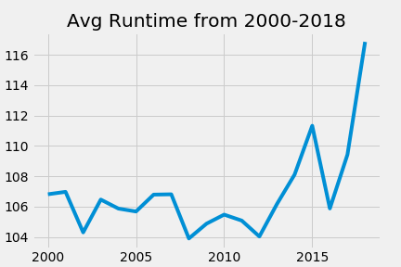
Box office vs. RUN-TIME
Hypothesis: Average run-time has decreased as people have lower attention spans.
Based on our sample, the average run-time has increased within the past decade.
Source: OMDB

Slide 16
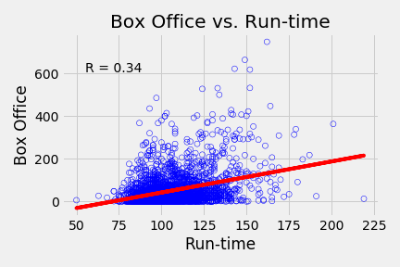
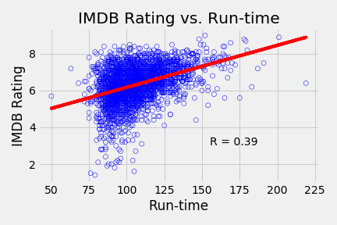
Box office vs. RUN-TIME
While run-time has been increasing recently, there is only a moderate correlation between run-time and both box office and critical success.
Source: OMDB

Slide 17
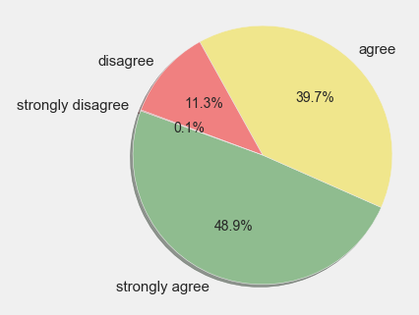
Do the critics and audience agree?
Hypothesis: Most of the movie are scored similarly (within SD of 1) between IMDB, Rotten Tomatoes, and Metacritic
By examining the standard deviation (SD) between the three scores (IMDB, RT, and MC), we can get an idea of the % of movies tend to have similar scores (SD ≤1)
SD | Agreement Level
0 to 1 | strongly agree
1 to 2 | agree
2 to 3 | disagree
3 or higher | strongly disagree

Slide 18
“Wait, you like that movie!?”
“Top 3” movies
Smallest spread (in SD) between scores
Box office of at least 100 million
Released since 2017
Mean movie score ≥ 8
Biggest spread (in SD) between scores
Box office of at least 100 million
Released since 2017
Mean movie score ≤ 4
“I like that movie too!”
Black Panther (SD=1.2; mean=8.6)
Get Out (SD=1.1; mean=8.6)
Wonder Woman (SD=1.0; mean=8.1)
Daddy’s Home 2(SD=2.0; mean=3.7)
Transformers: The Last Knight (SD=1.90; mean=3.1)
Fifty Shades Darker (SD=1.8; mean=3.0)

