Slide 1





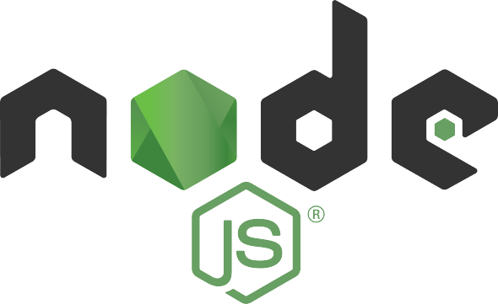
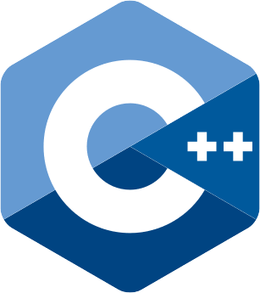

Vue.js
Docker build & push
IBM Code Engine
IBM Carbon
Docker build & push
IBM Code Engine
Express
IBM Cloud Object Storage (S3)

