Slide 1
Data Compression via Singular Value Decomposition
A Quantitative and Qualitative Analysis
CSI 401: Numerical Methods
Fall 2025 · Project Code: Python

Slide 2
Project Overview
Research Question
How effectively can SVD-based compression reduce image storage requirements while maintaining acceptable visual quality?
Presentation Structure
Objectives
I. From-Scratch SVD Implementation
II. Application to Image Data
Implement SVD from scratch
Apply to image compression
Quantify trade-offs
Analyze visual quality
III. Quantitative Analysis
IV. Qualitative Analysis
V. Extensions & Comparisons
VI. Final Synthesis
Key Constraint: No np.linalg.svd or np.linalg.eig

Slide 3

SECTION I
From-Scratch SVD Implementation
Mathematical Foundations & Numerical Methods

Slide 4
Mathematical Foundations
Singular Value Decomposition
Any m × n matrix A factorizes as: A = U Σ V
U (m × m)
Σ (m × n)
V (n × n)
Orthogonal matrix
Left singular vectors
(U^T)U = I
Diagonal matrix
Singular values σ
σ₁ ≥ σ₂ ≥ ... ≥ 0
Orthogonal matrix
Right singular vectors
(V^T)V = I
Key Insight: V = eigenvectors of (A^T)A; U = eigenvectors of A(A^T); σ = √λ
Challenge: Abel-Ruffini theorem → no closed-form eigenvalue solution for n≥5 → requires iterative numerical solver

Slide 5
Algorithm Implementation Stack
Implementation Layers
Core Algorithm Steps
1. Form Symmetric Matrix
handwritten_svd(A)
Compute S = (A^T)A (n × n symmetric)
2. Iterative QR Decomposition
QR Algorithm
A = QR → A = RQ
Converges to diagonal eigenvalue matrix
Iterative eigenvalue solver
Householder Reflections
3. Extract Singular Values
QR decomposition method
σi = √λi, sort descending
4. Compute U Matrix
Convergence: ~100-200 iterations for numerical stability
u = (1/σ) · Av for each σ > 0
Ensures sign consistency between U and V

Slide 6

SECTION II
Application to Image Data
Image-to-Matrix Conversion & Compression Scheme

Slide 7
Rank-k Compression Scheme
SVD as Sum of Rank-1 Matrices
Full SVD expresses A as sum of r rank-1 matrices (r = rank(A)):
Storage Requirements
Original: m × n values
Compressed: k(m + n + 1) values
Truncation Strategy
Keep only first k terms (k < r):
U: m × k matrix
Σ: k singular values
V: k × n matrix
Discards (r - k) least important components
Eckart-Young Theorem: A_k is the best possible rank-k approximation of A (minimizes reconstruction error)
Critical Limit: Compression only works if k < mn/(m+n+1) ≈ n/2 for square images

Slide 8

SECTION III
Quantitative Analysis
Storage vs. Fidelity Trade-offs

Slide 9
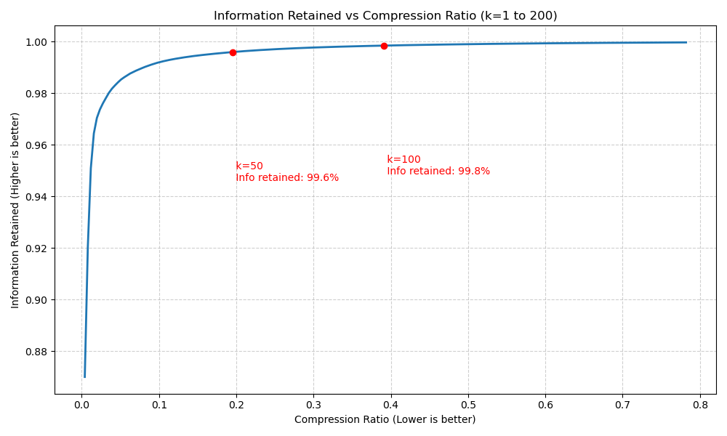
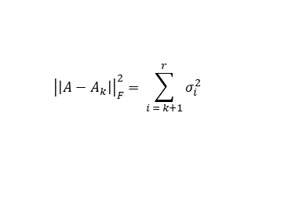

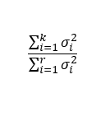
Quantitative Metrics
Compression Ratio
Compressed / Original
Lower is better
$$\frac{k\left(m+n+1\right)}{\left(m ∗ n\right)}$$
Frobenius Error
$${\left|\left|A−A_{k}\right|\right|}_{F}^{2}= \sum_{i = k+1}^{r}{σ_{i}^{2}}$$
Formula
Information Retained
$$\frac{\sum_{i=1}^{k}{σ_{i}^{2}}}{\sum_{i=1}^{r}{σ_{i}^{2}}}$$
Higher is better
Information Retained vs Compression Ratio
(Chart: k values from 1 to 200)

Slide 10
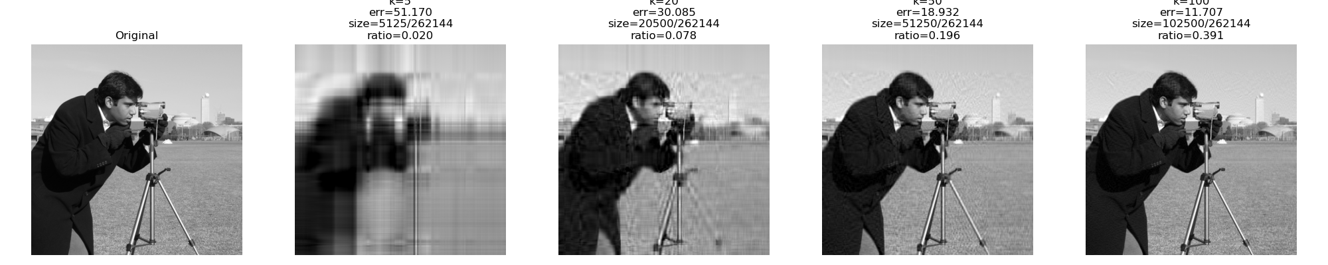
Experimental Results: 512x512 Image
Sweet Spot (k=50): 5:1 compression, 99.6% information retained
Diminishing Returns: k=50→100 doubles storage, adds only 0.2% of information retained
Break-even (k≈255): No compression benefit beyond this

Slide 11

SECTION IV
Qualitative Analysis
Visual Inspection & Image Quality

Slide 12
Visual Quality Assessment
Progressive Image Quality
Why SVD Works for Images
k = 1
Singular Value Decay
Single gradient; barely recognizable structure
Natural images show rapid exponential decay in singular values → information highly concentrated in first few components
k = 10
"Ghostly" with heavy distortion; main structure vaguely visible; clear artifacts
k = 50 ⭐ OPTIMAL SWEET SPOT
Natural Image:
Few large σ values + long tail ≈ 0
"Visually almost perfect" — sharp structure and lighting; fine textures slightly blurred but acceptable quality
k = 100
Random Noise:
Nearly flat σ spectrum (not compressible)
Nearly indistinguishable from original; minimal improvement over k=50
k = 512 (Original)
Perfect reconstruction; zero error
Bonus: Truncating tail removes high-frequency noise → SVD doubles as denoising
Key Finding: Visual quality mirrors quantitative metrics — sweet spot at k=50 where diminishing returns begin

Slide 13

SECTION V
Extensions
Color Images & Comparative Analysis

Slide 14
Extension: Color (RGB) Images
Storage Cost & Limitations
Total Storage:
Per-Channel SVD Methodology
Rank-k storage for RGB requires 3x the storage of Rank-k for Grayscale
1. Split: m×n×3 → three m×n matrices (R, G, B)
2. Compress: Apply rank-k SVD to each channel independently
Limitations
3. Clip: np.clip(A, 0, 255) for valid pixel range
Inefficient: Ignores high correlation between R, G, B channels
Human eye less sensitive to chrominance → aggressive compression possible on color channels
4. Recombine: Stack R, G, B → final m×n×3 image
Critical: Clipping is mandatory. At low k, reconstructed values can be negative or >255, causing severe artifacts

Slide 15

SECTION VI
Final Synthesis
Conclusions & Research Question Answered

Slide 16
Answering the Research Question
"How effectively can SVD-based compression reduce image storage requirements while maintaining acceptable visual quality, and what are the quantitative and qualitative trade-offs?"
Primary Finding
SVD-based compression is demonstrably effective for natural images. Effectiveness derives directly from low-rank structure where vast majority of information is concentrated in first few singular values.
Quantitative Trade-Off
Optimal Operating Point
Storage cost scales linearly with k
Fidelity follows
non-linear decay curve
Clear diminishing returns
k = 50: 5:1 compression
90% information retained
"Visually almost perfect"
Technical Achievement: Full SVD from scratch using QR Algorithm (iterative eigenvalue solver) + Householder Reflections (QR decomposition) + stable U-V linking
Value Proposition: Exceptional analytical tool for understanding image structure and information distribution

Slide 17
Future Directions
Performance Optimization: Implement shift strategies in QR algorithm for faster convergence; explore sparse matrix techniques
Thank You
Adaptive Compression: Auto-determine optimal k based on target quality or compression ratio; region-specific k values
Questions & Discussion
Comparative Benchmarking: Systematic comparison with JPEG, PNG, WebP across diverse datasets and quality metrics
Course: CSI 401 Numerical Methods
Semester: Fall 2025 · Project Code: Python
Institution: University at Albany, SUNY
Key Achievement: Full SVD implementation without NumPy SVD function.

