Slide 1
Interesting Stuff
AD stands for Anno Domini (Latin for "In the year of (Our) Lord"), abbreviated as AD. It defines an epoch based on the traditionally-reckoned year of the conception or birth of Jesus of Nazareth. it is used in the English language to denote years after the start of this time.
BC stands for Before Christ (from the Ancient Greek "Christos" or "Anointed One", referring to Jesus), abbreviated as BC, it is used in the English language to denote years before the start of this time.
A millennium (pl. millennia) is a period of one thousand years.
A century is a period of one hundred consecutive years. Centuries are numbered ordinally (e.g. "the nineteenth century").
A decade is a period of 10 years.

Slide 2
Interesting Stuff (cont’)
The decades from 1920 to 1999, are called "the Twenties", "the Sixties", etc. But the current decade has no universally accepted name. Some refer to the decade as the "twenty hundreds" while others may refer to it as the "two thousands". In written form, this could appear as "the '00s" or "the 2000s". But writing "the 2000s" or simply saying "the two-thousands" can cause confusion, since this could refer to the entire 21st century or even the entire millennium. Some people tried to popularize "the Noughties" as the decade's name. This is a play on words, nought means "zero" and noughties sounds both like nineties and naughty.
!Note - When writing the date as numbers, British and American English differ. To write the date 7th of September 2007 a Brit would write dd/mm/yy (07/09/07) and an American would write mm/dd/yy (09/07/07). This often causes great confusion. It's better to write the date in full (7th September 2007 or September 7th 2007). It also looks nicer.

Slide 3
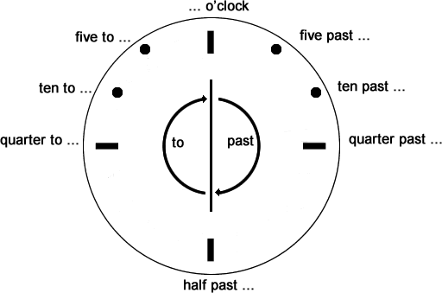
Time
In five minute increments, when it's past the hour (up to 30 minutes past) we say "past".
When it's before the hour (after 30 minutes past) we say "to".
There are 60 minutes in an hour.
30 minutes is half an hour, we say "half past" or "thirty".
15 minutes is quarter of an hour, we say "quarter past" or "fifteen" or "quarter to" or "forty-five".

Slide 4
Writing the time/http://www.worldtimezone.com/wtz-names/wtz-am-pm.html
Writing the time
- See more at: http://www.learnenglish.de/basics/time.html#sthash.biWAHB08.dpuf
morning | 00:01 - 11:59
a.m. - stands for Ante Meridiem/Ante Meridian (the time between midnight and noon) | 00:01 hrs - 12:00
noon or midday | 12:00
p.m. - stands for Post Meridiem/Post Meridian (after noon) | 12:01 - 24:00 hrs
afternoon | 12:01 - 18:00
evening | 18:01 - 22:00
night | 22:01 - 24:00
midnight | 24:00 / 00:00

Slide 5
Emails in English - How to Write an Email in English (Oxford Online English )
Contents:
1. How to Start Your Email 0:44:
2. Explaining Why You're Writing 2:52
3. Adding Details to Your Email 5:40
4. Adding a Call to Action to Your Email 9:33
5. Adding a Sign-off to Your Email 12:57
6. Writing an Email in English 14:42:

Slide 6
use appropriate greeting,
introduce your topic in a single sentence,
add details in a short paragraph,
add a call to action to explain what you need other person to do,
use an appropriate sign-off.
Source: https://www.youtube.com/watch?v=xay5TeJVSC0

