Slide 1
Collaborative LLMs in Academic Assessments
Miguel Fortuno, Ben Glasgall, David Organista
IDS6916 Research Practicum
School for Modeling, Simulation, and Training

Slide 2
AGENDA
Problem Statement
Motivation
Context/Background
Methodology
Results
Analysis
Discussion
Conclusions
Future Work

Slide 3
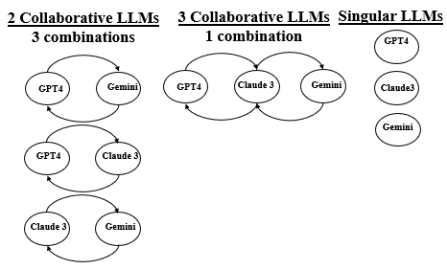
PROBLEM STATEMENT
Research Focus: Investigate how collaborative LLMs affect performance and accuracy in standardized multiple choice exams
RQ1: To what extent does the number of collaborative LLMs affect performance on college level preparatory exams across a variety of subjects?
RQ2: What is the ideal number of LLM agents to work together to achieve optimal results while managing computational cost?
Hypothesis: Collaborative efforts of LLMs will enhance performance in academic tests over single-agent systems. This improvement was expected due to the combined knowledge bases and reason strategies, which would lead to higher accuracy levels.
Figure 1: High level model depicting unique agent grouping.

Slide 4
MOTIVATION
Gap in Literature
Focus on individual LLMs in education; limited understanding on multi-agent collaboration
Enhancing Test Performance
Determine benefit of LLM collaboration
Advancing Educational AI
Contribute to development of ITS
Real-world Implications
Establish trust/confidence in LLMs within educational settings

Slide 5

BACKGROUND
Emerging Field
LLM-to-LLM vs. human-to-LLM
AI-supported test taking
Literature Review
Single LLMs taking professional/vocational exams
Multi-agent collaboration focused on decision making and task completion
Contributions
Impact of collaborative LLMs in academic setting
Provide understanding of potential future applications of multi-agent collaborative

Slide 6
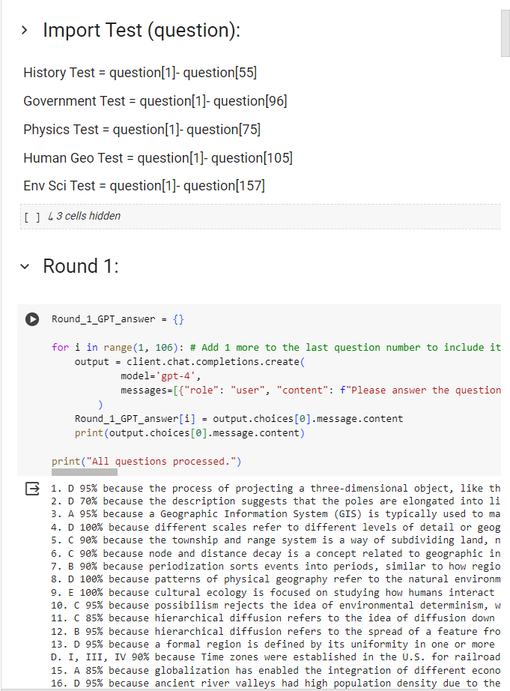
METHODOLOGY
LLMs (3):
GPT-4, Claude 3 Opus, & Gemini 1.0 Pro
Test Subjects (5):
History, government, environmental science, human geography, and physics.
Quantitative Metrics:
Percent and skill accuracy, confidence levels, number of agreement rounds, (feedback loop explanations)
IDEs:
Jupiter Notebooks (VS Code/Google Colab)
Individual testing:
Skill analysis and judge justification

Slide 7
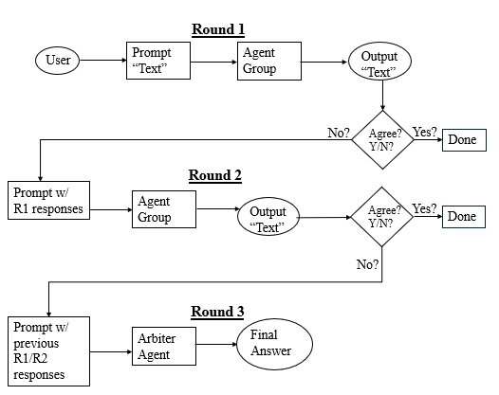
METHODOLOGY
3-iterative collaboration and feedback rounds.
Each round’s answers were auto graded to see if the agreement resulted in a correct answer.
Disputed answers were marked as incorrect, even if at least one agent was correct.
For two-LLM groups, the judge agent was the LLM that is not part of the 2-LLM group and thus not present in the first 2 rounds.
For the case of all three LLMs, the judge was determined by the greatest overall strength among all five subjects.
In both cases, the judge LLM took each agent’s round 2 outputs and a report on each agent’s skill strengths and weaknesses including its own to decide on the final outcome for that question.
Figure 2: 3-Round Multi-agent collaboration process with arbitration.

Slide 8
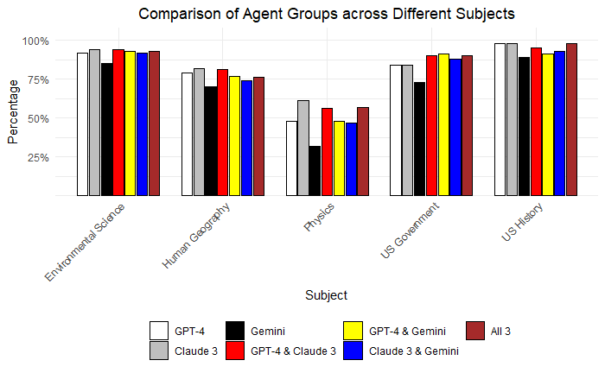
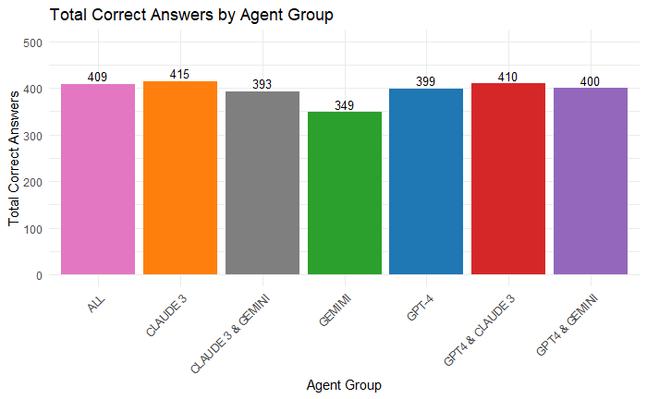
RESULTS

Slide 9
RESULTS (CONT.)
Agent Group | Subject
 | US His. | US Gov. | Phys. | Hum. Geogr. | Environ. Sci. | Overall Avg.
GPT | 98.2% | 84.4% | 48.0% | 79.0% | 92.4% | 80.4%
CL | 98.2% | 84.4% | 61.3% | 81.9% | 94.3% | 84.0%
GEM | 89.1% | 72.9% | 32.0% | 69.5% | 84.7% | 69.6%
GPT – CL | 94.5% | 89.6% | 56.0% | 81.0% | 93.6% | 82.9%
GPT – GEM | 90.9% | 90.6% | 48.0% | 77.1% | 93.0% | 79.9%
CL – GEM | 92.7% | 87.5% | 46.7% | 74.3% | 92.4% | 78.7%
ALL | 98.2% | 89.6% | 57.3% | 76.2% | 93.0% | 82.9%

Slide 10
ANALYSIS
Kruskal-Wallis Test
Dunn’s Test
Subject | Kruskal-Wallis Test Results
 | H Test Statistic
US His. | 9.14
US Gov. | 17.42**
Phys. | 16.81*
Hum. Geogr. | 6.38
Environ. Sci. | 13.29*
Group Cf. | P-Values by Subject
 | Environ. Sci.. | US Gov. | Phys.
GPT/ GEM | 0.0132 | 0.0242
CL/ GEM | 0.0020 | 0.0242 | 0.0003
GEM/ GPT – CL | 0.0038 | 0.0010 | 0.0033
GEM/ GPT – GEM | 0.0073 | 0.0005
GEM/ CL – GEM | 0.0132 | 0.0041
GEM/ALL | 0.0073 | 0.0010 | 0.0019
*α=0.05; **α=0.01

Slide 11
DISCUSSION
RQ1: To what extent does the number of collaborative LLMs affect performance on college level preparatory exams across a variety of subjects?
Subject Dependent
US History – Slightly negative
US Government – Positive
Physics – Slightly negative
Human Geography – Slightly negative
Environmental Science – Slightly negative
RQ2: What is the ideal number of LLM agents to work together to achieve optimal results while managing computational cost?
Claude 3 Opus – 1
Gemini 1.0 Pro – 2
GPT-4 - 1
Overall, we reject our hypothesis

Slide 12
CONCLUSIONS
Agreement increases with accuracy with diminishing return: ideal for other tasks?
Our current LLMs are “US-flavored”
Individual LLMs need to improve for educators and students to build trust.
Even with perfect LLMs, AI tutors should not replace human tutors
(Learning ≠ knowing answers)
Key Takeaways:
Multi-agent collaboration has some potential to improve overall accuracy
GPT-4 & Claude 3 Opus perform well on their own; Gemini 1.0 Pro benefits from multi-agent collaboration
LLM test results serve as potential teachable ability of the subject not short-cut/cheating techniques.

Slide 13
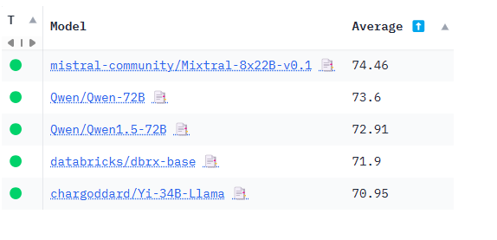
FUTURE WORK
More Large Language Models
LLaMa, Mixtral, Falcon, Vicuna
Different subjects
Language, arts, music
More trials
Different collaboration schemas
Ranked choice
Expert weighting
Screenshot of current rankings for pretrained large language models in the Hugging Face leaderboard. April 12, 2024

Slide 14
QUESTIONS?

