Slide 1
David Organista Spring 2024 Non-linear Dynamics
Analyzing Eye movements for non-Invasive mental health diagnostics

Slide 2
background
Most current Neurodevelopmental and symptomatic behaviors are diagnosed through clinical assessments, e.g., checklists and cognitive tests.
These diagnostic systems lack scientific rigor and reliability leading to underdiagnosis or misdiagnosis (Timimi 2014).
More objective and consistent diagnostics could mean better prevention/ treatment of mental conditions.

Slide 3

Why the eyes?
Natural eye-movement patterns and behaviors are involuntary and subconscious; almost impossible to control the subtilties of those structures—an unfiltered reflection of the mind.
No surgery needed: Biometric data collection without physical contact nor interference with natural behaviors.
Eye-tracking in natural settings

Slide 4

analyses
DFA measures self-similarity, where it reveals hidden structures in eye tracking data showing healthy eye-movements displaying fractal/pink noise (Aks et al., 2002; Coey et al., 2012).
Apparent chronic/episodic brain disorders have also been detected through eye-tracking metrics. Schizophrenia: fewer yet longer fixations; shorter distanced and longer lasting saccades (Bestelmeyer et al., 2006). Not limited to social contexts.
3. SampEn measures complexity, variability, and predictability where higher complexity generally means greater system health—to a certain point (Duran et al., 2013).
DFA: Detrended Fluctuation Analysis
SampEn: Sample Entropy

Slide 5
Can looking at a screen for 8 seconds accurately predict subtilities in mental health?

Slide 6


Slide 7
Methodology
Fixation duration: Insightful for emotional recognition and potentially for mental health diagnoses (Lu et al., 2015).
3 Groups: Healthy (control), Symptomatic (i.e., aggression & anxiety; symptoms of broader psychological condition) and diagnosed with neurodevelopmental disordered (i.e., ADHD/ADD/ASD) with 5 participants in each (15 total time series).
1,052 samples per participants, 120 HZ, 8.7 second duration.
DFA: Long-range temporal correlations (Hurst exponent; alpha value). SampEn: predictability of times series (m = 1; r =0.15[SD]).

Slide 8
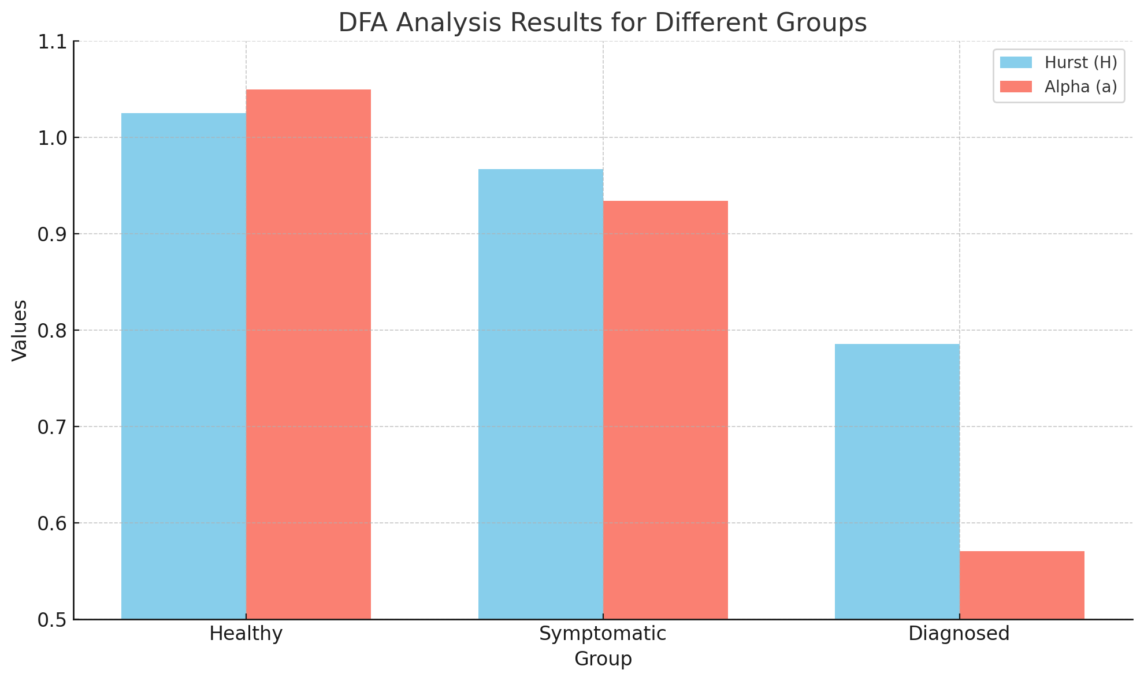
Results
Healthy Group: Highest Hurst exponent (H = 1.0248) suggesting more predictable, less complex eye movement patterns.
Symptomatic and Diagnosed Groups: Lower Hurst exponents (H = 0.9669 and H = 0.7854, respectively), indicating increased complexity and less predictability in eye movements. (closer to white)

Slide 9
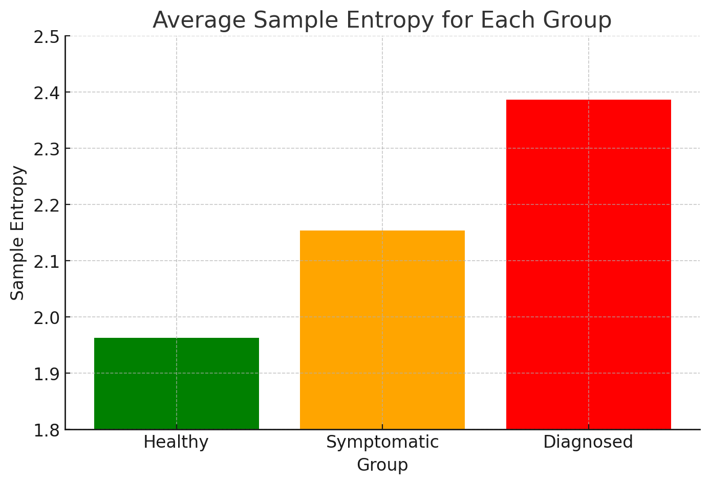
Results (cont’d)
Healthy Group: Lowest average SampEn (1.9625) indicating more regular and predictable patterns.
Diagnosed Group: Highest SampEn (2.3868), reflecting greater complexity and less predictability in eye movements, potentially due to the impact of neurodevelopmental disorders.

Slide 10
Conclusion & FUTURE directions
The combination of different analyses can detect subtleties in mental states through eye movements alone.
Individuals with diagnosed neurodevelopmental disorders display more complex and less predicable eye movement patterns compared to (mentally) healthy individuals.
Other eye-tracking metrics such as saccadic movements, blink rates, and pupil dilation could enhance the diagnostic accuracy (Bestelmeyer et al., 2015; Lu et al., 2015), specially in combination.
The growing trust in fractal and entropy analyses should facilitate the widespread of these methods across various educational and healthcare settings, making diagnostics more accurate, objective, and accessible for early screening and intervention strategies.

Slide 11
References
Aks, D. J., Zelinsky, G. J., & Sprott, J. C. (2002). Memory across eye-movements: 1/f dynamic in visual search. Nonlinear Dynamics, Psychology, and Life Sciences, 6, 1-25.
Bestelmeyer, P. E., Tatler, B. W., Phillips, L. H., Fraser, G., Benson, P. J., & St Clair, D. (2006). Global visual scanning abnormalities in schizophrenia and bipolar disorder. Schizophrenia Research, 87(1-3), 212-222.
Coey, C., Wallot, S., Richardson, M., & Van Orden, G. (2012). On the structure of measurement noise in eye-tracking. Journal of Eye Movement Research, 5, 1.
Duran, N. D., Dale, R., Kello, C. T., Street, C. N. H., & Richardson, D. C. (2013). Exploring the movement dynamics of deception. Frontiers in Psychology, 4, 140.
Lu, Y., Zheng, W. L., Li, B., & Lu, B. L. (2015). Combining eye movements and EEG to enhance emotion recognition. In Proceedings of the International Joint Conference on Artificial Intelligence (IJCAI) (Vol. 15, pp. 1170-1176).
Timimi, S. (2014). No more psychiatric labels: Why formal psychiatric diagnostic systems should be abolished. International Journal of Clinical and Health Psychology, 14(3), 208-215.

Slide 12
Any Questions?
David Organista
407-857-4349
David.Organista@ucf.edu

