Slide 1
Implementing DES Encryption Algorithm in Verilog
Presented by: Roni Zukerman and David Orlian
Course: Cryptography Algorithms and Verilog Implementation (130330)
Institution: Jerusalem College of Technology
Date: 21/9/2025

Slide 2
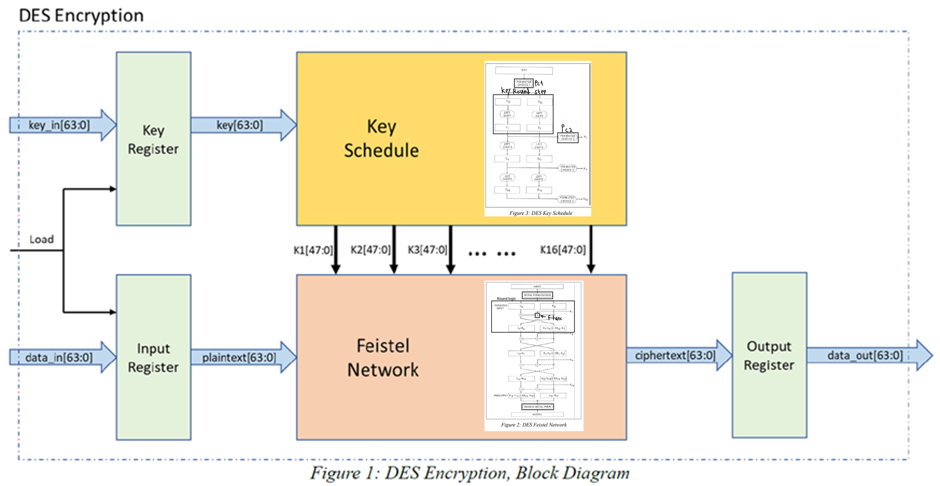
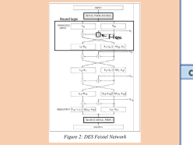
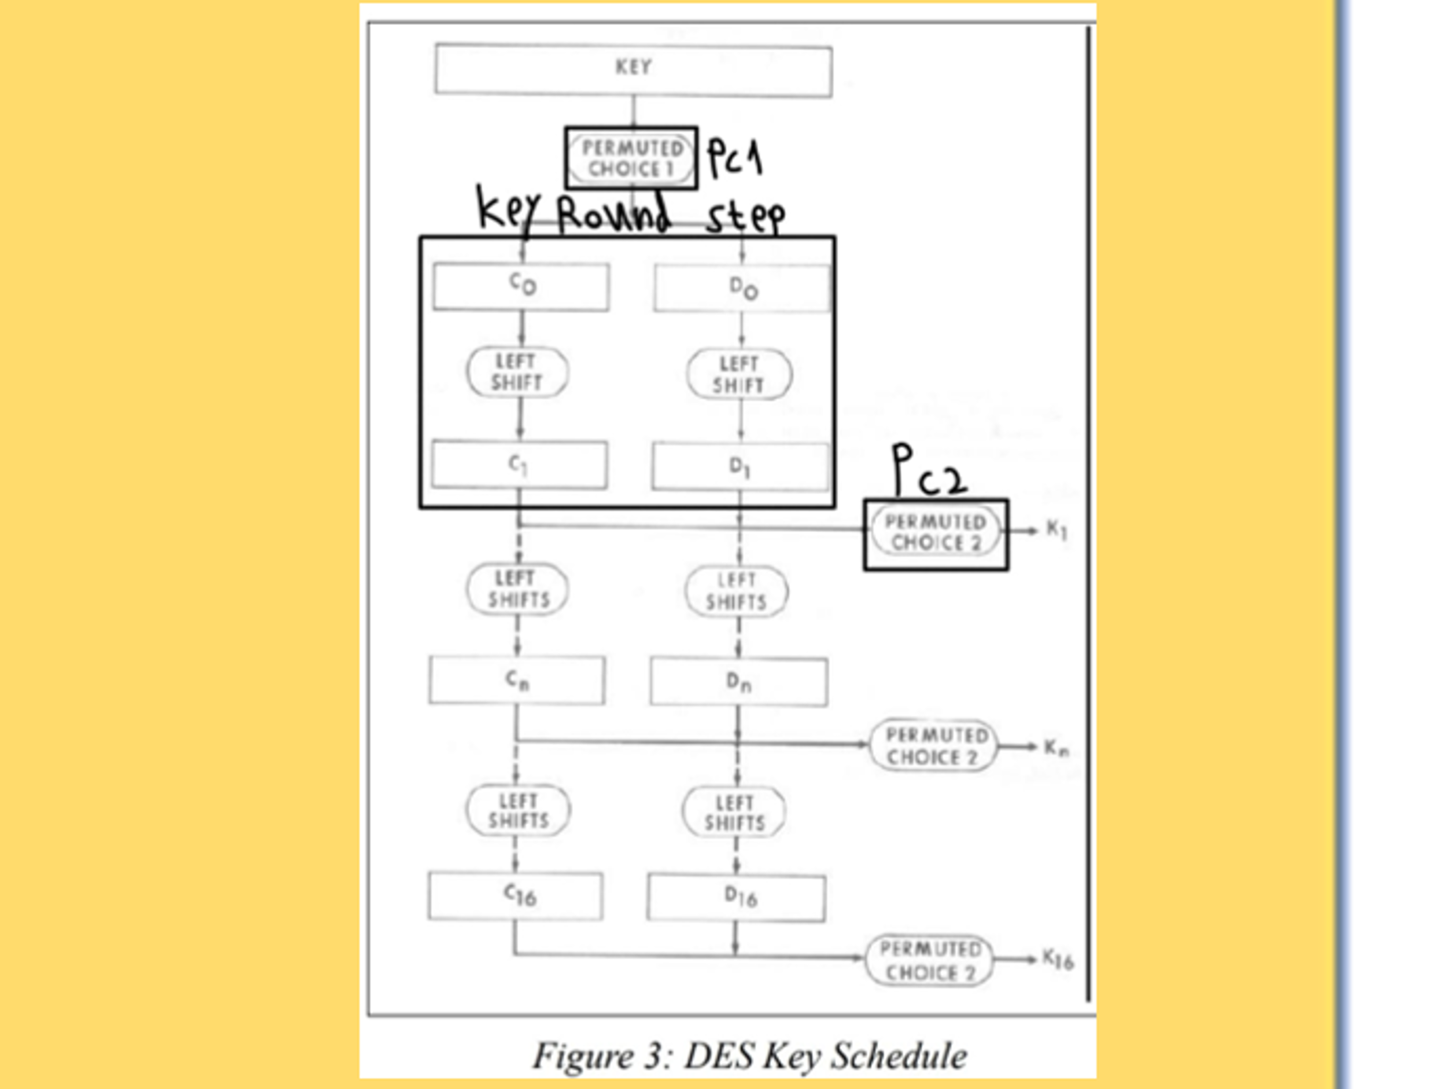

The DES Encryption Algorithm

Slide 3
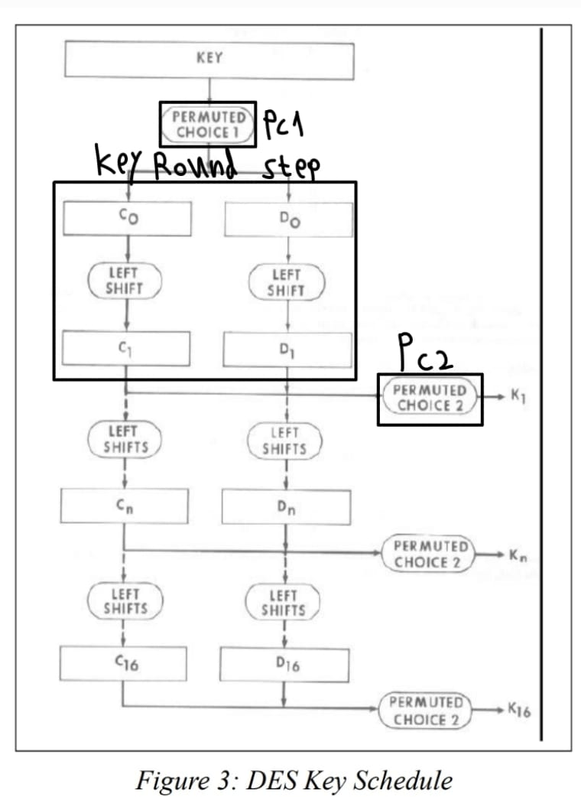
The DES Encryption Algorithm

Slide 4
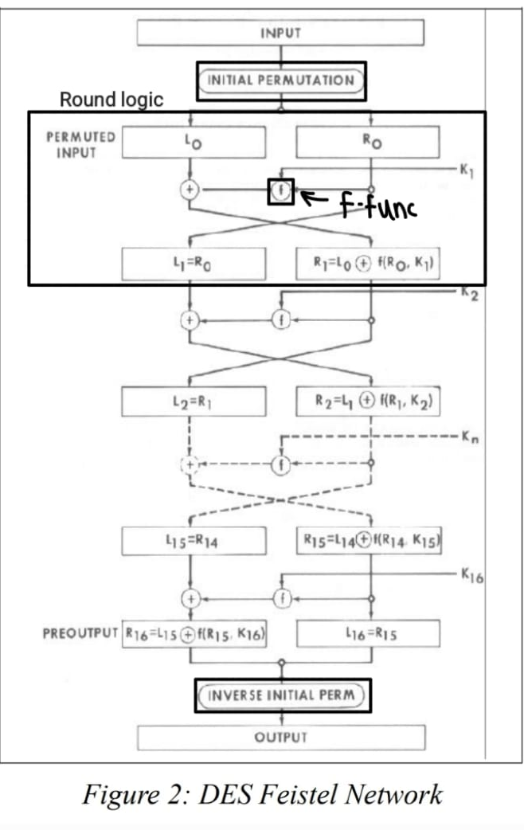

The DES Encryption Algorithm

Slide 5
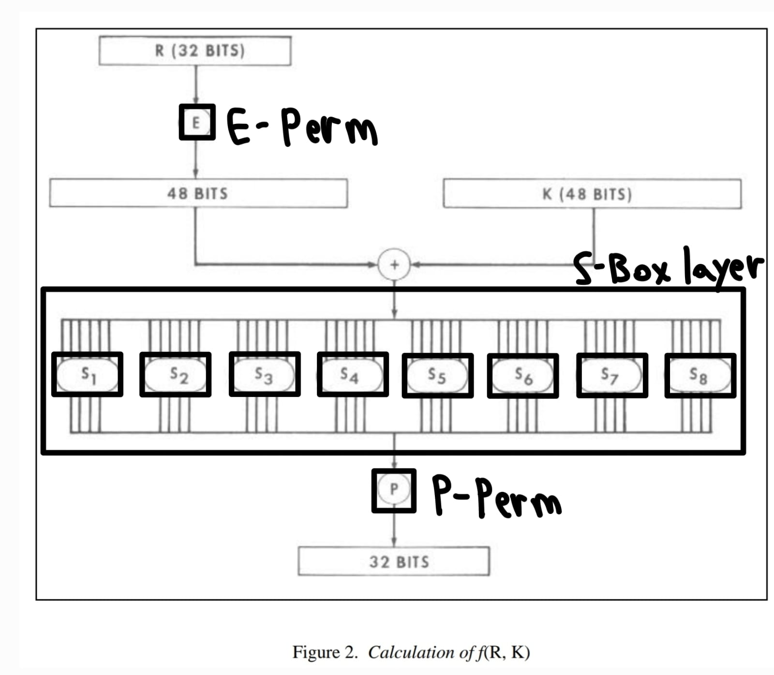
The DES Encryption Algorithm

Slide 6
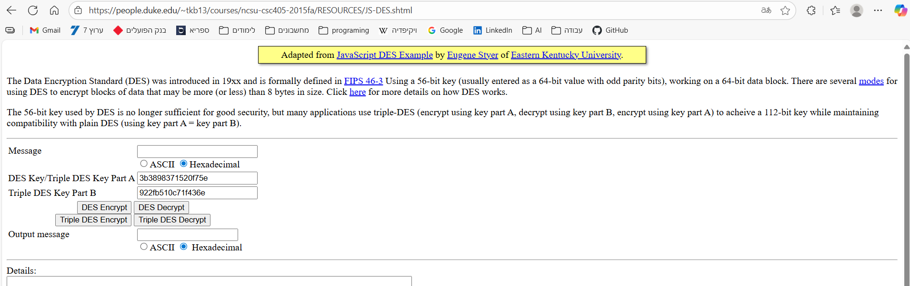
Testbench
Most of the testbenches are in the form of:
input data, output data and expected output
Python script to generate reliable test vectors with:
https://people.duke.edu/~tkb13/courses/ncsu-csc405-2015fa/RESOURCES/JS-DES.shtml

Slide 7
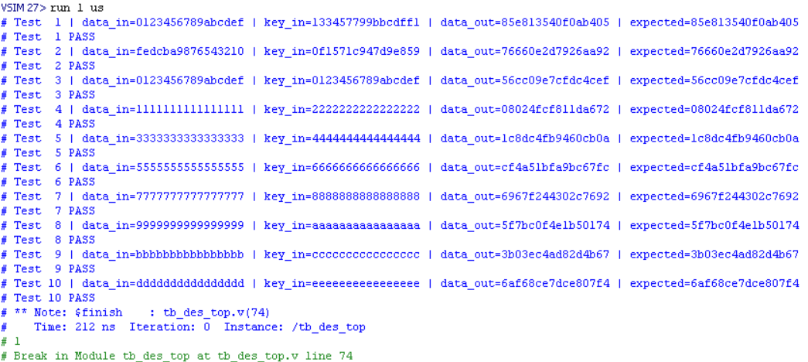
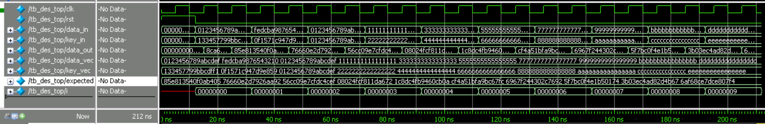
Simulation Results
Transcript:
Waveform:

Slide 8
Project Architecture
Approach: Loop unrolling architecture.
Target Device: Xilinx Artix-7 FPGA.
Frequency: Slowed down for implementation to 10MHz.

Slide 9
Synthesis Results
Tool Used: Vivado/Precision
Summary: Area utilization, critical path delay.
Screenshot: Synthesis summary report.

Slide 10
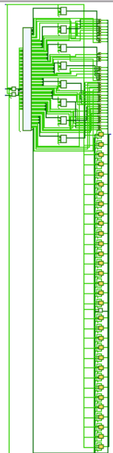
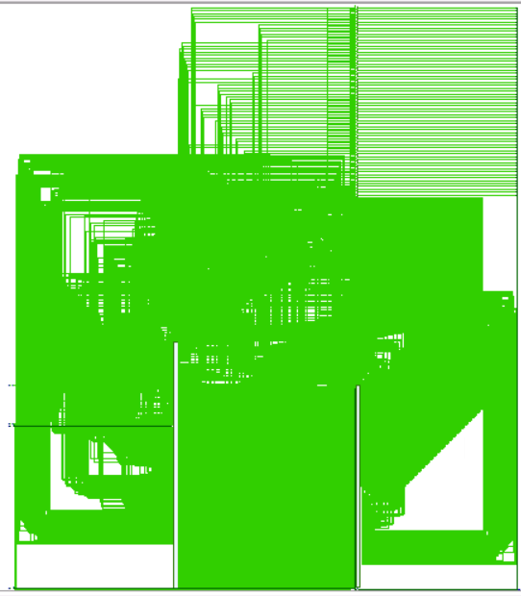
RTL schematic:
Technology schematic:

Slide 11
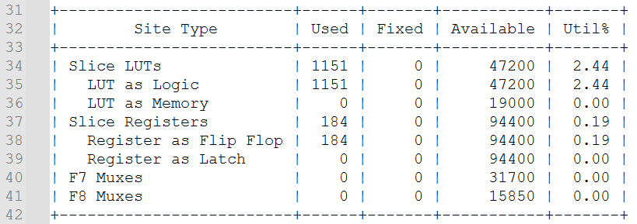
Place & Route Results
Screenshots: Place & Route overview.
Timing Reports: Achieved timing constraints.
Utilization: Final device resource usage.
I/O Reports
Pin Mapping: Constraints applied.
I/O Report: I/O utilization summary.
Screenshot: I/O constraints file or Vivado I/O view.

Slide 12
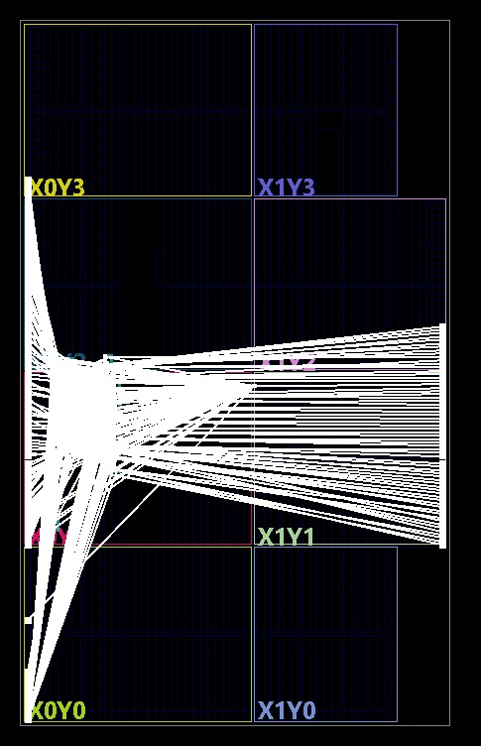
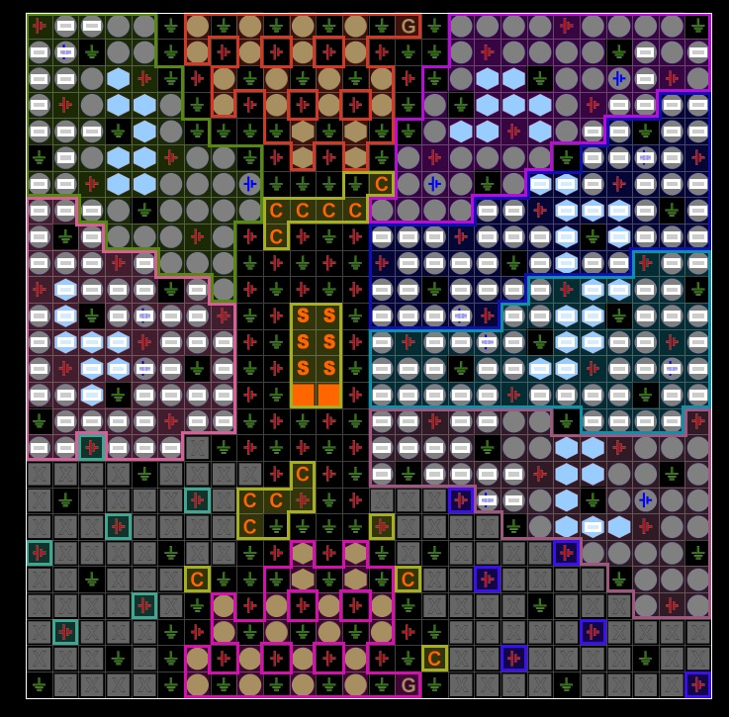
Device layout:
I/O report

Slide 13
Source & Gate-Level Simulation Results
Tools: ModelSim
Screenshots: Sample waveforms.
Outputs: $display and $monitor for debugging.
Validation: Test vectors matched expected DES outputs.

Slide 14
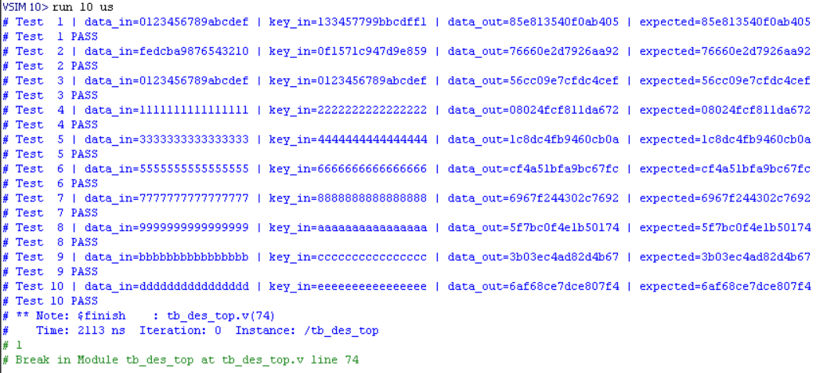
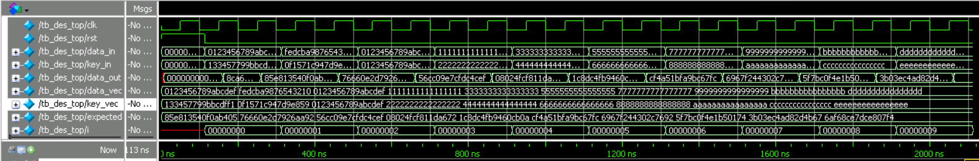
Transcript:
Waveform:

Slide 15
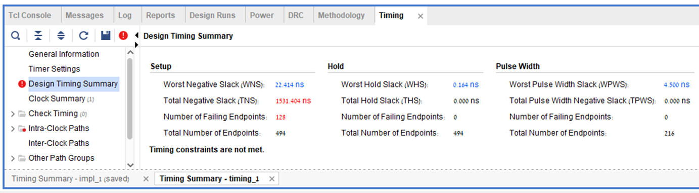
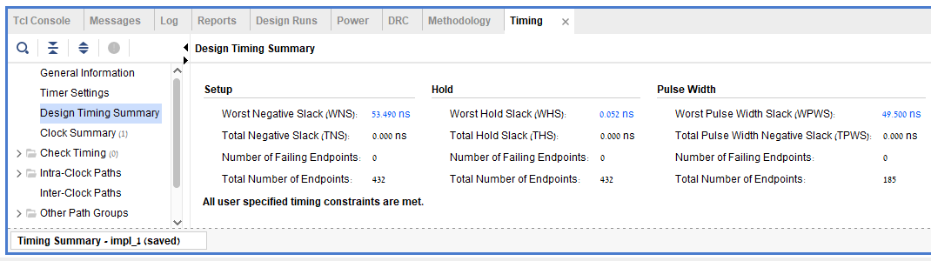
Critical Path & Throughput
Before fixing timing issue:
After fixing timing issue:

Slide 16

Calculation of Fmax and throughput by the vivado results:
$$WNS = 53.49[ns]$$
$$Critical Path Delay=100[ns]−53.49[ns]=46.51[ns]$$
$$F_{max}=\frac{1}{Critical Path Delay}=21.5[MHz]$$
$$Throughput=64 × F_{max}=1.376[\frac{GB}{s}]$$

Slide 17
Conclusions & Lessons Learned
Challenges: Debugging loop unrolling, simulation vs. synthesis.
What worked: Design met functional and timing goals.
Improvements: Possible pipelining, optimization.
Final note: Thank you and open to questions!

