Slide 1


Airplane Factory
Practicing the Agile concepts
Flávio Steffens / Rafael Prikladnicki – Airplance Factory 2009
Notes:
Hello!
Thanks for the interest on this agile game. This game was created in 2007 by Flavio Steffens de Castro (www.agileway.com.br) and was vastly implemented in a partnership with Rafael Prikladnicki (http://www.inf.pucrs.br/~rafael). We hope you enjoy.
The objective of this game is to create an environment for a class/audience where they can practice the concepts of Agile and SCRUM during a game. Be sure that you know the AgileManifesto and the SCRUM.
Here’s what you will need:
This file for the presentation. Fell free to modify the footer with your name/company – but please, keep our names, email and websites in the last slide.
A group of, at least, 8 people. You need to create two or more teams with 4-7 people each.
A lot of sheets of paper. This will be the material for creating the planes. We recommend that you need about 60 sheets for each team. You can have “used” sheets… more ecological.
One pen for each team. Don’t allow the teams to use more than one pen. Prefer that kind of pen that you can see the result easily.
A chronometer. This game is time-oriented.
An Excel/similar sheet to track the results of the teams. You may use the whiteboard if you want to. Check slide number 5 for a template of the table.
Also:
An whiteboard or similar, for you. To help you to draw/explain something.
A Prize! (highly recommend) You know, games are prize-oriented :) Buy a box of chocolate or something for the winning team. But also buy more two boxes for the final. The meaning of this is to make the people enjoy together in the end. So everyone will “win”.
[ATTENTION] when you find this statement, make sure that it’s an important insight about something :)
[ATTENTION] make sure that you know what kind of plane they will produce! It’s the most simple “jet paper plane” that you can define.
[EXTRA] when you find this statement in the observations, the use of the activities described there are optional. They could be suggestions to improve the game or even some experiences that you may use in the future. It’s highly recommended that you only do that when you already tested the “standard” game at least for one time.

Slide 2
Airplane factory
F.A.Q.
What is this?
  A game to help people to understand Agile and Scrum principles.
Why?
  It helps the understanding of these principles by doing in practice.
Is it work?
  Sure! It has been tested over a lot of groups and classes.
I like it! Can I use it?
  Sure, you can download from:
    http://www.agileway.com.br/2009/11/16/the-airplane-factory-game
  We just ask you to keep the names and contacts of the creators.
  And give us a feedback of your experience :)
Flávio Steffens / Rafael Prikladnicki – Airplance Factory 2009
Notes:
This slide is used to introduce the game. People tend to be a little unfaithful with games.
So, it’s nice to take a few moments to explain that people used to have more compromise and attention when they are acting and participating during the process.
Don’t be afraid of the faces of your audience during the first slides. You don’t need to convince them here. They will be all (or mostly) convinced at the end.
The less they know about SCRUM/Agile, better it will be the results.

Slide 3
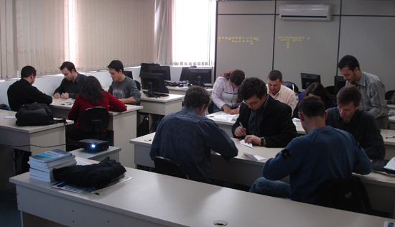
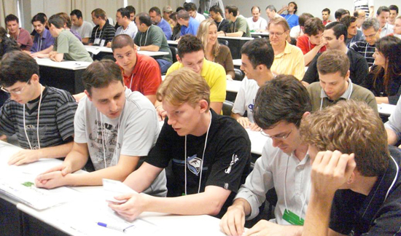
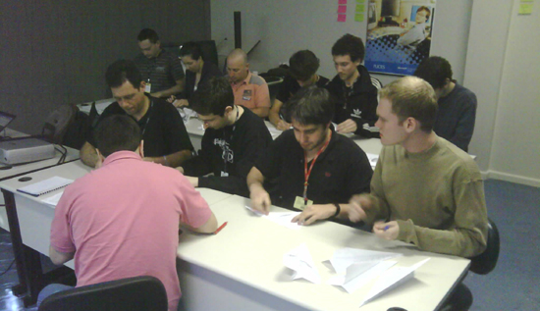
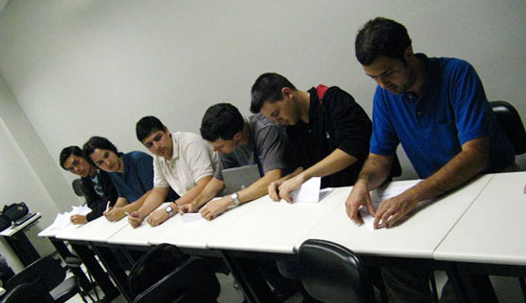
Airplane factory
F.A.Q.
Who have created?
  Flávio Steffens de Castro, author of www.agileway.com.br
  Rafael Prikladnicki, professor from PUCRS and agile coach and trainer www.inf.pucrs.br/~rafael
Flávio Steffens / Rafael Prikladnicki – Airplance Factory 2009
Notes:
This slide is used to introduce the game. People tend to be a little unfaithful with games.
So, it’s nice to take a few moments to explain that people used to have more compromise and attention when they are acting and participating during the process.
Don’t be afraid of the faces of your audience during the first slides. You don’t need to convince them here. They will be all (or mostly) convinced at the end.
The less they know about SCRUM/Agile, better it will be the results.

Slide 4
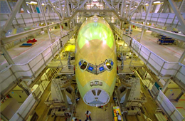
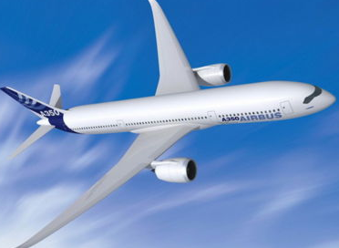
Airplane factory
Basic rules
Teams with 4-7 people
We will build paper airplanes
Iterations and re-planning of 2 minutes each
  Unconditional respect of time!
Production concept
  The engineering of production is a team decision
  Teams are not allow to stock sheets for production
The product (airplanes) MUST conform with the scope defined
  If a product doesn‘t pass the final quality review, it will not be accepted in the iteration
  Products that are unfinished can be used in the next iteration to be complete
Every team will represent a factory
Flávio Steffens / Rafael Prikladnicki – Airplance Factory 2009
Notes:
Here’s the basic rules of the game. Explain all of these to the audience. The rules will be fixed during the iterations, so don’t REALLY make people accomplished at the beginning :)
Each rule explained:
Teams with 4-7 people. We know that better teams works great when having small groups. Make sure each team have the same (or near the same) number of people.
We going to manufacture paper planes. Yeah, this is the final basic objective: create paper planes.
Iterations and re-planning of 2 minutes each. What you are telling now is that they will create cycles of PDCA (Plan-Do-Check-Act). They will have 2 minutes to build the planes. Then they will have 2 minutes to make a small retrospective and find out how to improve their process.
Unconditional respect of time. Two minutes is two minutes, not a second more or less. That’s your responsibility to make sure everyone understand this.
Line production concept. This is one of the most important thing on this game. They are not allow to “each person create a plane”. NO! It’s a line production. A restriction, like an automobile manufacturing.
The plane starts in an edge and ends in the other. That’s the basic principle of a line production. Each person will have different tasks. One draw, other paint, other check, etc.
The engineering of production is a team decision. How they will produce the plane is their responsibility. If the first one build the entire plane and only pass through the line, it’s ok. If everyone do only one task, it’s ok. Allow them to be free, respecting the line production concept. You will find that in each iteration they will improve a little, changing the last engineering.
Teams are not allow to stock sheets for production. Your task here is to create “packages” of paper sheets with 10 each. When the last sheet start in production, one team member can go to you and get another “package” with 10 more sheets. So, their stock will be 10 or less sheets, always. This create a more dynamic and complex game.
The product (planes) MUST be as the scope. Oh yeah, when you pass the scope to them, you are telling them that you will only accept planes that are 100% as agreed.
If a product doesn’t pass for the final quality review, it will not be accepted in the iteration. When you end an iteration, you will need to count how many planes each team manufactured. In this process, it’s your responsibility to check if each plane are 100%. Those who are failed, you give it back to the team and will not be counted.
Products that are unfinished can be used in the next iteration to be complete. Unfinished products - those who didn’t be approved in the quality or those which are in the middle of the production when the iteration ends – can be used in the next iteration. There will be no waste.
Every team will represent a factory. One thing that it’s important here: every team will have a logotype (as each air company usually does). To simplify this, name each team as a number (1), (2), (3), … and so on. Their logotypes will be a cycle with the number inside. Simple. Make sure that you name them and they know their team numbers.
[EXTRA]
Want to create a good chaos in the teams? Assign team members, secretly, as weak members.
Do this only if you are able to approach one member of every team (focus on the middle producers) and ask them to work as bad as they can.
Their objective is to delay as much as they can the production line. Tell them to do their tasks slowly, complain about decisions or products, etc.
If they want to dismiss the weak member, tell them you can’t allow this. Everyone must work.
What’s the point of this? To create a complete chaos in the teams. And also, to check – in the end – what the teams did to resolve the problem of having a weak member.
Discuss with them, in the conclusions, the ways to avoid this problem in real world, using the concepts that they just learned.
We tested this in a lot of classes. It’s not also funny (some weak members are very good actors!) but also a very good lesson to everyone.
But remember, you need to do this only when you can contact the members in secret.

Slide 5

Context
The beginning
The Air Force is planning to buy some new airplanes
The agent of the Air Force contacted your factories to check for your proposals
He want to know how much airplanes you can deliver in TWO minutes
Since he is very impatient, you have ONE minute to discuss and inform the number o airplanes you produce in a twe minute iteration
Flávio Steffens / Rafael Prikladnicki – Airplance Factory 2009
Notes:
So, here’s where all start.
To make it more fun, feel free to release the actor that you have inside. You going to be the presenter and the agent of Air Force. This is a game, but also a theatrical game ;)
The Air Force is planning to buy some new airplanes. Depending on your country, spend some time talking about the planes and companies that you know. Say that the Air Force isn’t satisfied with the actual planes, and want to buy some very new, reliable and beautiful planes.
The agent of the Air Force contacted your factories to check for your proposals. You are the agent. And you want to make sure that every company will achieve your scope. Say that you are very quality-oriented and will not accept any plane that can’t fly – yeah, a plane able to fly IS important, tell them. And you are not impressed with the last contacts that you had made. You know, create your own agent here :)
He want to know how much planes do you can deliver in TWO minutes. Emphasis the TWO MINUTES. Remember them the basic rules (line production and time respect!). Say that all you need to know, by now, is how many planes their factories are able to deliver in that timeline.
Since he is very impatient, you have ONE minute to discuss and pass a quantity. Emphasis again the ONE MINUTE. Make sure everyone understood that their first team objective is to discuss how many planes they can deliver in two minutes, and they have ONE minute to discuss and give you a number. Yeah, this is confusing. But this have a point.
You are giving them a short time to discuss, so most of them will not discuss about engineering, processes, scope, etc. You are pressing them to give what you want to know.
Just like in real life, when they often give estimates without even know better the project. You can, and should, argue about this in the conclusions.
RUN THE CLOCK.
[ATTENTION] Expect people to ask you: “But what is the scope of the plane?”. You will be surprised that only a few people will ask you this. But when they ask, tell them that you don’t have this information yet (“a plane is… a plane!”). Make them focus on a quantity number. The most unrealistic numbers you got here, the better will be. You will have fun when writing down some values, I bet. :)
[ATTENTION] Here you will be able to create the worksheet. You can use an EXCEL model or create on a whiteboard (or similar).
TIME FINISHED. Now, ask to each group the estimates that they found and write down in the “Beginning / Planned” box in the worksheet. This data has no use for the game, but it’s very interesting to show how can every group found different numbers and how different they will be in the end of the game.

Slide 6
Context
Proposal analysis
The Air Force liked the estimates and will open a competition
You will have TWO minutes to produce a prototype. The scope is:
  Had to have 12 windows
  Had to have a fly cabin
  Had to have the logotype of you company
    In the two wings
    In the tail
The prototype will be shown to the group.
Flávio Steffens / Rafael Prikladnicki – Airplance Factory 2009
Notes:
Ok, now is one of the most funny moments of the game. You all will enjoy this one :)
Continue your theatrical act.
The Air Force liked the estimates and will open a competition. Say the group that everyone will be on the competition.
You will have TWO minutes to produce a prototype. The scope is: Now is the time that they will first build a plane. Make sure that everyone has one or two paper sheet.
Had to have 12 windows. Here’s a little tricky. I had some groups that make the 12 windows in the same side! Yeah, that crazy. Most will do the right thing: 6/each side.
Had to have a fly cabin. A fly cabin is an obvious place where the pilots are. Make sure that they will draw it in each side.
Had to have the logotype of your company in the two wings and in the tail. This is only a thing to create a little difficult when producing the plane. Also, it’s good to identify later the planes of each group. Remember, the logotype is the number of the group with a circle. Something like (1), (2), etc.
The prototype will be shown to the group. When time is up, each group will present the plane to the others. This create the funny atmosphere that I mention.
RUN THE CLOCK.
Walk around or relax. See people trying to found out about engineering, production, etc. Don’t answer any question. They will ask things like “This is the plane?”, but don’t answer.
One thing that will get all of them. NONE of the groups that I had played figure out about that. The obvious requirement is to fly. Most of the planes won’t. You will see. But don’t tell them. If anyone asks about it, don’t answer anything. Also, think about some other requirements that are obvious for planes, but you didn’t give on the scope. Suggestions: lights, doors, gears, engine… use your imagination. Even if your final airplane don’t demand these requirements.
STOP THE CLOCK.
Ask if everyone have their planes. If a group doesn’t, say that they will need to present what they have. Ask for the first group to present their plane to the competitors. Ask them to name the plane and the requirements. When the first group finish, remember them that the plane need to fly! Most of the planes will not fly. When the group finished, make the applause session. Repeat this until every group present it.
[ATTENTION] If you have a lot of groups (more than 6) this could be a little awful. So, select half of them to present. But make the presentation, because it will be very fun!
When the last group finished, say that you will criticize each plane. Go talking about number 1, 2, etc. about the scope. Now reveal the “door” requirement, and ask to each group how they gonna make the passengers enter on the plane.
Say that no one understand what the Air Force wanted! And show the next slide...

Slide 7
Context
What the Air Force really wants
Here you add your type of airplane
Some photos or a draw will help! :)
Flávio Steffens / Rafael Prikladnicki – Airplance Factory 2009
Notes:
[ATTENTION] Maybe one group got the plane as you want. Congratulate it, but remember that the prototype isn’t what you going to buy.
Say to them that what the Air Force want to, is a simple plane! Get some bizarre planes and compare with the one in the slide. Ask them about the costs, materials, work, etc. that they spent to create something useless. This will be the first time that they will found out about productivity.
Make sure that everyone understood about how the plane will be. Say that the planes will be counted only when they are at the last stage of the line production and are equal to this plane as shown in the slide.
Remember to consider FLYING as requirement. Or you can add your own specials obvious requirements :)

Slide 8

Context
Work out!
Now with the scope, it’s time to work!
The winner will be who:
  Deliver more airplanes
  With less rework and less improvements
You will have 4 cycles of 2 minutes to produce the planes.
Also, will have 2 minutes at the end of each cycle to check and act about your production line, to increase productivity.
You will give the estimates in the beginning of each cycle.
Flávio Steffens / Rafael Prikladnicki – Airplance Factory 2009
Notes:
Ok, now it’s time to prepare for the work!
Now with the scope, it’s time to work! Again, make sure that everyone understand the scope.
The winner will be who:
Deliver the large quantity of planes This will avoid people to promise 5 planes, and no one more. Push them to productivity!
Deliver the quantity as promised Also it’s important to them to make the right estimates.
You will have 4 cycles of 2 minutes to produce the planes. You can adapt the number of cycles (sprints) to your reality. 4 is a good number, maximum in my opinion. Three is good too. More or less than these, and you won’t get the right game objective.
Also, will have 2 minutes at the end of each cycle to check and act about your production line, to increase productivity. Say to them that they will have two minutes to improve their line of production. By improving, they can even promise LESS planes if they want. In of the criteria of winning is to avoid the different between planned/done planes.
You will give the estimates in the beginning of each cycle. Make sure to collect each estimates in the beginning of the cycles. Every group should give a number of planned planes for that cycle.
Do not start the clock yet. You still have more 1 slides to them. The ROLES. :)

Slide 9
The roles
Client (write your name here)
  Will give the scope and approve each produced airplane
Team leader
    The leader can‘t build the airplanes. The leader should care the team, help to check/act the process, remove impediments and get the material.
Team
    Produce the airplanes and check/act the process.
Flávio Steffens / Rafael Prikladnicki – Airplance Factory 2009
Notes:
Client (write your name here) – Yeah, write your name on that space :)
Will give the scope and approve each produced plane – Again, you will approve each plane manufactured, at the end of each cycle. Check if they are equal to the scope. If not, the plane will return to the line, so the team can reuse it to complete if they want to. Also, remember to write down the estimates (planned) and the planes (done).
Team leader – Make the team choose one of them to be the team leader.
The leader can‘t build the planes. The leader should care the team, help to check/act the process, remove impediments and get the material. The leader isn‘t allow to build planes! So, make sure that they are stand up in front of the team. He will care, motivate, check the production, help any problem and get material. Remember that each group is allowed to have 10 paper sheets? So the team leader is responsable to get each package of paper.
Team
Produce the planes and check/act the process. The team produces and give ideas for improvement. Also, obvious, they can motivate each other.
[ATTENTION] if you are making the [EXTRA] about the weak worker (as described in the slide number 4) make sure that the weak won‘t be the team leader. Also, if the team leader found that the weak worker is not helping, tell that you can‘t allow them to quit the worker.
This is the slide that you can leave due the game. Now it’s time to work for real!
The basic dynamic of the game is:
The first cycle will begin with the 2 minutes for the check/act.
Then, they will give you a number as as estimate. You will write it down in the “planned” cell of the group.
Then they will have to produce the planes (following the rules) in 2 minutes.
Finished the time, you will count each produced plane that are equal to the scope as given.
You will write down the number of produced planes in the “done” cell of the group.
Start all over again, until you finish the cycles that you planned with them.
START THE CLOCK FOR THE FIRST MEETING AND GO UNTIL THE LAST CYCLE ENDS.
Finished the game and iterations? Pass the slide…

Slide 10

And the winner is...
Flávio Steffens / Rafael Prikladnicki – Airplance Factory 2009
Notes:
And the winner is… the group that achieve all these three goals:
Produced more planes
Promised more planes
Had the less difference between planned/done
Give the group winner your prize (you had a prize, aren’t you?).
Now, say that it’s time for the retrospective of the game. Make sure that everyone calm down and sit :)

Slide 11
Retrospective
Analysing the game
Did you get what the client wanted in the beginning?
Did the prototype help?
Did the estimates better as we better understand the requirements?
Did the teams find their production limit?
Was the concept of inspect/adapt useful?
Flávio Steffens / Rafael Prikladnicki – Airplance Factory 2009
Notes:
Now it’s your time to make them think about the game. You can discuss with them without following only the statements here. But they are some nice ones to discuss.
Did you get what the client wanted in the beginning? Discuss about requirements, needs and things that client always wanted, but never know how to pass away. Is their requirement really important? Is he tell you all the requirements? Discuss about the door and fly requirements of the plane.
The prototype helped or was a mess? Most will think that it‘s a mess, since you tell them something about it. But let them think: what if they haven‘t produced a prototype, but started a cycle producing the planes that they imagine that the client wanted? What will be a REAL mess? The plane prototype, here, helped the groups to understand what the client really wanted.
The estimates gone better with time? You should have in most of them, a graphic that are similar to the slide number 16. With in the beginning, a totally different estimate than production. And during each cycle, the difference will decrease until planned/done planes are equals. Also, the trend are that the estimates start to increase, so the team is trying to improve their production.
The teams found their production limit? The limit is when a group produces a number that they can‘t do more than it. Only improving all the process. This is why inspect/adapt could help them to find their limits and try to find ways to step-by-step increase it more!
The concept of inspect/adapt was useful? Well, you can discuss a little about the two minutes that they spent each cycle, by discussing their processes. No one will say that it‘s useful :)
[EXTRA] In the retrospective you can reveal that each team had a weak worker. Discuss about this with them. What they going to do in the real life?

Slide 12
Retrospective
Analysing the game
Were the teams motivated?
Did the cycles help to increase the previsibility?
What is better for you and the client:
  Deliver all the airplanes in 10 minutes?
  Deliver a % of airplanes each 2 minutes?
Flávio Steffens / Rafael Prikladnicki – Airplance Factory 2009
Notes:
Continuing…
The work in teams aren‘t motivating? Discuss a little bit about the psychological feeling of the game. The motivation of working really as a team isn‘t great? People works better in teams. A team is different from a group. A team work together for a similar objective. A group usually dont work together.
The empowerment doesn‘t helped the process? What about having the power to give opinions and improve the process? Everyone feels motivated when they know that his opinion are important.
The cycles didn‘t help to increase the previsibility? Is always better to make an estimate when you have less time of work. The risks are decresed a lot!
What is better for you and the client:
Deliver all the planes in 10 minutes?
Deliver a % of planes each 2 minutes? End with this question. Ask them if they will feel motivated in the first option. Ask them if they will produce as many planes (and with quality) if they need work for a long time. Ask them to imagine not 10 minutes, but SIX MONTHS or A YEAR. What about work and deliver products in every TWO WEEKS or A MONTH?

Slide 13
Conclusion
Congratulations! You had just lived na Agile Process!
The teams became motivated and auto-managed
The team leader worked for the team
The work process became more eficient and organized
The communication became strong and powerful
You inspected and adapted, through iterations!
Flávio Steffens / Rafael Prikladnicki – Airplance Factory 2009
Notes:
Now it’s time to let the group know (if they didn’t know yet) that they just completed an agile process!
The teams became motivated and auto-managed. The challenges, the empowerment and the environment makes everyone more motivated. People like to be in places where they knew that they do difference. Also, the motivation emerges from themselves, not from a manager slaping them.
The team leader worked for the team. The team leader (or scrum master) worked FOR the team. That means that their main responsability is to support the team, making sure that they have all they need to achieve the objectives of the project. Common companies are based on hierarchy, where the BOSS give orders to the EMPLOYEES. Agile environment is not hierarchy oriented, but business and objective oriented. So, everyone are working to achieve the same objetive and everyone helps, in their roles.
The work process became more eficient and organized. Why we need to have a lot of forms, paper, long meetings and burocracy when everything can be simple? A simple line of production could be improve for lots and lots of time. And it will always became more simple than earlier. Why we need to build our real processes so complex?
The communication became strong and powerful. The communication is the main problem of projects in world. Specially if you have your process complex. Agile is based on people and communication, so what you did during the line prodution is to talk! At least in the check/act phase. Communication is powerful, make sure that everyone on the team talks to each other. Transparency always.
You inspect and adapt, in iterations! Inspect and adapt works better when you have iterations with fixed time. If you could fix as many variables as you can, like team, time, scope, etc. Then you will have measures that will help you to seek for improvement and combat the waste.
Keep you process simple, empower people, encourage communication and inspect and adapt. That‘s the moral of the game.

Slide 14
Conclusion
Agile Manifesto
Individuals and interactions over processes and tools
Working software over comprehensive documentation
Customer collaboration over contract negotiation
Responding to change over following a plan
Flávio Steffens / Rafael Prikladnicki – Airplance Factory 2009
Notes:
Well, I will not say nothing about this. :)
The first value was vastly practiced in the game.
The second also.
The third was mainly important in the “prototype” phase. Later, when the client accepted or not the planes.
The fourth was the “inspect and adapt” moral.
That’s it. All the values are practiced in the game! Congratulate everyone for the nice time you spent together. And make a “eat’n’drink’ little party so everyone can discuss about the experience and the game!

Slide 15
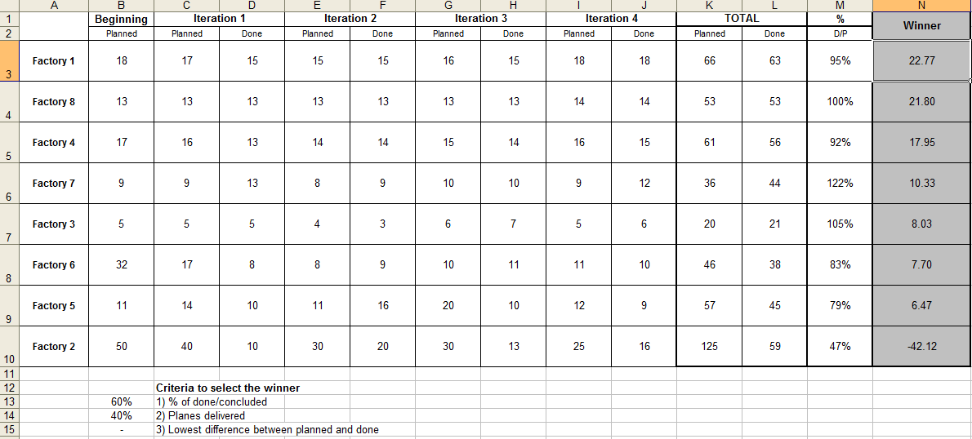
The spreadsheet – an example that can be used
Flávio Steffens / Rafael Prikladnicki – Airplance Factory 2009
Notes:
This is and example of the worksheet. You can create it in a whiteboard or using an Excel spreadsheet.

Slide 16
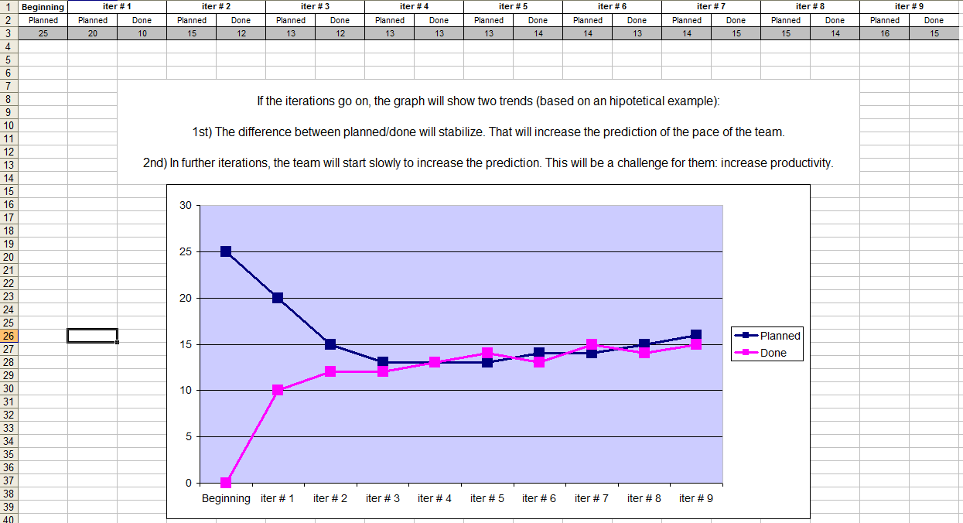
The spreadsheet – an example that can be used
Flávio Steffens / Rafael Prikladnicki – Airplance Factory 2009
Notes:
This is a graphic is optional. You can use it to show the differences between the estimations in the beginning (when nothing is really known) and the later sprints, when team knows more about the product, their pace, etc.
In your groups, if you plot the quantities, you will see that most of the groups will have a graphic like this one.

Slide 17
Thank you!
Hope you had fun! :)
Questions? Sugestions?
flavio.steffens@gmail.com
rafael.prikladnicki@gmail.com
http://www.agileway.com.br http://www.inf.pucrs.br/~rafael
Flávio Steffens / Rafael Prikladnicki – Airplance Factory 2009
Notes:
Feel free to insert your email and website also. But please, keep our email and my blog too.
You can give this copy of file to everyone, this game is to help everyone to understand what Agile is. So, enjoy!
Thanks for downloading.
---
Cheers,
Flávio Steffens de Castro
05/november/2009
www.agileway.com.br
Flavio.steffens@gmail.com

