Slide 1
The Epoch FPGA Phone
Digilient North American Competition
David McGinnis & Kyle Green

Slide 2
Background
No exposure to CSSE or ECE early in a child’s life
This causes no motivation for entering the field later.
We need something that teaches them, while tapping into a popular item.
Also needs to grow with them, due to cost of technology.

Slide 3
More Background
Smartphones are a hot commodity
Make a modifiable, open-source smartphone for grade school students
Can be used originally for course work & organizational skills
Later, kids can learn how to modify their phones
Gives them feeling of accomplishment, while also encouraging them to enter CS and ECE fields.

Slide 4
Overall Architecture
Assembler
The BitEpicness Processor
Phone Module
Resistive Touchscreen
VGA Adapter
SD Card Reader
Seven-Segment Display
Switch Inputs
Keyboard Input
MiniC Compiler
McOS Operating System

Slide 5
Why FPGAs?
Software is easy to modify, but hardware is not.
FPGA gives ability to easily modify hardware
Students can modify, and see what happens
No worrying about electrical dangers such as blown capacitors or electrical shock.
Notes:
Mention Picoblaze Processor

Slide 6
Overall Features
32-bit MIPS-like Processor
16 MB of RAM
VGA Display Capabilities
Resistive Touchscreen Interface
Hardware Phone Interface
Keyboard Input
Switches and Displays for Debugging
C Compiler, Assembler and Custom OS

Slide 7
The Epoch Processor
32-bit processor based on MIPS
16 bit instruction length
33 operations with 4 or 5 bit op codes
16 registers, 13 of which are general purpose registers
1KB Instruction ROM
Coprocessor with four registers
Operations chosen for flexibility
All operations have register-based equivalents
Allows 16-bit and 32-bit operation

Slide 8
The BitEpicness Processor Architecture
Instruction Fetch/Decode
Register Fetch
Execute
Memory Fetch/Branch
Writeback

Slide 9
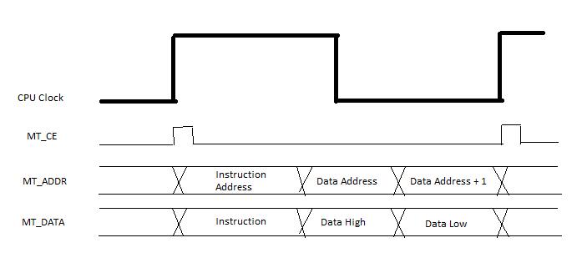
Memory Management
CellularRAM used for instruction and data memories
For each CPU clock cycle, 3 values are read from memory

Slide 10
I/O: The Port System
Simplistic, yet flexible
All operations are reduced to reading or writing to ports
Each I/O peripheral gets one port
Software interrupts get any port larger than 32 representable by a 32-bit number
More complex operations use special structured commands

Slide 11
VGA Module
320x256 resolution screen, with 3 bit color
GPU included for drawing
Draws text, pixels, and colored boxes
Adaptable to add more functionality

Slide 12
Keyboard Module
Uses PS/2 port to receive input from keyboard
Scan codes from keyboard are translated to ASCII
Processor is then interrupted to indicate key press
Errors are detected and checked for

Slide 13
Touchscreen Module
Allows single-touch touchscreen experience
Actual system uses spare Nintendo DS touchscreen
Simpler to implement than capacitive touchscreen
May be switched to capacitive touchscreen in a later release

Slide 14
SD Card Reader
Reads memory in 512 byte chunks
Used to load OS and programs
Saves to temporary memory, then transfers to permanent place
SD Card format required allows 16 programs and a 13 character title
First block contains meta-data
First program contains OS, which is automatically loaded by bootloader.

Slide 15
Debugging Modules
Seven-segment display
Easy to use, and guaranteed to work
Displays 32-bit number, 16 bits at a time
Switches
Allow flawless input for testing
Simple interface makes it easy to capture
Libraries in C also support both of these with special, custom commands.

Slide 16
Software Support
Assembler
Assembles all assembly programs into binary
Creates either coe or raw binary formats
Includes pseudo-instruction la
MiniC Compiler
Supports a large subset of ANSI C
Includes other additions
McOS Operating System
Simple, segmented OS
One program may run at a time

Slide 17
Challenges
Debugging
Tricky due to not being able to simulate well
Source of problems was not obvious
Regression Testing
No easy way to test entire system at once
Unit tests helped software, but no analog to hardware
Working with many different peripherals
All of them had their own issues
Not knowing exactly what the peripherals were doing.

Slide 18
Current Status & Future
Currently ~80% finished
Working:
32-bit processor
Compiler/Assembler
VGA Support
SD Card Loading
In Progress:
Phone Hardware
Keyboard
Resistive Touchscreen
McOS

Slide 19
Conclusions & Lessons Learned
Good learning tool for us and for others
Organization and architecture is key
So is regression testing
Debugging techniques
No break points, so print-outs instead
A task might be larger than it seems
Would recommend to any CSSE or ECE student

Slide 20
Demo

Slide 21
Questions???

