Slide 1
SAMI: Smart Apartment Management Interface
http://www.raisingsami.wordpress.com

Slide 2
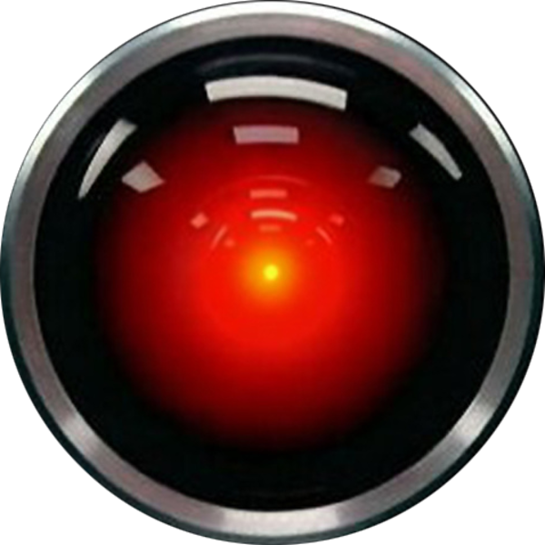

Background
SAMI is a voice-controlled system for managing the apartment.
Inspirations
2001: A Space Odyssey’s HAL
Eureka’s SARAH
IPhone’s Siri
Started as side project in August, 2012, and is still under constant development

Slide 3
Move from LabVIEW to C#
Originally intended to be programmed in LabVIEW
Started with a NI-6211 and a studio-quality microphone.
Issues cropped up, causing bad recognition results
Any speech more than five feet away wasn’t recognized correctly.
Problem was determined to be due to ambient noise
Some simple to moderate signal conditioning didn’t help.
Using the Kinect gave much better results from as far away as 30 feet
Due to large amount of .NET libraries needed for Kinect, move to Kinect required us to move our source code to C#.

Slide 4
Current Functionality Implemented
Weather Forecast
SAMI is capable of looking up the weather forecast, using the Weather Channel’s API.
Timers
SAMI can set timers to alert us after a specified duration or at a specific time.
Movie Show Times
SAMI can look up movie showtimes. The user can narrow the search for specific movies or specific theaters. This uses Tribune Media Services’ API.
Remote
SAMI can turn on the TV, change the volume, set the show to record, and change the channel, using an Arduino Uno.

Slide 5
Architecture Overview
Overall architecture of SAMI uses plugins for functionality.
Each one holds phrases to understand and functionality to enable.
Dialog instances hold information about user input.
Conversation instances hold state of current task being discussed.
Multi-threaded
Uses a producer-consumer architecture
Stack of dialogs recognized and a queue of conversations currently being held connect the two threads.
Uses Kinect and Microsoft SDKs for speech recognition and synthesis.

Slide 6
Static Structure Diagram

Slide 7
Sequence Diagram for Typical Conversation

Slide 8
Lessons Learned
While speech recognition is a solved problem for phones and cars, distance is still a huge problem in the field.
This is true regardless of the quality of the microphone, instead being because of ambient noise.
Microsoft’s Kinect SDK is pretty powerful, although poorly documented.
In particular, the grammar is very difficult to work with.
Once you understand the mappings in concepts between C#/C++/Java and LVOOP, LVOOP is reasonably easy to work with.
Public APIs can be difficult to find, and sometimes just are not available at all.

Slide 9
Future of SAMI
We plan on expanding the current plugins to allow for additional options.
We would also plan on adding features such as:
Access to Big Oven for recipes
Access to calendars and email
Motion detection for a security system
Smart phone app to access SAMI remotely
Ability to turn control lights and window blinds
Ability to check TV guide

